Slide 1
Picobot
Slides adapted from CS5 at HMC
[original slides]

Slide 2
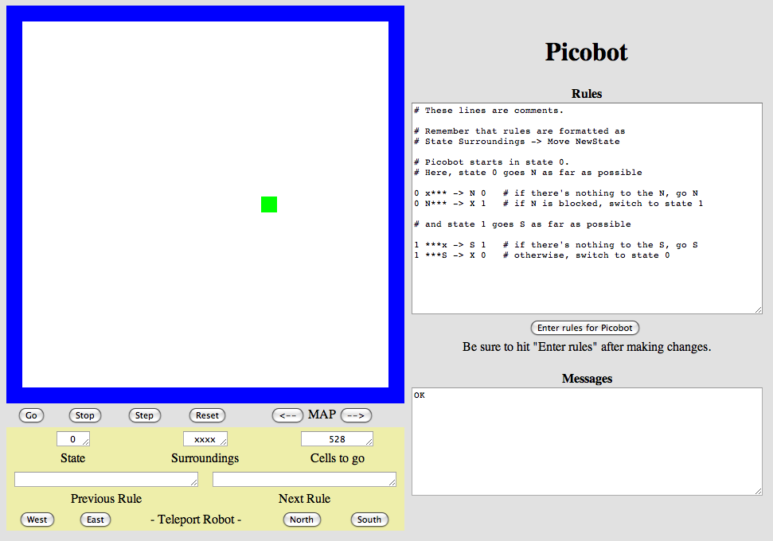
Another language already?
Picobot!
Python
General-purpose language
you might see 50% by the end of the term
even then, <1% of its libraries!
Picobot
Special-purpose language
you'll see 100% in the next 10 minutes
The Picobot simulator
www.cs.ucla.edu/~todd/picobot.html

Slide 3
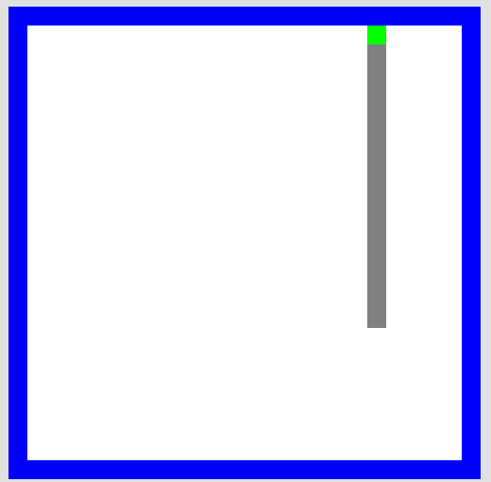
Challenge: Room Coverage
Goal: full-room coverage with only local sensing…
walls
Picobot
area not covered (yet!)
area already covered
Picobot can't tell…
Inspiration?

Slide 4
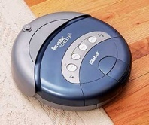
Challenge: Room Coverage
Goal: full-room coverage with only local sensing…
walls
Picobot
area not covered (yet!)
area already covered
The Roomba!
can't tell "vacuumed" from "unvacuumed" area

Slide 5
Surroundings
N
Picobot can only sense things directly to the N, E, W, and S
W
E
S
For example, here its surroundings are
NxWx
N E W S
Surroundings are always in NEWS order.

Slide 6
What are these surroundings?
Surroundings are always in NEWS order.
N E W S
NxWx

Slide 7
Surroundings
N
How many distinct surroundings are there?
W
E
S

Slide 8
Surroundings
N
How many distinct surroundings are there?
W
E
2⁴
== 16 possible
S
xxxx
Nxxx
xExx
xxWx
xxxS
NExx
NxWx
NxxS
xEWx
xExS
xxWS
NEWx
NExS
NxWS
xEWS
NEWS
(won’t happen)

Slide 9
Picobot programming ~ rules
ignore for now
surroundings
direction
ignore for now
0
xxxx
E
0
“If my surroundings look like xxxx, take one step to the East”
The Picobot program consisting of this rule simply executes the rule continually until the rule does not apply.

Slide 10
Picobot programming ~ rules
ignore for now
surroundings
direction
ignore for now
0
xxxx
E
0
0
xExx
N
0
A Picobot program consists of 1 or more rules of this form.
At each step, Picobot finds the first matching rule and executes it.
What rule can we add after the above rule to make a Picobot program that navigates to the northeast corner of the room?

Slide 11
Picobot programming ~ rules
ignore for now
surroundings
direction
ignore for now
0
xxxx
E
0
0
xExx
N
0
Problem: the robot won’t move at all if started along the north, west, or south wall. How to address?
More rules!
Example: 0 Nxxx → E 0
But we need a LOT of rules…
Wildcards allow many rules to be expressed at once…

Slide 12
Wildcards
I only care about EAST being EMPTY
Asterisks * are wild cards. They match walls or empty space:
ignore for now
surroundings
direction
ignore for now
0
*x**
E
0
NWS may be wall or empty space
E must be empty
8 surroundings in one rule

Slide 13
No Ambiguity Allowed!
ignore for now
surroundings
direction
ignore for now
0
x***
S
0
0
***x
N
0
Both rules apply if the surroundings are xxxx (or a few other scenarios).
The Picobot execution engine rejects programs that contain such ambiguities.

Slide 14
Picobot programming ~ rules
ignore for now
surroundings
direction
ignore for now
0
xxxx
E
0
0
xExx
N
0
How to update these rules to always reach the northeast corner, from any starting position?

Slide 15
State
Can we make a Picobot program that “paints” an entire row?
Perhaps surprisingly, no!

Slide 16
State
Can we make a Picobot program that “paints” an entire row?
Problem: From the same spot in the room, the Picobot needs to sometimes go east and sometimes west.
Solution: Give the Picobot a bit of memory, so it can remember where it needs to go next.

Slide 17
State
I am in state 0.
My surroundings
are xxWS.
Picobot's memory is a single number, called its state.
State is the internal context of a computation, i.e., its subtask.
0
Picobot always starts in state 0.
State and surroundings represent everything Picobot knows about the world
self-contained
but not simplistic

Slide 18
State
current state
surroundings
direction
next state
0
xxxx
E
0
“If my surroundings look like xxxx and I’m in state 0, take one step to the East and stay in state 0”

Slide 19
Painting a row with state
current state
surroundings
direction
next state
# paint to the east until you hit the wall
0
xxxx
E
0
# if at the east wall, change to state 1
0
xExx
X
1
# paint to the west until you hit the wall
1
xxxx
W
1
Note: the first and third rules are NOT ambiguous.

Slide 20
Homework: Paint the whole room!

Slide 21
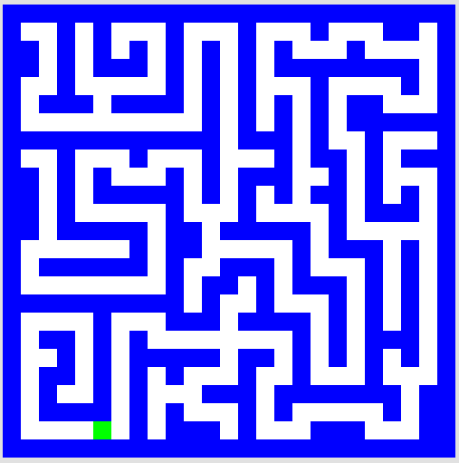
Maze coverage?

Slide 22
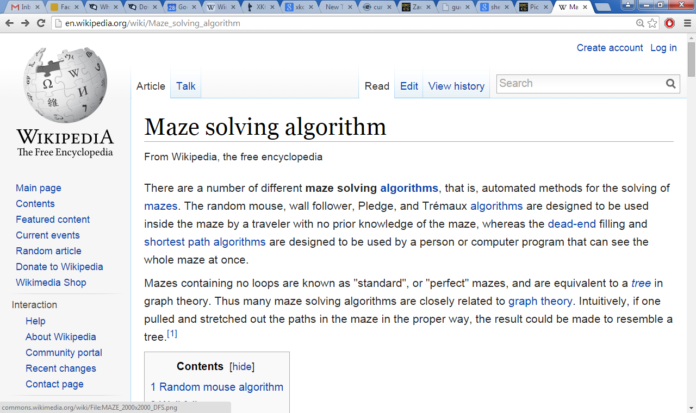
Right Hand Rule

Slide 23
Maze strategies?
Right Hand Rule
Keep your "right hand" on the wall, Picobot!

Slide 24
Maze strategies?
Right Hand Rule
Keep your "right hand" on the wall, Picobot!
State 0
State 1
State 2
State 3
We'll need to use state to represent the direction Picobot is facing.

Slide 25
Suppose Picobot wants to traverse a maze with its right hand always on the wall...
(A) CORRIDOR rule
If you're facing N with a wall at right and space ahead then go forward”
0
xE**
->
N
0
state 0 means "still facing north"
0
(A)
(B) INTERSECTION rule
“If you're facing North and lose the wall, then get over to the wall now!”
0
0
.
->
E
1
(B)
(C) DEAD END rule
Write 1 or 2 rules to tell Picobot to do the right thing if it hits a dead end.
0
(C)
Repeat this IDEA for all four states, representing all four facing directions.

Slide 26
Suppose Picobot wants to traverse a maze with its right hand always on the wall...
(A) CORRIDOR rule
If you're facing N with a wall at right and space ahead then go forward”
0
xE**
->
N
0
state 0 means "still facing north"
0
(A)
(B) INTERSECTION rule
“If you're facing North and lose the wall, then get over to the wall now!”
0
0
*x**
->
E
1
state 1 means "now facing east"
(B)
(C) DEAD END rule
Write 1 or 2 rules to tell Picobot to do the right thing if it hits a dead end.
0
NE**
->
X
2
state 2 means "now facing west"
0
(C)
Repeat this IDEA for all four states, representing all four facing directions.

