Slide 1
Data Mining
Tutorial
Gregory Piatetsky-Shapiro
KDnuggets

Slide 2
Outline
Introduction
Data Mining Tasks
Classification & Evaluation
Clustering
Application Examples

Slide 3
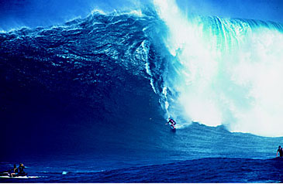
Trends leading to Data Flood
More data is generated:
  Web, text, images …
  Business transactions, calls, ...
  Scientific data: astronomy, biology, etc
More data is captured:
  Storage technology faster and cheaper
  DBMS can handle bigger DB

Slide 4
Largest Databases in 2005
Winter Corp. 2005 Commercial Database Survey:
  Max Planck Inst. for Meteorology , 222 TB
  Yahoo ~ 100 TB (Largest Data Warehouse)
  AT&T ~ 94 TB
www.wintercorp.com/VLDB/2005_TopTen_Survey/TopTenWinners_2005.asp

Slide 5
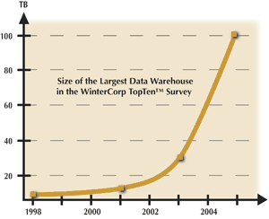
Data Growth
In 2 years (2003 to 2005),
the size of the largest database TRIPLED!

Slide 6
Data Growth Rate
Twice as much information was created in 2002 as in 1999 (~30% growth rate)
Other growth rate estimates even higher
Very little data will ever be looked at by a human
Knowledge Discovery is NEEDED to make sense and use of data.

Slide 7
Knowledge Discovery Definition
Knowledge Discovery in Data is the
non-trivial process of identifying
  valid
  novel
  potentially useful
  and ultimately understandable patterns in data.
from Advances in Knowledge Discovery and Data Mining, Fayyad, Piatetsky-Shapiro, Smyth, and Uthurusamy, (Chapter 1), AAAI/MIT Press 1996

Slide 8
Related Fields
Machine
Learning
Visualization
Data Mining and
Knowledge Discovery
Statistics
Databases

Slide 9
Statistics, Machine Learning and
Data Mining
Statistics:
  more theory-based
  more focused on testing hypotheses
Machine learning
  more heuristic
  focused on improving performance of a learning agent
  also looks at real-time learning and robotics – areas not part of data mining
Data Mining and Knowledge Discovery
  integrates theory and heuristics
  focus on the entire process of knowledge discovery, including data cleaning, learning, and integration and visualization of results
Distinctions are fuzzy

Slide 10
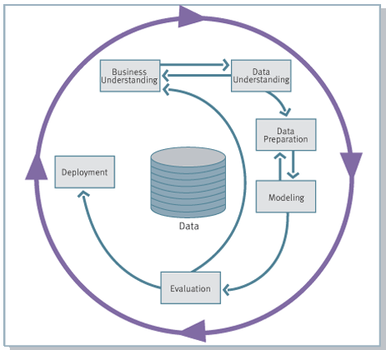
Knowledge Discovery Process flow, according to CRISP-DM
see
www.crisp-dm.org
for more
information
Monitoring
Continuous
monitoring and
improvement is
an addition to CRISP

Slide 11

Historical Note:
Many Names of Data Mining
Data Fishing, Data Dredging: 1960-
  used by statisticians (as bad name)
Data Mining :1990 --
  used in DB community, business
Knowledge Discovery in Databases (1989-)
  used by AI, Machine Learning Community
also Data Archaeology, Information Harvesting, Information Discovery, Knowledge Extraction, ...
Currently: Data Mining and Knowledge Discovery
are used interchangeably

Slide 12
Data Mining Tasks

Slide 13
Some Definitions
Instance (also Item or Record):
  an example, described by a number of attributes,
  e.g. a day can be described by temperature, humidity and cloud status
Attribute or Field
  measuring aspects of the Instance, e.g. temperature
Class (Label)
  grouping of instances, e.g. days good for playing

Slide 14
Major Data Mining Tasks
Classification: predicting an item class
Clustering: finding clusters in data
Associations: e.g. A & B & C occur frequently
Visualization: to facilitate human discovery
Summarization: describing a group
Deviation Detection: finding changes
Estimation: predicting a continuous value
Link Analysis: finding relationships
…

Slide 15
Classification
Learn a method for predicting the instance class from pre-labeled (classified) instances
Many approaches: Statistics,
Decision Trees, Neural Networks,
...

Slide 16
Clustering
Find “natural” grouping of instances given un-labeled data

Slide 17
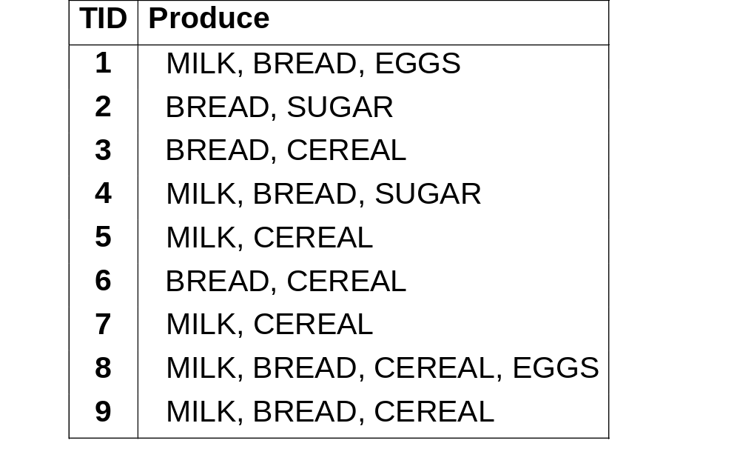
Association Rules &
Frequent Itemsets
Transactions
Frequent Itemsets:
Milk, Bread (4)
Bread, Cereal (3)
Milk, Bread, Cereal (2)
…
Rules:
Milk => Bread (66%)

Slide 18
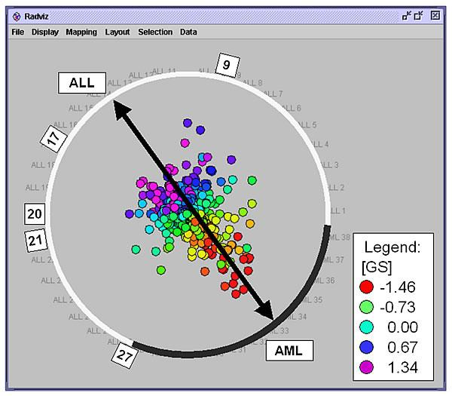
Visualization & Data Mining
Visualizing the data to facilitate human discovery
Presenting the discovered results in a visually "nice" way

Slide 19
Summarization
Describe features of the selected group
Use natural language and graphics
Usually in Combination with Deviation detection or other methods
Average length of stay in this study area rose 45.7 percent,
from 4.3 days to 6.2 days, because ...

Slide 20
Data Mining Central Quest
Find true patterns
and avoid overfitting
(finding seemingly signifcant
but really random patterns due
to searching too many possibilites)

Slide 21
Classification Methods

Slide 22
Classification
Learn a method for predicting the instance class from pre-labeled (classified) instances
Many approaches: Regression,
Decision Trees,
Bayesian,
Neural Networks,
...
Given a set of points from classes
what is the class of new point ?

Slide 23
Classification: Linear Regression
Linear Regression
  w₀ + w₁ x + w₂ y >= 0
Regression computes wi from data to minimize squared error to ‘fit’ the data
Not flexible enough

Slide 24
Regression for Classification
Any regression technique can be used for classification
  Training: perform a regression for each class, setting the output to 1 for training instances that belong to class, and 0 for those that don’t
  Prediction: predict class corresponding to model with largest output value (membership value)
For linear regression this is known as multi-response linear regression

Slide 25
Classification: Decision Trees
if X > 5 then blue
else if Y > 3 then blue
else if X > 2 then green
else blue
Y
3
2
5
X

Slide 26
DECISION TREE
An internal node is a test on an attribute.
A branch represents an outcome of the test, e.g., Color=red.
A leaf node represents a class label or class label distribution.
At each node, one attribute is chosen to split training examples into distinct classes as much as possible
A new instance is classified by following a matching path to a leaf node.

Slide 27
Weather Data: Play or not Play?
Outlook | Temperature | Humidity | Windy | Play?
sunny | hot | high | false | No
sunny | hot | high | true | No
overcast | hot | high | false | Yes
rain | mild | high | false | Yes
rain | cool | normal | false | Yes
rain | cool | normal | true | No
overcast | cool | normal | true | Yes
sunny | mild | high | false | No
sunny | cool | normal | false | Yes
rain | mild | normal | false | Yes
sunny | mild | normal | true | Yes
overcast | mild | high | true | Yes
overcast | hot | normal | false | Yes
rain | mild | high | true | No
Note:
Outlook is the
Forecast,
no relation to
Microsoft
email program

Slide 28
Example Tree for “Play?”
Outlook
sunny
overcast
rain
Humidity
Yes
Windy
high
normal
true
false
No
Yes
No
Yes

Slide 29
Classification: Neural Nets
Can select more complex regions
Can be more accurate
Also can overfit the data – find patterns in random noise

Slide 30
Classification: other approaches
Naïve Bayes
Rules
Support Vector Machines
Genetic Algorithms
…
See www.KDnuggets.com/software/

Slide 31
Evaluation

Slide 32
Evaluating which method works the best for classification
No model is uniformly the best
Dimensions for Comparison
  speed of training
  speed of model application
  noise tolerance
  explanation ability
Best Results: Hybrid, Integrated models

Slide 33
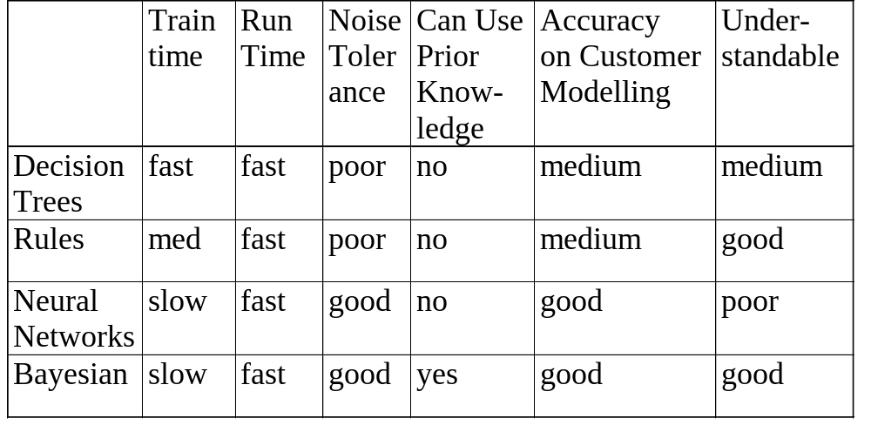
Comparison of Major Classification Approaches
A hybrid method will have higher accuracy

Slide 34
Evaluation of Classification Models
How predictive is the model we learned?
Error on the training data is not a good indicator of performance on future data
  The new data will probably not be exactly the same as the training data!
Overfitting – fitting the training data too precisely - usually leads to poor results on new data

Slide 35
Evaluation issues
Possible evaluation measures:
  Classification Accuracy
  Total cost/benefit – when different errors involve different costs
  Lift and ROC curves
  Error in numeric predictions
How reliable are the predicted results ?

Slide 36
Classifier error rate
Natural performance measure for classification problems: error rate
  Success: instance’s class is predicted correctly
  Error: instance’s class is predicted incorrectly
  Error rate: proportion of errors made over the whole set of instances
Training set error rate: is way too optimistic!
  you can find patterns even in random data

Slide 37
Evaluation on “LARGE” data
If many (>1000) examples are available, including >100 examples from each class
A simple evaluation will give useful results
  Randomly split data into training and test sets (usually 2/3 for train, 1/3 for test)
Build a classifier using the train set and evaluate it using the test set

Slide 38
Classification Step 1:
Split data into train and test sets
THE PAST
Results Known
+
Training set
+
-
-
Data
+
Testing set

Slide 39
Classification Step 2:
Build a model on a training set
THE PAST
Results Known
+
Training set
+
-
-
Data
+
Model Builder
Testing set

Slide 40
Classification Step 3:
Evaluate on test set (Re-train?)
Results Known
+
Training set
+
-
-
Data
+
Model Builder
Evaluate
Predictions
+
-
+
-
Y
N
Testing set

Slide 41
Unbalanced data
Sometimes, classes have very unequal frequency
  Attrition prediction: 97% stay, 3% attrite (in a month)
  medical diagnosis: 90% healthy, 10% disease
  eCommerce: 99% don’t buy, 1% buy
  Security: >99.99% of Americans are not terrorists
Similar situation with multiple classes
Majority class classifier can be 97% correct, but useless

Slide 42
Handling unbalanced data – how?
If we have two classes that are very unbalanced, then how can we evaluate our classifier method?

Slide 43
Balancing unbalanced data, 1
With two classes, a good approach is to build BALANCED train and test sets, and train model on a balanced set
  randomly select desired number of minority class instances
  add equal number of randomly selected majority class
How do we generalize “balancing” to multiple classes?

Slide 44
Balancing unbalanced data, 2
Generalize “balancing” to multiple classes
  Ensure that each class is represented with approximately equal proportions in train and test

Slide 45
A note on parameter tuning
It is important that the test data is not used in any way to create the classifier
Some learning schemes operate in two stages:
  Stage 1: builds the basic structure
  Stage 2: optimizes parameter settings
The test data can’t be used for parameter tuning!
Proper procedure uses three sets: training data, validation data, and test data
  Validation data is used to optimize parameters

Slide 46
Making the most of the data
Once evaluation is complete, all the data can be used to build the final classifier
Generally, the larger the training data the better the classifier (but returns diminish)
The larger the test data the more accurate the error estimate

Slide 47
Classification:
Train, Validation, Test split
Results Known
+
Model
Builder
+
Training set
-
-
Data
+
Evaluate
Model Builder
Predictions
+
-
+
-
Y
N
Validation set
+
-
+
-
Final Evaluation
Final Test Set
Final Model

Slide 48
Cross-validation
Cross-validation avoids overlapping test sets
  First step: data is split into k subsets of equal size
  Second step: each subset in turn is used for testing and the remainder for training
This is called k-fold cross-validation
Often the subsets are stratified before the cross-validation is performed
The error estimates are averaged to yield an overall error estimate

Slide 49
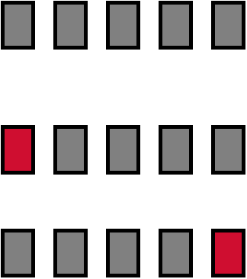
Cross-validation example:
Break up data into groups of the same size
Hold aside one group for testing and use the rest to build model
Repeat
Test

Slide 50
More on cross-validation
Standard method for evaluation: stratified ten-fold cross-validation
Why ten? Extensive experiments have shown that this is the best choice to get an accurate estimate
Stratification reduces the estimate’s variance
Even better: repeated stratified cross-validation
  E.g. ten-fold cross-validation is repeated ten times and results are averaged (reduces the variance)

Slide 51
Direct Marketing Paradigm
Find most likely prospects to contact
Not everybody needs to be contacted
Number of targets is usually much smaller than number of prospects
Typical Applications
  retailers, catalogues, direct mail (and e-mail)
  customer acquisition, cross-sell, attrition prediction
  ...

Slide 52
Direct Marketing Evaluation
Accuracy on the entire dataset is not the right measure
Approach
  develop a target model
  score all prospects and rank them by decreasing score
  select top P% of prospects for action
How do we decide what is the best subset of prospects ?

Slide 53
Model-Sorted List
Use a model to assign score to each customer
Sort customers by decreasing score
Expect more targets (hits) near the top of the list
No | Score | Target | CustID | Age
1 | 0.97 | Y | 1746 | …
2 | 0.95 | N | 1024 | …
3 | 0.94 | Y | 2478 | …
4 | 0.93 | Y | 3820 | …
5 | 0.92 | N | 4897 | …
… | … |  | … | …
99 | 0.11 | N | 2734 | …
100 | 0.06 | N | 2422
3 hits in top 5% of the list
If there 15 targets overall, then top 5 has 3/15=20% of targets

Slide 54
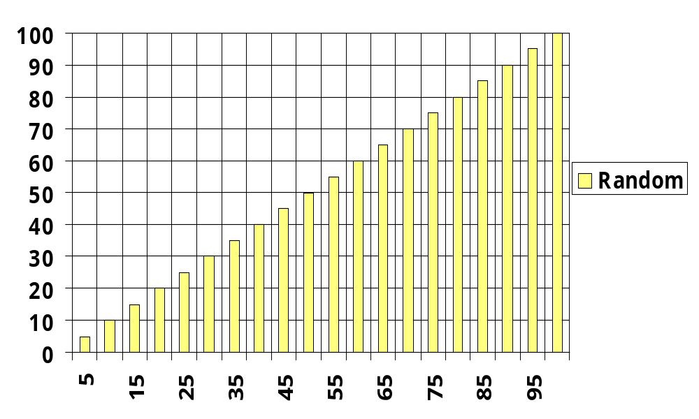
CPH (Cumulative Pct Hits)
Definition:
CPH(P,M)
= % of all targets
in the first P%
of the list scored
by model M
CPH frequently
called Gains
Cumulative % Hits
Pct list
5% of random list have 5% of targets
Notes:
Potential benefit of a good customer segmentation is very high, but hard to estimate objectively. For tactical tasks, we have some analytical tools that we can use. First a brief review of the notion of lift.

Slide 55
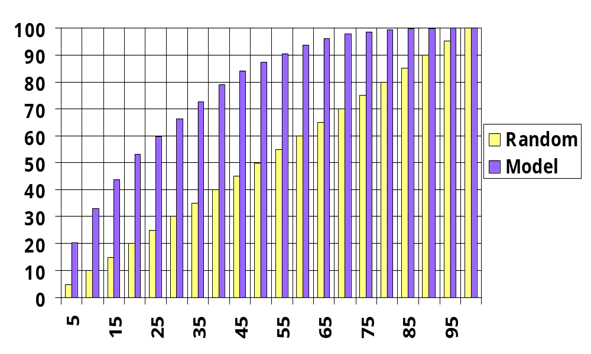
CPH: Random List vs Model-ranked list
Cumulative % Hits
Pct list
5% of random list have 5% of targets,
but 5% of model ranked list have 21% of targets CPH(5%,model)=21%.

Slide 56
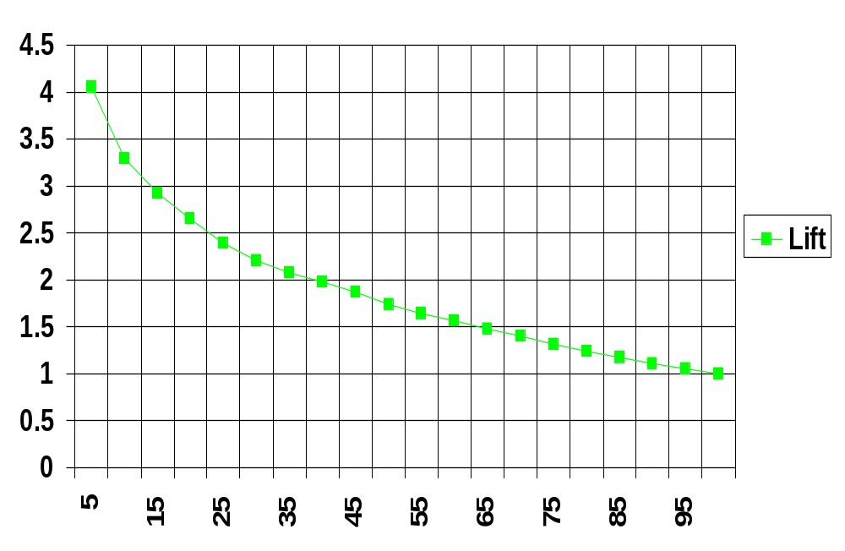
Lift
Lift(P,M) = CPH(P,M) / P
Lift (at 5%)
= 21% / 5%
= 4.2
better
than random
Note: Some authors use “Lift” for what we call CPH.
P -- percent of the list

Slide 57
Lift – a measure of model quality
Lift helps us decide which models are better
If cost/benefit values are not available or changing, we can use Lift to select a better model.
Model with the higher Lift curve will generally be better

Slide 58
Clustering

Slide 59
Clustering
Unsupervised learning:
Finds “natural” grouping of instances given un-labeled data

Slide 60
Clustering Methods
Many different method and algorithms:
  For numeric and/or symbolic data
  Deterministic vs. probabilistic
  Exclusive vs. overlapping
  Hierarchical vs. flat
  Top-down vs. bottom-up

Slide 61
Clustering Evaluation
Manual inspection
Benchmarking on existing labels
Cluster quality measures
  distance measures
  high similarity within a cluster, low across clusters

Slide 62
The distance function
Simplest case: one numeric attribute A
  Distance(X,Y) = A(X) – A(Y)
Several numeric attributes:
  Distance(X,Y) = Euclidean distance between X,Y
Nominal attributes: distance is set to 1 if values are different, 0 if they are equal
Are all attributes equally important?
  Weighting the attributes might be necessary

Slide 63
Simple Clustering: K-means
Works with numeric data only
Pick a number (K) of cluster centers (at random)
Assign every item to its nearest cluster center (e.g. using Euclidean distance)
Move each cluster center to the mean of its assigned items
Repeat steps 2,3 until convergence (change in cluster assignments less than a threshold)

Slide 64
K-means example, step 1
1
c₁
Y
Pick 3
initial
cluster
centers
(randomly)
c₂
c₃
X

Slide 65
K-means example, step 2
c₁
Y
c₂
Assign
each point
to the closest
cluster
center
c₃
X

Slide 66
K-means example, step 3
c₁
c₁
Y
Move
each cluster center
to the mean
of each cluster
c₂
c₃
c₂
c₃
X

Slide 67
K-means example, step 4a
Reassign
points
closest to a different new cluster center
Q: Which points are reassigned?
c₁
Y
c₃
c₂
X

Slide 68
K-means example, step 4b
Reassign
points
closest to a different new cluster center
Q: Which points are reassigned?
c₁
Y
c₃
c₂
X

Slide 69
K-means example, step 4c
1
c₁
Y
3
A: three points with animation
2
c₃
c₂
X

Slide 70
K-means example, step 4d
c₁
Y
re-compute cluster means
c₃
c₂
X

Slide 71
K-means example, step 5
c₁
Y
c₂
move cluster centers to cluster means
c₃
X

Slide 72
Data Mining Applications

Slide 73

Problems Suitable for Data-Mining
require knowledge-based decisions
have a changing environment
have sub-optimal current methods
have accessible, sufficient, and relevant data
provides high payoff for the right decisions!

Slide 74
Major Application Areas for
Data Mining Solutions
Advertising
Bioinformatics
Customer Relationship Management (CRM)
Database Marketing
Fraud Detection
eCommerce
Health Care
Investment/Securities
Manufacturing, Process Control
Sports and Entertainment
Telecommunications
Web

Slide 75
Application: Search Engines
Before Google, web search engines used mainly keywords on a page – results were easily subject to manipulation
Google's early success was partly due to its algorithm which uses mainly links to the page
Google founders Sergey Brin and Larry Page were students at Stanford in 1990s
Their research in databases and data mining led to Google

Slide 76
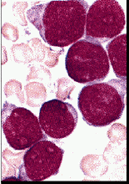
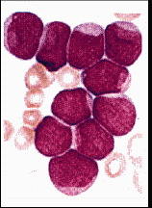

Microarrays: Classifying Leukemia
Leukemia: Acute Lymphoblastic (ALL) vs Acute Myeloid (AML), Golub et al, Science, v.286, 1999
  72 examples (38 train, 34 test), about 7,000 genes
ALL
AML
Visually similar, but genetically very different
  Best Model: 97% accuracy,
  1 error (sample suspected mislabelled)

Slide 77
Microarray Potential Applications
New and better molecular diagnostics
  Jan 11, 2005: FDA approved Roche Diagnostic AmpliChip, based on Affymetrix technology
New molecular targets for therapy
  few new drugs, large pipeline, …
Improved treatment outcome
  Partially depends on genetic signature
Fundamental Biological Discovery
  finding and refining biological pathways
Personalized medicine ?!

Slide 78
Application:
Direct Marketing and CRM
Most major direct marketing companies are using modeling and data mining
Most financial companies are using customer modeling
Modeling is easier than changing customer behaviour
Example
  Verizon Wireless reduced customer attrition rate from 2% to 1.5%, saving many millions of $

Slide 79


Application: e-Commerce
Amazon.com recommendations
  if you bought (viewed) X, you are likely to buy Y
Netflix
  If you liked "Monty Python and the Holy Grail",
  you get a recommendation for "This is Spinal Tap"
Comparison shopping
  Froogle, mySimon, Yahoo Shopping, …

Slide 80
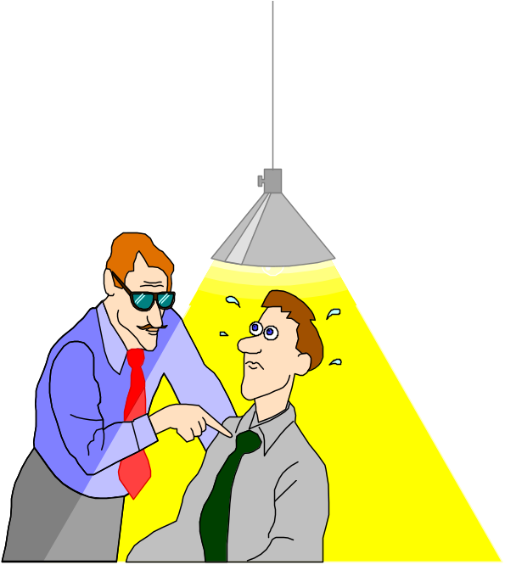
Application:
Security and Fraud Detection
Credit Card Fraud Detection
  over 20 Million credit cards protected by Neural networks (Fair, Isaac)
Securities Fraud Detection
  NASDAQ KDD system
Phone fraud detection
  AT&T, Bell Atlantic, British Telecom/MCI

Slide 81
Data Mining, Privacy, and Security
TIA: Terrorism (formerly Total) Information Awareness Program –
  TIA program closed by Congress in 2003 because of privacy concerns
However, in 2006 we learn that NSA is analyzing US domestic call info to find potential terrorists
  Invasion of Privacy or Needed Intelligence?

Slide 82
Criticism of Analytic Approaches to Threat Detection:
Data Mining will
be ineffective - generate millions of false positives
and invade privacy
First, can data mining be effective?

Slide 83

Can Data Mining and Statistics be Effective for Threat Detection?
Criticism: Databases have 5% errors, so analyzing 100 million suspects will generate 5 million false positives
Reality: Analytical models correlate many items of information to reduce false positives.
Example: Identify one biased coin from 1,000.
  After one throw of each coin, we cannot
  After 30 throws, one biased coin will stand out with high probability.
  Can identify 19 biased coins out of 100 million with sufficient number of throws

Slide 84
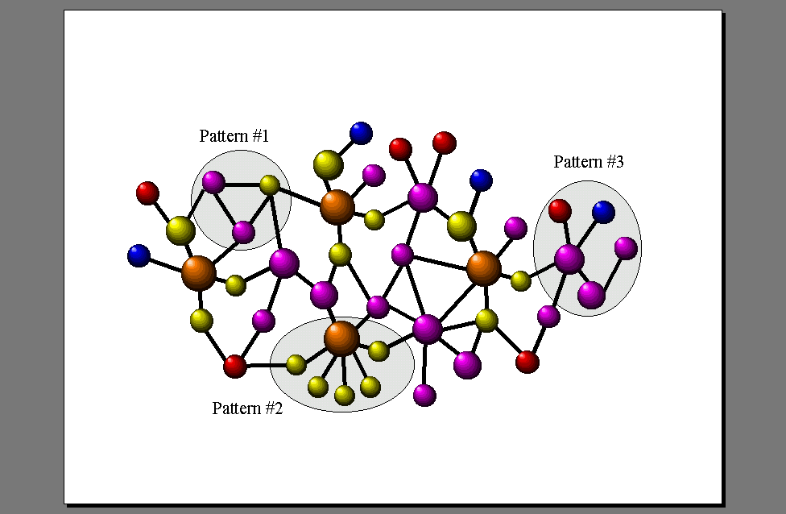
Another Approach: Link Analysis
Can find unusual patterns in the network structure

Slide 85
Analytic technology can be effective
Data Mining is just one additional tool to help analysts
Combining multiple models and link analysis can reduce false positives
Today there are millions of false positives with manual analysis
Analytic technology has the potential to reduce the current high rate of false positives

Slide 86
Data Mining with Privacy
Data Mining looks for patterns, not people!
Technical solutions can limit privacy invasion
  Replacing sensitive personal data with anon. ID
  Give randomized outputs
  Multi-party computation – distributed data
  …
Bayardo & Srikant, Technological Solutions for Protecting Privacy, IEEE Computer, Sep 2003

Slide 87
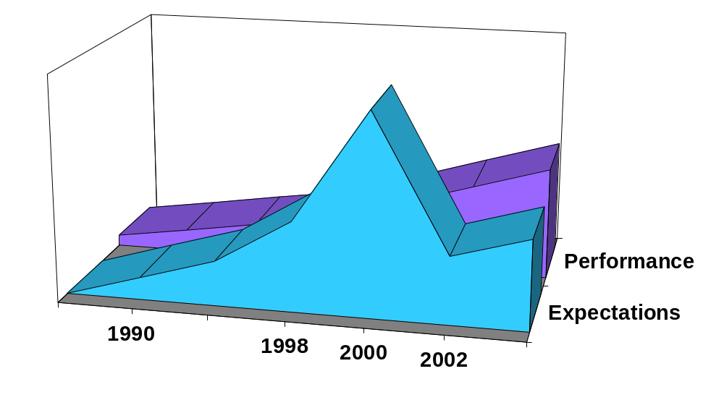
The Hype Curve for
Data Mining and Knowledge Discovery
Over-inflated
expectations
Growing acceptance
and mainstreaming
rising
expectations
Disappointment
2005

Slide 88
Summary
Data Mining and Knowledge Discovery are needed to deal with the flood of data
Knowledge Discovery is a process !
Avoid overfitting (finding random patterns by searching too many possibilities)

Slide 89
Additional Resources
www.KDnuggets.com
data mining software, jobs, courses, etc
www.acm.org/sigkdd
ACM SIGKDD – the professional society for data mining

