Slide 1

PRESENTATION ON WEB GENERATION

Slide 2
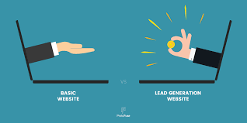
Web Generation
Web 1.0, web 2.0, web 3.0 and web 4.0 were described as four generations of the web. The characteristics of the generations are introduced and compared.

Slide 3
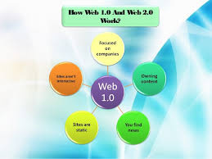
What is Web 1.0 and example?
An example might be a personal Web page that gives information about the site's owner, but never changes. A Web 2.0 version might be a blog or MySpace account that owners can frequently update.

Slide 4
web generation benefits
The flexibility allows them to develop and build up their personal libraries, bookmarks, and search engines. Web 2.0 makes communication easier with each other, generating and spreading content, knowledge, and ideas between peers and creating expert professional networks.

Slide 5
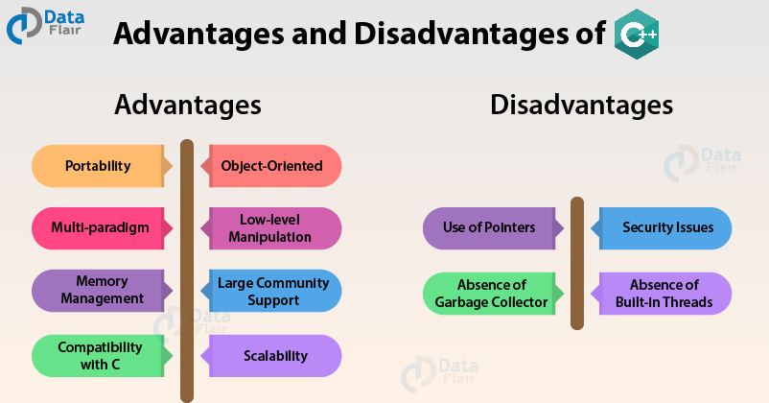
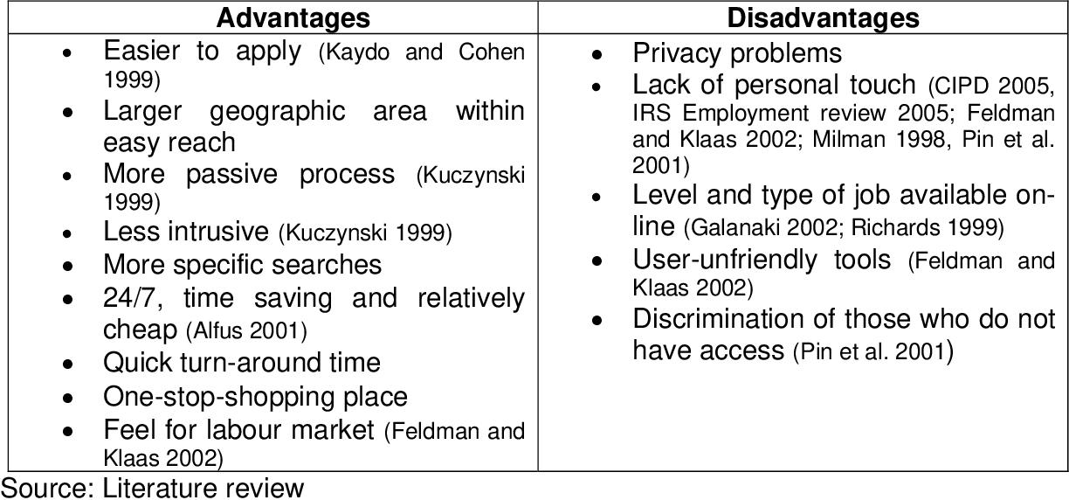
web generation advantages and disadvantages

Slide 6
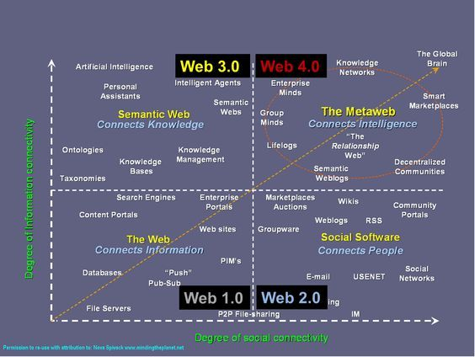
What are the three types of web?
They identified three typical web environments that represented different levels of information sincerity: hoaxes, weaker sincere sites, and stronger sincere sites

Slide 7
THE END
PRESENTED BY FATIMA IMDAD

