Slide 1
MINI PROJECT 2 SQL: FROM DATA TO INSIGHT
IRMA FERNANDEZ
JANNA JULIAN
LUIS PABLO
RICARDO CASTANHEIRA
Ironhack Data Analytics Bootcamp

Slide 2
PROJECT OVERVIEW
- Research questions:
Is it worth opening a new Airbnb listing in New York?
What is the most profitable district and the best strategy for maximizing revenue ?
- Hypotheses:
1. Manhattan is more profitable.
2. Entire homes/apartments are more in demand.
3. Availability 365 days correlates with revenue.

Slide 3
DATA ACQUISITION & WRANGLING
- Data: New York City Airbnb open data (Kaggle)
1. Data Cleaning:
- Remove irrelevant columns, standardize textual fields (listing names, remove punctuation).
- Export reference lists (neighbourhoods and room types) for easy SQL population.
2. Database Population:
- Tables were created using `drawSQL-mysql.sql`.
- Data was inserted using SQL scripts and/or CSV imports.
- Foreign key constraints ensured data integrity between tables.
3. Analysis-ready Data:
- The cleaned DataFrame was used for further visualizations and SQL insights.

Slide 4
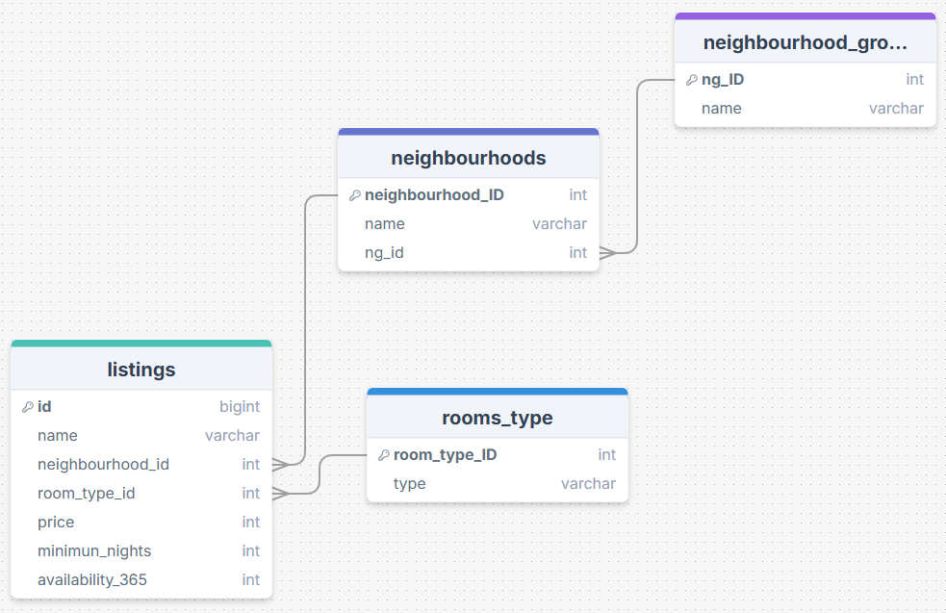
ENTITY RELATIONSHIP DIAGRAM (ERD)

Slide 5
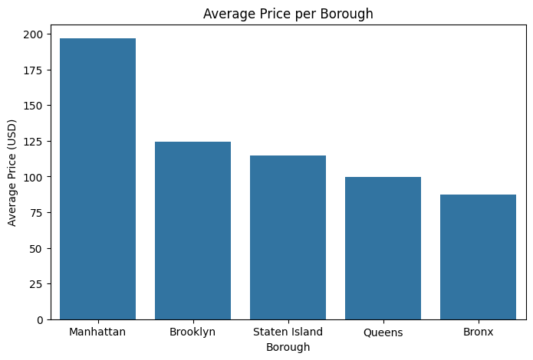
VISUALIZATION 1 – AVERAGE PRICE BY BOROUGH

Slide 6
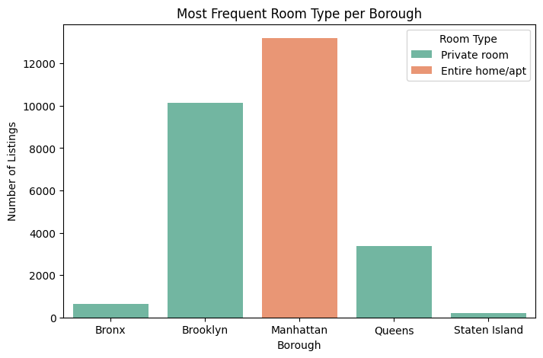
VISUALIZATION 2 – ROOM TYPE DISTRIBUTION

Slide 7
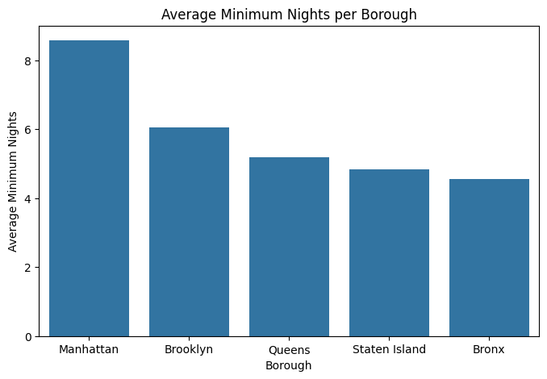
VISUALIZATION 3 – AVAILABILITY VS PRICE

Slide 8
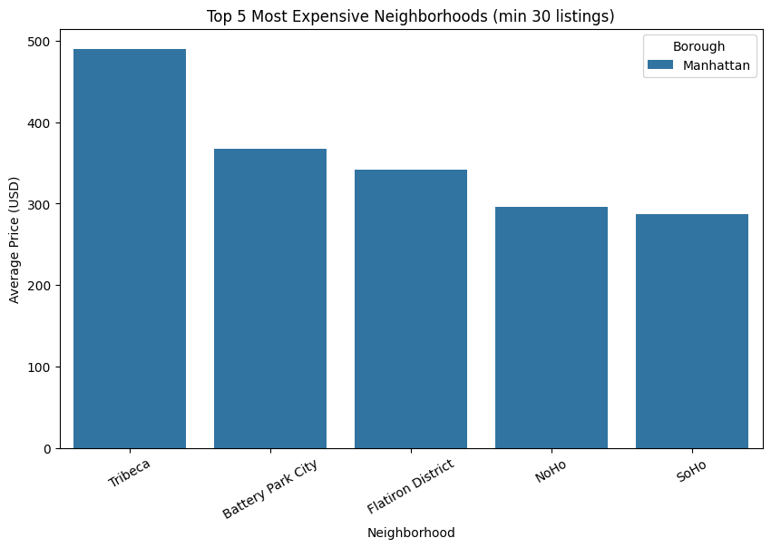
LUXURY MARKET

Slide 9
FINDINGS
Manhattan and Brooklyn have the highest average price per night at ~$200 and ~$120 respectively.
Room type: Renting entire homes is more popular in Manhattan, private rooms are more popular in all other boroughs.
Average stay: Manhattan listings have the longest stays (~8.5 nights), all other neighbourhoods trail slightly behind. (~4 to 6 nights).
Luxury market: Highly concentrated in Manhattan (Tribeca, SoHo, Battery Park City neighbourhoods).

Slide 10
CONCLUSIONS & RECOMMENDATIONS
It is a good business opportunity to open a new Airbnb listing in New York City.
Manhattan and Brooklyn are the most profitable boroughs.
Best option: Renting private rooms in Brooklyn is the best choice.
Alternative: Target Manhattan luxury neighborhoods renting an entire apartment at premium pricing.
Recommended strategy: Set prices slightly below the borough average and aim to have highest possible availability.

Slide 11
MAJOR OBSTACLES & LESSONS LEARNED
CHALLENGES
Data quality issues
SQL complexity
Time pressure
LESSONS
Timely data cleaning is essential
Staging tables and normalization is very demanding
Great team communication is crucial to overcome challenges

