Slide 1
K-Nearest Neighbors (KNN)
Supervised Classification Learning Algorithm

Slide 2

Learning Objectives
Conceptually understand the KNN algorithm
Identify typical business problems where this algorithm might be useful
Apply KNN in a Python data analytics script
Note: KNN is the abbreviation for K-Nearest Neighbors

Slide 3
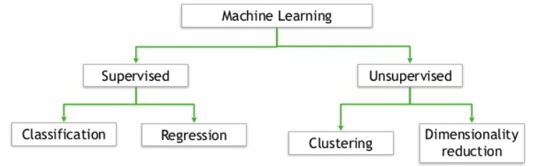
What is KNN?
Supervised because the algorithm learns from known (labeled) training data.
Binary classification: Predicting win or loss of a potential client
Multi-classification: Predicting which product the customer will purchase (more than two categories or classes)

Slide 4
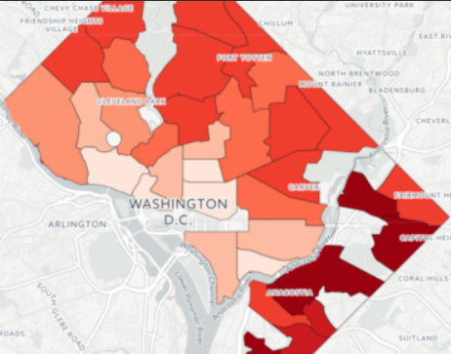


What is KNN?
The idea is relatively straightforward. We make a prediction about how to classify something based on its neighbors. It is based on the idea of physical neighborhoods. Neighborhoods are filled with similar (not different) types of people.

Slide 5

What is KNN?
There is no statistical model associated with KNN!
It just plots (or builds an efficient representation of) the training data and uses that plot to make classification decisions on the test/validation data.
Huh?
How is that possible?

Slide 6
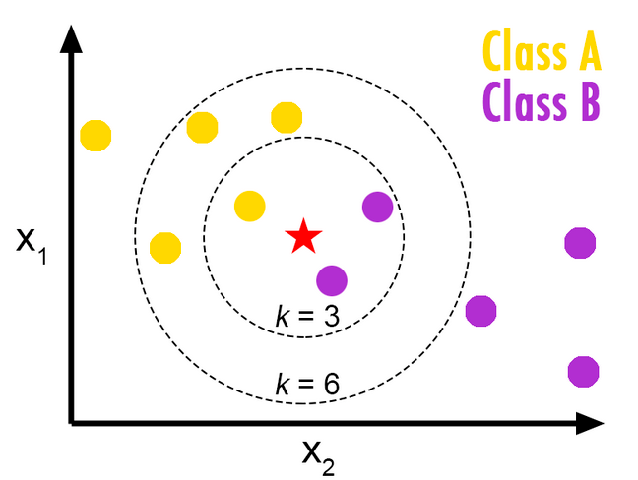
What is KNN?
Should the ‘star’ be classified as Class B (purple) or Class A (yellow)?
The yellow and purple data points are from the training data set.
This data point is an un-seen data point in the testing/validation data set

Slide 7
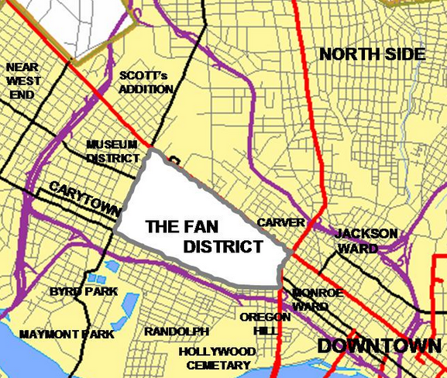
What is KNN?
Key is to pick the correct ‘k’ so we accurately reflect the current neighborhood without adding in ‘things’ from other neighborhoods.
Conceptualize the k as a distance metric.
If we pick too large of a ‘k’ then we might be comparing an individual who lives in the Fan District with an individual who lives in the Downtown neighborhood.
If we pick too small of a ‘k’ then we might not be capturing all of the diversity within a specific neighborhood!
Picking the right ‘k’ hyper-parameter is the key to a KNN prediction!

Slide 8
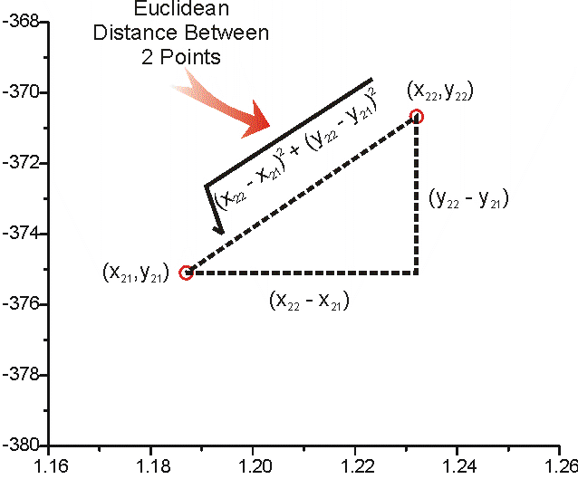
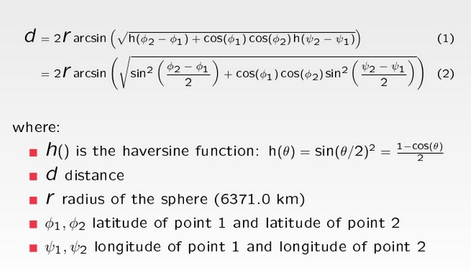
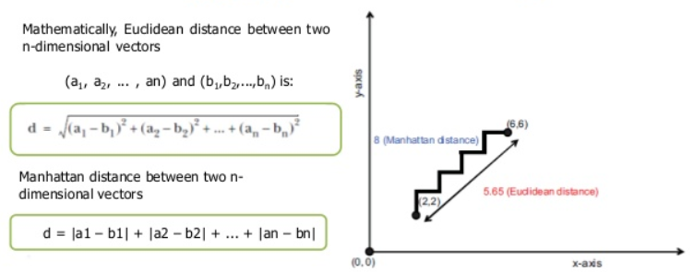
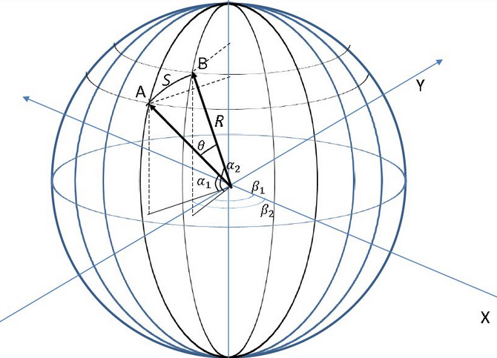
K as a Distance Metric
If K is a distance metric, how is distance calculated? We have choices!

Slide 9

What is KNN?
KNN is a lazy evaluator that uses the properties of the training data to make predictions of the new data. In essence, it uses the training data properties to make predictions directly. It is also referred to as a non-parametric technique since there is no formal statistical model that must be learned.

Slide 10
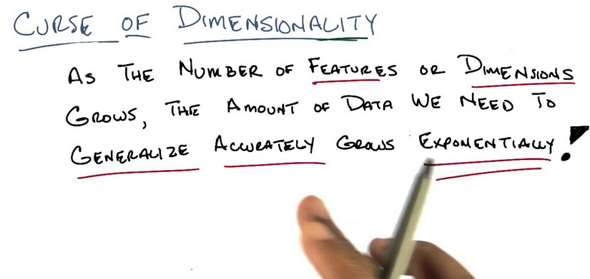
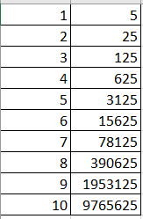
Gotcha’s

Slide 11
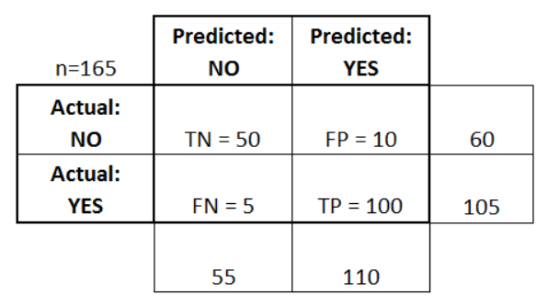
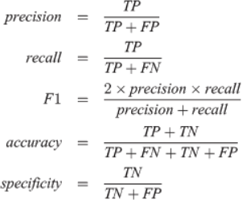
Evaluation Criteria
Confusion Matrix
Other Metrics

Slide 12
Business Use Cases
Classify markets into different return groups.
Predict whether an employee is a high or low ‘flight’ risk.
Classify job candidates as high or low risk of joining.
Classify projects as good or bad investments.
Classify workers based on previous successes & failures.
Predict an ETFs potential return based on nearest neighbor investments.
Classify an Account in the general ledger as high or low risk for fraud based on similar accounts
Classify whether a potential customer will sign a contract with the firm or not.
Classify whether a customer will go to a competitor or not.

Slide 13
Application in Python
Business scenario for this example
We work in a human resources department and we want to classify our current employees based on their ‘flight’ risk. In other words, does an employee have a low, medium or high risk of leaving the company? Our predictor dimensions (features) are the employee’s current salary, their job level, their years of education, the percentage of time that they travel for their job, and their gender.
https://scikit-learn.org/stable/modules/generated/sklearn.neighbors.KNeighborsClassifier.html

