Slide 1

Introduction to Linear Regression as a Machine Learning (cost minimization) Problem

Slide 2
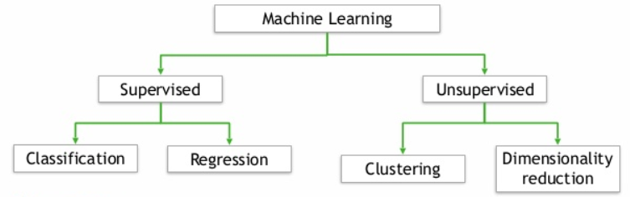
Supervised Machine Learning
Supervised because the algorithm learns from known training data.

Slide 3

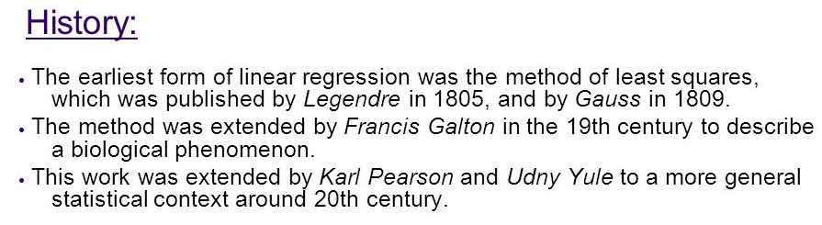
Regression is the data analyst’s workhorse for traditional analytics and for supervised machine learning problems!

Slide 4
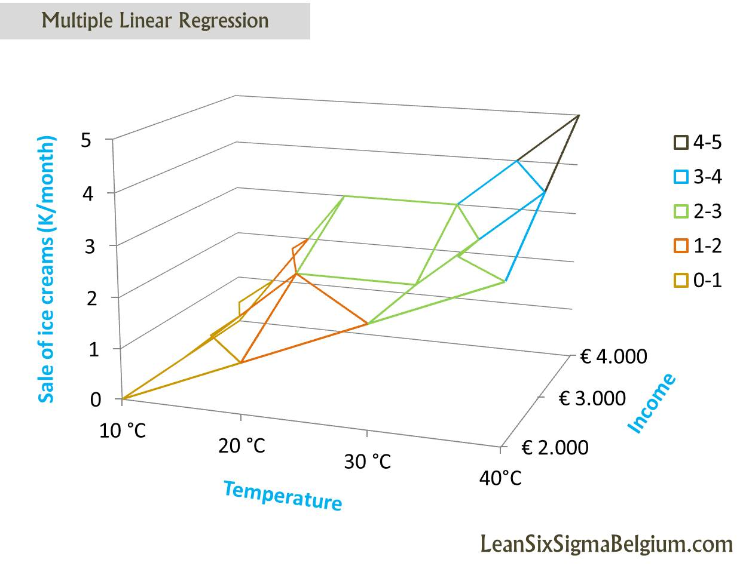
Multiple regression is used to explain the variance of an outcome (dependent) variable from several (multiple) independent variables. It answers how and to what extent the independent variables affect the outcome variable.
Is X a statistically significant predictor of Y?
Analysts care tremendously whether each independent variable is statistically significant!
We typically decide on the independent variables in a top down manner based on the expertise of the analysts.

Slide 5
Explanatory vs. Predictive
Subtle but important distinction
Explanatory models explain the past typically using the entire sample in a single model.
Primarily designed to test correlation-related hypotheses (e.g., historical correlation between employee gender and salary)
These hypotheses are developed based on analyst expertise.
Predictive models attempt to make a prediction related to unseen data.
Primarily designed to make predictions concerning new observations (i.e., how well does the model hold up to new data).
Must have a random sample of testing and training data to accomplish this objective.

Slide 6
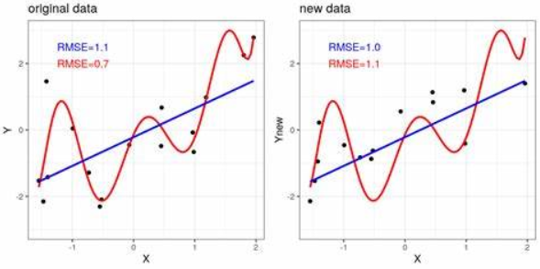
Its All About the Model Fit!
In the context of a supervised machine learning problem, we are primarily concerned about model fit instead of the statistical significance of the independent variables.
If the model adequately fits our training data, then we can use that model to make predictions about future (or unseen) data, which is our testing or validation data..

Slide 7
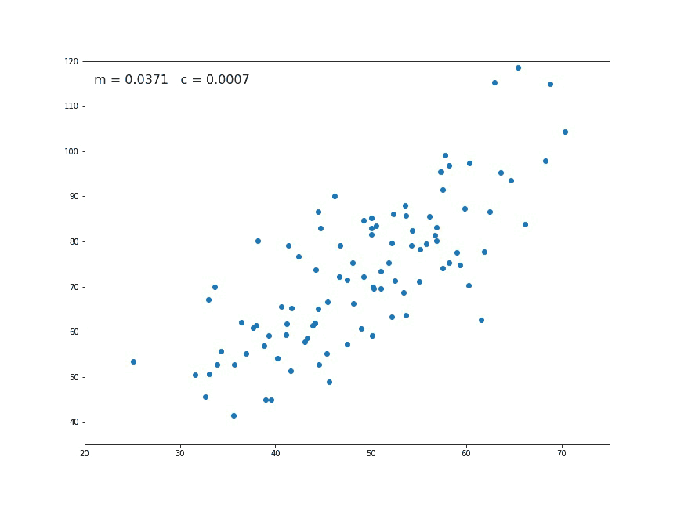
RegressionClassifier
To maximize model fit, the sklearn RegressionClassifier attempts to minimize a particular cost function through a variant of the gradient descent process.
A loss (or error) function is for a single training example. A cost function is the average loss over the entire training dataset.

Slide 8
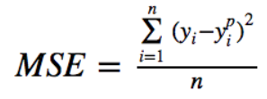
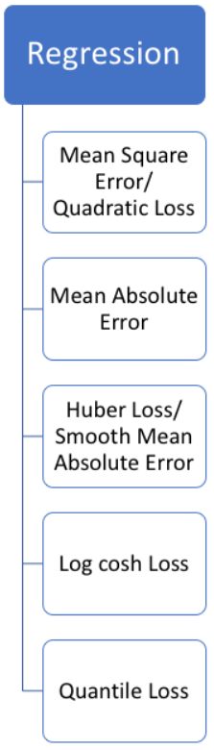
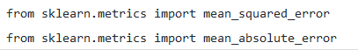
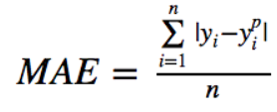
Standard Loss Functions
If we are attempting to minimize losses, how does the machine learning algorithm calculate losses for each example in the training data set?
L2
L1

Slide 9
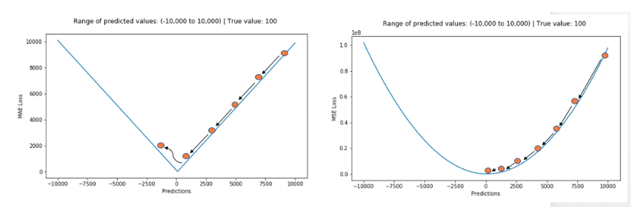
Standard Loss Functions
L1
L2
L1 loss is more robust to outliers in the training data but its derivatives are not continuous, which makes it inefficient at converging to a solution.

Slide 10
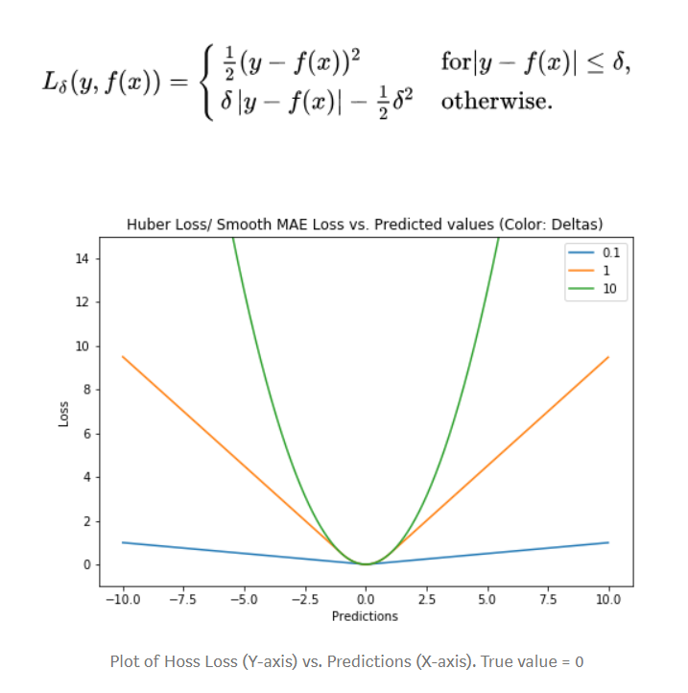
Standard Loss Functions
Hybrid L1/L2
Residuals larger than delta are minimized with L1 (which is less sensitive to large outliers), while residuals smaller than delta are minimized “appropriately” with L2.
Notes:
# huber loss
def huber(true, pred, delta):
loss = np.where(np.abs(true-pred) < delta , 0.5*((true-pred)**2), delta*np.abs(true - pred) - 0.5*(delta**2)) return np.sum(loss)

Slide 11
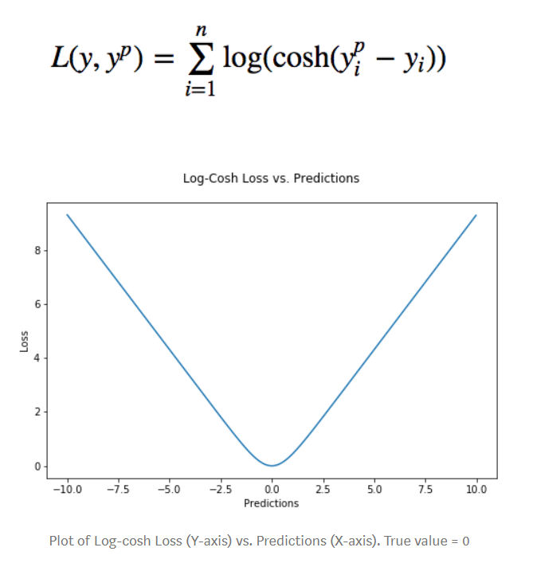
Standard Loss Functions
The logarithm of the hyperbolic cosine ('logcosh’) works mostly like the mean squared error, but will not be so strongly affected by the occasional wildly incorrect prediction.
Notes:
# log cosh loss
def logcosh(true, pred):
loss = np.log(np.cosh(pred - true)) return np.sum(loss)

Slide 12
Gradient Descent
After we calculate the loss for each observation, how do we find parameters that minimize the losses across all of the observations (cost minimization)?
predicted sales = 22 + 14*rating + 19*salary
We follow a gradient descent process. Essentially, you start by defining the initial parameter values and, from there, gradient descent uses calculus to iteratively adjust the values so they minimize the given cost-function.
"A gradient measures how much the output of a function changes if you change the inputs a little bit." — Lex Fridman (MIT)
A gradient measures the change in all weights with regard to the change in error (similar to a slope function). The higher the gradient, the steeper the slope and the faster a model can learn. But if the slope is zero, the model stops learning. A gradient is a partial derivative with respect to its inputs.

Slide 13
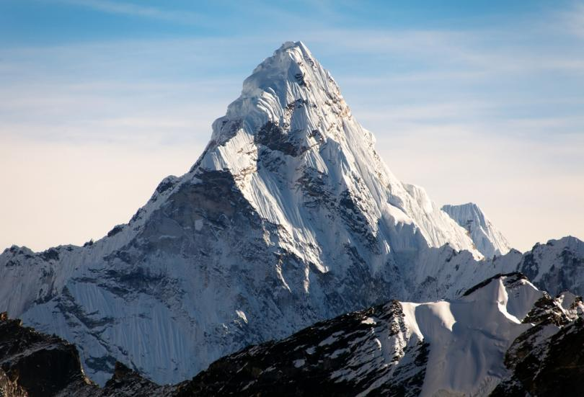
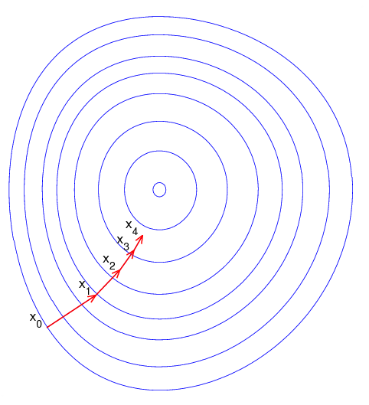
Gradient Descent
Notes:
Note that the gradient ranging from X0 to X1 is much longer than the one reaching from X3 to X4. This is because the steepness/slope of the hill, which determines the length of the vector, is less. This perfectly represents the example of the hill because the hill is getting less steep the higher it's climbed. Therefore a reduced gradient goes along with a reduced slope and a reduced step size for the hill climber.

Slide 14
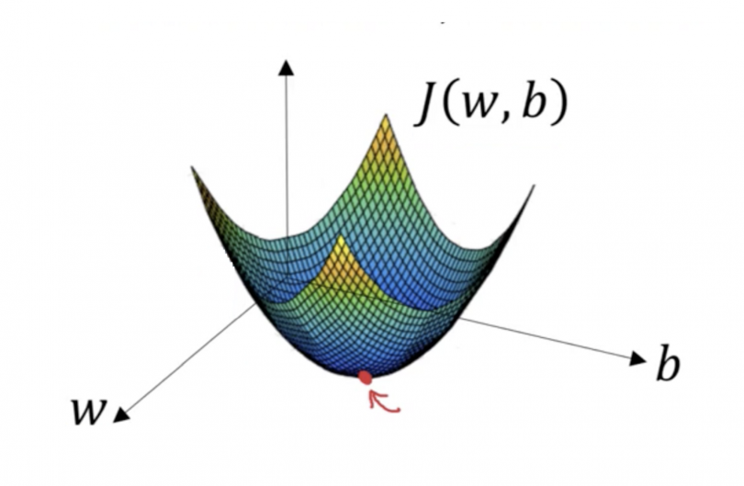
Gradient Descent
We want to find the values of w and b that correspond to the minimum of the cost function (red arrow).
To start finding the right values we initialize w and b with some random numbers.
Gradient descent then starts at that point and it takes one step after another in the steepest downside direction until it reaches the point where the cost function is as small as possible.

Slide 15
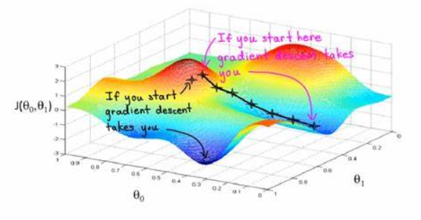
Gradient Descent
The ‘random’ starting point is key, especially if there are many peaks and valleys in our data! Might find a local minimum and not a global minimum.

Slide 16
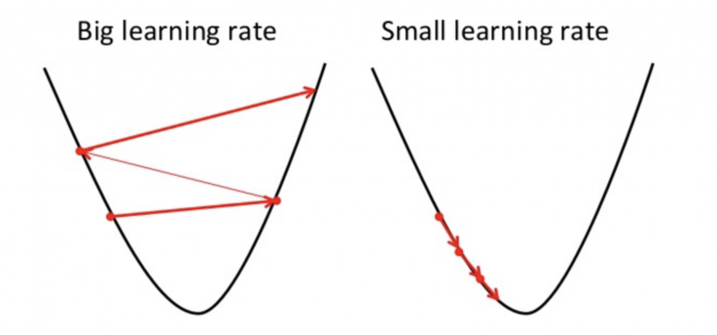
Gradient Descent
With each step down, the gradient descent algorithm learns. It may have a fast or a slow learning rate!

