Slide 1

Logistic Regression
Logistic Regression Machine Learning Classifier (SGDClassifier & LogisticRegression estimators)
What type of machine learning algorithm can we use when our dependent variable is binary (0 or 1), which is the case for many management problems?

Slide 2
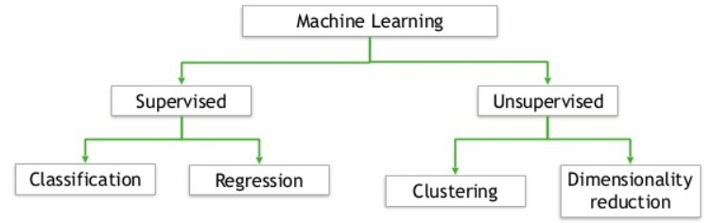
Logistic Regression
Supervised because the algorithm learns from known (labeled) training data.
Binary classification: Yes or No, True or False, Win or Lose, and so on
Can we predict the probability that an employee will quit or predict whether our company will win a client contract or not?
NOTE: We can run a multinomial logistic regression (multi-classification) but that is beyond the scope of this discussion.

Slide 3
Management Examples
Can we predict whether a female employee who is 25 years old and has been working in the same role for the past 24 months will quit?
Can we predict whether my company will be successful when we expand into the Washington, DC market?
Can we predict whether a potential new hire with 10 years of experience will accept our job offer at a pay rate of 75K per year to join our company?
Can we predict whether a current customer who has 15 prior purchases of our related product offerings and has been a customer for 5 years will purchase our new product offering?

Slide 4
Management Examples
Can we predict whether our new social media campaign on a similar platform will be successful?
What do all of these managerial questions have in common?
The outcome variable (DV) is binary (yes or no)
So what?
Why is this important?

Slide 5
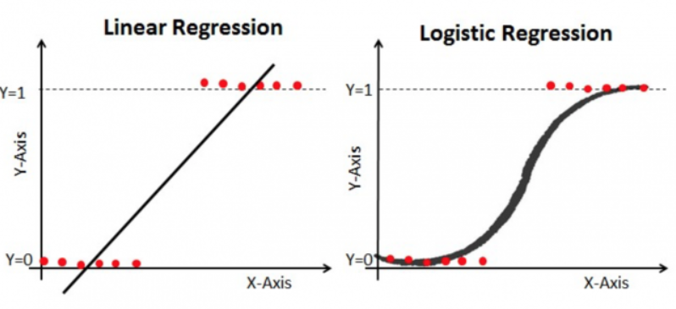
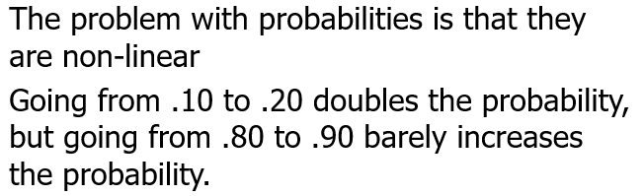
Management Examples

Slide 6

We do need a quick math refresher to interpret our results properly

Slide 7

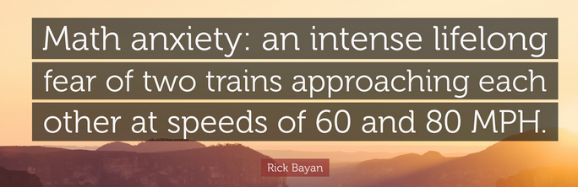
Math Refresher
Our python packages do most of the math for us so there is nothing to fear! However, we do have to conceptually understand a few concepts to understand our results.

Slide 8


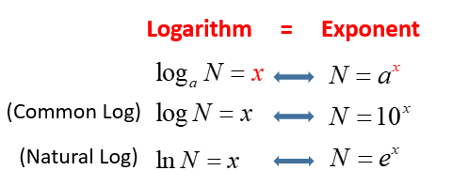
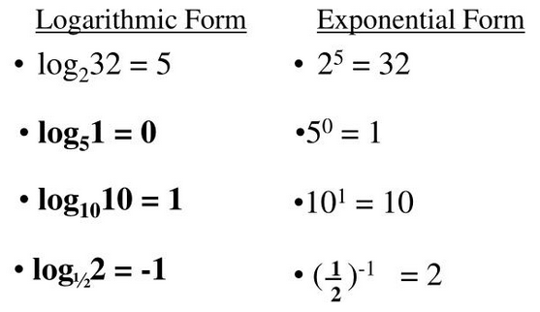
Math Refresher
e is a mathematical constant equal to ~2.71828
Notes:
http://www.mclph.umn.edu/mathrefresh/logs.html

Slide 9
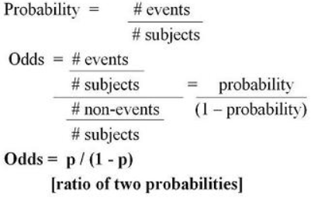
Math Refresher
For instance, we have 100 employees and 20 of them are satisfied with their job and 80 of them are dissatisfied with their job. Let’s calculate these values!
Probability of dissatisfied employee is 80/100 or 0.8 and the probability of a satisfied employee is 20/100 or 0.2.
Odds ratio of a dissatisfied employee is (80/100)/(1-(80/100)) = 4 to 1
Odds ratio of a satisfied employee is (20/100)/(1-(20/100)) = 0.25
Notes:
Odds ratios range from 0 to positive infinite
Odds ratios less than 1 = less than .50 probability, greater than 1 means greater than .50 probability

Slide 10
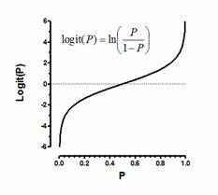
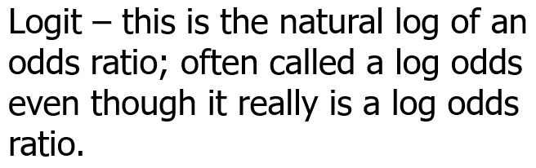
Math Refresher
Now, combine the natural log (log base e) and odds together.
Log (ln) of the odds or ln(p/(1-p)), which is referred to as LOGIT(P)

Slide 11

Unlike a KNN classification supervised machine learning algorithm, a logistic regression classification creates a parametric (statistical) model that can be explored to understand our predictions, in the same manner as a linear regression model supervised machine learning algorithm.
Again, don’t be scared of the math because our python packages will inevitably do most of the math for us. However, certain packages might give us the odds whereas others might give us the probabilities.

Slide 12
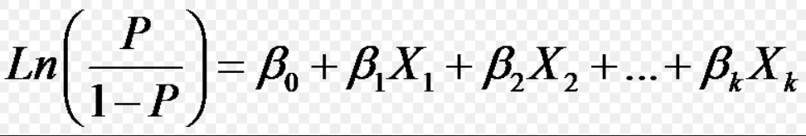
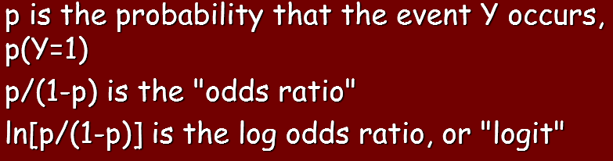
Logistic Regression
Transform our dependent variable by calculating probabilities, odds (well odds ratios), and then taking the natural log of the odds ratios

Slide 13
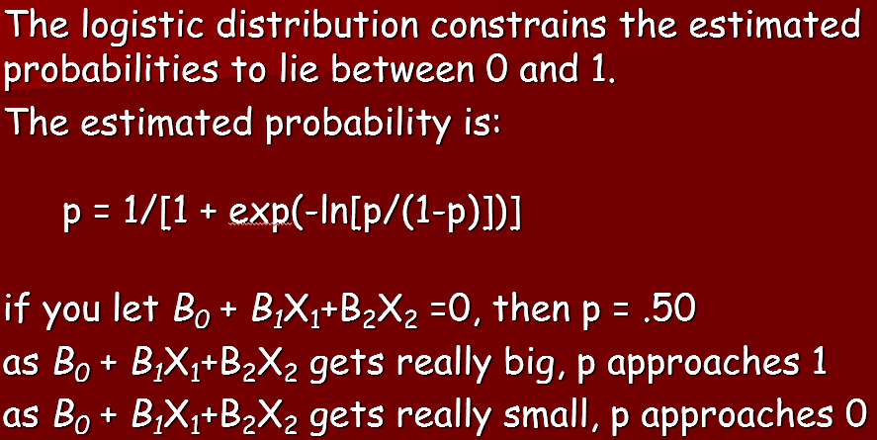
Logistic Regression

Slide 14
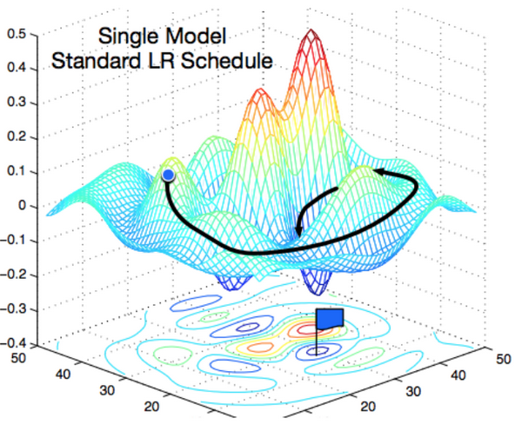
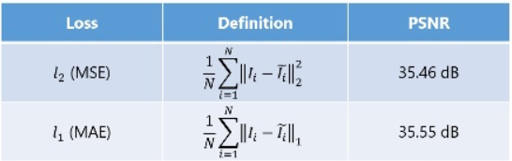
Logistic Regression
Follow a process of gradient descent to minimize a cost function, which is the minimum of the losses (error term).
Losses are the difference between line (curve) of best fit and the individual observations.
L1 or L2 loss function

Slide 15
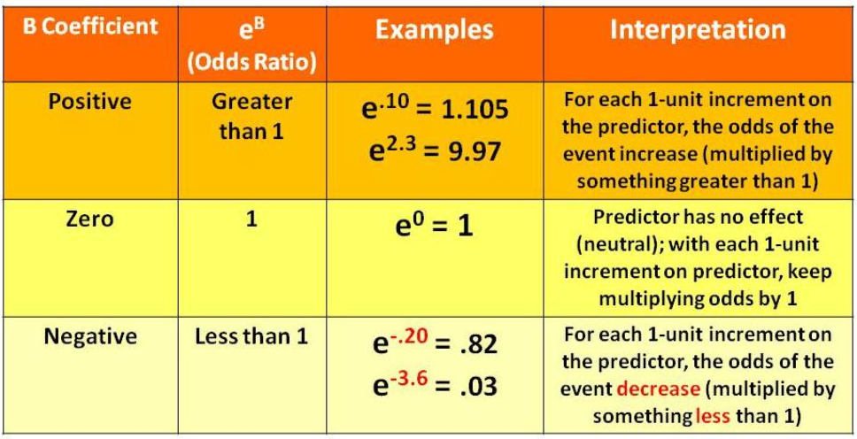
Logistic Regression

Slide 16
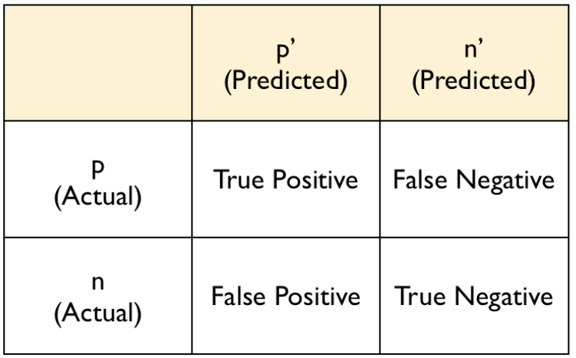
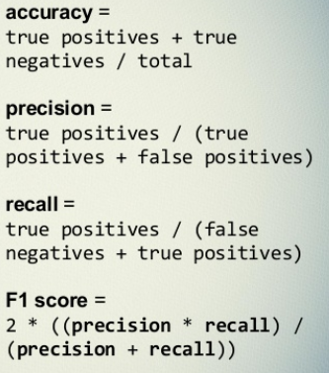
Logistic Regression
How often is the model “confused?”
Type 2 Error
Type 1 Error

Slide 17
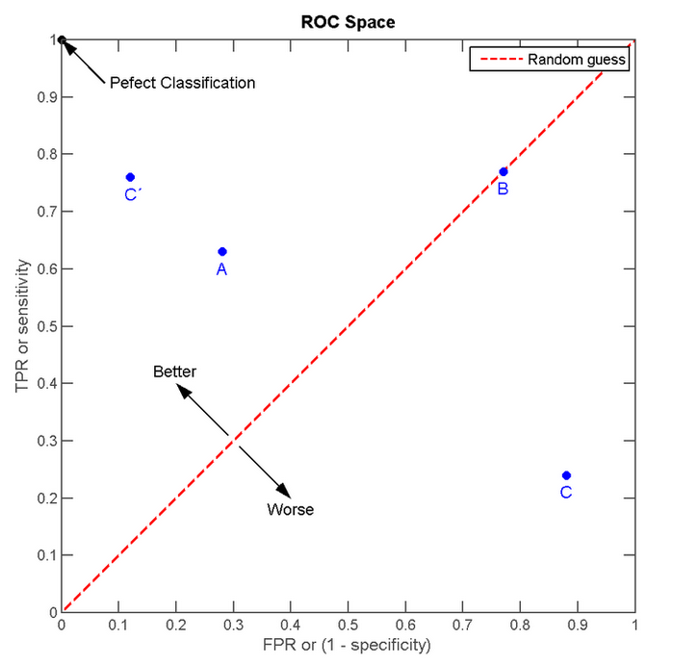
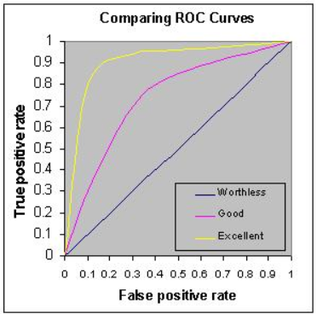
Logistic Regression
Stands for receiver operating characteristic, which is a graphical representation of the true positive rate (TPR) on the y-axis against the false positive rate (FPR) on the x-axis.

