Slide 1
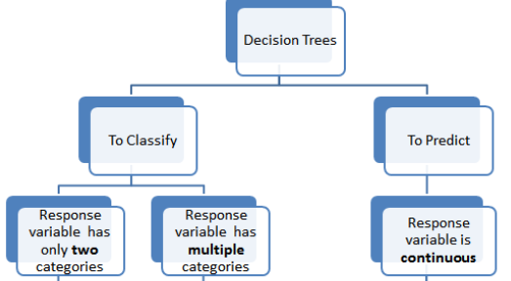
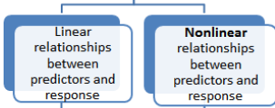
Decision Trees

Slide 2
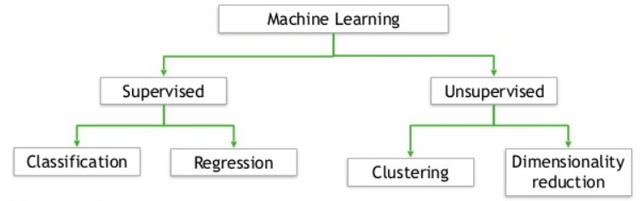
Decision Trees
Supervised because the algorithm learns from known (labeled) training data.
It can be used for both classification and regression supervised machine learning problems.
The use of a tree (with nodes and leaves) to minimize a loss function, which can lead to a better solution (especially with non-linear relationships)

Slide 3
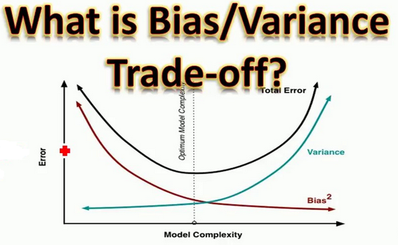
We need to discuss two concepts that are important for all machine learning algorithms (but particularly relevant for decision trees):
Bias
Variance
and one technique specific to Decision Trees
Cost Complexity Pruning

Slide 4
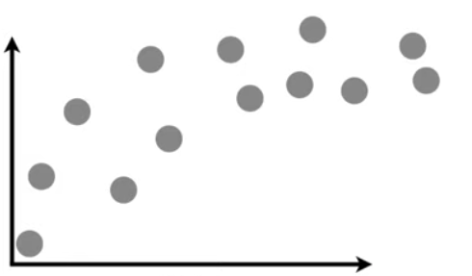
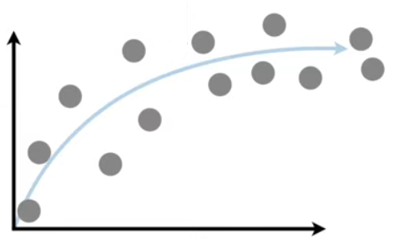
Bias/Variance Tradeoff
For this discussion, we want to predict sales revenue from sales person experience. In general, there is a positive relationship but the effect levels-off whereby more sales experience is no longer correlated with greater revenue.
Revenue
Revenue
Experience
Experience

Slide 5
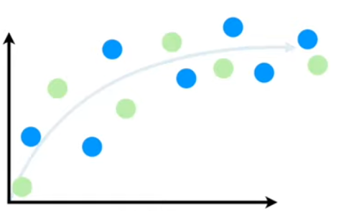
Bias/Variance Tradeoff
We randomly split the data into testing and training data sets! For this example, the blue circles will be used for training and the green circles used for testing the model.
Revenue
Experience

Slide 6
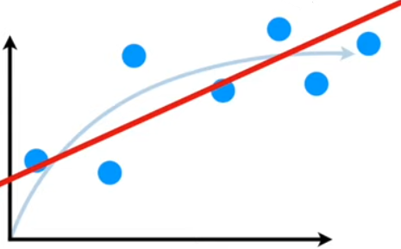
Bias/Variance Tradeoff
Let’s use the RegressionClassifier (i.e., Least Squares) to fit a model to the training data set.
We can see that this straight line (or any straight line for that matter) that gets fit via the linear Regression Classifier does not have the flexibility to accurately replicate the true relationship between sales experience and revenue.
Revenue
Experience
The inability for the machine learning algorithm to represent the true relationship in a training data set is referred to as bias.

Slide 7
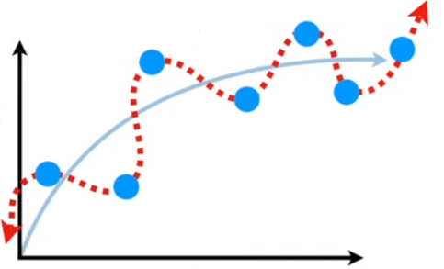
Bias/Variance Tradeoff
Let’s now say we apply PolynomialFeatures to fit a model to the training data set. We might get an idiosyncratic model for our training data set
This model can handle the true relationship in the training data set, which means that it has very little bias.
Revenue
Wonderful! Or is it?
Experience

Slide 8
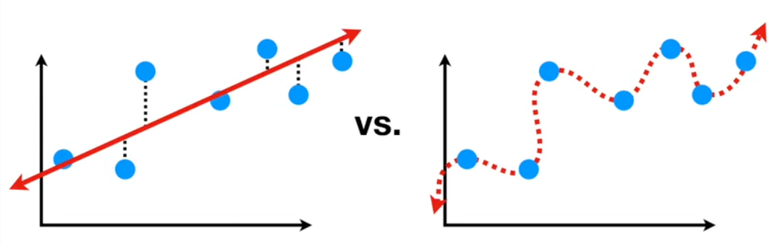
Bias/Variance Tradeoff
If we compare the two potential models (one with high bias and one with low bias) by summing the L2 losses (i.e., sum of the squared residuals), then the model on the right “wins” because the sum of the squared residuals is almost 0! It is a near perfect model with the training data set.
Revenue
Revenue
Experience
Experience

Slide 9
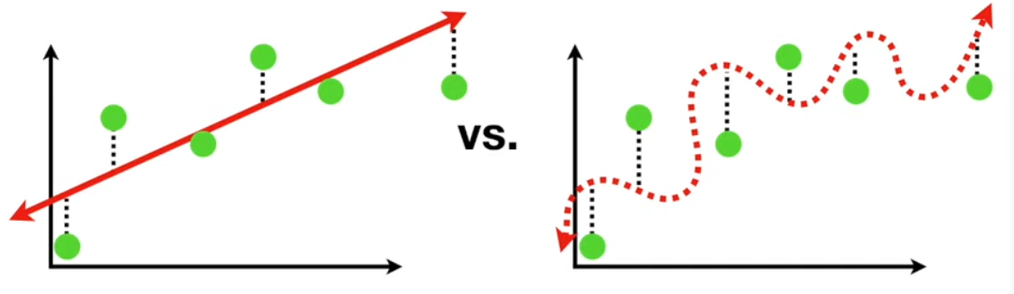
Bias/Variance Tradeoff
Now, let’s see how the two models predict our testing data because the true test for a model is how well the model fits unseen data. Here (although hard to see in the picture), the straight line fits the testing data better.
Revenue
Revenue
Experience
Experience
The difference in fits between the training data set and the testing data set is referred to as variance.

Slide 10
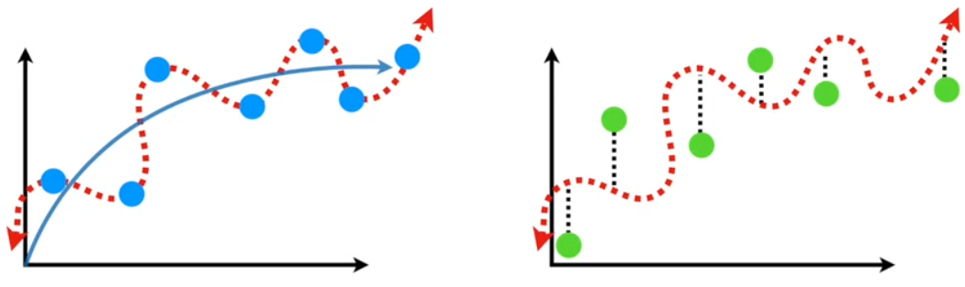
Bias/Variance Tradeoff
The curved squiggly line has low bias but high variability. It is so idiosyncratic to the training data that is difficult to predict how well it will fit unseen testing data.
Revenue
Revenue
Experience
Experience
This is referred to as overfitting a model that works really well for the training data set but really poorly with the testing data set.

Slide 11
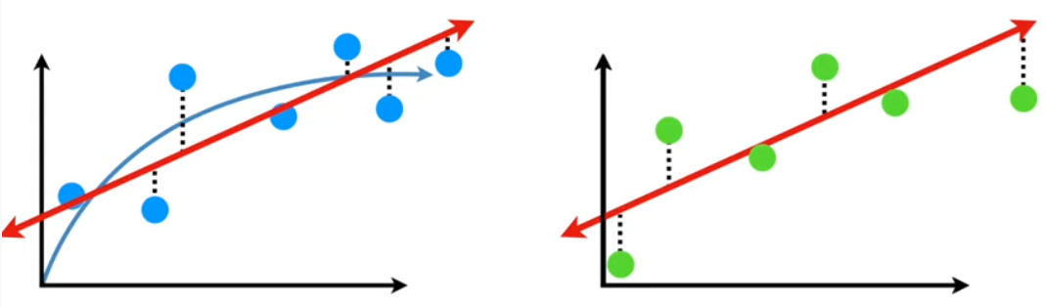
Bias/Variance Tradeoff
The straight line has high bias but low variability. It is does not accurately represent the true relationship but it fits the training data roughly the same as the unseen testing data.
Revenue
Revenue
Experience
Experience
Straight line will consistently make good predictions but not great predictions. We might refer to the straight line as underfitted!

Slide 12
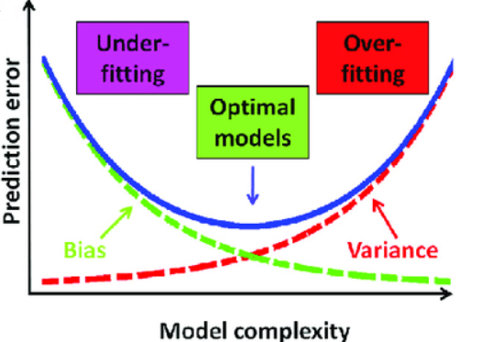
Bias/Variance Tradeoff
A great machine learning model is one with low bias and low variance!
We don’t want an overly simple model (high bias) or an overly complex model (high variance). We want to balance these two!

Slide 13
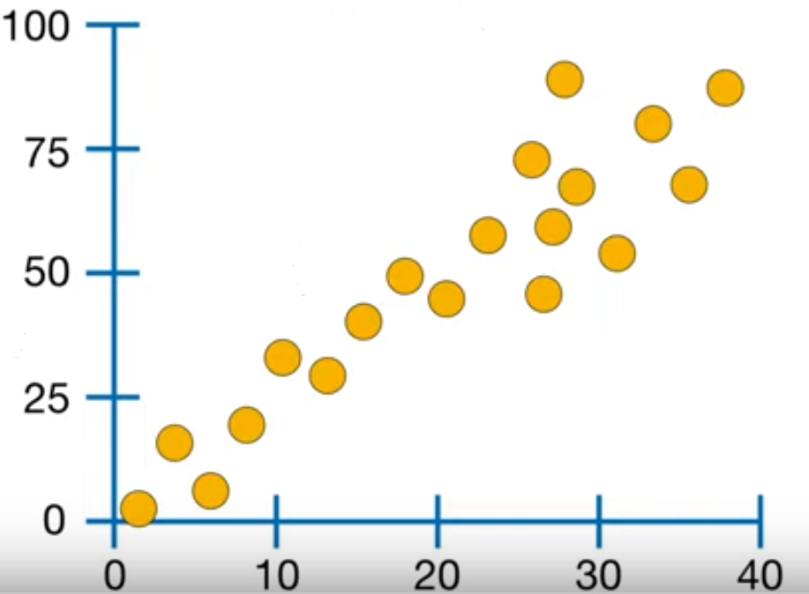
Regression Decision Trees
Percent Effective
Percent Effective
Sales Team Size
Sales Team Size

Slide 14
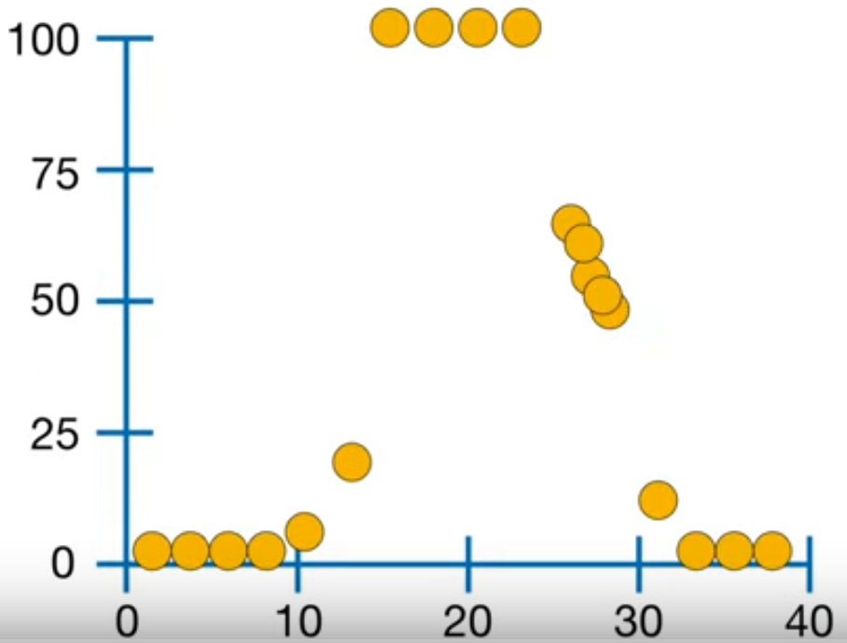
Regression Decision Trees
This straight line clearly does not fit our data terribly well!
Even a polynomial line probably won’t work terribly well
One option is to use a regression decision tree, which is a type of decision tree.
Percent Effective
Sales Team Size

Slide 15
Regression Decision Trees
Size < 14.5
4.2% Effective
Size >= 29.5
Contract Won
2.5% Effective
Size >= 23.5
True
False
52.8% Effective
100% Effective

Slide 16
Regression Decision Trees
Where did these values come from for the branches and leaves?
Calculate the average of the observations in each condition!
Size < 14.5
4.2% Effective
Size >= 29.5
2.5% Effective
Size >= 23.5
Percent Effective
52.8% Effective
100% Effective
Sales Team Size

Slide 17
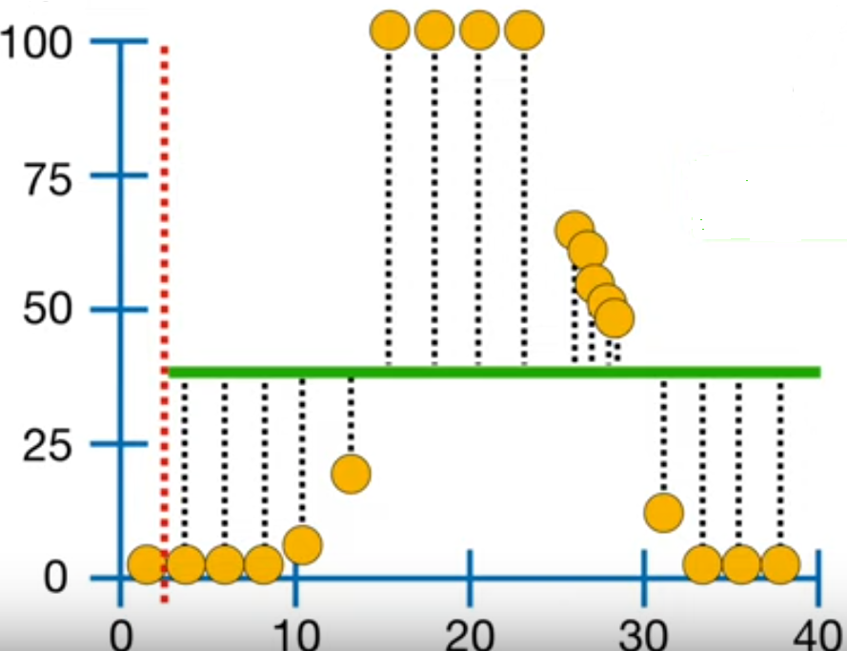
Regression Decision Trees
Where did these numbers come from for our each branch in our tree? Decision trees are built starting at the top!
Size < 3
Average 0
Average 38.8
Add up the losses (squared residuals) for each point when size < 3, which is 27,468.5.
Percent Effective
Size < 5
Average 0
Average 41.1
5 is the average of the next two data points. Now, add up the losses for each point when size < 5.
Sales Team Size

Slide 18
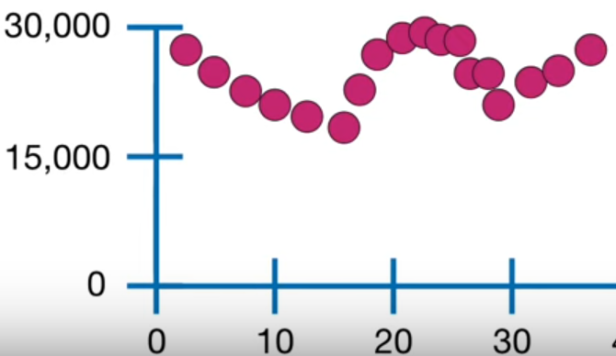
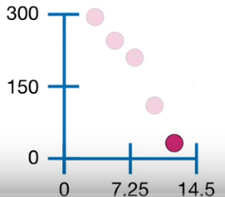
Regression Decision Trees
Repeat this process for each level of our size feature! Plot the residuals
Size < 14.5
Size < 11.5
Average 38.8
Avg 1
Avg 20
Sum of Squared Residuals
There are six data points where size is < 14.5. We could then split those six data points again!
Sum of Squared Residuals
Sales Team Size

Slide 19
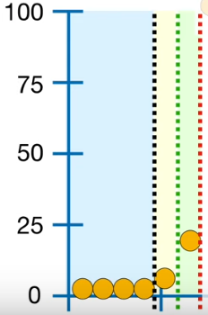
Regression Decision Trees
Repeat this process for each level of our size feature! We keep splitting the groups until we can’t split anymore
Size < 14.5
Size < 11.5
Avg 38.8
Size < 9
Avg 20
Avg 0
Avg 5
Each leaf fits the training perfectly! This is actually bad because the model has no bias but probably high variance!
How to fix this? Stop splitting when a group has a minimum number (typically 20 but I use 7 in this example)

Slide 20
Regression Decision Trees
This branch only has six observations so we will not re-split and create a leaf with the average of the 6 observations.
Size < 14.5
Avg 4.2
Avg 38.8
Now we repeat this process for the other side of the tree
Size < 14.5
Percent Effective
Size >= 29.5
Avg 2.5%
Sales Team Size
The right leaf contains more than 7 observations so we will re-split it!

Slide 21
Regression Decision Trees
This branch only has six observations so we will not re-split and create a leaf with the average of the 6 observations.
Size < 14.5
Avg 4.2%
Avg 38.8%
Now we repeat this process for the other side of the tree
Size < 14.5
Size >= 29.5
Percent Effective
Avg 2.5%
Size >= 23.5
Sales Team Size
Avg 52.8%
Avg 100%

Slide 22
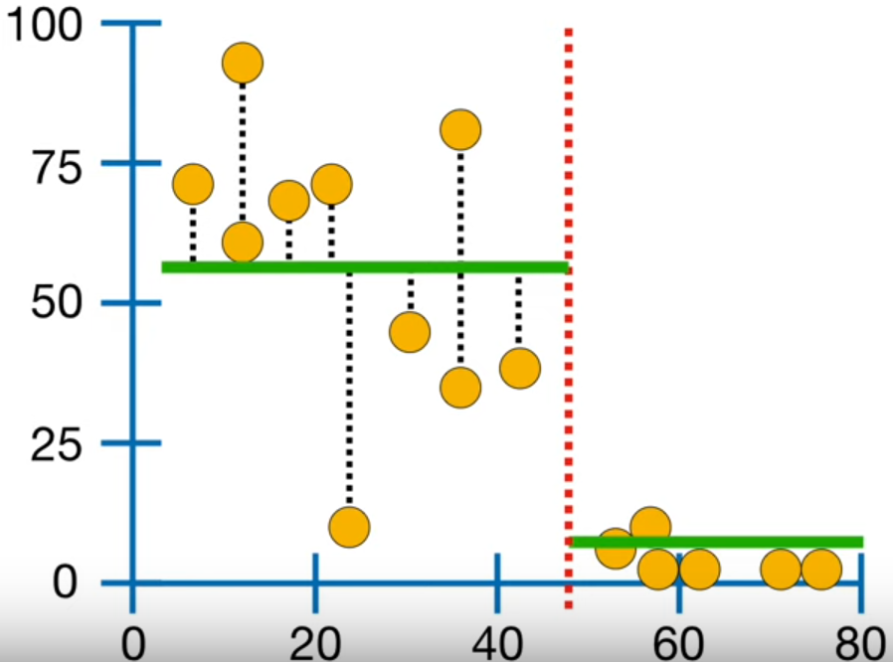
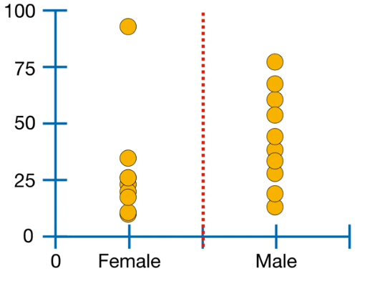
Regression Decision Trees
Now how do we set up a decision tree when we have multiple features?
Size < 14.5
SSR: 19,564
Average 4.2
Average 38.8
Percent Effective
Exp >50
SSR: 12,017
Average 3
Average 52
Sales Team Exp
Leader Gender=Female
SSR: 20,738
Percent Effective
Average 12
Average 40
Leader Gender

Slide 23
Regression Decision Trees
The feature with the lowest sum of squared residuals becomes the root.
Exp >50
Average 3
Size < 29.5
Average 20
Leader Gender=Female
Average 50
Average 100
As we grow the tree, we compare the lowest sum of squared residuals for each predictor. When a leaf has less than the minimum number of observations, we stop splitting them!

Slide 24

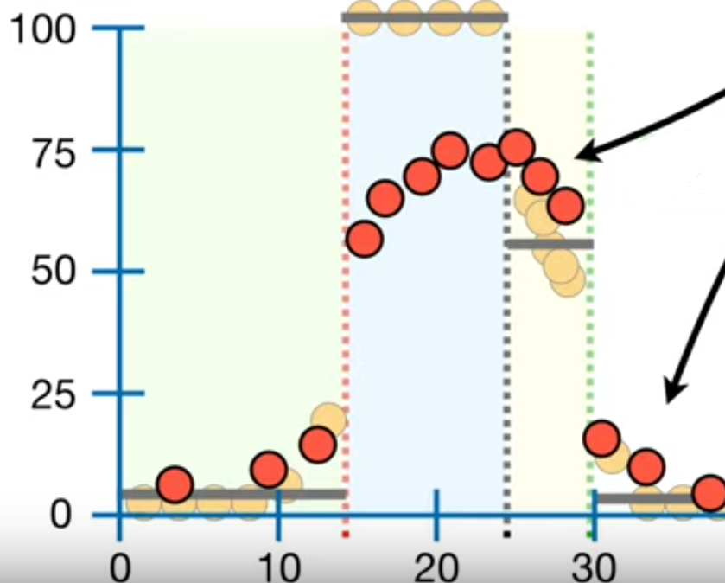
Regression Decision Trees
Like all trees, we sometimes need to prune them! There are several methods that we can use but we will focus on cost complexity pruning or weakest link pruning.

Slide 25
Regression Decision Trees
Size < 14.5
Size < 14.5
4.2% Effective
Size >= 29.5
4.2% Effective
Size >= 29.5
2.5% Effective
Size >= 23.5
2.5% Effective
73.8% Effective
52.8% Effective
100% Effective

Slide 26
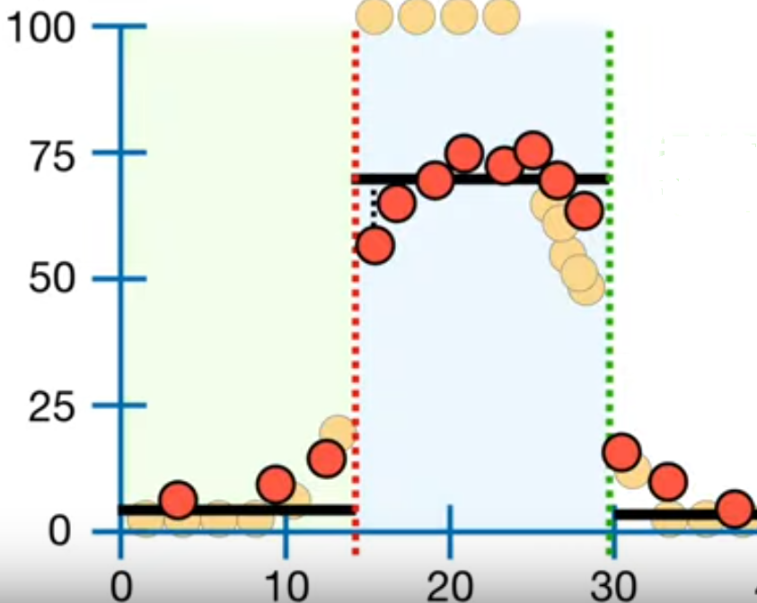
Regression Decision Trees
The pruned tree does not fit the training data as well but it fits the testing data better. Hence, the balance between variance and bias: greater bias but less variance

Slide 27
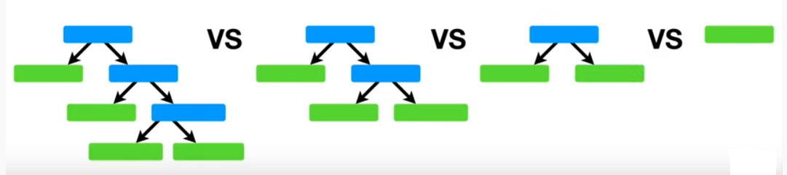
Regression Decision Trees
We can keep pruning all the way up to the root!
How do we know when to stop pruning?

Slide 28

Regression Decision Trees
We start by calculating the sum of the squared residuals for each tree. Then, we apply a penalty term for the complexity of the model!
Alpha is the penalty value (a hyperparameter that we set) and “T” is the number of terminal nodes (leaves). The objective of this process is variance reduction!
SSR: 543.8
SSR: 5494.8
SSR: 19243.7
SSR: 28897.2

Slide 29
Regression Decision Trees
Alpha is the penalty value (a hyperparameter that we set) and “T” is the number of terminal nodes (leaves).
SSR: 543.8
SSR: 5494.8
SSR: 19243.7
SSR: 28897.2

