Slide 1


DATABASE SYSTEMS
DR. ROA'A ALI ABDULLAH MOHAMMEDQASEM
CAFE ORDER SYSTEM — PRESENTATION
Irmak Kahya B2205.010080
Zeynep Eminoğlu B2305.010075
Emirhan Akbal B2205.010149

Slide 2
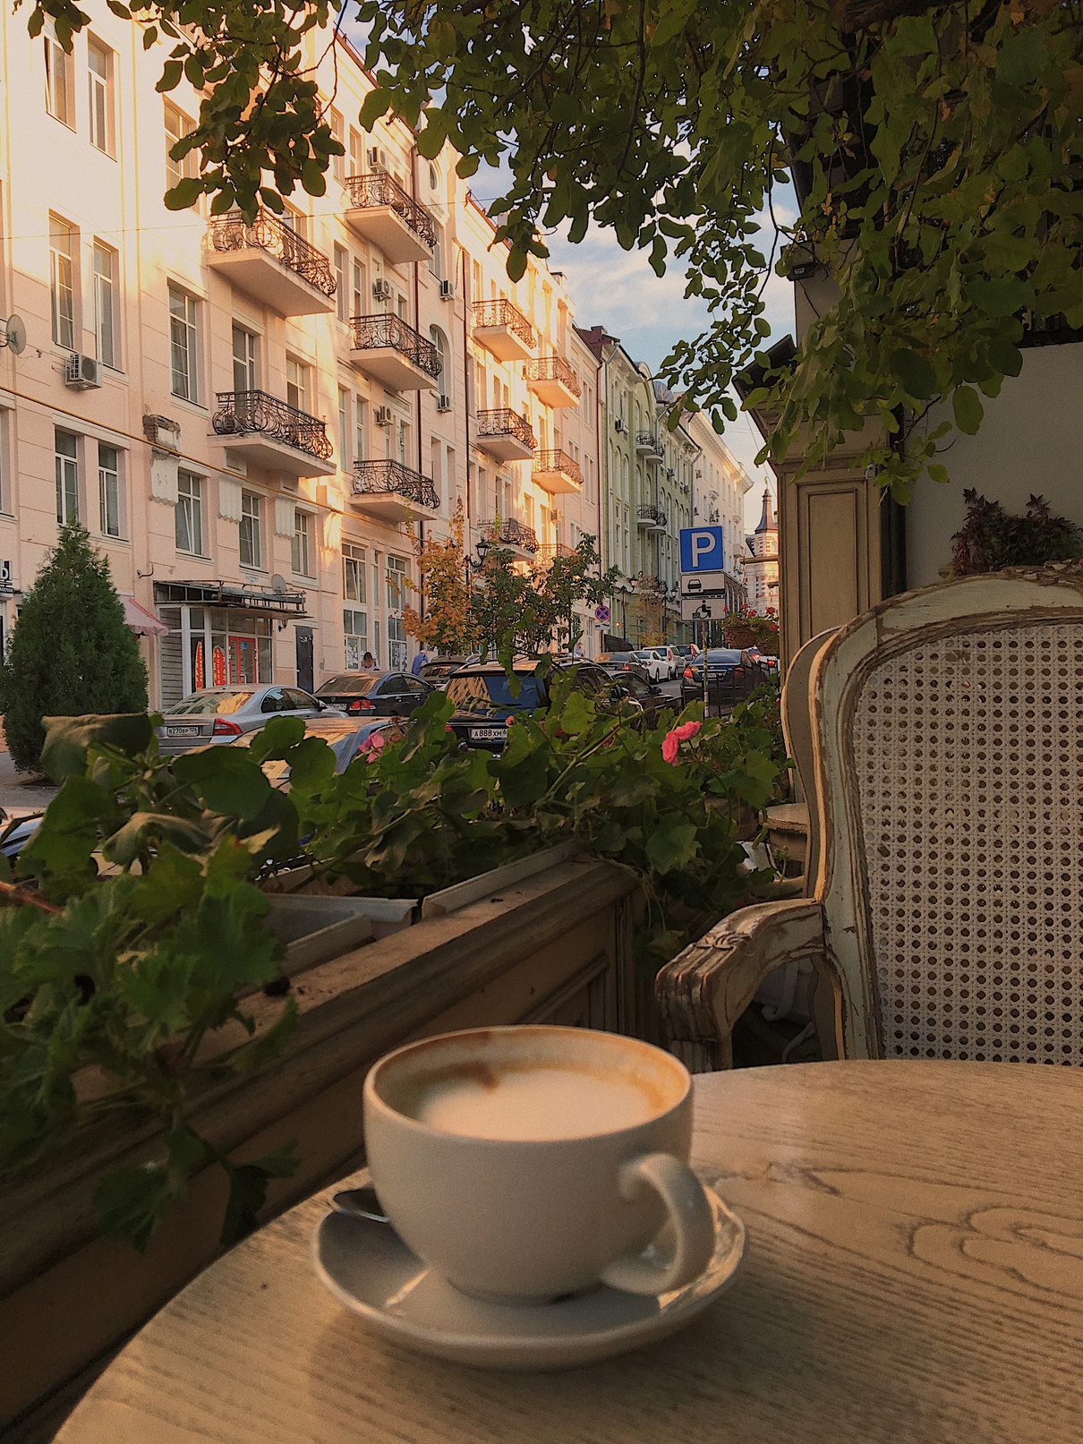

CAFE ORDER SYSTEM
Orders and Managements with Java Swing and MySQL
About Project :
- allows customers to browse the menu
- place their orders
- display total cost
-gets the address
-Download a reciept as pdf
- allowing managements to managers such as supply management , staff management, manager management, sales management. Helps to add worker, manager , supplier , showing how much , which product sailed at a certain date.

Slide 3
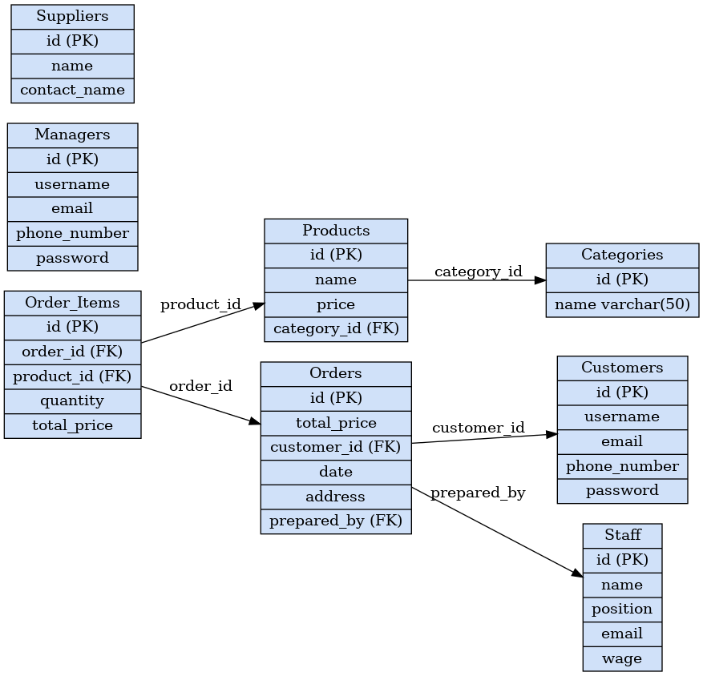
DATABASE SCHEMA
Categories and the Products Tables:
Each product belongs to a category.
Customers, Orders, and Order Items Tables:
Each order must be placed by a customer, so every order has a customer_id.
in the order items table an order can have multiple products, each product has both an order_id and a product_id.

Slide 4

Tables:
CREATE TABLE orders (
id INT AUTO_INCREMENT PRIMARY KEY,
total_price DECIMAL(10,2) NOT NULL,
customer_id INT NOT NULL,
date TIMESTAMP DEFAULT CURRENT_TIMESTAMP,
address VARCHAR(250) not null,
prepared_by int,
Foreign Key (customer_id) references customers (id),
Foreign Key (prepared_by) references staff(id)
);
CREATE TABLE order_items (
id INT AUTO_INCREMENT PRIMARY KEY,
order_id INT NOT NULL,
product_id INT NOT NULL,
quantity INT NOT NULL,
total_price DECIMAL(10,2) NOT NULL,
FOREIGN KEY (order_id) REFERENCES orders(id),
FOREIGN KEY (product_id) REFERENCES products(id)
);
CREATE TABLE suppliers (
id INT AUTO_INCREMENT PRIMARY KEY,
name VARCHAR(100) not null ,
contact_name VARCHAR(100) unique NOT NULL
);
CREATE TABLE managers(
id INT AUTO_INCREMENT PRIMARY KEY,
username VARCHAR(100) NOT NULL unique,
email VARCHAR(100) NOT NULL unique,
phone_number VARCHAR(20) unique,
password VARCHAR(100) NOT NULL
);
CREATE TABLE categories (
id INT AUTO_INCREMENT PRIMARY KEY,
name VARCHAR(50) NOT NULL
);
CREATE TABLE customers (
id INT AUTO_INCREMENT PRIMARY KEY,
username VARCHAR(100) NOT NULL unique,
email VARCHAR(100) NOT NULL unique,
phone_number VARCHAR(20) NOT NULL unique,
password VARCHAR(100) NOT NULL
);
CREATE TABLE products (
id INT AUTO_INCREMENT PRIMARY KEY,
name VARCHAR(100) NOT NULL,
price DECIMAL(10,2) NOT NULL,
category_id INT NOT NULL,
FOREIGN KEY (category_id) REFERENCES categories(id)
);
CREATE TABLE staff (
id INT AUTO_INCREMENT PRIMARY KEY,
name VARCHAR(100) unique not null,
position ENUM('waiter', 'chef', 'cashier', 'barista', 'dishwasher', 'pastry chef', 'cleaner', 'delivery person') NOT NULL,
email VARCHAR(100) unique NOT NULL,
wage DECIMAL(10,2) NOT NULL
);

Slide 5

INSERT INTO:
INSERT INTO categories (name) VALUES
('Breakfast'),
('Appetizers'),
('Soup'),
('Hamburger'),
('Pizza'),
('Pasta'),
('Chicken'),
('Salads'),
('Deserts');
INSERT INTO products (name, price, category_id) VALUES
('Breakfast Spread', 300.00, 1),
('Menemen', 70.00, 1),
('Fried Egg', 60.00, 1),
('Toast', 90.00, 1),
('Sandwich ', 70.00, 1);
INSERT INTO products (name, price, category_id) VALUES
(‘ Bruschetta’, 60.00, 2),
('Mozzarella Stick', 75.00, 2),
(' Stuffed Mushrooms', 80.00, 2),
(' French Fries ', 55.00, 2),
(' Onion Rings', 42.00, 2);
INSERT INTO products (name, price, category_id) VALUES
(‘Tomato Soup ', 90.00, 3),
(' Lentil Soup’, 70.00, 3),
(' Tripe Soup’, 80.00, 3),
(' Chicken Broth’, 100.00, 3),
(' Vegetable Soup', 75.00, 3);
INSERT INTO products (name, price, category_id) VALUES
('Classic Hamburger', 390.00, 4),
('Cheeseburger', 400.00, 4),
('Double Burger', 500.00, 4),
('BBQ Burger', 490.00, 4),
('Veggie Burger', 350.00, 4);
INSERT INTO products (name, price, category_id) VALUES
('Margherita Pizza', 290.00, 5),
('Pepperoni Pizza', 350.00, 5),
('Four Cheese Pizza', 320.00, 5),
('Mixed Pizza', 400.00, 5),
('Vegetarian Pizza',290.00, 5);
INSERT INTO products (name, price, category_id) VALUES
('Spaghetti Bolognese', 190.00, 6),
('Fettucine Alfredo', 180.00, 6),
('Penne Arabiata', 170.00, 6),
('Lasagne', 285.00, 6),
('Napolitan Pasta, 170.00, 6);
INSERT INTO products (name, price, category_id) VALUES
('Grilled Chicken', 275.00, 7),
('Breaded Chicken', 170.00, 7),
('Buffalo Wings', 168.00, 7),
('Chicken Schnitzel', 172.00, 7),
('Chicken Wrap', 165.00, 7);
INSERT INTO products (name, price, category_id) VALUES
('Caesar Salad', 150.00, 8),
('Tuna Salad', 200.00, 8),
('Mediterranean Salad', 148.00, 8),
('Chicken Salad', 155.00, 8),
('Quinoa Salad', 153.00, 8);
INSERT INTO products (name, price, category_id) VALUES
('Cheesecake', 245.00, 9),
('Tiramisu', 150.00, 9),
('Chocolate Souffle', 148.00, 9),
('Brownie’, 238.00, 9),
('Magnolia Pudding’, 142.00, 9);
Origins

Slide 6
INSERT INTO staff (name, position, email, wage) VALUES
('Ayşe Yılmaz', 'waiter', 'ayse.yilmaz@restaurant.com', 52000.00),
('Mehmet Kaya', 'waiter', 'mehmet.kaya@restaurant.com', 54000.50),
('Zeynep Demir', 'waiter', 'zeynep.demir@restaurant.com', 58000.75),
('Ali Şahin', 'chef', 'ali.sahin@restaurant.com', 85000.00),
('Fatma Aydın', 'chef', 'fatma.aydin@restaurant.com', 92000.00),
('Can Bulut', 'cashier', 'can.bulut@restaurant.com', 62000.50),
('Elif Toprak', 'cashier', 'elif.toprak@restaurant.com', 65000.00),
('Eren Yıldız', 'barista', 'eren.yildiz@restaurant.com', 68000.75),
('Selin Çelik', 'barista', 'selin.celik@restaurant.com', 72000.00),
('Cem Kurt', 'dishwasher', 'cem.kurt@restaurant.com', 50000.00),
('Deniz Arslan', 'dishwasher', 'deniz.arslan@restaurant.com', 51000.00),
('Aslı Tekin', 'pastry chef', 'asli.tekin@restaurant.com', 75000.00),
('Burak Koç', 'pastry chef', 'burak.koc@restaurant.com', 78000.50),
('Derya Yılmaz', 'cleaner', 'derya.yilmaz@restaurant.com', 50000.00),
('Emre Can', 'cleaner', 'emre.can@restaurant.com', 52000.00),
('Fırat Demir', 'delivery person', 'firat.demir@restaurant.com', 55000.00),
('Gizem Şen', 'delivery person', 'gizem.sen@restaurant.com', 58000.00);
INSERT INTO customers (username, email, phone_number, password) VALUES
('ethan22', 'ethan@gmail.com', '5553216547', 'password123'),
('sophia47', 'sophia@gmail.com', '5554327658', 'mypassword456'),
('noah58', 'noah@gmail.com', '5555438769', 'secure789'),
('harper99', 'harper@gmail.com', '5556549870', 'pass1234'),
('jaxon11', 'jaxon@gmail.com', '5557650981', 'jpassword567'),
('avery15', 'avery@gmail.com', '5558762092', 'averypassword678'),
('mila22', 'mila@example.com', '5554562310', 'milapassword890'),
('zoe66', 'zoe@gmail.com', '5552340198', 'zoepassword234'),
('luca89', 'luca@gmail.com', '5553451209', 'lucapassword567'),
('dylan32', 'dylan@gmail.com', '5559873203', 'dylan1234');
INSERT INTO managers (username, email, phone_number, password) VALUES
('Irmak Kahya', 'ırmak@gmail.com', '5559497473', 'ırmak123123'),
('Emirhan Akbal', 'emirhan@gmail.com', '5512344543', 'emirhan123123'),
('Zeynep Eminoğlu', 'zeynep@gmail.com', '5555438768', 'zeynep123123');

Slide 7

Database Update:
UPDATE products SET image_path = 'image/lentilsoup.jpg' WHERE name = 'Lentil Soup';
UPDATE products SET image_path = 'image/magnoliapudding.jpg' WHERE name = 'Magnolia Pudding';
UPDATE products SET image_path = 'image/margheritapizza.jpg' WHERE name = 'Margherita Pizza';
UPDATE products SET image_path = 'image/mediterraneansalad.jpg' WHERE name = 'Mediterranean Salad';
UPDATE products SET image_path = 'image/menemen.jpg' WHERE name = 'Menemen';
UPDATE products SET image_path = 'image/mixedpizza.jpg' WHERE name = 'Mixed Pizza';
UPDATE products SET image_path = 'image/mozarellasticks.jpg' WHERE name = 'Mozzarella Stick';
UPDATE products SET image_path = 'image/napolitanpasta.jpg' WHERE name = 'Napolitan Pasta';
UPDATE products SET image_path = 'image/onionrings.jpg' WHERE name = 'Onion Rings';
UPDATE products SET image_path = 'image/pennearabiata.jpg' WHERE name = 'Penne Arabiata';
UPDATE products SET image_path = 'image/pepperonipizza.jpg' WHERE name = 'Pepperoni Pizza';
UPDATE products SET image_path = 'image/quinoasalad.jpg' WHERE name = 'Quinoa Salad';
UPDATE products SET image_path = 'image/sandwich.jpg' WHERE name = 'Sandwich';
UPDATE products SET image_path = 'image/souffle.jpg' WHERE name = 'Chocolate Souffle';
UPDATE products SET image_path = 'image/spaghettibolognese.jpg' WHERE name = 'Spaghetti Bolognese';
UPDATE products SET image_path = 'image/stuffedmushrooms.jpg' WHERE name = 'Stuffed Mushrooms';
UPDATE products SET image_path = 'image/tiramisu.jpg' WHERE name = 'Tiramisu';
UPDATE products SET image_path = 'image/toast.jpg' WHERE name = 'Toast';
UPDATE products SET image_path = 'image/tomatosoup.jpg' WHERE name = 'Tomato Soup ';
UPDATE products SET image_path = 'image/tripesoup.jpg' WHERE name ='Tripe Soup';
UPDATE products SET image_path = 'image/tunasalad.jpg' WHERE name = 'Tuna Salad';
UPDATE products SET image_path = 'image/vegetablesoup.jpg' WHERE name = 'Vegetable Soup';
UPDATE products SET image_path = 'image/vegetarianpizza.jpg' WHERE name = 'Vegetarian Pizza';
UPDATE products SET image_path = 'image/veggieburger.jpg' WHERE name = 'Veggie Burger';
select*from products;
UPDATE products SET image_path = 'image/bbqburger.jpg' WHERE name = 'BBQ Burger';
UPDATE products SET image_path = 'image/breadedchicken.jpg' WHERE name = 'Breaded Chicken';
UPDATE products SET image_path = 'image/breakfastspread.jpg' WHERE name = 'Breakfast Spread';
UPDATE products SET image_path = 'image/brownie.jpg' WHERE name = 'Brownie';
UPDATE products SET image_path = 'image/bruschetta.jpg' WHERE name = 'Bruschetta';
UPDATE products SET image_path = 'image/buffalowings.jpg' WHERE name = 'Buffalo Wings';
UPDATE products SET image_path = 'image/caesaarsalad.jpg' WHERE name = 'Caesar Salad';
UPDATE products SET image_path = 'image/cheeseburger.jpg' WHERE name = 'Cheeseburger';
UPDATE products SET image_path = 'image/cheesecake.jpg' WHERE name = 'Cheesecake';
UPDATE products SET image_path = 'image/chickenbrothsoup.jpg' WHERE name = 'Chicken Broth';
UPDATE products SET image_path = 'image/chickensalad.jpg' WHERE name = 'Chicken Salad';
UPDATE products SET image_path = 'image/chickenschnitzel.jpg' WHERE name = 'Chicken Schnitzel';
UPDATE products SET image_path = 'image/chickenwrap.jpg' WHERE name = 'Chicken Wrap';
UPDATE products SET image_path = 'image/classicburger.jpg' WHERE name = 'Classic Hamburger';
UPDATE products SET image_path = 'image/doubleburger.jpg' WHERE name = 'Double Burger';
UPDATE products SET image_path = 'image/fettucinialfredo.jpg' WHERE name = 'Fettucine Alfredo';
UPDATE products SET image_path = 'image/fourcheesepizza.jpg' WHERE name = 'Four Cheese Pizza';
UPDATE products SET image_path = 'image/frenchfries.jpg' WHERE name = 'French Fries ';
UPDATE products SET image_path = 'image/friedegg.jpg' WHERE name = 'Fried Egg';
UPDATE products SET image_path = 'image/grilledchicken.jpg' WHERE name = 'Grilled Chicken';
UPDATE products SET image_path = 'image/lasagne.jpg' WHERE name = 'Lasagne';

Slide 8
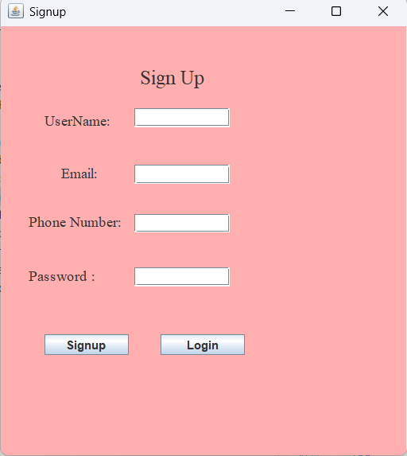
Sign Up Page
In sign up page , The user will open a new account and it will be added to customer table . All fields are required to open a new acount . After opening an account with username, email,phone number, password by clicking the login button , the user can go to login page and enter to cafe order page by filling the user enterance .Adding a manager can be made by the other managers from managements system for security so this page works for users only.

Slide 9
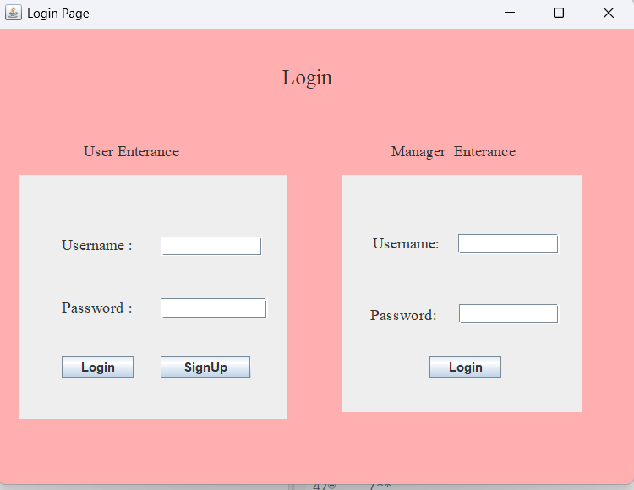
Login Page:
In the login page , we have user enterance and manager enterence . We get the users from customer table and manager enterance from manager table .If user doesn’t have an account ,from signup button can go to signup page to open a new account.
When user enters from user enterance ,it will go to cafe order system . When manager enters from manager enterance , it will go to management system .

Slide 10
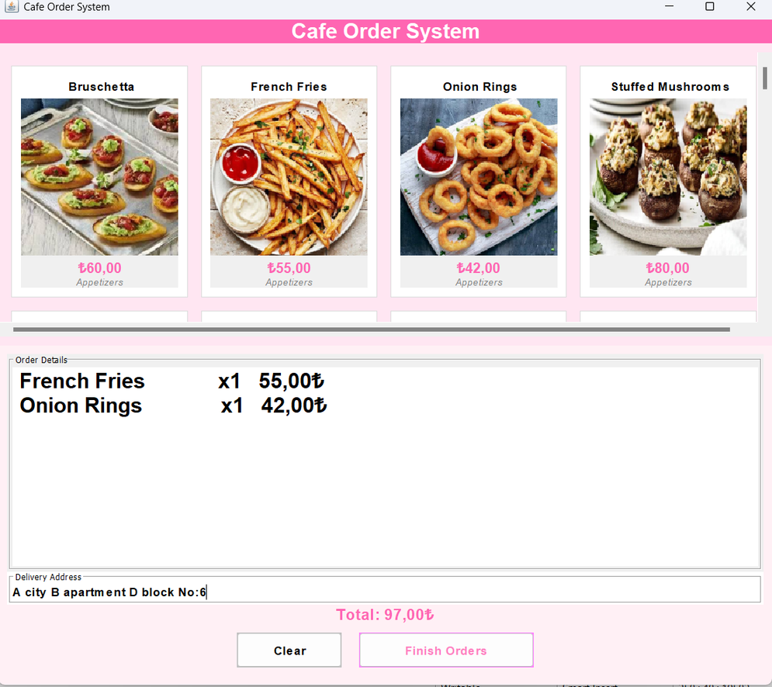
USER INTERFACE
📌 The interface displays products in a grid layout with images, names, prices, and categories.
🛒 Users can click any product to add it to the order list below.
📂 Each product also shows its category (e.g., Breakfast, Appetizers) in italic for visual grouping.
💵 The selected items appear in the text area, showing quantity and price per item.
🧮 The total amount is calculated and shown at the screen.
📍There is a delivery address field , it takes the address of the customer to deliver .It is required.

Slide 11
user Interface
CLEAR ORDER BUTTON
The "Clear Order" button allows users to quickly remove all selected items from their current order. Whether the customer changes their mind or wants to start a new order from scratch, this button resets the order form to its initial state with a single click.

Slide 12
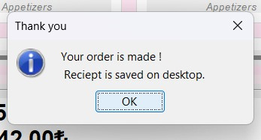
Order FInIshed
Confirmation Message
After the user clicks “Finish Orders” and the order is successfully completed,
a pop-up message appears:
“Your order is made! Receipt is saved on desktop.”
This confirms that the order has been placed and the receipt has been saved as a PDF file on the user’s desktop.
This message provides feedback to the user and improves the interaction flow.

Slide 13
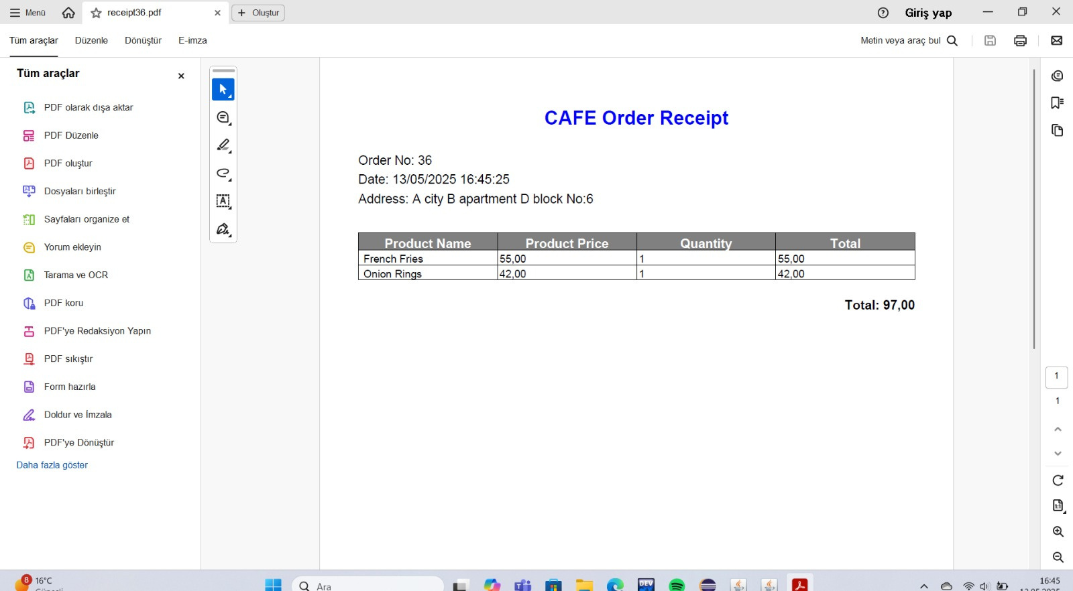
Cafe Order RecIpt
This is the PDF file that is automatically generated after each completed order.
It includes:
🆔 Order Number
🕒 Date and Time
📍 Delivery Address
🍽 Product list with prices, quantities, and totals
💰 Final total price
The PDF format is created using the iText library in Java and saved directly to the user’s desktop, providing a real, printable receipt.

Slide 14
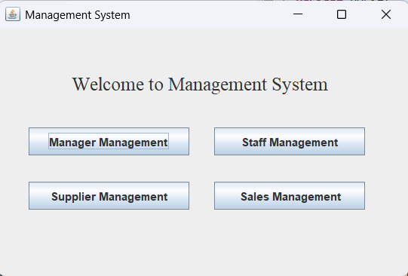
MANAGER INTERFACE
Management Main Page
This is the main page of management , We have manager management , staff management , supplier management and sales management. This page has buttons to go to those pages.

Slide 15
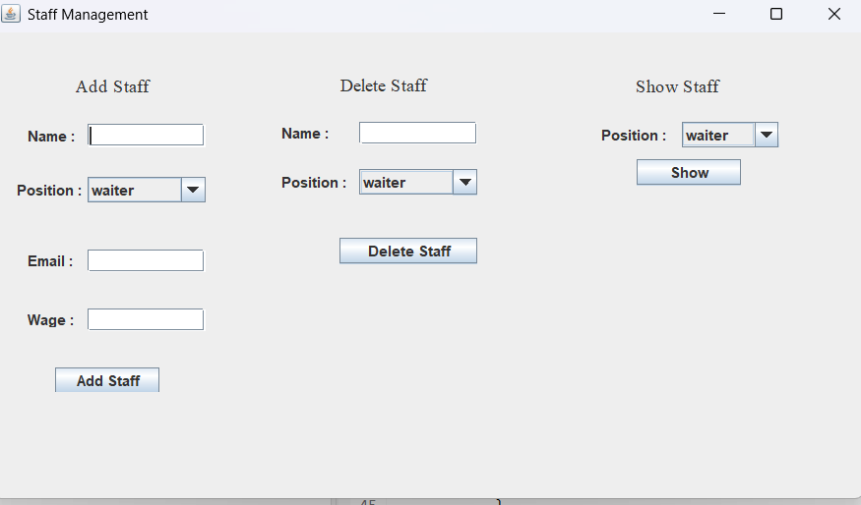
Staff Management
In Staff Management, We have 3 functionallities . The first one is adding a staff . To add a new staff we add name , email and wage .We choose the position of a staff from the positions the cafe has than by clicking the add button, the user will be saved to staff table.
From delete staff part , we can write the name and choose the position of a staff we want to delete by clicking the delete button the staff wil be deleted from staff table.

Slide 16
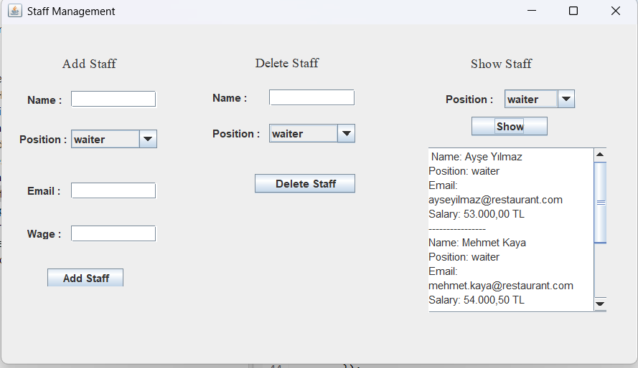
From show staff part, we can choose a positions to see each staff on that posittion and their information by clicking the show button . We have the name, position , email ,and wage of the staff to show .

Slide 17
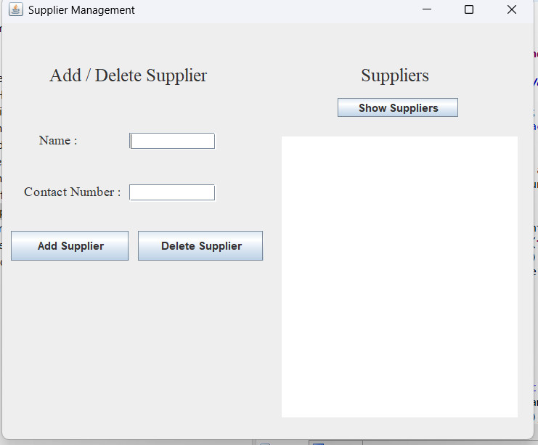
Supplier Management
In this page , We have adding a supplier part we enter the name and contact number of a supplier and click on add supplier button to add suplier . To add a supplier the name and contact number are crucial . For deleting the supplier just name is enough the delete supplier button deletes the supplier from supplier table. We have suppliers part, by clicking show suppliers we list the suppliers as tabble with names and contact number

Slide 18
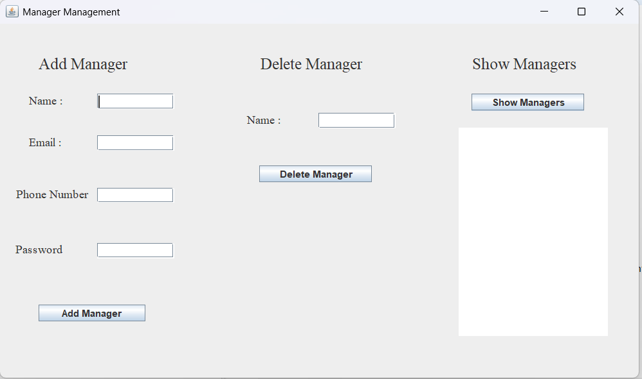
Manager Management
➕ Add Manager:
Managers can be added by entering name, email, phone number, and password.
The manager is added to manager table with these information.
➖ Delete Manager:
A manager can be removed from manager table by typing their name and clicking the Delete Manager button.

Slide 19
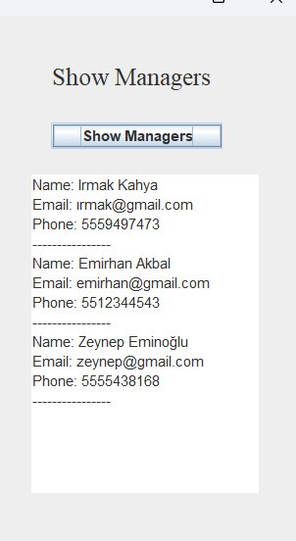
👁️ Show Managers:
Displays a list of all registered managers currently in the system with name, email, and phone number.
🔐 Access Control:
This page is accessible only to managers on manager table , ensuring security and restricted control.

Slide 20
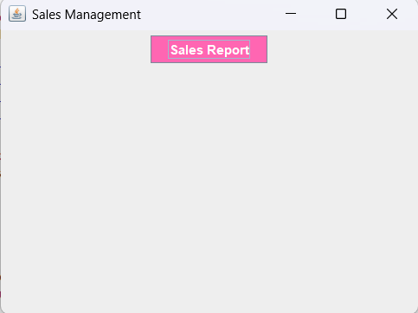
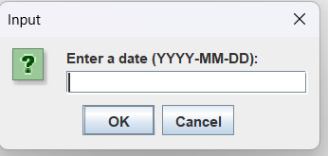
Sales Management
🪟On the sales management page, users can generate a daily sales report by clicking the “Sales Report” button.
This feature does not require admin privileges — any logged-in user can access it.
The report allows users to view how many units of each product were sold on a selected date.
This helps in tracking sales trends and daily product performance in the café environment.
📅 When the sales report button is clicked, the system prompts the user to enter a specific date in YYYY-MM-DD format.
After submitting the date, the system queries the database and retrieves the number of products sold on that day.
This simple interaction enhances the user experience and enables targeted, date-specific reporting.

Slide 21
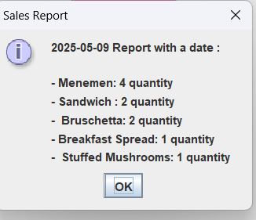
Sales Management
This dialog appears after the user enters a specific date for generating a sales report. The system queries the database and displays a summary of all products sold on that day along with their quantities. It provides a clear and user-friendly overview of daily sales, helping staff monitor product demand. The feature enhances decision-making by showing which items are most frequently ordered on a given day.

Slide 22
THANK YOU
FOR LISTENING

