Slide 1
AI In Return Logistics​
Notes:
Hi, today as a team we are going to present our business idea of implementing ai in return logistics

Slide 2
$729,000,000,000
Total return logistics loss for 2024 according to National Retail Federation [3]
Notes:
While research, we observed that there was a 729 billion usd worth of loss regarding the return products of ecommerce companies

Slide 3
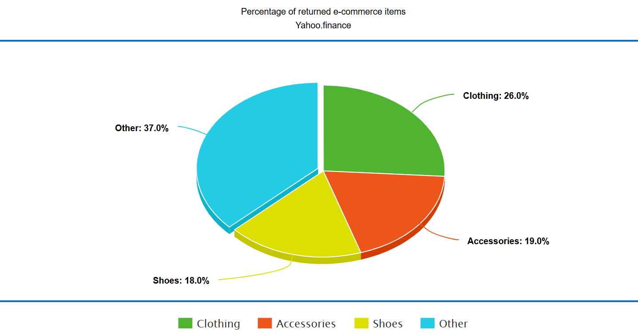
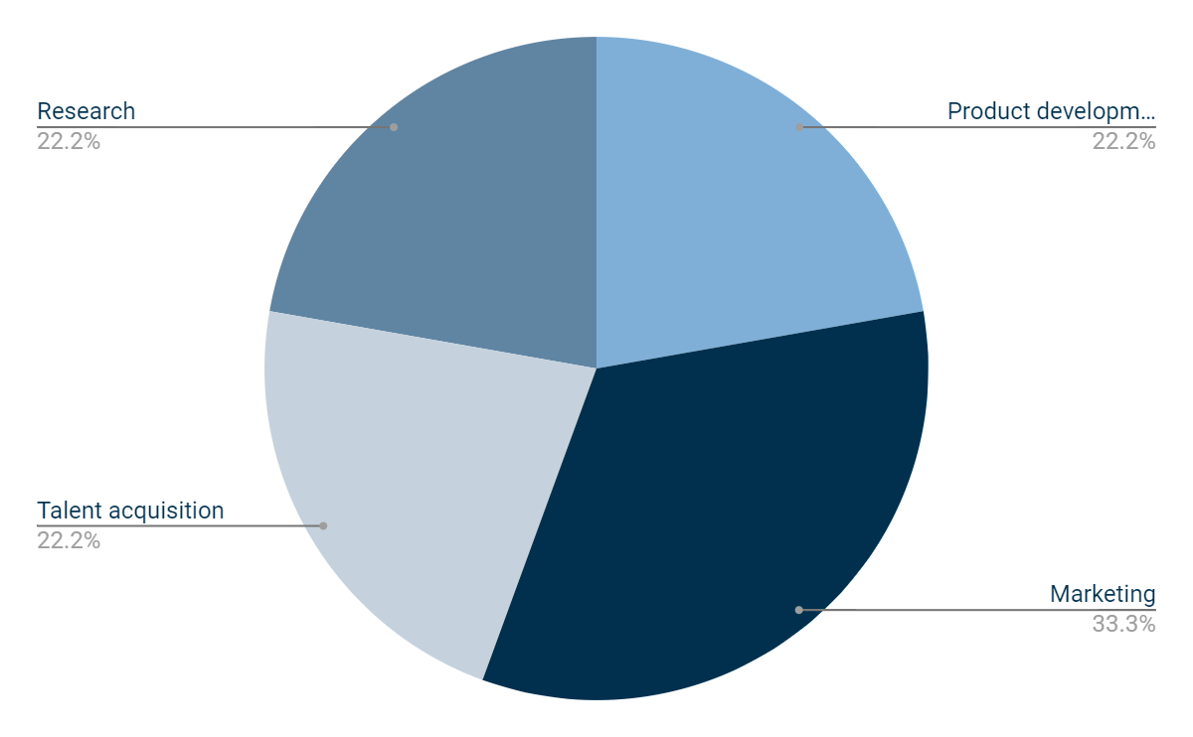
1,000,000,000
$998,300,000
$1,500,000,000
$1,000,000,000
[3-4]
Product development
Marketing
Research
Notes:
Once we dig deep in the statistics, we realized that combining clothing and shoes, textile products occupied 44 percent of that loss

Slide 4

Business Plan Specifications
Target Area
Target Market
Our Service
Imported textile products such as clothes, shoes that align with return policies
An AI-driven extension for major large e-commerce companies (Amazon, eBay, Shein) that manage big volumes of sale.
All around the world, for the demos we will focus on City of Toronto [1]
Notes:
That’s why we are going to focus on textile products, specifically imported products since they cause the most loss.
We offer an An AI-driven extension for major large e-commerce companies. Textile products alone might have a small value, but their big amount will save a great amount of money.
Our target is all round the world, but regarding our demo datas later on we will focus on city of ontario

Slide 5
Business Plan Integration
01
02
03
Determine optimal warehouse locations based on user data
Collect returned products that align with return policies in the warehouses
AI-powered automated email system for customers with shared interests in warehouse products
Notes:
Our plan consists of 3 parts. 1. Determining a optimal warehouse location based on user data
2. The imported returned products will be collected in these warehouses which will reduce shipping back fee
3. Finally, an AI- power automated mail system will inform possible customers for the product depending on their interests

Slide 6
Key Stakeholders
High Interest
3PL
AI & Data Analytics Companies
Consumers
Low Influence
High Influence
Government Regulators
Low Interest

Slide 7
Warehouse Location Optimization Parameters
Transportation Services
Median total income
03
Amazon Purchase & Return Density
02
04
Population 18 to 64 years
01
05
Land Availability & Cost
Notes:
All these criteria play a crucial role in determining the location of the warehouse but in different weights, More about the process in the further presentations

Slide 8



AI Powered Notification System
I
P
O
Input
Our input is the product that is returned to the warehouse
Process
AI system compares the product features and user interests
Output
AI-driven system sends mails to users that might be interested
Notes:
More about the process in the further presentations

Slide 9
How much do we save ? [2] [5-10]
We aim to reduce/increase it by save (%)
reduce by 60%
increase by 20%
increase by 10%
-
reduce by 80%
Current Cost (US$)
364.5 billion $
64.15 billion $
96.2 billion $
-
1.5 billion metric tons (CO2)
Predicted Cost (US$)
145.8 billion $
76.98 billion $
105.82 billion $
-
0.3 billion metric tons (CO2)
Percentage of current return logistics cost (%)
50%
20%
30%
-
-
Net Save ($)
+218.7 billion $
-12.83 billion $
- 9.72 billion $
+196.15 billion $
1.3 billion metrics tons (CO2)
Total loss = 729 billion$
Shoes + Clothing = 44%
320.76 billion$
Transportation Cost
Labor Cost
Storage & Warehouse Costs
Net Save
Carbon Footprint

Slide 10
Bibliography
City of Toronto - boundaries - area - geographical size. (2021, October 29). City of Toronto. https://www.toronto.ca/home/311-toronto-at-your-service/find-service-information/article/?kb=kA06g000001cvc9CAA
Ravichandran, M., K. E. K. Vimal, Kumar, V., Kulkarni, O., Sundaramali Govindaswamy, & Kandasamy, J. (2023). Environment and economic analysis of reverse supply chain scenarios for remanufacturing using discrete-event simulation approach. Environment Development and Sustainability, 26(4), 10183–10224. https://doi.org/10.1007/s10668-023-03141-z
Research and Markets. (2024, April 23). Reverse Logistics Global Market Report 2024: A $900+ Billion Industry by 2028 - Long-term Forecasts to 2033 Featuring Major Players - Deutsche Post DHL, UPS, FedEx, Schenker, Kuehne + Nagel. Yahoo Finance. https://finance.yahoo.com/news/reverse-logistics-global-market-report-074600861.html?guccounter=1&guce_referrer=aHR0cHM6Ly93d3cuZ29vZ2xlLmNvbS8&guce_referrer_sig=AQAAALyEvuWvyGVtc9vqEPZKEdwLJ10PTy-mL3LeXR_GN23NzAf5VflNMFZVQ5ghPzenXuqQo33RChwCDZN486eJkiUkDVbRJTr5LXNogy6jPIq6ZEOj8aCnBKvPlGWGmD16j-atJ55Tiy-QY4IDq6n8STihHlpZ7oQzP_UqGEGHSZ-n
What items are returned most often in ecommerce? (2023). Loopreturns.com. https://www.loopreturns.com/blog/items-returned-most-often-ecommerce/
Hothem, S. (2015, September 28). Reverse Logistics for Clothing: Finding Cost Saving Opportunities. Barrettdistribution.com. https://www.barrettdistribution.com/reverse-logistics-for-clothing-finding-cost-saving-opportunities
Loboda, V. (2023, April 6). The True Cost of Apparel Returns: Alarming Return Rates Require Loss-Minimization Solutions [Research]. 3DLOOK. https://3dlook.ai/content-hub/the-true-cost-of-apparel-returns/
https://www.mckinsey.com/~/media/mckinsey/industries/metals%20and%20mining/our%20insights/succeeding%20in%20the%20ai%20supply%20chain%20revolution/succeeding-in-the-ai-supply-chain-revolution.pdf
McKinsey & Company. (2021). Metals and Mining Practice Succeeding in the AI supply-chain revolution New technology solutions could be transformative-but only if executives properly prepare their organizations. https://www.mckinsey.com/~/media/mckinsey/industries/metals%20and%20mining/our%20insights/succeeding%20in%20the%20ai%20supply%20chain%20revolution/succeeding-in-the-ai-supply-chain-revolution.pdf
Lechtenberg, S., & Hellingrath, B. (2021). Applications of artificial intelligence in supply chain management: Identification of main research fields and greatest industry interests. https://www.econstor.eu/bitstream/10419/234061/1/1758326867.pdf

Slide 11
The Flow of the rest of the Presentation
Breakdown of the AI-integrated notification system
Business Plan Presentation
Breakdown of the code for Warehouse Location Optimizer
UI/UX Interface in Figma

