Slide 1
Warehouse Location Optimization
A Data-Driven Approach

Slide 2
Project Overview
1
2
3
4
Objective
Methodology
Identify the optimal location for new warehouses in City of Toronto.
Developed code using Gemini, Google AI Studio, and Colab.
Data Source
Data Processing
Synthetic data based on City of Toronto archives.
Generative AI processed data, compiled into an Excel file.

Slide 3
Key Parameters for Location Selection
Population (15-64)
Purchase and return density
Target areas with an active consumer base.
Prioritize areas with high shopping flow.
Median Total Income
Focus on wealthy neighborhoods with higher purchase and return potential.
Land availability and cost
Transportation Services
Minimize opening expenses by selecting areas with available and affordable land.
Ensure user accessibility to the warehouse.

Slide 4
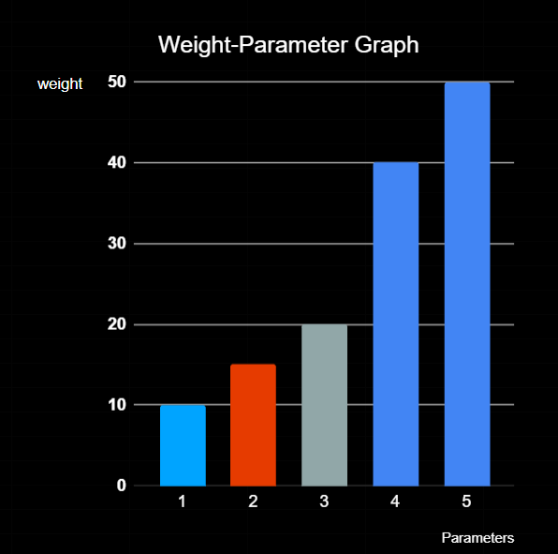
Hierarch Between Parameters
1. Population (15-64)
2. Median Total Income
3. Transportation Services
4. Land Availability & Cost
5. Purchase Density

Slide 5
READ INPUT DATA

Slide 6
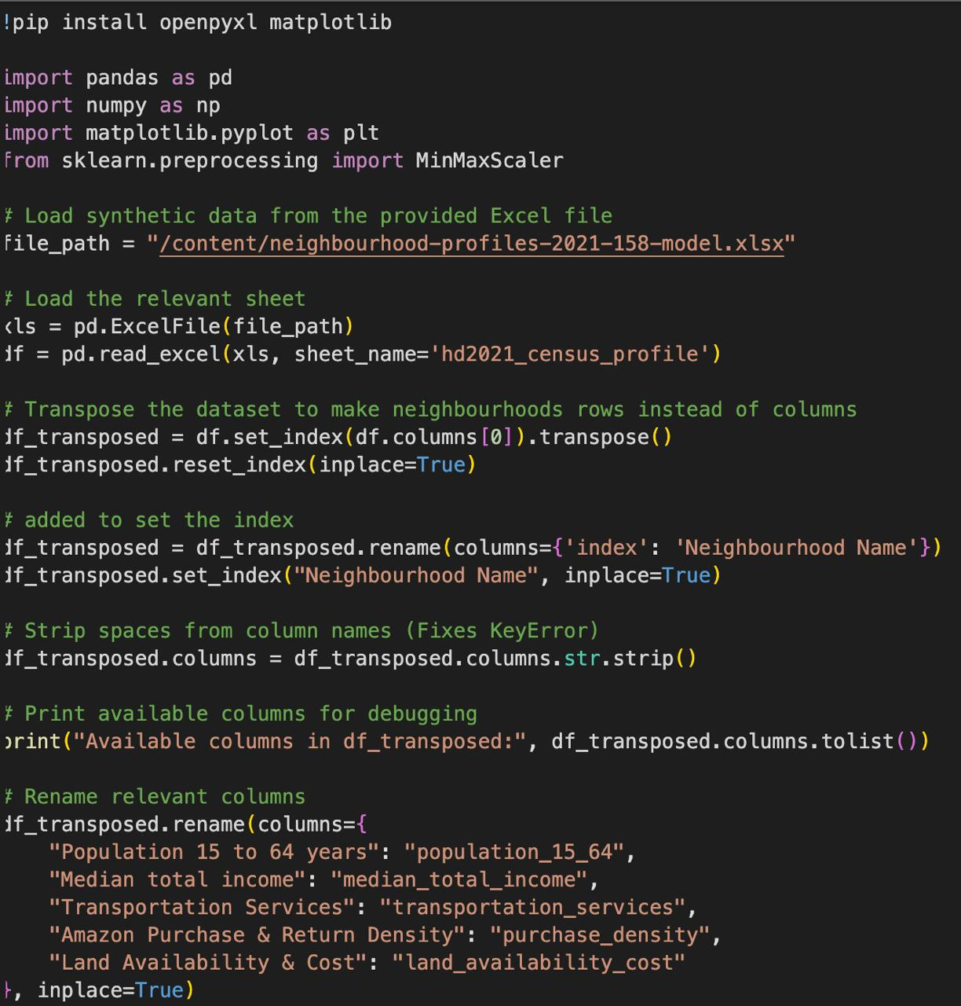

Slide 7
PROCESS DATA
WITH PARAMETER WEIGHTS

Slide 8
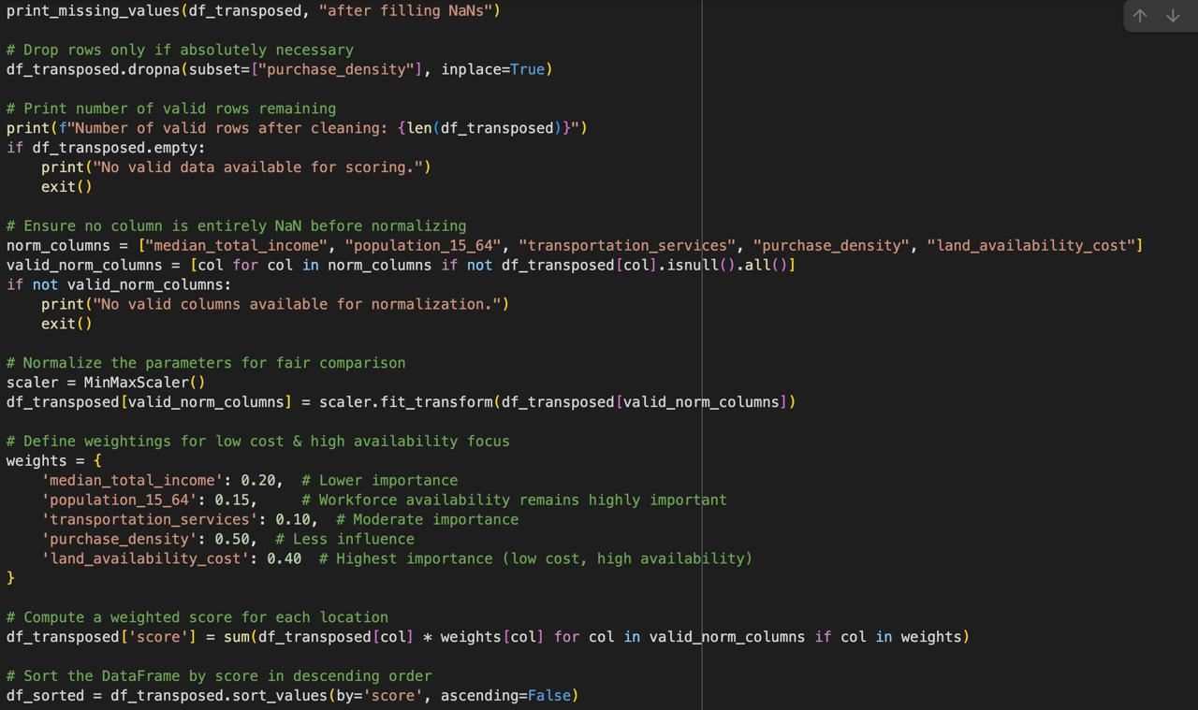

Slide 9
PRINT RANKING FOR POSSIBLE WAREHOUSE LOCATIONS

Slide 10
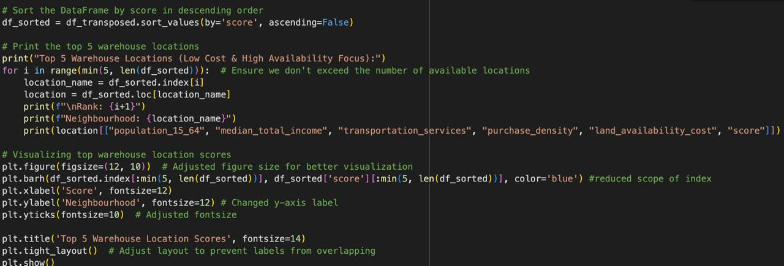

Slide 11
RANKING OUTPUT

Slide 12
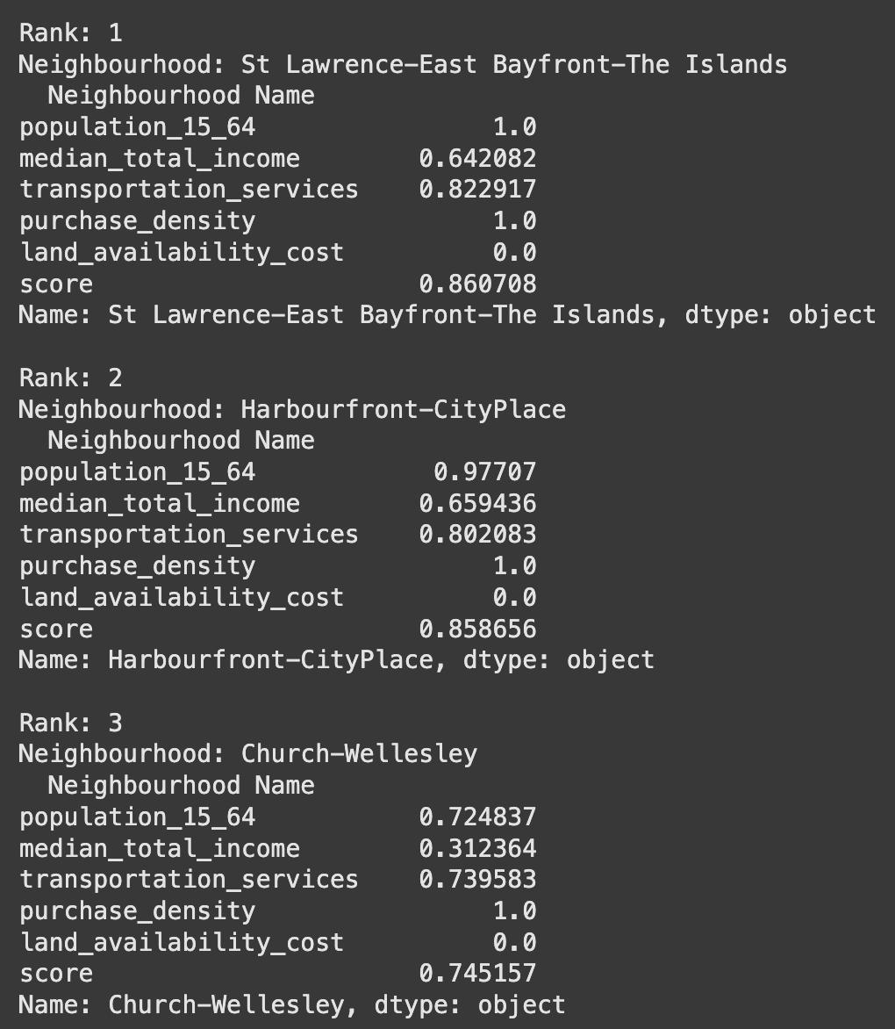
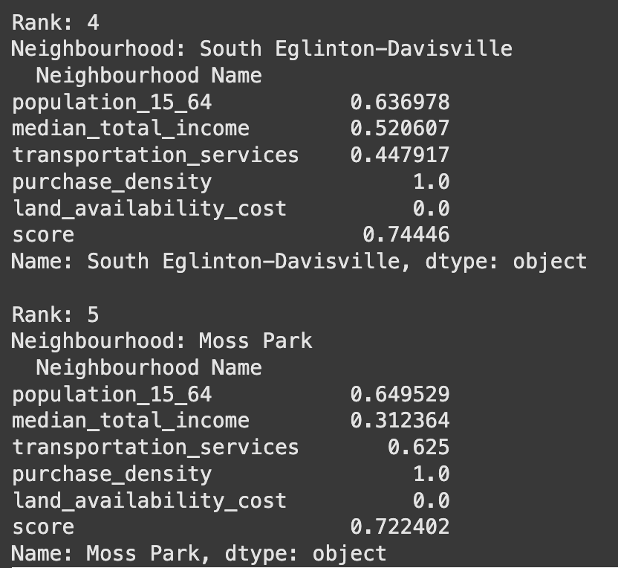

Slide 13
