Slide 1
PS – 5
Sorting

Slide 2

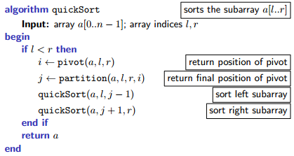
Quick-sort

Slide 3

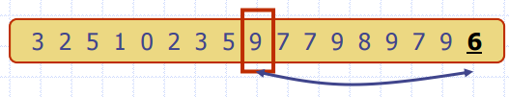
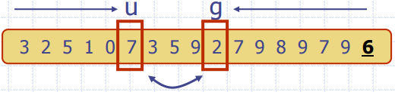

Quick-sort 2-way partitioning
Select pivot.
Partitions:
Sub-array with elements less than pivot and call quick-sort again.
Sub-array with elements greater than pivot and call quick-sort again.
Partitioning:

Slide 4
Quick-sort 3-way partitioning
When there are repeated elements in the data, the algorithm loses time dealing with them in 2-way partitioning.
Select pivot.
Partitions:
Sub-array with elements less than pivot and call quick-sort again.
Sub-array with elements equal to the pivot.
Sub-array with elements greater than pivot and call quick-sort again.

Slide 5
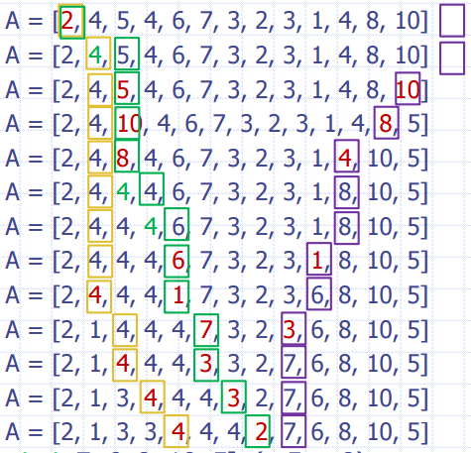
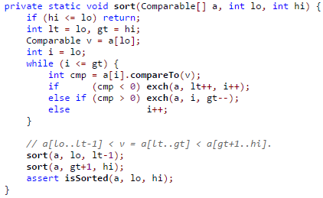
Quick-sort 3-way partitioning
lo: 0, hi: 12, p: 1, A[p] = 4 i: lt: gt:
p
Output: A=[2, 1, 3, 3, 2, 4, 4, 4, 7, 6, 8, 10, 5] (lt: 5, gt: 8)

Slide 6
A visual comparison of sorting algorithms
We will only check Quick sort 2-way and 3-way; but you can analyze the rest in your free time.
https://www.toptal.com/developers/sorting-algorithms

Slide 7
Quick-sort pivoting strategies
Quick-sort does not guarantee O(n log n) complexity.
Pivot selection is the most crucial part for a better time complexity.
Good choice: Leads to O(n log n)
Worst choice:
Say, you selected the largest/smallest item.
One sub-array is always empty while the other contains all elements.
Recursion is applied only on the second group.
O(n²) complexity

Slide 8
Passive Strategies
Left, right or center element as pivot:
Advantages: Fast and easy
Disadvantages: Might cause worst case time complexity.
Random element as pivot: Select random element from the input / shuffle input data and use one of the approaches above
Advantages: Fast and easy, better for real world data
Disadvantages: Might encounter smallest or largest element and cause worst case time complexity, an overhead for random element selection or shuffling

Slide 9
Active Strategies
Theoretically best strategy: Finding the median.
Advantages: Sub-arrays are split equally. Guaranteed to achieve O(n log n)
Disadvantages: Computationally inefficient. Finding the median has O(n) complexity.
Approximate the median!
Median of Three (Mo3)
Ninther

Slide 10

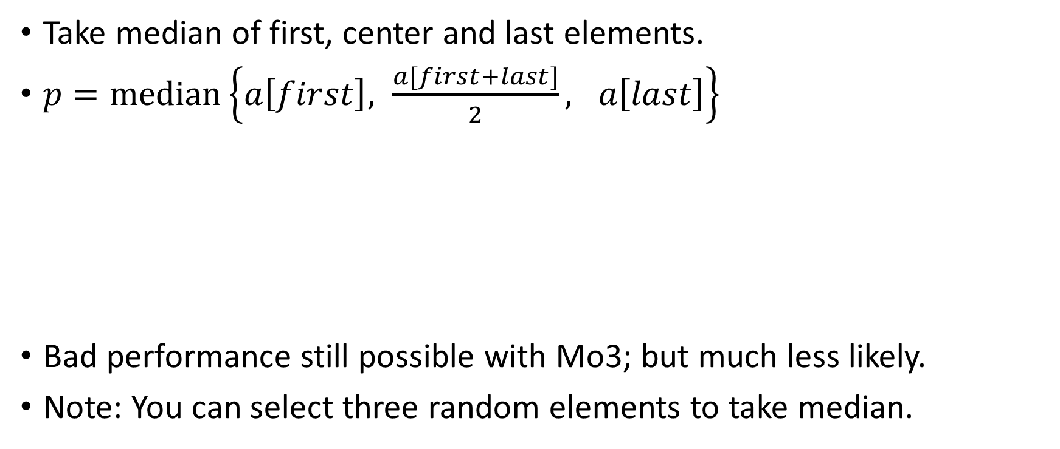
Median of 3 (Mo3)
Take median of first, center and last elements.
$p=median\left\{a\left[first\right], \frac{a[first+last]}{2}, a\left[last\right]\right\}$
Bad performance still possible with Mo3; but much less likely.
Note: You can select three random elements to take median.

Slide 11
Median of 3 (Mo3)
int center = (low + high)/2;
// median of three
int pivot = Math.max(Math.min(array[low],array[center]), Math.min(Math.max(array[low],array[center]),array[high]));

Slide 12
Quick Select
Goal: Given an array of n items, find the k^{th} smallest item.
NOT A SORTING ALGORITHM, MORE OF A SEARCH/SELECTION ALGORITHM
Select a pivot p.
Partition the array:
Sub-array with values less than pivot
Sub-array with values greater than pivot.
If k^{th} item is the pivot, you found it.
Else,
If it is smaller than pivot, set the high value to p-1 and call again.
If it is larger than pivot set the low value to p+1 and call again.
If you want to find k smallest elements, get all elements before the pivot when find k, the order is not important.

Slide 13
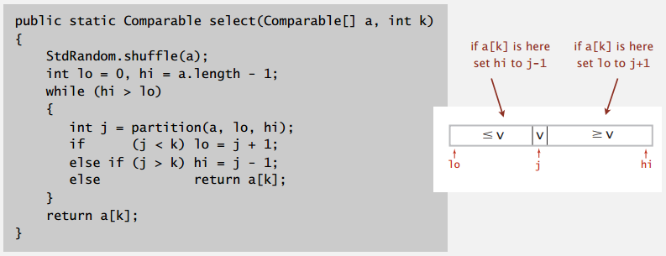
Quick Select
https://upload.wikimedia.org/wikipedia/commons/0/04/Selecting_quickselect_frames.gif

