Slide 1
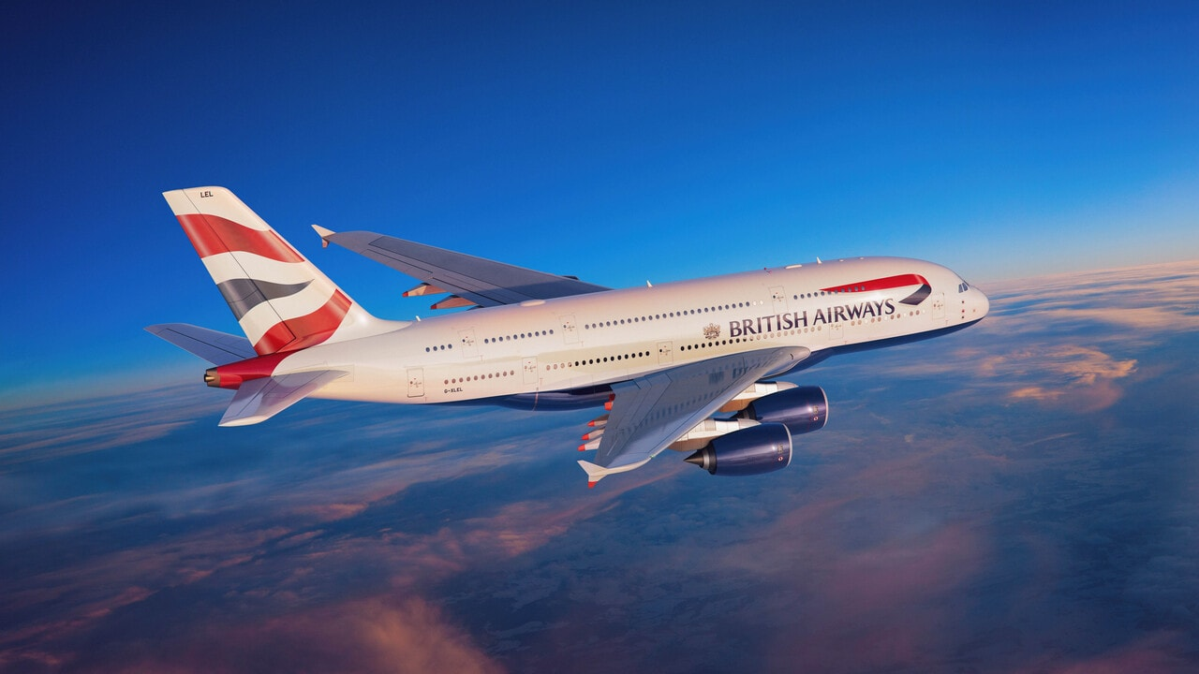
British Airways
Customer Sentiment and Experience Analysis of British Airways Reviews
11/08/2024

Slide 2
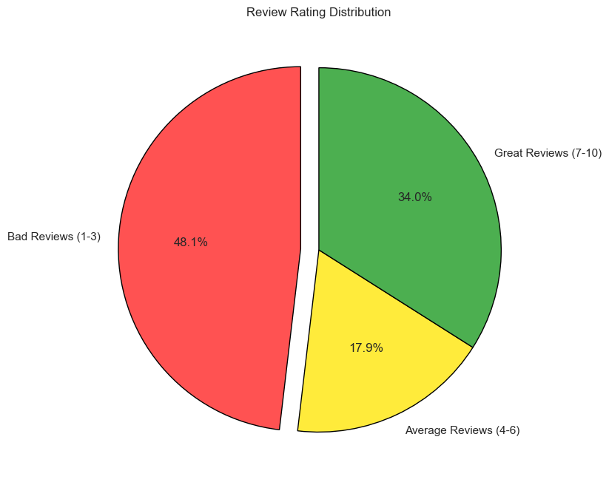
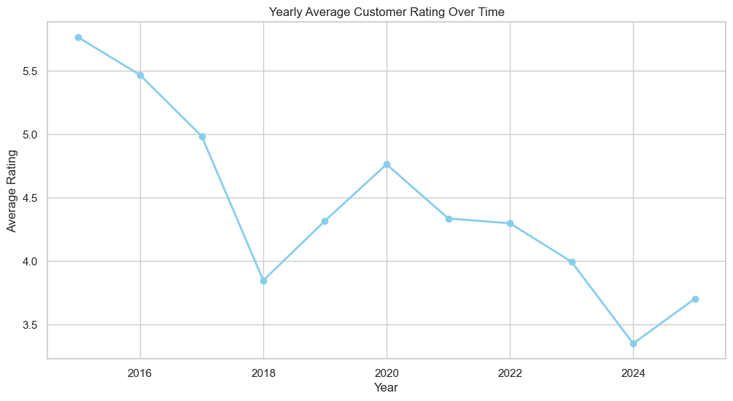
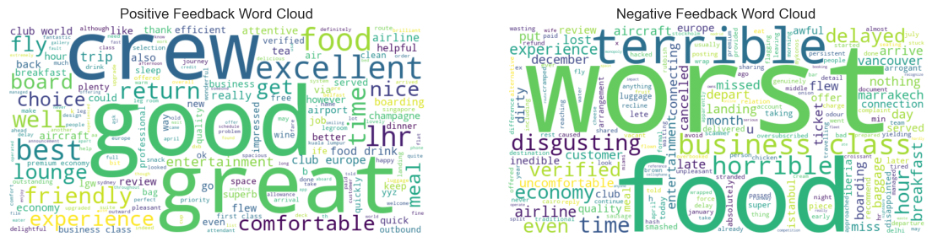
"Key Metrics"
Reviews from 72 countries
3598 Reviewers
Average Rating: 4 .6 / 10
The UK has the highest number of reviews, with 2,227, followed by the USA and Australia, with 427 and 145 reviews, respectively.
Positives: Friendly staff and quality food are highly appreciated.
Pain Points: Seat discomfort, limited legroom, and frequent delays lower satisfaction.
Suggestions:
Enhance Seating: Improve seat comfort and legroom.
Reduce Delays: Focus on minimizing flight delays.
Maintain Service Quality: Continue investing in staff training and food quality to boost positive reviews.

