Slide 1

Peter Clapham
Informatics Support Group
Notes:
This document has several example slides, a slide of colours, and a slide with a grid.
Save locally as a Design Template (for Windows by default it will go to a Template folder: you can choose somewhere else). You can then open the template at any time and Save as a normal presentation.
The colours have been chosen to work well on projection (they look a little odd on monitors, even as screen show). By default, recommended colours appear in the colour option boxes.
To view the template, choose, View>Master>Slide Master [to come back, choose View>Normal].
The grid on the last slide is provided to help with consistent positioning – notes are given on the grid page.

Slide 2


About the Institute
Funded by Wellcome Trust.
  2nd largest research charity in the world.
  ~700 employees.
Large scale genomic research.
  Sequenced 1/3 of the human genome (largest single contributor).
  We have active cancer, malaria, pathogen and genomic variation studies.
All data is made publicly available.
  Websites, ftp, direct database. access, programmatic APIs.

Slide 3
The Sanger Institute: a little background
Founded 1992 as a UK sequencing centre with an initial 5 year plan to sequence
2 yeast, the nematode worm and 1/6 th of the human genome.
1997
(yeast genome
completed)
2003
(first mouse genome draft
Malarial parasite sequence
completed)
2008
(start of 1000
genome project)
1992
2001
(First draft of
human genome.
Sanger upped
contribution to 1/3)
2005
(WTGCCC
established)
2010
(Completion of 1000 genomes
Start or uk10k study)

Slide 4
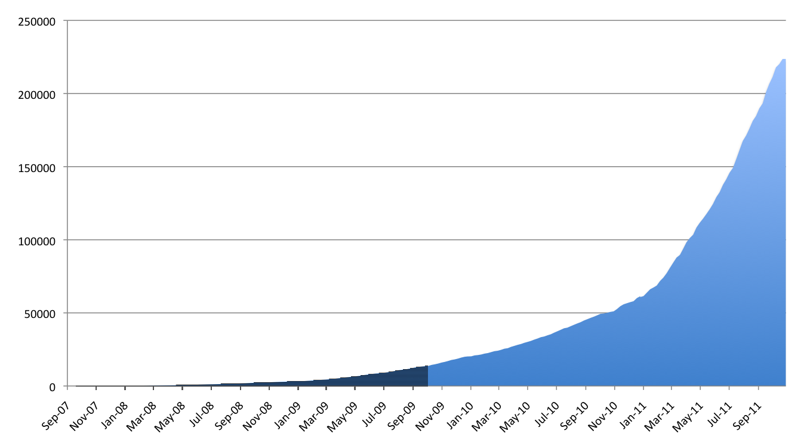
Sequence till 2011

Slide 5
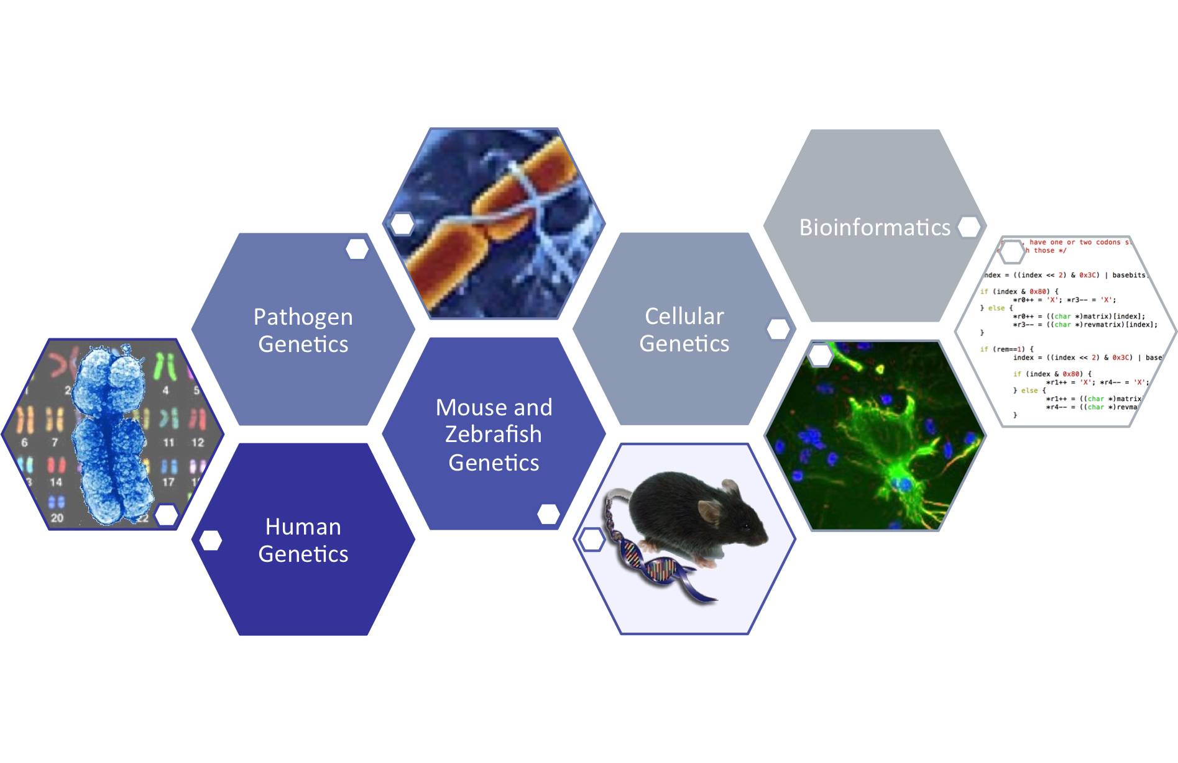

Research Programmes

Slide 6
Beginnings
Sanger started with a single zone to accept bam and bai files produced from the central sequencing pipeline.
This is THE starting point for all our usergroups who make use of locally produced sequence data, so the service needs to be:
Solid at it's core. 2 am support calls are bad(tm)
Vendor agnostic.
Sensibly maintainable.
Scalable, in terms of capacity and remain relatively performant.
Extensible

Slide 7
iRODS layout
Oracle RAC
Cluster
Data lands by preference onto iRES servers in the green datacenter room
Data is then replicated to Red room datacenter via a resource group rule with checksums added along the way
Both iRES servers are used for r/o access and replication does work either way if bad stuff happens.
Various data and metadata integrity
Checks are made.
Simple, scalable and reliable (so far)
IRODS server
IRES servers
SAN
attached
luns
from
various
vendors

Slide 8
Metadata Rich
attribute: library
attribute: total_reads
attribute: type
attribute: lane
attribute: is_paired_read
attribute: study_accession_number
attribute: library_id
attribute: sample_accession_number
attribute: sample_public_name
attribute: manual_qc
attribute: tag
attribute: sample_common_name
attribute: md5
attribute: tag_index
attribute: study_title
attribute: study_id
attribute: reference
attribute: sample
attribute: target
attribute: sample_id
attribute: id_run
attribute: study
attribute: alignment
Example attribute fields →
Users query and access data largely from local compute clusters
Users access iRODS locally via the cli

Slide 9
Sysadmin Perspective
Keep It Simple works.
  Reflected by very limited downtime aside from upgrades
The core has remained nicely solid
Upgrades can be twitchy (2.4 → 3.3.1 over the past few year has not been without surprises...)
Some queries need some optimisation. Fortunately we have some very helpful DBA's

Slide 10
End User Perspective
Users are particularly happy with the meta data rich environment.
Now they can find their files and gain access in a reliable fashion.
So far so good. Satisfied users.
So happy they've requested iRODS areas for their specific use
purposes

Slide 11
Federating Zones
Top level zone (sanger) acts as a Kerberos enabled portal
Users login here and receive a consistent view of the world.
Allows separation of impact between user groups
  Zone server load
  Different access control requirements.
  Clear separation as groups consider implementing their own rules within their zone
Each zone has it's own group oversight which is responsible for managing
  it's disk utilisation. Separation reduces horse trading and makes the
  process much less involved...

Slide 12
Sanger Zone Arrangement
Sanger 1
Portal zone
(provides Kerberised access)
Federation using head
zone accounts
/seq
/uk10k
/humgen
/Archive

Slide 13
Pipeline Team Perspective
In general stuff is fine BUT some particular pain points have been found.
The good news is that some have been addressed, such as improving client icommand exit codes (svn 3.3 tree) and the ability to now create groups and populate them as an igroupadmin.
Other pain points, data entry into iRODS is not Atomic.
No re-use of connections
Local use of Json formatting, not natively supported by iRODS clients

Slide 14
But iRODS is Extensible
Java API
Python API
C API

Slide 15
Baton
Thin layer over parts of the iRODS C API
JSON support
Connection friendly
Comprehensive logging
autoconf build on Linux and OSX
Current state
Metadata listing
Metadata queries
Metadata addition
https://github.com/wtsi-npg/baton.git

