Slide 1

Feedback Assignment 1
The Boltzmann Asylum
Ivo Roghair
Chemical Process Intensification / Multiphase reactors group - Dept of Chemical Engineering and Chemistry

Slide 2
Some points of interest on the assignment
It is still unknown which of the the randi or rand generator is faster:
The randi operation is optimized, but probably has quite a bit more checks and procedures before it generates the output
The rand operation “8 * ceil(rand(n,1))” involves a ceil and vector operation done by me, but may not involve as many internal procedures
Boltzmann constant: 0.37… 6000
Movement:
array of choices [ [0, 1]; [1, 1]; [1, 0]; [1, -1] … etc… ];
Sine/cosine roundoff: round(8*sin(2*pi*rand(1,1)))
Some very inspiring variational rules:
Collisions
Deathmatch among patients
3D

Slide 3
Some advice for programming
Use of parameter struct: useful to keep data together, especially for specialized Matlab function. Not very clear to use it as a dump-it-all argument for user-defined functions; it is unknown which and how many parameters are of actual relevance to a function.
Don’t plot within functions that you are going to re-use as part of a larger code. It will clutter your desktop with all kinds of figure windows. Use a flag if necessary.
If you’re copying code (and perhaps change a detail for a different case) it is worthwhile to consider generalizing it into a function.

Slide 4
Some advice for reporting
Keep important figures in text! Don’t use the appendix to dump everything to save space. Appendix is for additional interesting info, not crucial to the point you’re about to make.
Does my figure convey the point?

Slide 5
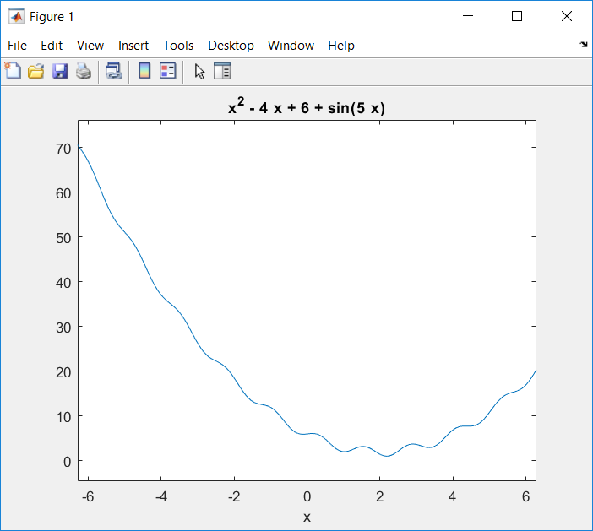
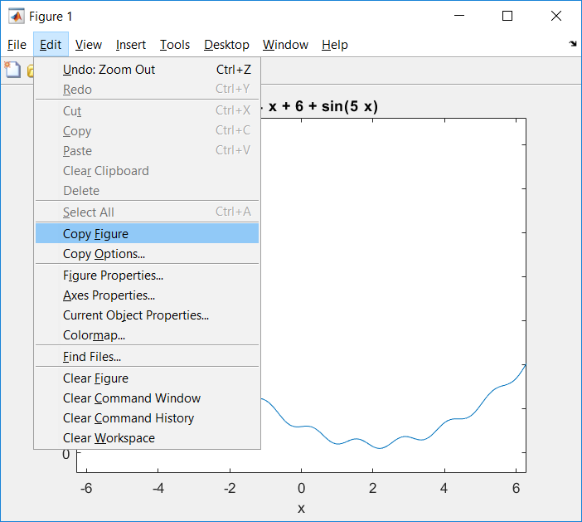
Creating Figures

Slide 6
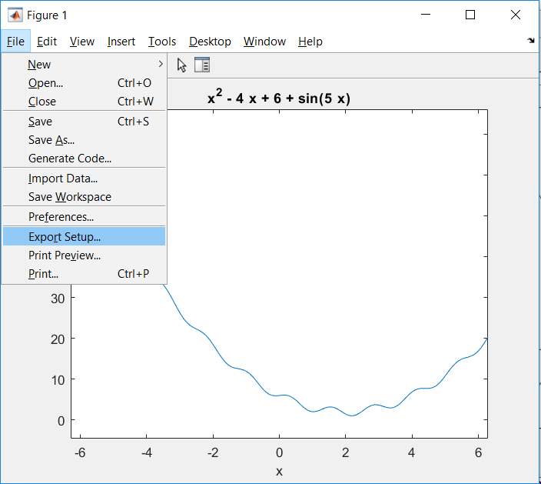
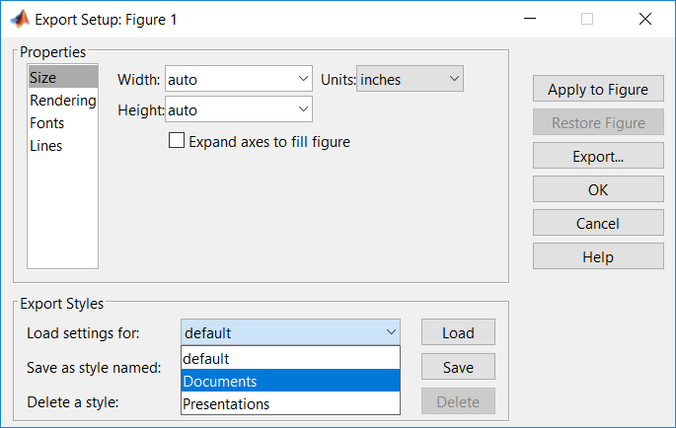
Creating Figures

Slide 7
Creating Figures
Don’t use print-screen
Don’t save as jpg. Save as .png, .pdf, .eps.
Don’t forget to save as .fig as well (to allow editing later on)
Choose font size about the size of document text (max 2pt smaller)

