Slide 1
Engineering nanoparticles to locally activate T cells in the tumor microenvironment
Dangge Wang1,2,3, Tingting Wang1,3, Haijun Yu1,2*, Bing Feng1,3, Lei Zhou1 , Fangyuan Zhou1 , Bo Hou1 , Hanwu Zhang1 , Min Luo4 , Yaping Li1,5*

Slide 2
Introduction
Immune checkpoint blockade (ICB) therapy uses anti PDL1 antibodies (aPDL1) to target PDL1 in tumor cells
Problems with ICB:
Immunological tolerance of tumors
“on-target but off-tumor binding” with normal tissues
Effective only for primary tumor therapies
Proposed MMP-2 sensitive aPDL1/ICG-based nanoparticle (S-aPDL1/ICG@NP)
Stable in blood circulation
Passively accumulates at tumor site
Highly specific
Combined with PDT to promote CTLs infiltration

Slide 3
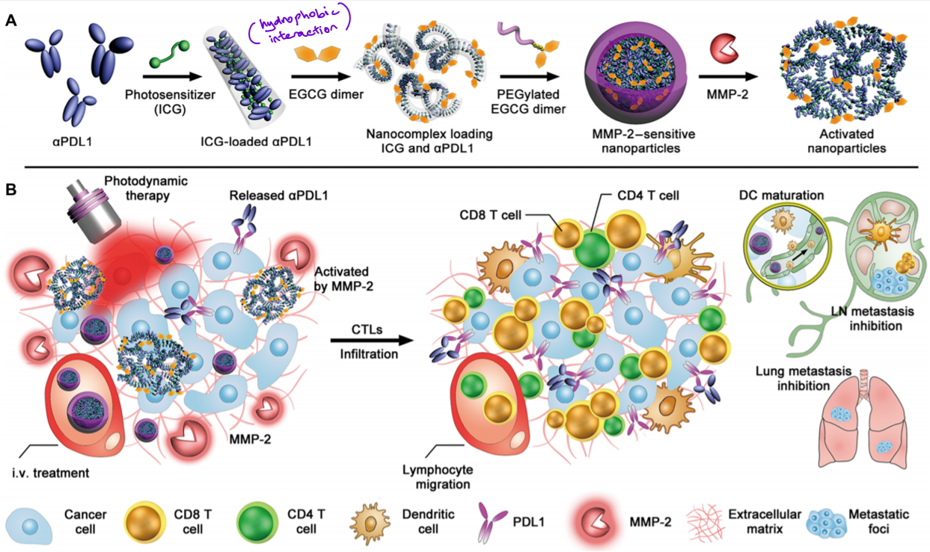
Engineering of S-aPDL1/ICG@NP

Slide 4
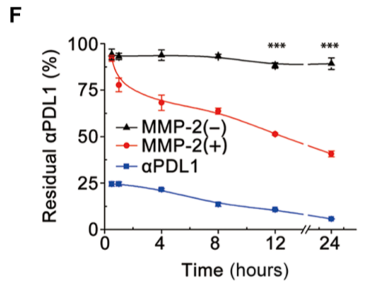
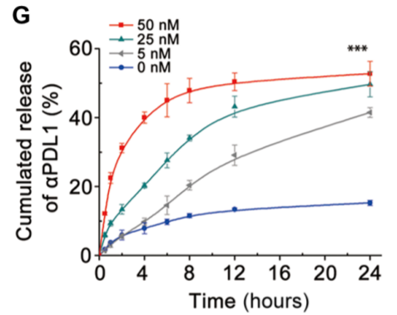
Results
Good Serum stability :
Only 12% of aPDL1 released in 10% BSA solution
Satisfactory stability against enzyme degradation of aPDL1 :
<10% of aPDL1 degraded by proteinase K
aPDL1 release in tumor microenvironment :
Avoid antibody leakage
Activated at tumor site

Slide 5
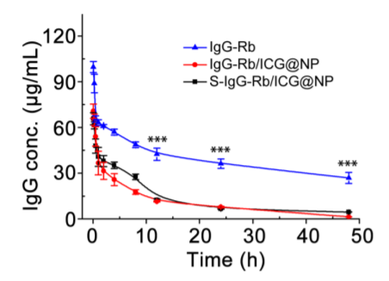
Pharmacokinetic profile in vivo
Conducted on rats using rhodamine B (Rb)-labeled IgG-based nanocomplexes
Quick blood clearance of nanoparticles

Slide 6
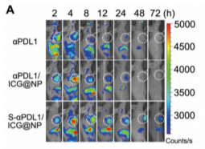
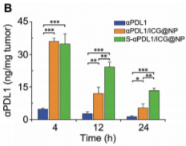
Biodistribution in tumor-bearing mice
Free aPDL1 non-specifically distributed
S-aPDL1/ICG@NP specifically accumulated at tumor sites
Increased intratumor accumulation and retention due to MMP-2 mediated activation of the nanoparticle

Slide 7
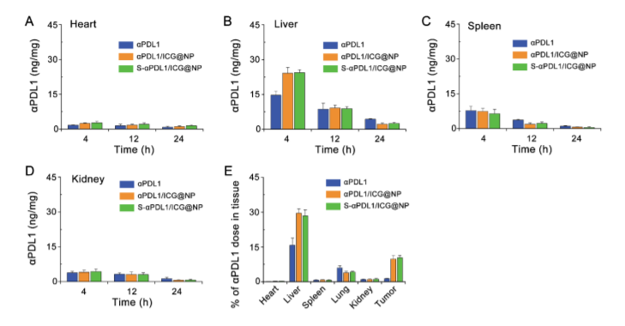
Accumulation of aPDL1 in liver could cause immune-related adverse effects
PEG shells of nanoparticle weaken interaction between the compressed antibodies and PDL1 in livers

Slide 8
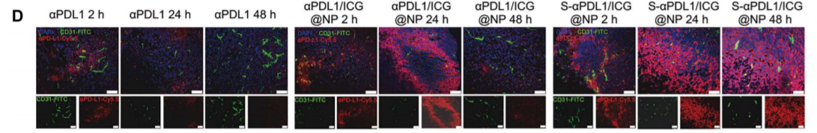
Overcoming limited tumor penetration
Result from tumor burden / load
Released aPDL1 from S-aPDL1/ICG@NP facilitated deep tumor penetration

Slide 9
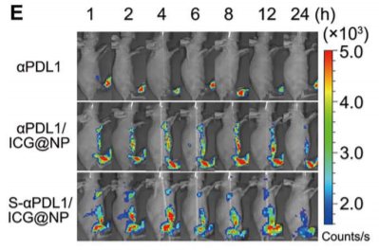
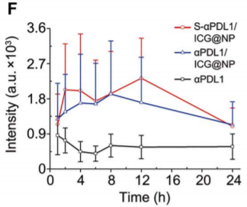
Potential lymph nodes targeting for lymphatic metastasis tumors
Footpad injection to deliver nanoparticles to the lymphatic metastasis tumors
High accumulation of S-aPDL1/ICG@NP at lymphatic systems (strong fluorescence signals)

Slide 10
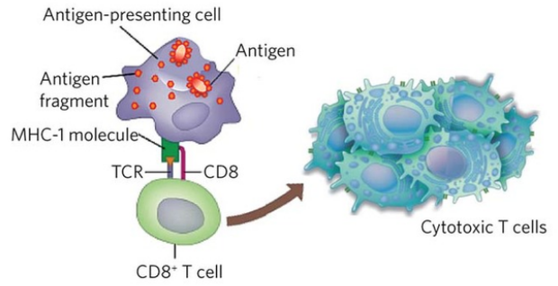
Role of dendritic cells in antitumor immune response
Dendritic cells (DCs) digests/proteolyzes antigen and loads to MHC-1
TCR on CD8+ cells recognizes it and proliferates
Cytotoxic T lymphocytes

Slide 11
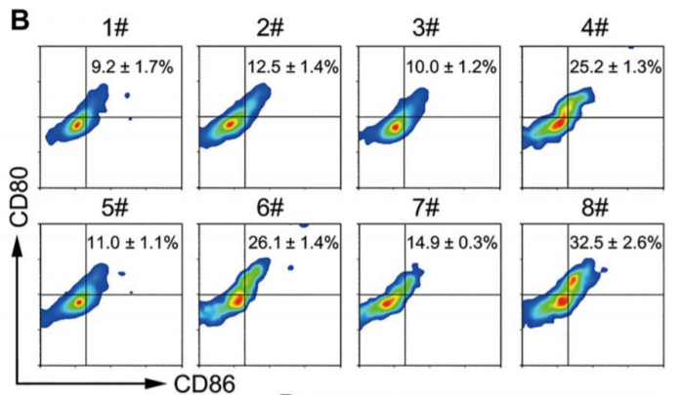
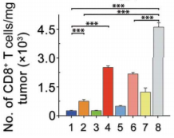
Acceleration on DC maturation in vivo
Influence of PDT :
Illuminated tumors with laser and harvested 3 days after treatment
Influence of aPDL1 on immune response
Conclusion: S-aPDL1/ICG@NP + PDT induces maturation of DCs & robust CD8+ T cell infiltration -> antitumor immunity
(B) Maturation of DCs in tumors after treatments [1#, PBS; 2#, aPDL1; 3#, S-ICG@NP; 4#, S-ICG@NP + laser (S-ICG@NP+L); 5#, aPDL1/ICG@NP; 6#, aPDL1/ICG@NP + laser; 7#, S-aPDL1/ICG@NP; 8#, S-aPDL1/ICG@NP + laser; laser power density, 1.2 W/cm2 ; n = 3)]

Slide 12
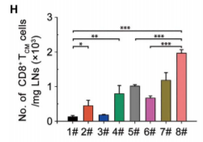
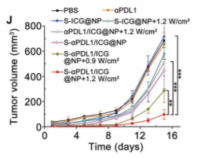
Immune memory effects in vivo
Frequency of central memory T-cells in LNs was examined 25 days after initial treatment
ICB Therapy + PDT induces long term immune memory effect for immunotherapy

Slide 13
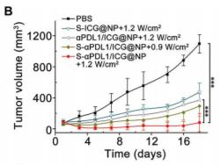
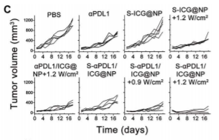
ICB therapy + PDT for tumor metastasis in LNs
Inhibits tumor metastasis to LNs with S-aPDL1/ICG@NP + laser at popliteal LN
Activates an immune response to kill metastatic cancer cells
High LN specificity

Slide 14
Challenges
Limitation of NIR laser delivery (need special endoscope) for PDT treatment
Highly dependent of MMP-2 expression by tumor
Possibility of aPDL1@NPs suppressing immune-related adverse events

Slide 15
Aims
Understand how aPDL1 nanoparticles interact with tumor microenvironment
Need improved design for diverse set of solid tumors, especially deep tumors

Slide 16
Hypothesis
The conjugation of immunofluorescence with PDL1 antibodies will aid in understanding of the interaction of S-aPDL1/ICG@NP with tumor microenvironment
Direct immunofluorescence is used here to visualize the action of the antibodies during the process, which can be further studied to improve the design of the nanoplatform

Slide 17
Method
Conjugate antibodies with fluorescent dye such as fluorescein isothiocyanate (FITC)
Incorporate the marked PDL1 antibodies into the nanoplatform with the same procedure
Once systemically administered, exposure to light through PDT will excite the fluorescent dye on the antibody, which can be observed for further studies

