Slide 1
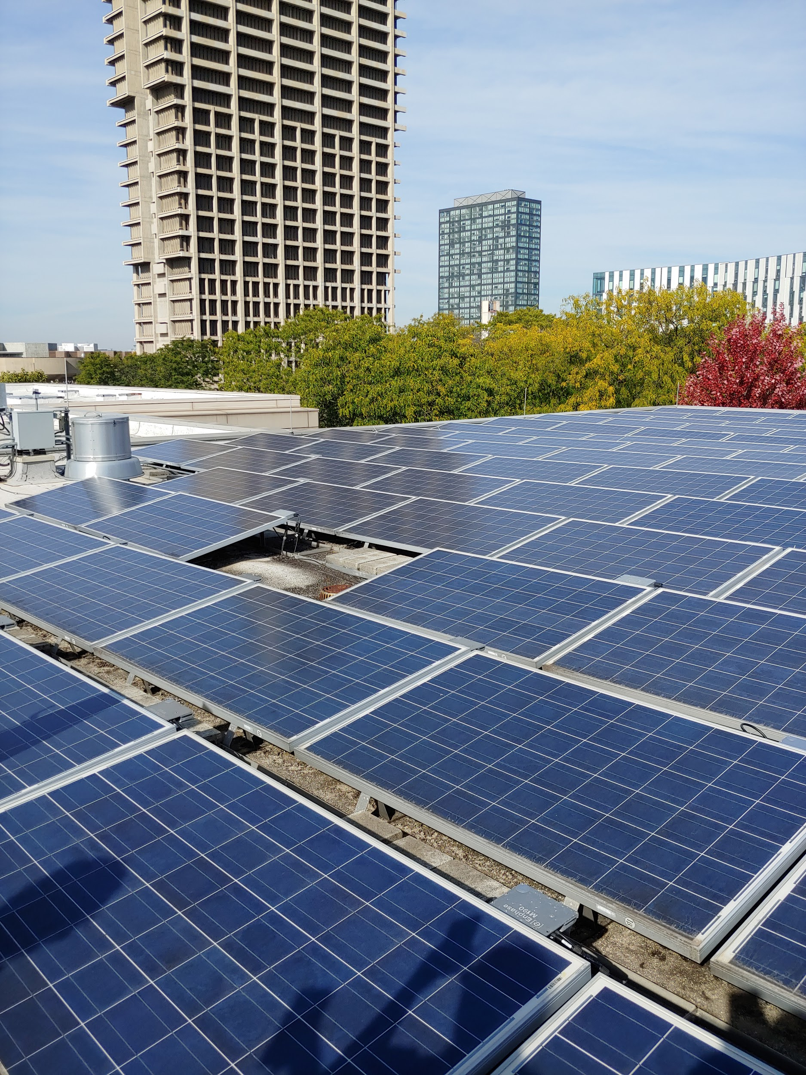


Going Green - EIB
By: Ariel Maret, Diana Awimrin, Leena Daniel, Sherin Skariah, and Zainab Ahmed

Slide 2
Why?
Goal : Design a renewable energy system for the new chemical engineering building to provide electricity during power outages
EIB uses electricity to operate the ventilation system
If there is a power outage, everyone must evacuate building due to ventilation
Without ventilation, anyone could inhale hazardous chemicals.
Staff and students all lose out time that could have been spent for important lectures, tests/quizzes, and work

Slide 3
What is the goal?
Produce electricity using existing photovoltaic cells
­To store 6 hours worth of energy in the battery
Use excess electricity produced for in EIB

Slide 4

Power Used By EIB
Average Energy for 6 hours 19, 222 kW
Peak 5,640.00 kWh
Peak Occurred on: 30-Sep-19 11:30:00 AM CDT
*High Temp Hot Water and Chilled Water are produced at Co-Generation Plant and then distributed to UIC.

Slide 5
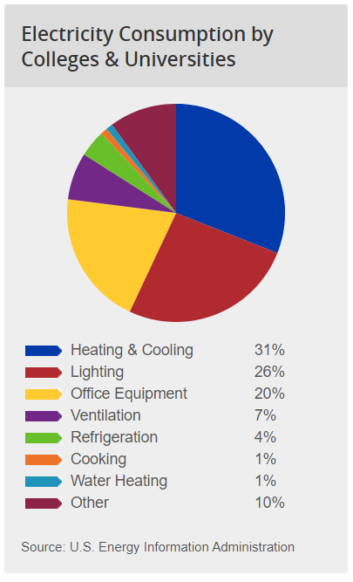
Power Used By EIB
Building uses the most electricity on Tuesdays
Investigated only supplying power to certain panels
Each lab has their own panel (fume hood)
Main ventilation system in mechanical room.
{1}

Slide 6
Photovoltaic Analysis
Number of Solar Panels Used: 469 solar panels
Total Solar Array : 101.5 kW
Total Energy Produced by Solar Panels in a day: 446.6 kWh
Total Energy Produced by 469 Solar Panels: 101.5kW
Peak Hour in Chicago: 4.4 hours
Area these solar panels will need: 7,591 ft²
Area on EIB roof available: 9,856 ft²
Maintenance
The solar panels do not have much maintenance except for cleaning the tops, which can be done every three months.

Slide 7
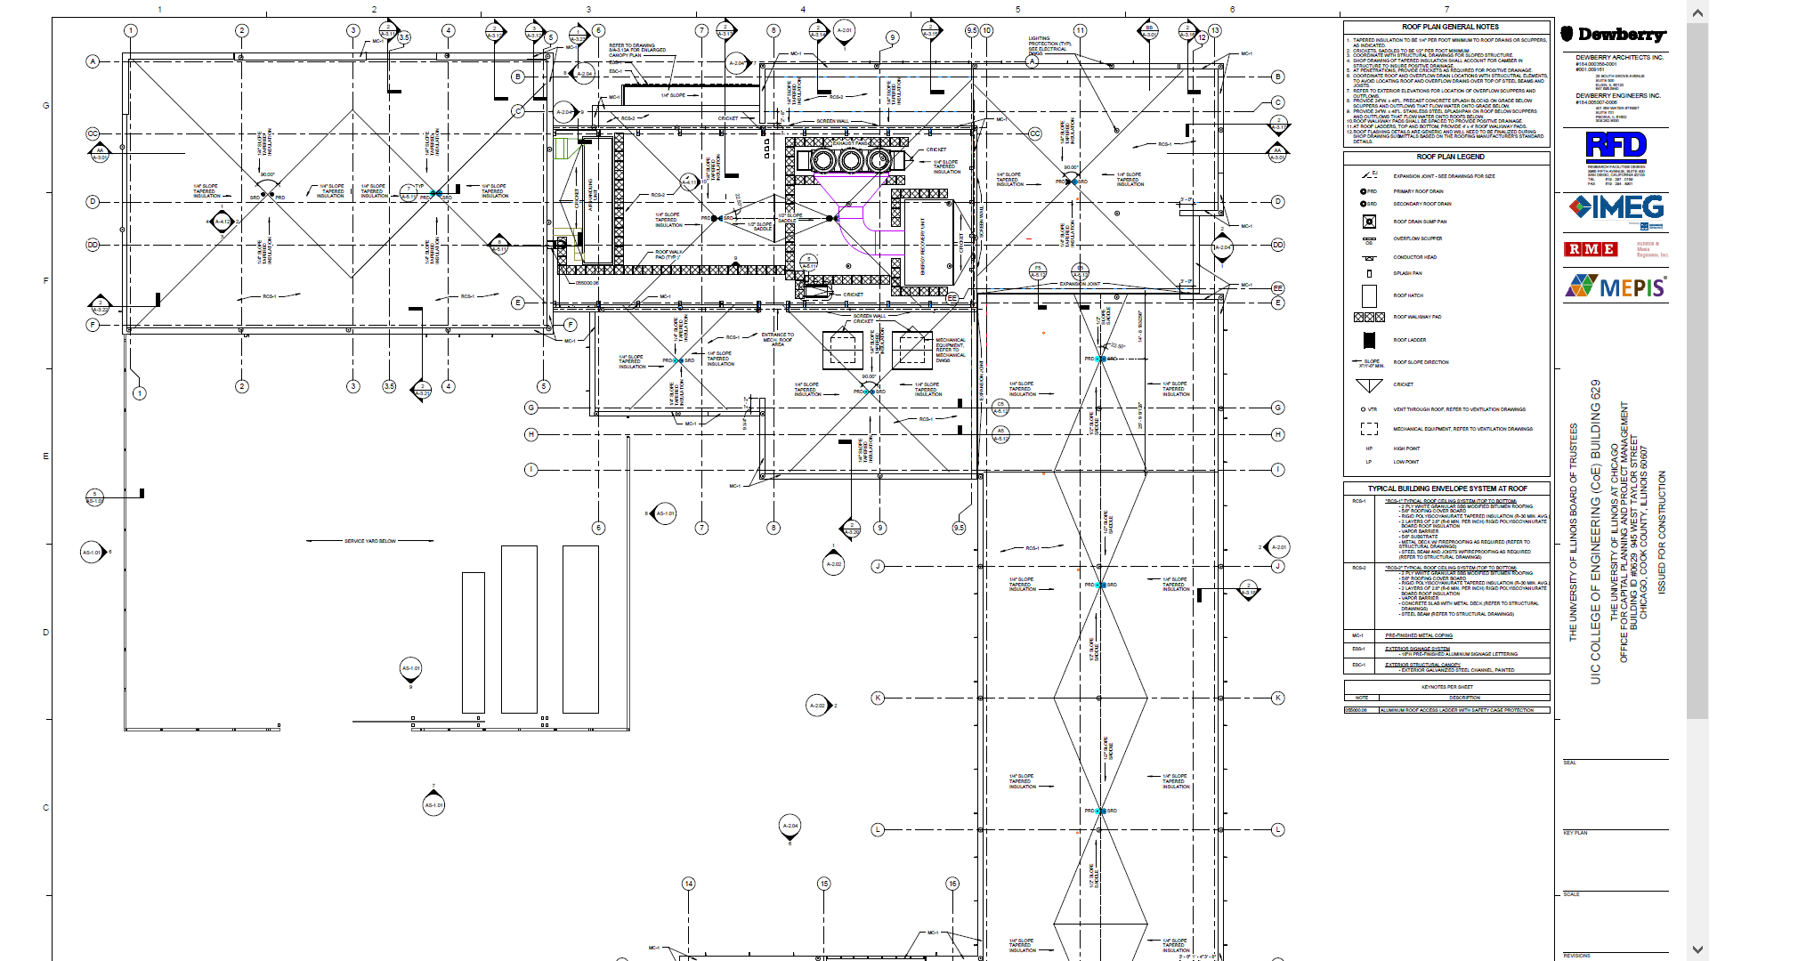
Solar Panels Here

Slide 8
Photovoltaic Analysis Continued...
Cost of Battery
$9,611,250
Cost of Controller
$2,000
Cost of Inverter - Each panel already has their own microinverter
$1,400,000
Cost of Installation
$2,800,000
Total Cost of the system Upfront
$13,813,250
Total Life-Cycle Cost for the system
$38,445,000

Slide 9
Solar REC’s
Legislation in Illinois requires utilities to generate a certain percentage of their electricity from solar power
As of right now, UIC buys REC’s
Once UIC starts producing solar energy, REC’s fewer would need be bought

Slide 10
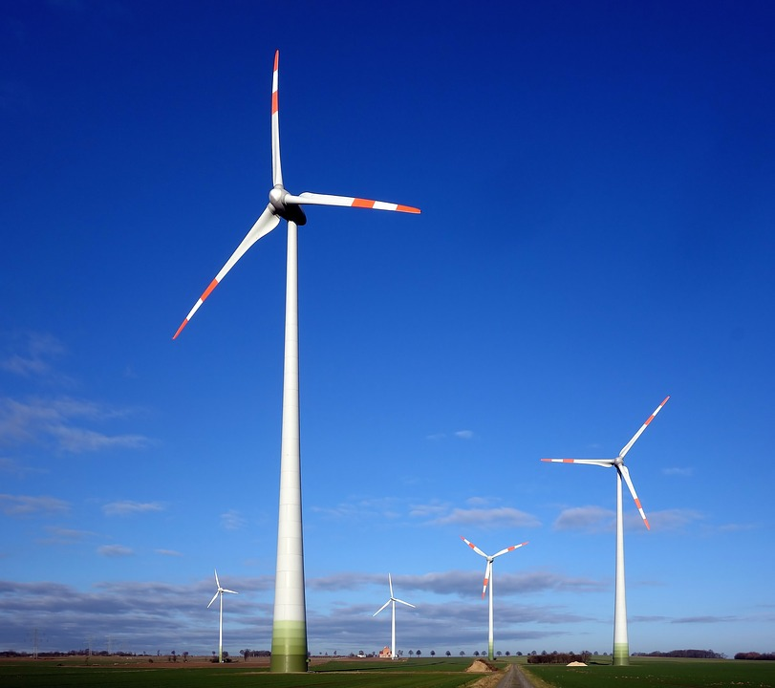
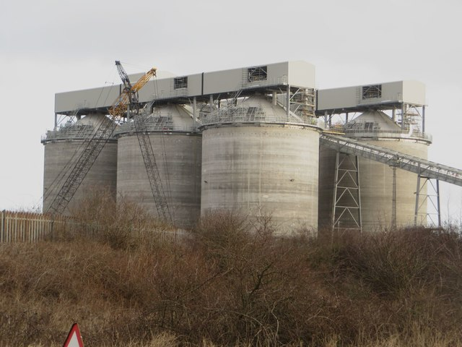

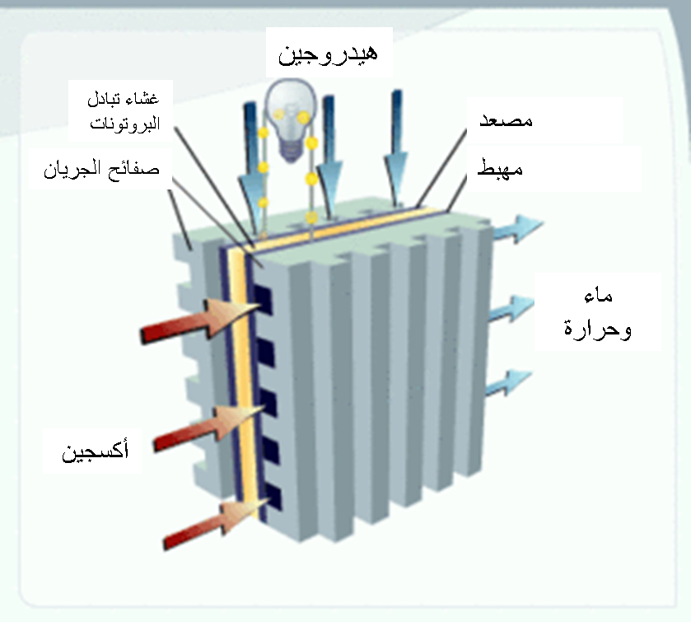
Alternatives

Slide 11
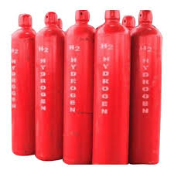
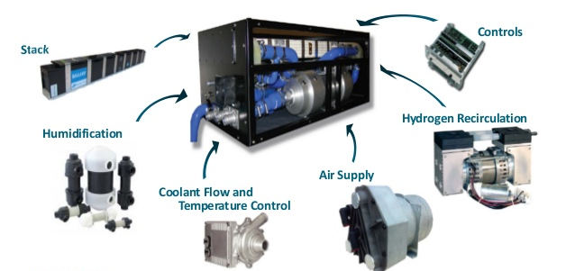
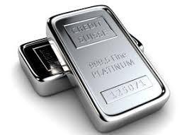
Fuel Cell Analysis
Cost of Platinum = $940/troy ounce
Total: $84,622
Cost of hydrogen=$13.99/kg
Total Cost: $62,675
Cost of Storage = $21,535,595
BOP and Cell Stack Cost = $2,500/kW
Total: $24,227,545

Slide 12


Fuel Cell Analysis
Installation = $2,240,000
Lifetime of 5,000 hours: Around 23 years at minimum
Fuel Cell Cost = $42,640,479
Total Upfront Cost in 2019
$64,176,075
Major contributor to price is hydrogen storage

Slide 13
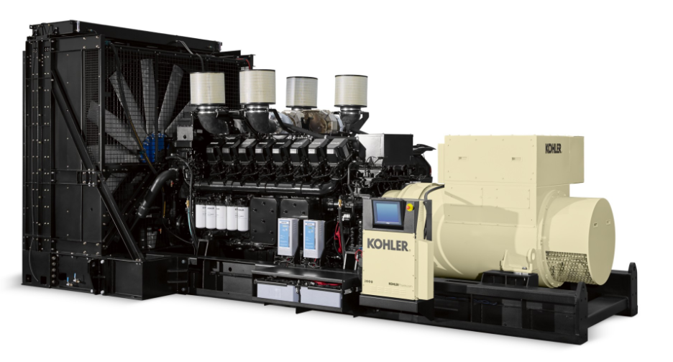
Diesel Generator Analysis
15 year life-span
Peak Power Usage EIB requires: 5,600 kWh
Kohler KD2800, 60 Hz: $1,062,000
$2,124,000
Installation cost generator of 25kW - 30 kW: $24,000
Scale up: $5,376,000
Operation and Maintenance
$20,045

Slide 14
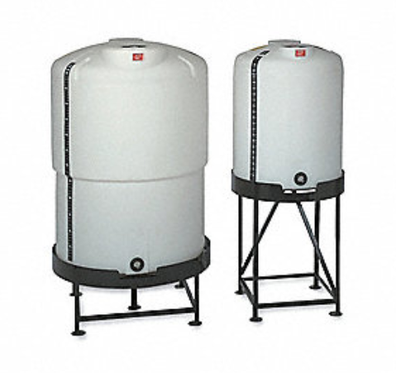
Diesel Generator Analysis
Fuel Consumption
$2.81 per gallon
Over 15 years: $1,106,519
Fuel Delivery: 13% of fuel cost per liter
$143,848
Fuel Storage Tank
$500 for a 300 gallon tank
Total Cost of Generator System Upfront
$8,770,884

Slide 15
Conclusion
Diesel Price: $8,770,884
Fuel Cell price: $64,176,075
Photovoltaic System Price for 10 years: $38,445,000
Without the installed solar system, 274 REC’s would need be bought over the next 15 years
Total cost savings from installed system = $20,000
Even though diesel may be less expensive, UIC is reducing its carbon footprint by investing in renewable energy.

Slide 16
Cost Savings
Without the installed solar system, 274 REC’s would need be bought over the next 15 years
Total cost savings = $20,000

Slide 17
References
www.comed.com/WaysToSave/ForYourBusiness/Pages/CollegesUniversities.aspx.
https://www.turbinegenerator.org/solar/illinois/chicago/
www.solarpowerrocks.com/solar-basics/how-much-electricity-does-a-solar-panel-produce/.
https://www.wholesalesolar.com/blog/battery-maintenance-tips/
https://www.solar-electric.com/learning-center/solar-charge-controller-basics.html
www.worldstandards.eu/electricity/plug-voltage-by-country/.
http://resources.kohler.com/power/kohler/industrial/pdf/g5588.pdf?_ga=2.94447583.294529856.1574638722-1684978695.1574638722
https://resources.kohler.com/power/kohler/industrial/pdf/GSA_Product_List.pdf
www.globalpetrolprices.com/USA/Illinois/diesel_prices/.
www.grainger.com/product/9MDM6?

Slide 18
References
https://www.researchgate.net/figure/Comparison-of-Fuel-Cell-Cost-Estimates-for-Stationary-and-Mobile-PEM-Fuel-Cell-Systems_tbl5_254703613
https://www.researchgate.net/figure/Comparison-of-Fuel-Cell-Cost-Estimates-for-Stationary-and-Mobile-PEM-Fuel-Cell-Systems_tbl5_254703613
https://www.relakhs.com/mutual-funds-taxation-rules-fy-2019-20-ay-2020-21/.
https://cafcp.org/content/cost-refill
https://www.macrotrends.net/2540/platinum-prices-historical-chart-data.
https://www.macrotrends.net/2540/platinum-prices-historical-chart-data
https://netl.doe.gov/sites/default/files/netl-file/FCHandbook7.pdf
https://www.solsystems.com/srec-customers/srec-basics-faq/

