Slide 1

Para-xylene Production Through Methylation of Toluene
Mentor: Adam Brostow
Authored by: Mahamat Abdraman, James Fell, Rongwei Lin, William Rawson
FEBRUARY 4, 2020

Slide 2
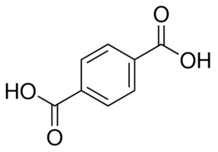
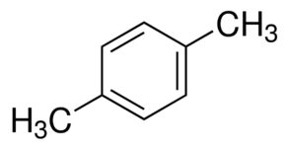
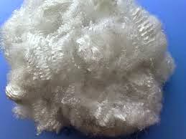
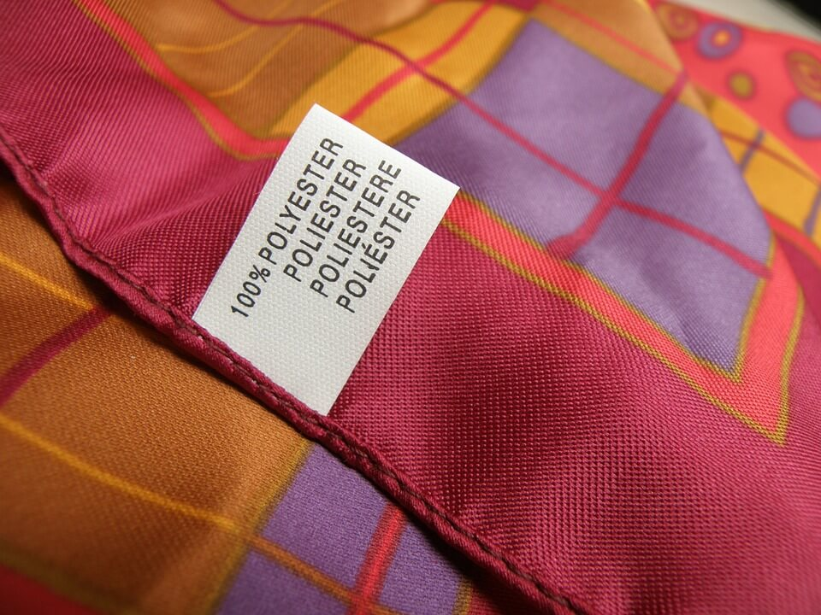
Introduction
[1]
[2]
Para-xylene is used as a building block in the manufacture of chemicals sought after in the plastic industry, such as terephthalic acid (TPA), purified terephthalic acid (PTA), and dimethyl-terephthalate (DMT).
Chemical Structure C₆H₄(CH₃)₂
Purified Terephthalic Acid
[3]
[4]
Polyester Fiber
Textiles

Slide 3
Introduction
What industry is para-xylene produced?
Petrochemical Industry
Products of an aromatic plant : BENZENE + PARA-XYLENE
Separation technology can be difficult and costly due to the xylene isomers
But the question remains, what makes para-xylene worth it?
But what about Para- , ortho- , or meta-?

Slide 4
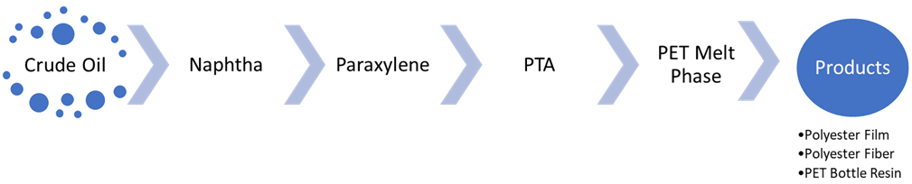
Market Analysis (Value Chain)
Crude Oil Price
Profitability of Paraxylene
Demand/Supply for Polyester

Slide 5
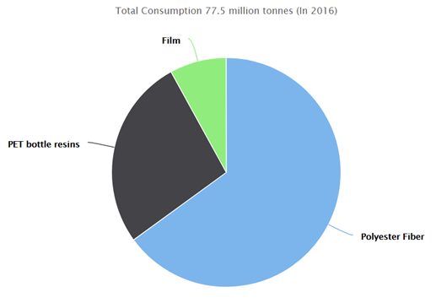
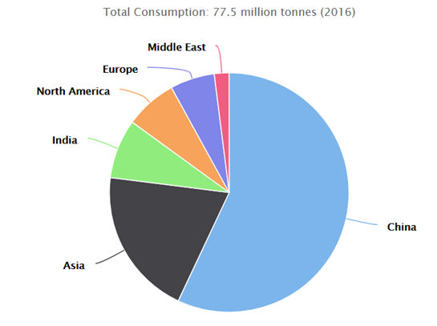
Market Analysis (Market Drivers)
Demand of PTA per Application (2016)
Demand of PTA per Region (2016)
Polyester Fiber (65%), PET Bottle Resins (27%), Film (8%) [5].
China (57%), Asia (20%), India (8%), North America (7%), Europe (6%), Middle East (2%) [5].

Slide 6
Market Analysis (Feed Stock Pricing)

Slide 7
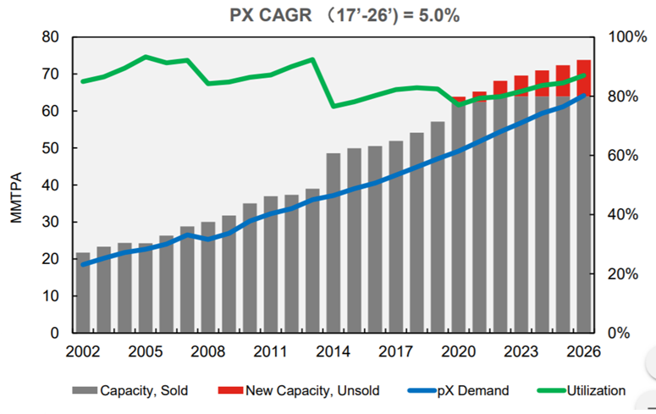
Market Analysis (Looking Forward)
Global demand, capacity, and utilization of PX [7].

Slide 8
Goals And Objectives
Purpose: The purpose of this report is to provide an innovative and novel design for the production of para-xylene.
The design will implement existing technological models, such as the methylation of toluene, while also incorporating new energy optimization ideas that will produce para-xylene of optimal purity.
Less Utilities
Lower Capital Costs
More Economically and environmentally viable

Slide 9
Design Basis
Produce 4.5 MMTPA of para-xylene
Compete with Hengli Petrochemical (4.5 MMTPA) and Reliance Industries (4.3 MMTPA)
Higher output will protect against any further market downturns in para-xylene prices
Produce para-xylene with a purity of 99.9% purity
Customers demand higher purity para-xylene [8]
Recover 99% of the para-xylene from the reformed naphtha feed
Higher recoveries of para-xylene means less by-products and higher margins.
Recover 97% of the para-xylene from the methylation of toluene
Higher recoveries form the conversion from the methylation of toluene means increased main product revenues and lower production of less valuable by-products.

Slide 10
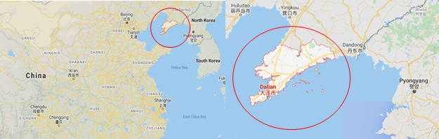
Design Basis
Location of our Para-xylene Production Facility: Dalian, China
Access to ports, existing petrochemical infrastructure, largest producers of TPA are in Dalian, cheap electricity, import natural gas and raw materials.
[9]

Slide 11
Process Description
Unconverted Paraffins
H₂
Fuel gas
Fuel gas
Fuel gas
BTX
EB
Paraffins
BTX
EB
C₉₊ aromatics
Liquid Reformate
Naphtha
C₇₊ aromatics
Reforming Unit
Reformate
Stabilizer
Splitter
Extraction Unit
C₉₊ aromatics
H₂
Fuel gas
Benzene
Xylenes
C₉₊ aromatics
Benzene Toluene
Xylene rerun Column
General Toluene Conversion
Toluene
Benzene Column
Fractionation Column
C₉₊ aromatics
H₂
Fuel gas
Xylenes and C₉₊ to xylene column
PX recovery Unit
Adsorption or Crystallization
Xylene Isomerization Unit
Equilibrium aromatics mixture
Xylenes
PX depleted
[10]
Paraxylene
Undesired heavy aromatics

Slide 12
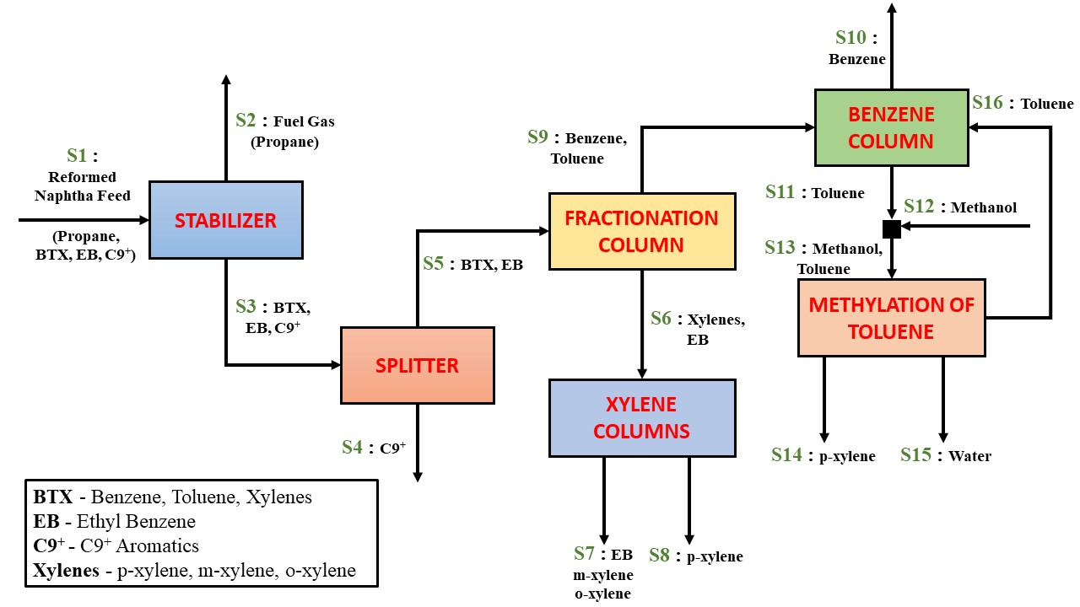
ExxonMobil based process

Slide 13
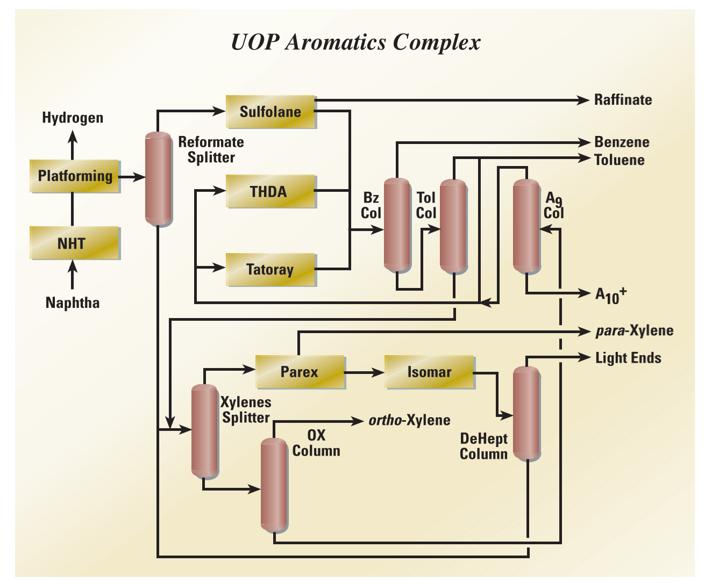
UOP process
[11]

Slide 14
Strengths / Weakness
UOP
Oversupply of Toluene in market Profitable Production
ADS-37 adsorbent 99.9% PX purity and 97% or higher recovery
Low selectivity of 90% Extensive separation process
If benzene by product demand low Low production profit
Toluene Methylation
Mg-ZSM-5 Catalyst, low residence time Selectivity higher than 92.7%
Conventional distillation Avoid extensive energy consumption
Increase in methanol cost Production is less profitable

Slide 15
Chosen Solution
Methylation of toluene method to produce para-xylene
Preheated to a predetermined temperature.
Streams are mixed, heated again, and then supplied to reactor.
The selectivity of the reaction is maximized.
The methylation reactor converts toluene to ortho-, meta-, and para-xylene according to the following chemical reactions:
C7H8 + CH3OH p-C8H10 + H2O
C7H8 + CH3OH m-C8H10 + H2O
C7H8 + CH3OH o-C8H10 + H2O

Slide 16
Chosen Solution
Separation of para-xylene and meta-xylene.
Toluene methylation is the most optimal para-xylene production process.
It requires less complex and less extensive separation columns.
The relative volatility of benzene/toluene and o-xylene/para-xylene is 3.09 and 1.17.
The similar molecular structure, thus extractive distillation does not work.
Para-xylene and meta-xylene can be separated by reactive distillation [12]

Slide 17
Chosen Solution
M-xylene reacts preferentially with di-t-butylbenzene (DTBB) and t-butylbenzene (TBB) to form t-butyl-m-xylene (TBMX) and benzene (B). The reactions are shown below:
DTBB + m-X TBMX + TBB
TBB + m-X TBMX + B
The reaction occurs quickly and reaches equilibrium immediately.
The kinetics of the reactions are shown below:[13, 14]
K^{R} = x_{TBMX} x_{TBB}/ x_{DTBB} x_{m-X} = 0.6
K^{R} = x_{TBMX} x_{B} / x_{TBB} x_{m-X} = 0.16

Slide 18
Advantages of Chosen Solution
High purity of para-xylene
No benzene by-products and No co-feed of hydrogen
maximize the utilization of toluene[15]
Less equipment
Toluene disproportionation unit and Parex unit
Monitoring equipment is very sensitive
More stable and continuous product yields.[15]
Environment Friendly

Slide 19
BFD

Slide 20
Material Balance
Table 1: Material balance of the para-xylene production process through the methylation of toluene.

Slide 21
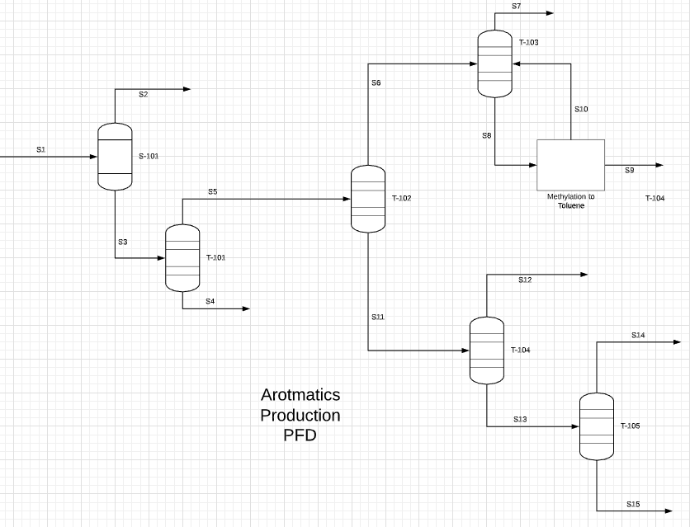
PFD of Overall Process
Preliminary version of PFD.
Specific window for our design.
Simplified version of the overall process, for simulation purposes.
Excludes certain units based on our assumed feedstock.

Slide 22
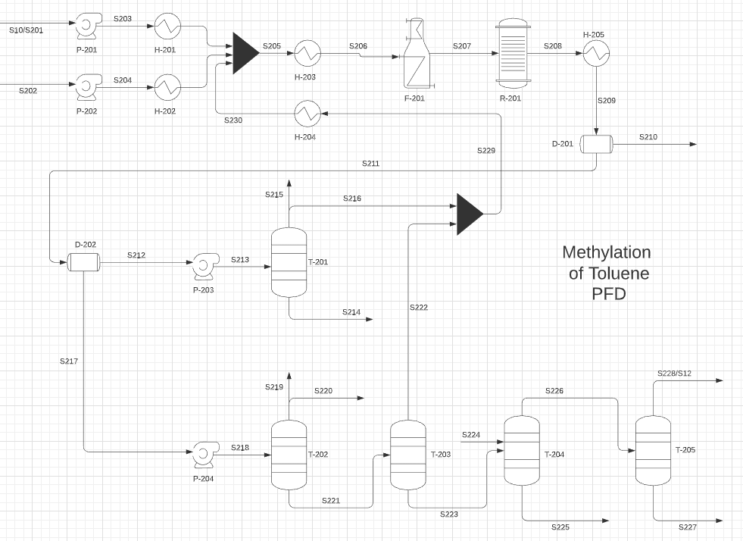
PFD of Methylation of Toluene Process
Preliminary version of the PFD.
Zoomed in window for a more complex simulation.
This is where the heart of the optimization will occur.
Includes more specific equipment.

Slide 23
References
“p-Xylene 296333.” C6H4(CH3)2, www.sigmaaldrich.com/catalog/product/sial/296333?lang=en®ion=US.
“Terephthalic Acid 185361.” Terephthalic Acid 98%, www.sigmaaldrich.com/catalog/product/aldrich/185361?lang=en®ion=US.
Kiron, Mazharul Islam. “Polyester Fiber: Characteristics of Polyester Fiber: Properties of Polyester Fiber: Uses of Polyester Fiber.” Textile Learner: One Stop Solution for Textiles, textilelearner.blogspot.com/2011/07/polyester-fiber-characteristics-of_11.html.
Kiron, Mazharul Islam. “Polyester Fiber: Characteristics of Polyester Fiber: Properties of Polyester Fiber: Uses of Polyester Fiber.” Textile Learner: One Stop Solution for Textiles, textilelearner.blogspot.com/2011/07/polyester-fiber-characteristics-of_11.html.
“Paraxylene (PX) Uses and Market Data.” Icis, www.icis.com/explore/resources/news/2007/11/05/9076062/paraxylene-px-uses-and-market-data/.
“Purified Terephthalic Acid (PTA) Production and Market.” Plastics Insight, www.plasticsinsight.com/resin-intelligence/resin-prices/purified-terephthalic-acid-pta/.
Bhattacharya, Neelay. “Advances in Aromatics Technology: Lowers Paraxylene Cost of Production.” UOP Honeywell, 3 Oct. 2017.
Fischer, Oskar, and Bernhard Jans. “Process for Ultra-Purification of Paraxylene.” Process for Ultra-Purification of Paraxylene, www.digitalrefining.com/article/1000442,Process_for_ultra_purification_of_paraxylene.html.
Figure adapted from Google Maps ©

Slide 24
References
10. Andrew, Griffis. “WO2013085681A1 - Production Process of Para -Xylene and Apparatus Thereof.” Google Patents, World Intellectual Property Organization, 13 June 2013, patents.google.com/patent/WO2013085681A1/en.
11. Trần, Vũ. “UOP Aromatics Complex.” Academia.edu - Share Research, 2003, www.academia.edu/9478499/UOP_Aromatics_Complex.
12. Saito, Shozaburo, et al. “Separation of Meta- And Para-Xylene Mixture By Distillation Accompanied By Chemical Reactions.” Journal of Chemical Engineering of Japan, vol. 4, no. 1, 1971, pp. 37–43., doi:10.1252/jcej.4.37.
13. S. Venkataraman, W.K. Chan, and J. F. Boston, “Reactive distillation using ASPEN PLUS,” Chemical Engineering Progress, vol. 86, no. 8, pp. 45-54, 1990.
14. K. Pitzer and D. Scott, “Additions and Corrections – The Thermodynamics and Molecular Structure of Benzene and Its Methyl Derivitives.,” Journal of the American Chemical Society, vol. 65, no. 12, p. 2481. Dec. 1943.
15. “EMTAM Toluene Selective Alkylation with Methanol: ExxonMobil Chemical.” EMTAM Toluene Selective Alkylation with Methanol | ExxonMobil Chemical, www.exxonmobilchemical.com/en/catalysts-and-technology-licensing/xylenes-production/toluene-selective-alkylation-with-methanol.

