Slide 1
Polylactic Acids for Our Bioplastic Assets
By: Diana Awimrin, Leena Daniel, Thomas Mazur, Yohannes Teweldeberhan

Slide 2
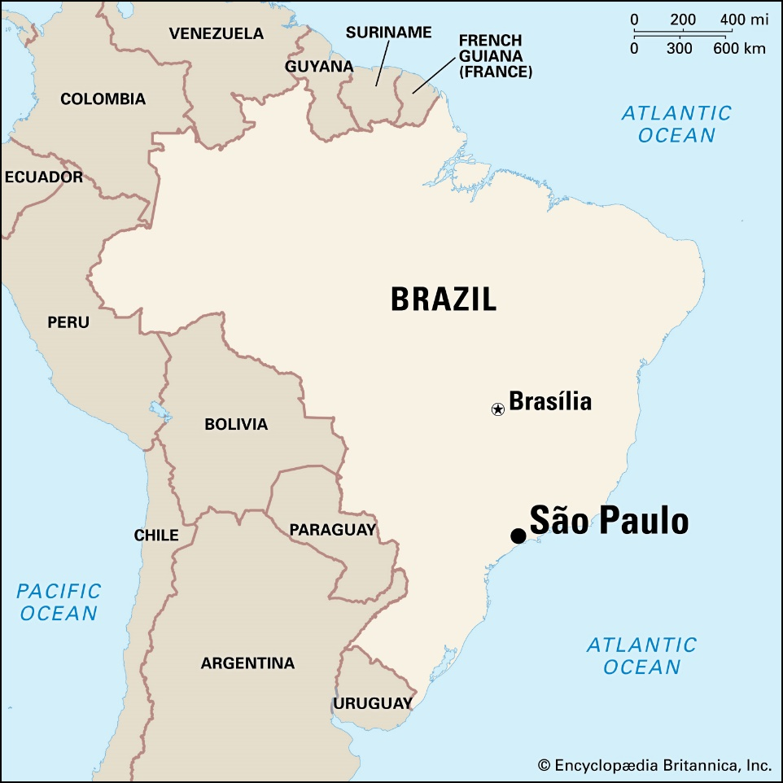
Design Basis
Plant Location | São Paulo, Brazil
Raw Material | Sugarcane Bagasse
Product Purity | 98%
Hours of Operation | 8000 hrs.
Plant Production Rate | 30 KT/year

Slide 3
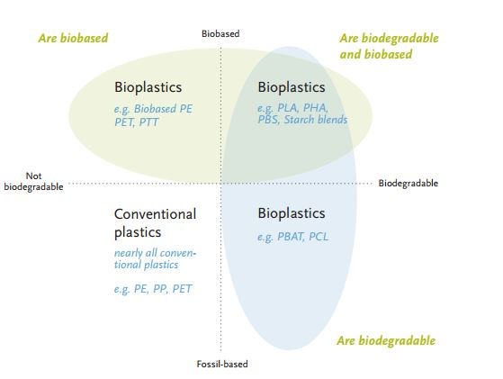
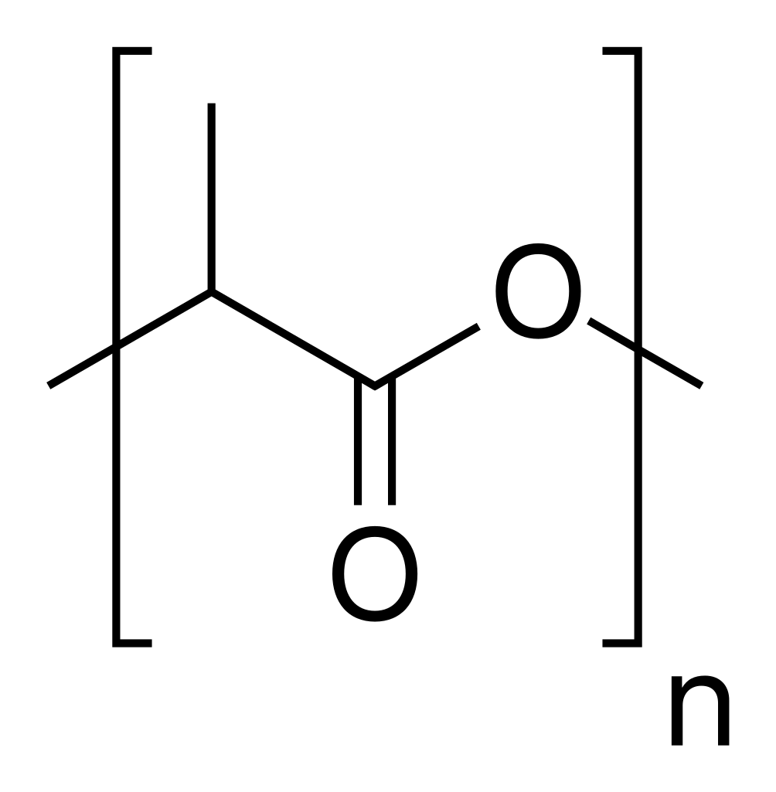
Polylactic Acid (PLA)
Produced from fermentation of sugars into lactic acid
Considered a bioplastic
Biodegradable
Figure 1: Types of plastics ^{[1]}

Slide 4
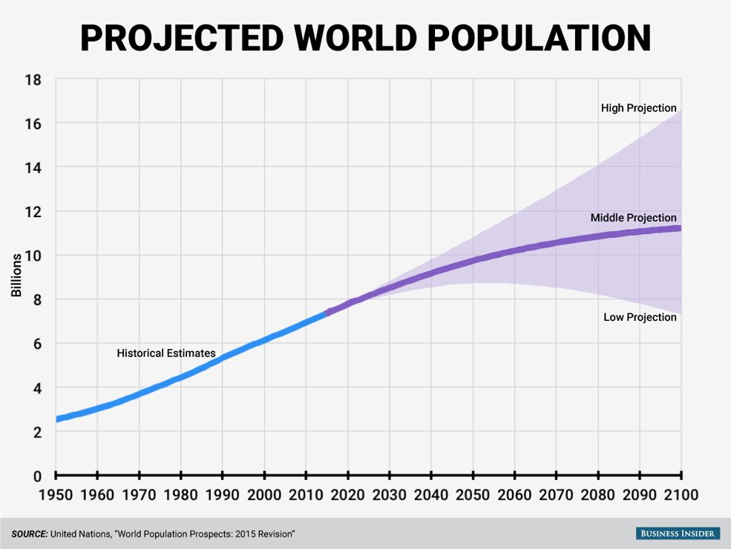
Reasons for PLA
Food production will increase
due to population growth.
Packaging and container
production likely to increase
to compensate food production.
Figure 2: World population projection ^{[2]}

Slide 5
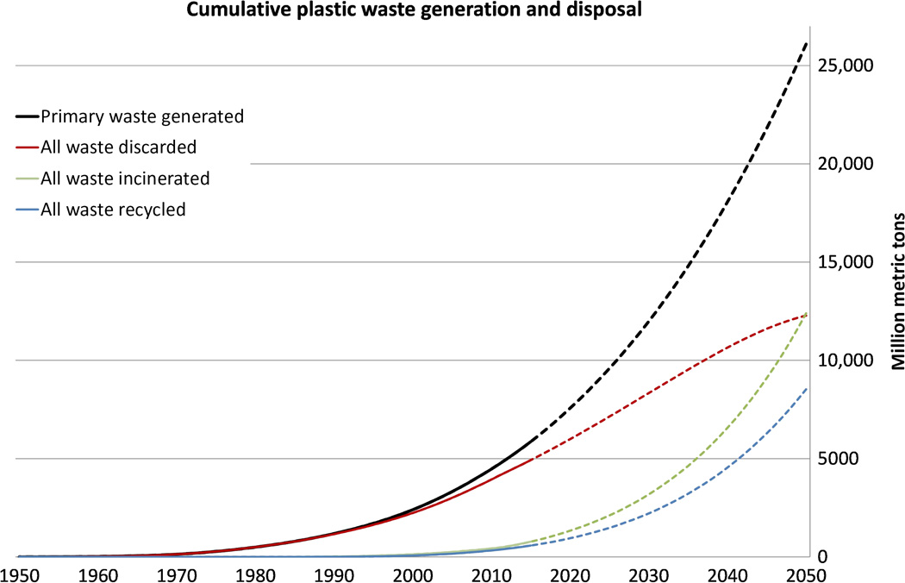
Reasons for PLA
Bio-plastics make up less than 1% of the total plastics market. ^{[3]}
Global plastic production
740 billion pounds.
Growth rate of
4% per year (2016). ^{[3]}
U.S. plastic production
117 billion pounds (2017). ^{[3]}
Figure 3: Plastic waste generation/disposal ^{[4]}

Slide 6
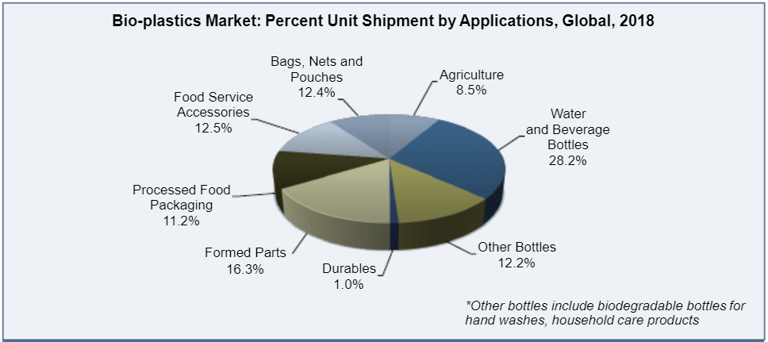
Market Analysis
Bioplastics used in many industries
Water and Beverage Bottles
Food Service Accessories
Processed Food Packaging
Figure 1: Bio-plastics Market Applications ^{[5]}

Slide 7
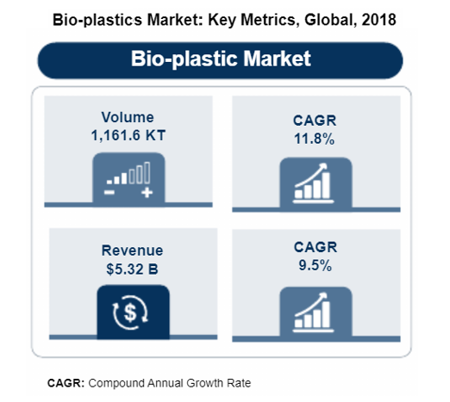
Market Projections
Figure 3: Bio-plastic Global Metrics ^{[5]}

Slide 8
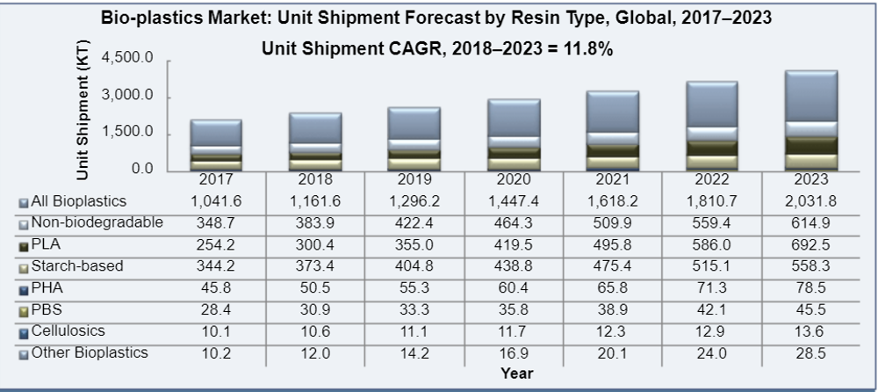
Market Projections
PLA makes up ~ 25% of all bioplastics produced
By 2023, PLA expected to make up ~34% of all bioplastics produced
Figure 2: Bio-plastic Market Projections for Individual Resin Types ^{[5]}

Slide 9
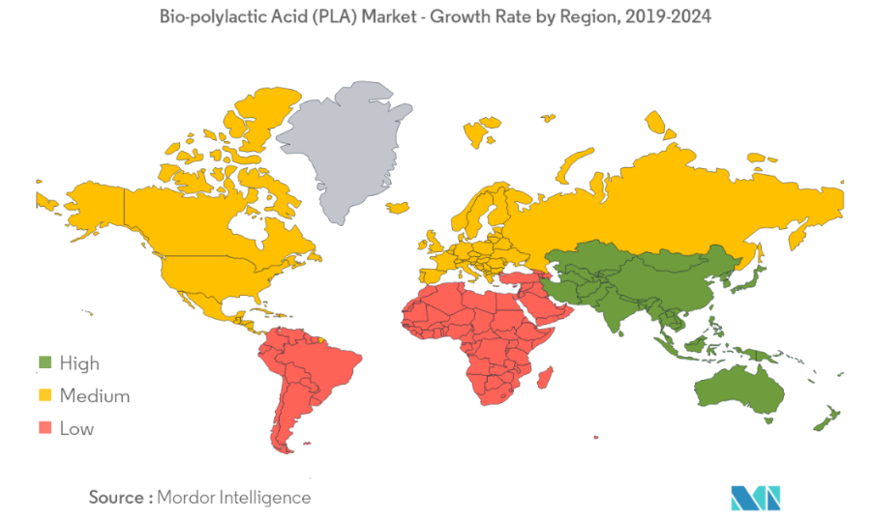
Market Drivers
Interest in creating sustainable and green materials for everyday products
Government incentives encourage manufacturers to produce bioplastics
PLA can be produced from the waste of already cultivated crops
Figure 5: PLA Market Growth Rate ^{[6]}

Slide 10
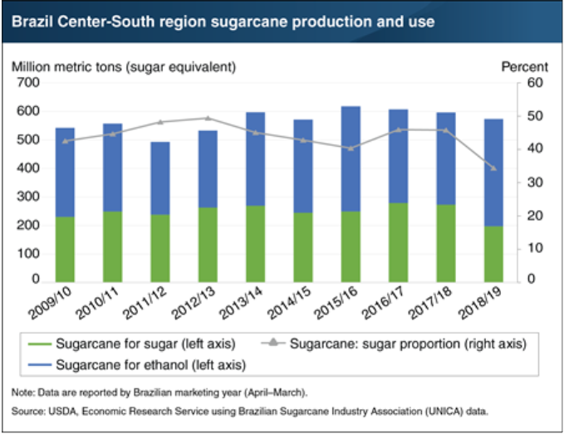
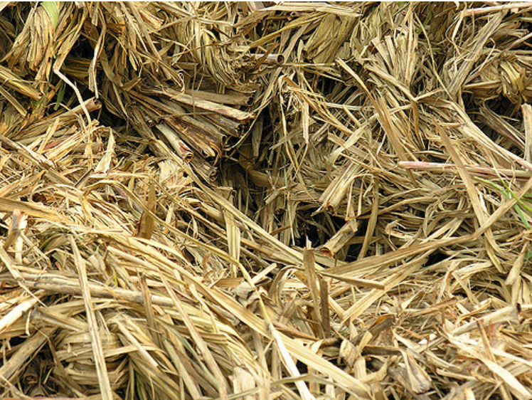
Feedstock : Sugarcane Bagasse
Location: São Paulo, Brazil
Produces 60% of Brazil’s production (670 tons sugarcane/year)
1-ton sugarcane = 250 - 270 kg bagasse [7]
1-ton dry bagasse = $18 [8]
Sugarcane used to produce sugars and ethanol
Figure 7: Brazil Sugarcane Production and Use ^{[9]}

Slide 11
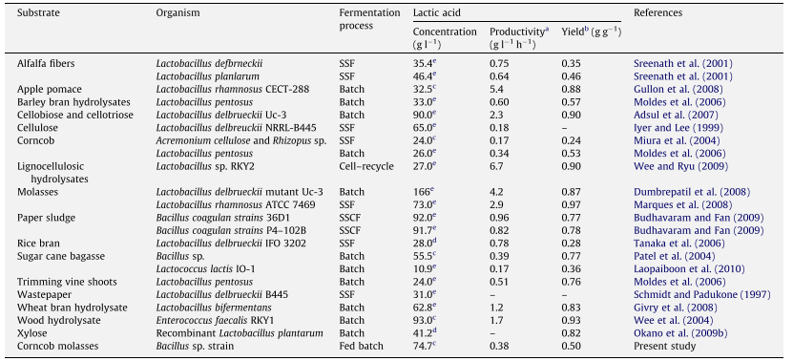
Competing Processes
Table 1: Comparison of Lactic Acid Production Using Various Raw Materials ^{[10]}
To produce polylactic acids, lactic acids must be produced
Types of Raw Materials: Apple Pomace, Sugarcane Bagasse, Corncobs, or Potato Peels
Each of these biomass waste products contain amounts of sugars that can be converted into lactic acid
Table 1, shows the comparison of the lactic acid from the raw materials

Slide 12
Competing Process Continued…
Synthesis of Lactic Acids: Chemical Synthesis or Fermentation
Chemical Synthesis uses petroleum as the raw material ^{[11]}
This process takes the raw material that goes through a reaction to make lactonitrile
The lactonitrile goes through an acid hydrolysis to produce the lactic acid
Fermentation uses a bacteria to start the process and can occur through either through batch, fed-batch, and continuous fermenter ^{[12]}
Batch Fermentation Process ^{[11]}
All the components are added into the fermenter before the process begins
Prevents contaminants from coming in due to it being a closed system
Fed-batch Fermentation Process ^{[13]}
The components are added in together at constant rates
High concentrations of lactic acids are produced
After multiple cycles, there can be a build up of inhibiting substances
Continuous Fermentation Process ^{[11]}
A fresh feed is constantly being added while the previously fermented batch is coming out
The productivity is twice as better than the batch and fed-batch fermenters
There’s high concentrations of lactic acids produced

Slide 13
Competing Process Continued…
Polymerization can occur through lactic condensation and coupling, azeotropic dehydration and condensation, or Ring Opening Polymerization (ROP) of Lactide
Lactic Condensation and Coupling ^{[14]}
Coupling agents used to increase molecular weight, but can cause impurities to cause the polymer to be less biodegradable
Azeotropic Dehydration and Condensation ^{[14]}
Lactic acid and catalysts must be azeotropically dehydrated to increase molecular weight, but process can cause there to be degradation and high toxicity
ROP of Lactide^{[14]}
Only method that creates pure polylactic acids with high molecular weights
Tin compounded catalysts used due to the high catalytic efficiency and low toxicity levels, which are FDA approved
Control and quality in production^{[15]}

Slide 14
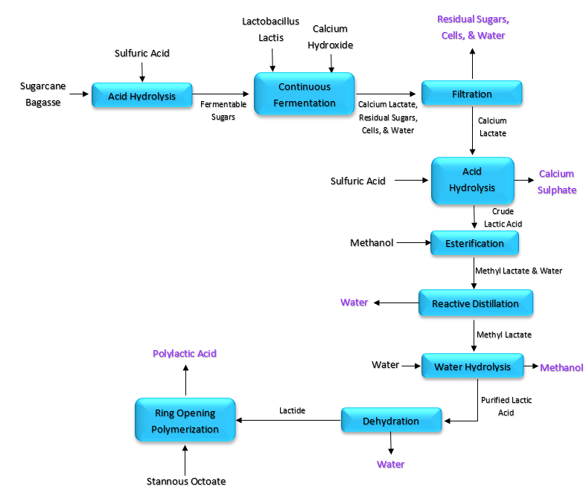
Chosen Process
Figure 8: BFD of the Polylactic Acid Production from Sugarcane Bagasse

Slide 15
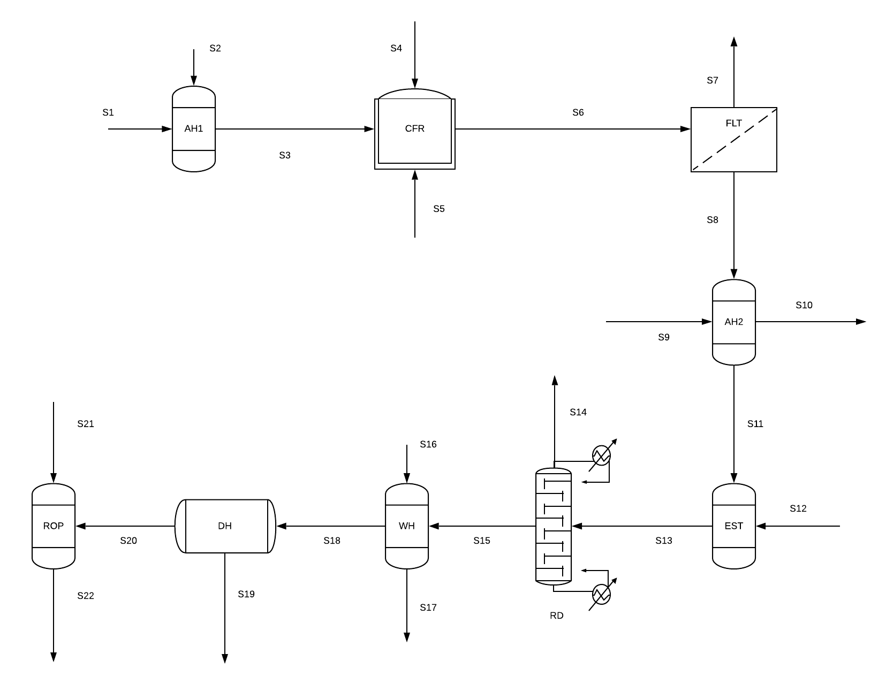
PFD

Slide 16
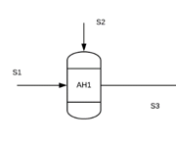
Material Balances Acid Hydrolysis Pretreatment of Bagasse material with diluted Sulfuric acid for 34% yield of glucose
Components | Streams
 | (mol/hr) |  |  | (kg/hr) |  |  | (lb/hr)
 | IN |  | OUT | IN |  | OUT | IN |  | OUT
 | S1 | S2 | S3 | S1 | S2 | S3 | S1 | S2 | S3
Glucose | 208523.92 |  | 70898.13 | 37566.84 |  | 12772.72 | 21014.18 |  | 28159.00
Sulfuric Acid |  | 14596.67 | 145.97 |  | 1431.63 | 14.32 |  | 3156.19 | 31.56
Residues |  |  |  |  |  | 26211.42 |  |  | 57786.23
 |  |  | SUM | 37566.84 | 1431.63 | 38998.46
 |  |  | Mass Balance |  |  | 0.00

Slide 17
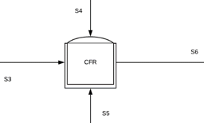
Continuous Fermentation Reactor Fermentation based on conversion by Bacteria of 85% ^{[12]}
Components | Streams
 | (mol/hr) |  |  | (kg/hr) |  |  | (lb/hr)
 | IN |  | OUT | IN |  | OUT | IN |  | OUT
 | S3 | S4 | S6 | S3 | S4 | S6 | S3 | S4 | S6
Glucose | 70898.13 |  | 1417.96 | 12772.72 |  | 255.45 | 28159.00 |  | 563.18
Calcium Hydroxide |  | 70898.13 |  |  | 5252.98 |  |  | 11580.83
Calcium Lactate |  |  | 120526.83 |  |  | 15565.56 |  |  | 34316.14
Water |  |  | 120526.83 |  |  | 2171.32 |  |  | 4786.95
Residues |  |  |  |  |  | 33.37
 |  |  | SUM | 12772.72 | 5252.98 | 18025.71
 |  |  | Mass Balance |  |  | 0.00

Slide 18
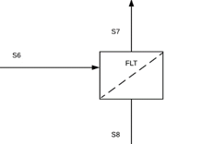
Filtration Based on the assumption of having filtration with yield of 97%
Components | Streams
 | (mol/hr) |  |  | (kg/hr) |  |  | (lb/hr)
 | IN |  | OUT | IN |  | OUT | IN |  | OUT
 | S6 | S7 | S8 | S6 | S7 | S8 | S6 | S7 | S8
Glucose | 1417.96 | 1417.96 |  | 255.45 | 255.45 |  | 563.18 | 563.18
Calcium Hydroxide
Calcium Lactate | 120526.83 | 3615.80 | 116911.02 | 15565.56 | 466.97 | 15098.59 | 34316.14 | 1027.33 | 33286.66
Water | 120526.83 | 120526.83 |  | 2171.32 | 2171.32 |  | 4786.95 | 4786.95
 |  |  | SUM | 17992.34 | 2893.75 | 15098.59
 |  |  | Mass Balance |  |  | 0.00

Slide 19
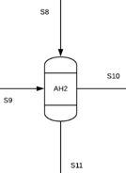
Acid Hydrolysis Based on 92% yield of Calcium Lactate to LA ^{[16]}
Components | Streams
 | (mol/hr) |  |  |  | (kg/hr) |  |  |  | (lb/hr)
 | IN |  | OUT |  | IN |  | OUT |  | IN |  | OUT
 | S8 | S9 | S10 | S11 | S8 | S9 | S10 | S11 | S8 | S9 | S10 | S11
Calcium Lactate | 116911.02 |  | 9352.88 |  | 15098.59 |  | 1207.89 |  | 33286.66 |  | 2657.36
Lactic Acid |  |  |  | 107558.14 |  |  |  | 9688.84 |  |  |  | 21360.20
Sulfuric Acid |  | 40918.86 | 9104.45 |  |  | 4013.28 | 892.95 |  |  | 8847.76 | 1964.49
Calcium Sulphate |  |  | 53779.07 |  |  |  | 7321.48 |  |  |  | 16141.09
Residues |  |  |  |  |  |  |  | 0.71
 |  |  |  | SUM | 15098.59 | 4013.28 | 9422.32 | 9689.55
 |  |  |  | Mass Balance |  |  |  | 0.00

Slide 20
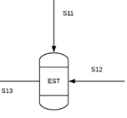
Esterification Based on 85% conversion to Methyl lactate
Components | Streams
 | (mol/hr) |  |  | (kg/hr) |  |  | (lb/hr)
 | IN |  | OUT | IN |  | OUT | IN |  | OUT
 | S11 | S12 | S13 | S11 | S12 | S13 | S11 | S12 | S13
Water |  |  | 46250.00 |  |  | 833.21 |  |  | 1836.90
Lactic Acid | 53779.07 |  | 7529.07 | 4844.42 |  | 678.22 | 10680.10 |  | 1492.08
Methanol |  | 53779.07 | 6184.59 |  | 1723.08 | 198.15 |  | 3798.74 | 435.93
Methyl Lactate |  |  | 46250.00 |  |  | 4861.34 |  |  | 10717.40
Residues |  |  |  |  |  | -3.42
 |  |  | SUM | 4844.42 | 1723.08 | 6567.50
 |  |  | Mass Balance |  |  | 0.00

Slide 21
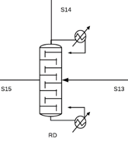
Reactive Distillation Based on 90% of Methyl lactate and water removal ^{[17]}
Components | Streams
 | (mol/hr) |  |  | (kg/hr) |  |  | (lb/hr)
 | IN | OUT |  | IN | OUT |  | IN | OUT
 | S13 | S14 | S15 | S13 | S14 | S15 | S13 | S14 | S15
Water | 46250.00 | 46250.00 |  | 833.21 | 833.21 |  | 1836.90 | 1836.90
Methyl Lactate | 46250.00 | 4625.00 | 41625.00 | 4861.34 | 486.13 | 4375.20 | 10717.40 | 1069.49 | 9645.66
 |  |  | SUM | 5694.54 | 4375.20 | 1319.34
 |  |  | Mass Balance |  |  | 0.00

Slide 22
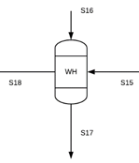
Water Hydrolysis Based on conversion of 97% Methanol
Components | Streams
 | (mol/hr) |  |  |  | (kg/hr) |  |  |  | (lb/hr)
 | IN |  | OUT |  | IN |  | OUT |  | IN |  | OUT
 | S15 | S16 | S17 | S18 | S15 | S16 | S17 | S18 | S15 | S16 | S17 | S18
Water |  | 41625 |  |  |  | 749.89 |  |  |  | 1653.21
Lactic Acid |  |  |  | 41625.00 |  |  |  | 3749.58 |  |  |  | 8266.40
Methanol |  |  | 42692.31 |  |  |  | 1367.86 |  |  |  | 3015.61
Methyl Lactate | 41625 |  |  |  | 4375.20 |  |  |  | 9645.66
Residues |  |  |  |  |  |  |  | 7.65
 |  |  |  | SUM | 4375.20 | 749.89 | 1367.86 | 3757.23
 |  |  |  | Mass Balance |  |  |  | 0.00

Slide 23
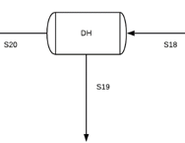
Dehydration Assumption greater than 90% of Methanol is removed
Components | Streams
 | (mol/hr) |  |  | (kg/hr) |  |  | (lb/hr)
 | IN | OUT |  | IN | OUT |  | IN | OUT
 | S18 | S19 | S20 | S18 | S19 | S20 | S18 | S19 | S20
Lactic Acid | 41625.00 |  | 41625.00 | 3749.58 |  | 3749.58 | 156076.27 |  | 156076.27
Methanol | 1367.86 | 1231.08 |  | 43.83 | 43.83
 |  |  | SUM | 3793.41 | 43.83 | 3749.58
 |  |  | Mass Balance |  |  | 0.00

Slide 24

Ring-Opening Polymerization Assumption of the end-product to have Polymer grade of 20,000 (g/mol) and 30 Kilo Ton per year
Components | Streams
 | (mol/hr) |  |  | (kg/hr) |  |  | (lb/hr)
 | IN |  | OUT | IN |  | OUT | IN |  | OUT
 | S20 | S21 | S22 | S20 | S21 | S22 | S20 | S21 | S22
Lactic Acid | 42468.75 |  | 849.38 | 3825.59 |  | 76.51 | 8433.96 |  | 168.32
Polylactic Acid |  |  | 187.50 |  |  | 3750.00 |  |  | 8267.33
Residues |  |  |  |  |  | -0.93
 |  |  | SUM | 3825.59 |  | 3825.58
 |  |  | Mass Balance |  |  | 0.00

Slide 25
References
[1]Bioplastic (PLA) Packaging Supplier. 2019, http://www.qualityprintpackaging.com/bioplastic-packaging-supplier.
[2]Kiersz, Andy. “The World Could Have Another Billion People in Thirteen Years.” Insider Inc., 2015, https://www.businessinsider.com/un-world-population-projections-2015-7?op=1.
[3] Shogren, Randal, et al. “Plant-Based Materials and Transitioning to a Circular Economy.”Sustainable Production and Consumption, vol. 19, Elsevier B.V., 2019, pp. 194–215, doi:10.1016/j.spc.2019.04.007.
[4]Geyer, Roland, et al. “Production, Use, and Fate of All Plastics Ever Made.” Science Advances, vol. 3, no. 7, 2017, pp. 25–29, doi:10.1126/sciadv.1700782.
[5] Global Bio-Plastic and Bio-Plastic Additives Market, Forecast to 2023, Frost & Sullivan
[6] “Bio-Polylactic Acid (PLA) Market: Growth, Trends, and Forecast (2020 - 2025).” Market Research - Consulting, Reports, Advisory, Sizing, www.mordorintelligence.com/industry-reports/bio-polylactic-acid-pla-market.
[7] Wischral, Daiana, et al. “Lactic Acid Production from Sugarcane Bagasse Hydrolysates by Lactobacillus Pentosus: Integrating Xylose and Glucose Fermentation.” Biotechnology Progress, vol. 35, no. 1, 2019, doi:10.1002/btpr.2718.
[8] Marques, Fabrício. “Bagasse Is the Target.” Revista Pesquisa Fapesp, revistapesquisa.fapesp.br/en/2011/04/20/bagasse-is-the-target-2/.
[9] “Low Sugar Prices on the World Market Help Spur Brazil's Ethanol Production.” USDA ERS - Chart Detail, www.ers.usda.gov/data-products/chart-gallery/gallery/chart-detail/?chartId=93427.
[10] Wang, Limin, et al. “Efficient Production of L-Lactic Acid from Corncob Molasses, a Waste By-Product in Xylitol Production, by a Newly Isolated Xylose Utilizing Bacillus Sp. Strain.” Bioresource Technology, vol. 101, no. 20, 2010, pp. 7908–15, doi:10.1016/j.biortech.2010.05.031.
[11] Krishna, B. S., et al. “Industrial Production of Lactic Acid and Its Applications.” International Journal of Biotech Research, vol. 1, no. 1, 2018, pp. 42–54.
[12] Thongchul, Nuttha. “Production of Lactic Acid and Polylactic Acid for Industrial Applications.” Bioprocessing Technologies in Biorefinery for Sustainable Production of Fuels, Chemicals, and Polymers, 2013, pp. 293–316, doi:10.1002/9781118642047.ch16.
[13] Djukić-Vuković, A., et al. “Towards Sustainability of Lactic Acid and Poly-Lactic Acid Polymers Production.” Renewable and Sustainable Energy Reviews, vol. 108, no. December 2018, Elsevier Ltd, 2019, pp. 238–52, doi:10.1016/j.rser.2019.03.050.
[14] Properties, Thermal. 9 Synthesis, Properties, Environmental and Biomedical Applications of Polylactic Acid. no. 2008, 2020.
[15] Sin, Lee Tin, et al. 2 Overview of Poly (Lactic Acid). no. 2012, 2020.
[16]Liu, Chenguang, Yuliang Jia, and Aihua He. 2013. “Preparation of Higher Molecular Weight Poly (L -Lactic Acid) by Chain Extension.” International Journal of Polymer Science 2013: 1–7. https://doi.org/10.1155/2013/315917.
[17] “Biodegradable Polylactic Acid.” High Performance Textiles, no. MAR. 1999.

