Slide 1
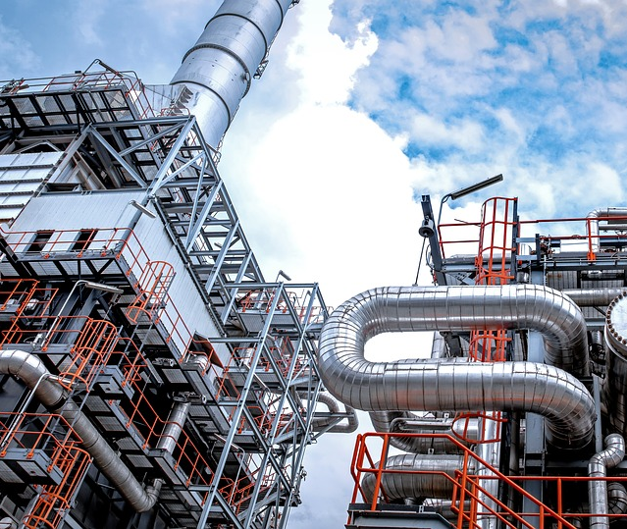
Advanced MTO Process in India
Group #10
Sinan Masoud
Khalil Shehadeh
Emily Sobie
Esteban Vazquez-Elizondo
Mentor: Bipin Vora

Slide 2
Why MTO in India?
MTO, which stands for methanol-to-olefins, provides the link between the use of coal and natural gas in the petrochemical industry.
The objective in this project is to base the plant in India, which has the highest growing population in the world, and is in dire need of meeting its olefin demand in order to avoid becoming dependent on other countries.
The investment in a methanol plant in Angola, Africa will boost the economy and create new jobs. This could potentially be the initial steps into getting the country out of poverty.
The investment in the methanol plant will provide access to the methanol at a lower price than what India is currently paying the Middle East for methanol. By doing this, MTO process will be economically optimized, due to a lower price of methanol, while also helping meet the increase in demand of ethylene and propylene in India.

Slide 3
Design Basis
The MTO Plant will be built on the west coast of India, near Mumbai
The plant production total is 667,384 metric tons of olefins per year
Ethylene and propylene will have a 99.4% purity
The amount of methanol required is 1,623,000 metric tons per year

Slide 4
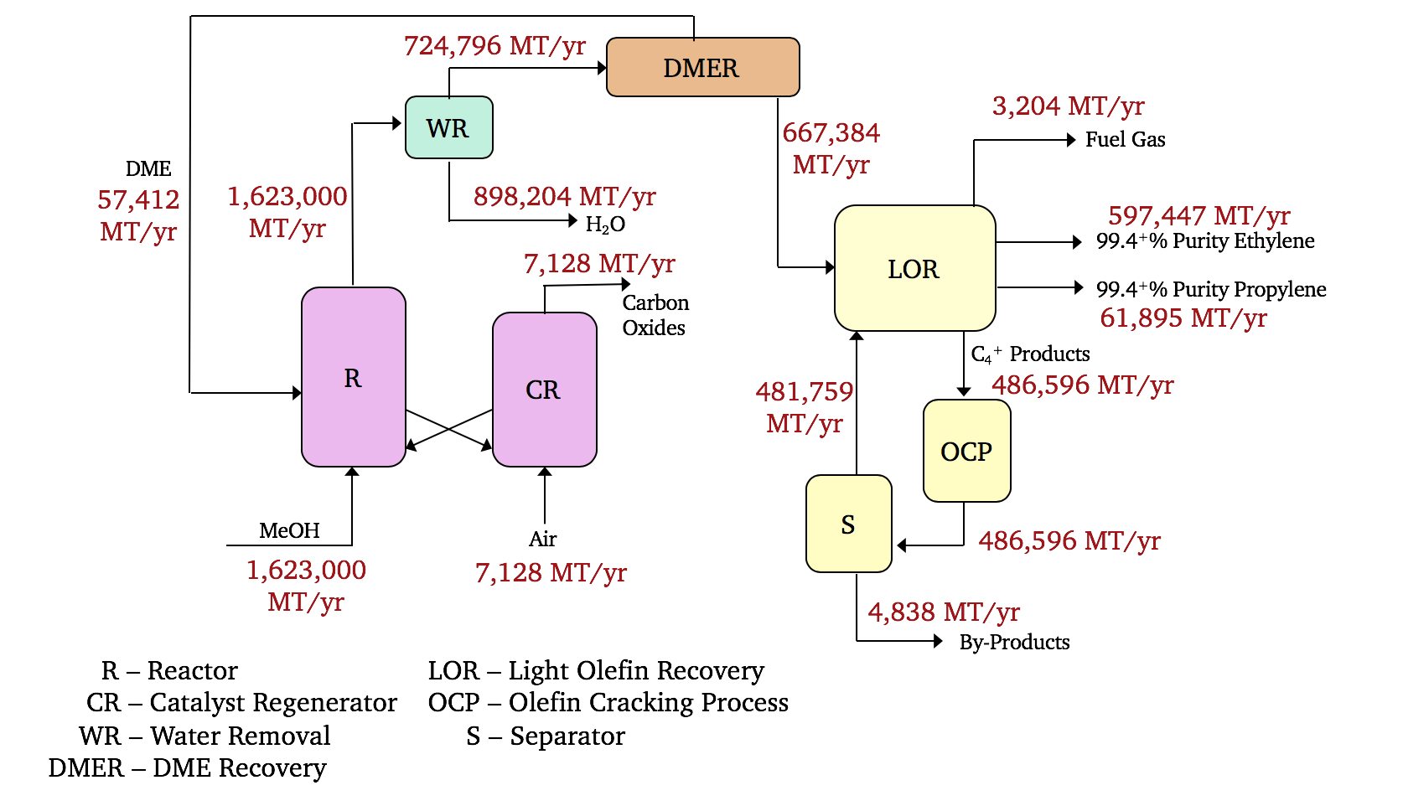
BFD
Figure 1 –Advanced MTO Process BFD.

Slide 5
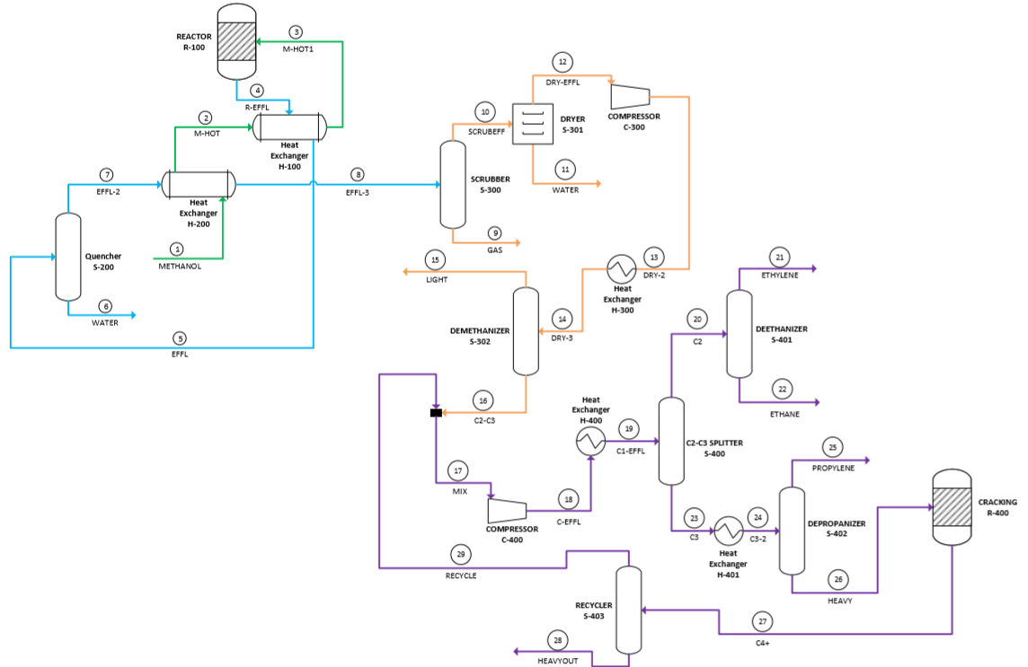
PFD
Figure 2 –Overall MTO PFD

Slide 6
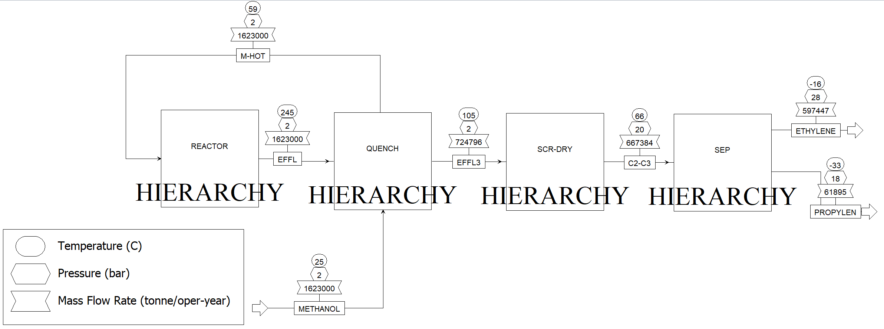
Aspen Simulation PFD

Slide 7
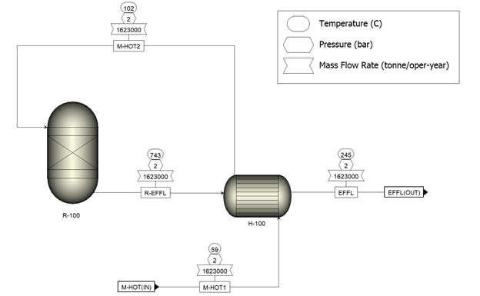
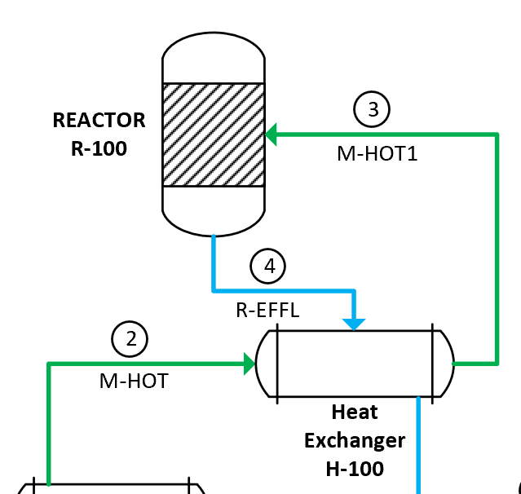
Process Flow Diagram: Reactor Hierarchy
The first stage of the process flow diagram is the reactor stage
The methanol enters through a heat exchangers before going to the reactor.
Figure 3 – Reactor Hierarchy PFD & BFD

Slide 8
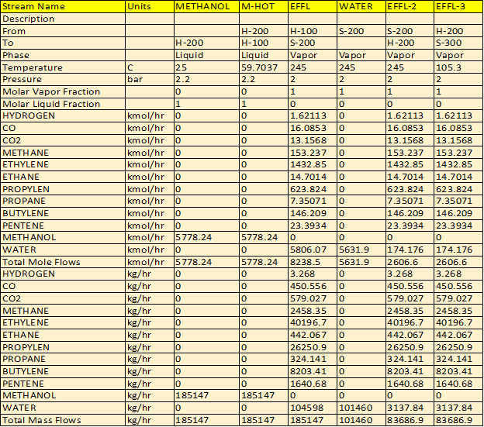
Reactor Hierarchy: Stream Details

Slide 9
Reactor Hierarchy: Equipment Sizing
REACTOR Hierarchy Equipment
# | Aspen ID | Industry Name | Duty (kW) | Specifications | Material
1 | R-100 | R-Yield Reactor | 56245.6 | 1016.3 K, 2 bar, Diameter= 0.457m, Height= 2.591m | Carbon Steel
2 | H-100 | Shell&Tube Heat Exchanger | 38146.3 | Inlet: Thot=387.25 K Tcold=298.15 K Outlet: Thot=378.45 K Tcold=300.139 K | Carbon Steel

Slide 10
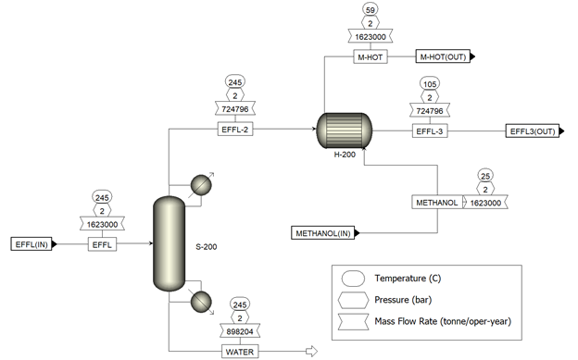
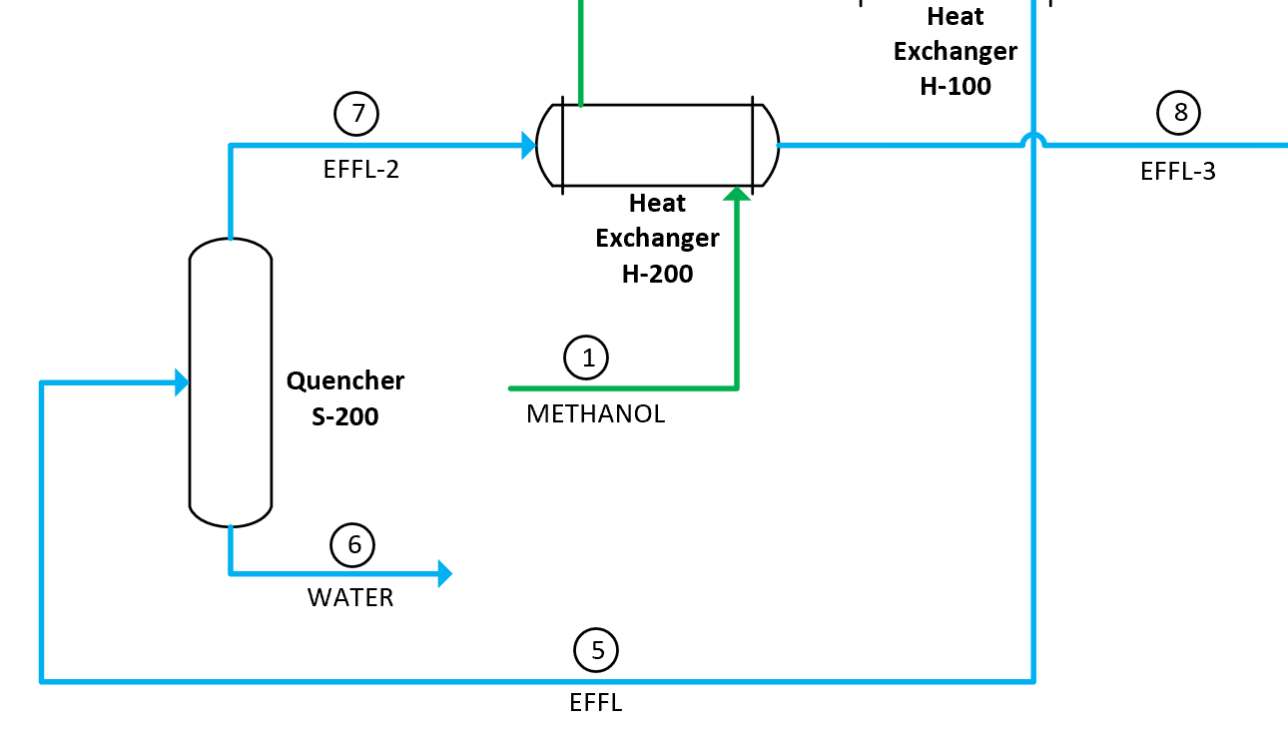
Process Flow Diagram: Quench Hierarchy
This stage of the process has the product stream of the reactor going through a Seperator/quencher, where the water is separated out.
After the Seperator, the top product stream goes through a heat exchanger.
Methanol enters with this product stream into the heat exchanger and the third effluent stream goes out to the next stage.
Figure 4 – Quenching Hierarchy PFD & BFD

Slide 11
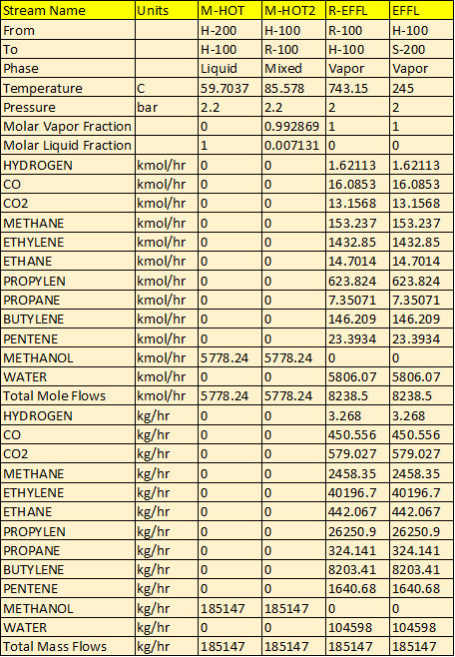
Quench Hierarchy: Stream Details

Slide 12
Quench Hierarchy: Equipment Sizing
QUENCH Hierarchy Equipment
# | Aspen ID | Industry Name | Duty (kW) | Specifications | Material
1 | H-100 | Shell &Tube Heat Exchanger | 546.578 | Inlet: Thot=387.25 K Tcold=298.15 K Outlet: Thot=378.45 K Tcold=300.139 K | Carbon Steel

Slide 13
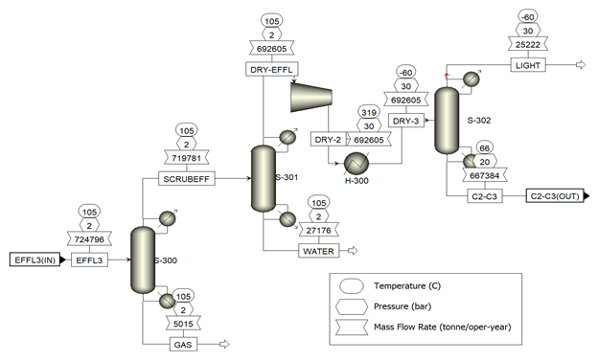
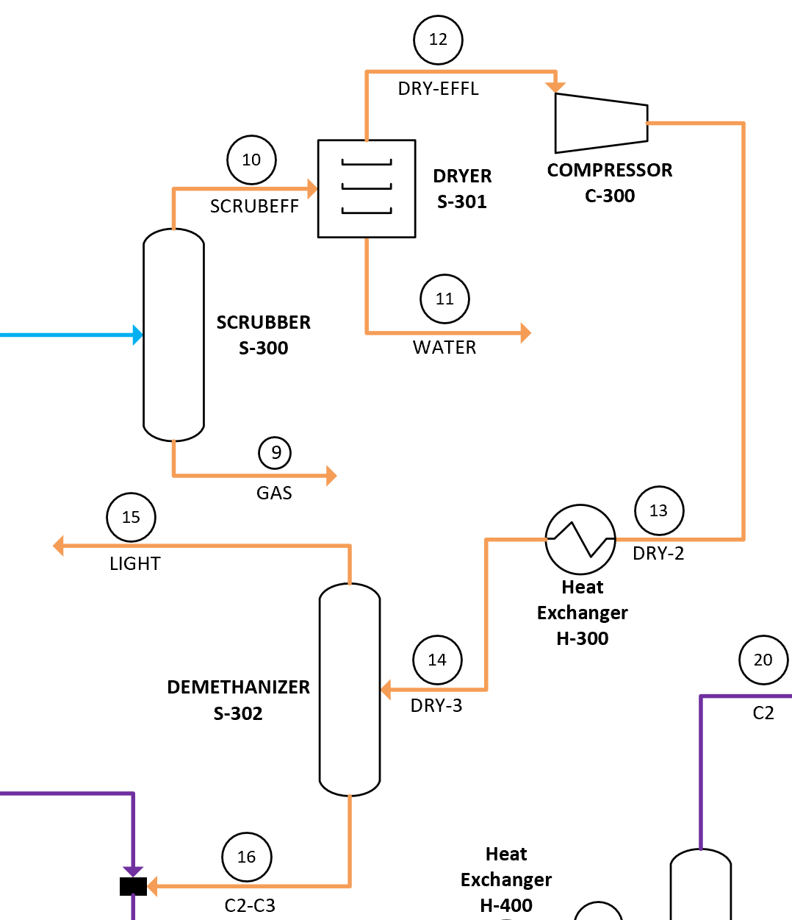
Process Flow Diagram: Scrubbing/Drying Hierarchy
This stage of the process is where the water is scrubbed off from the effluent stream and the C2-C3 hydrocarbons are separated out.
Figure 5 – Scrubbing and Drying Hierarchy PFD & BFD

Slide 14
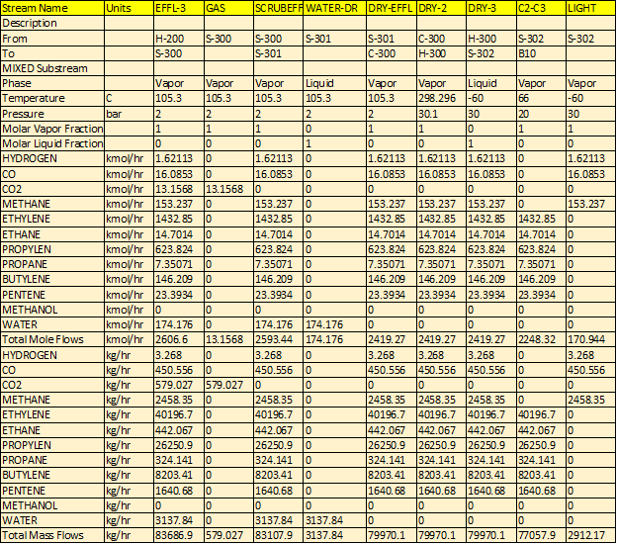
Scrubbing/Drying Hierarchy : Stream Details

Slide 15
Scrubbing/Drying Hierarchy: Equipment Sizing
SCR/DRY Hierarchy Equipment
# | Aspen ID | Industry Name | Duty (kW) | Specifications | Material
1 | C-300 | Isentropic Compressor | 56245.6 | 1016.3 K, 2 bar | Carbon Steel
2 | H-300 | Shell & Tube Heat Exchanger | 38146.3 | Inlet: Thot=387.25 K Tcold=298.15 K Outlet: Thot=378.45 K Tcold=300.139 K | Carbon Steel
3 | S-302 | Demethanizer - Kettle Reboiler | 310.1 | 34 trays, 30 bar, 255.78 K, Diameter=2.133m, Height=6.4m | Carbon Steel

Slide 16
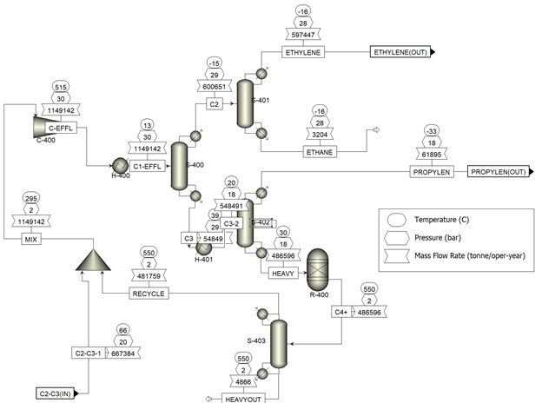
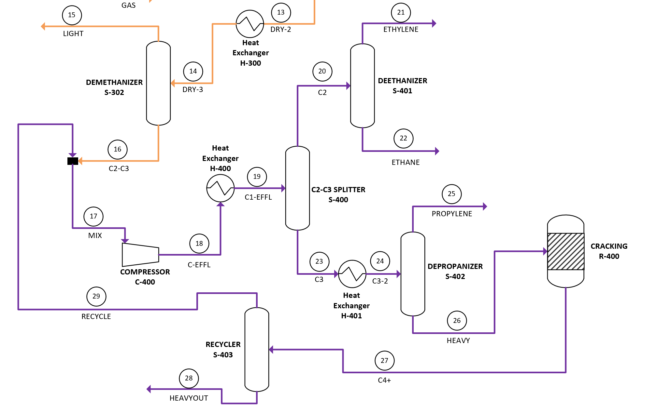
Process Flow Diagram: Separation/Cracking Hierarchy
This stage of the process is where the ethylene and propylene products are separated out.
Figure 5 – Separation and Cracking Hierarchy PFD & BFD

Slide 17
Separation/Cracking Hierarchy: Stream Details

Slide 18
Separation/Cracking Hierarchy: Equipment Sizing
SEP Hiearchy Equipment
1 | R-400 | R-Yield Reactor | 40991.59 | 823.15 K, 2 bar, Diameter= 1.676m, Height= 6.4m | Carbon Steel
Reboilers
# | Aspen ID | Industry Name | Duty (kW) | Specifications | Material
2 | S-400 | C2-C3 - Kettle Reboiler | 8000 | 38 trays, 19 bar, 312.4 K, Diameter=2.9m, Height= 35.36m | Carbon Steel
3 | S-401 | Deethanizer - Kettle Reboiler | 114.52 | 60 trays, 28 bar, 272.52 K, Diameter=1.677m,Height=54.25m | Carbon Steel
4 | S-402 | Depropanizer - Kettle Reboiler | 2000 | 195 trays, 18 bar, 303.17 K, Diameter=1.372m, Height= 171.91m | Carbon Steel

Slide 19
Separation/Cracking Hierarchy: Equipment Sizing
Condensers
# | Aspen ID | Industry Name | Duty (kW) | Specifications | Material
5 | S-400 | C2-C3 - Partial Vapor | -8000 | 38 trays, 19 bar, 258.25 K | Carbon Steel
6 | S-401 | Deethanizer - Partial Vapor | -1120.6 | 60 trays, 28 bar, 256.79 K | Carbon Steel
7 | H-400 | Shell&Tube Heat Exchanger | -50300 | Inlet: Thot=788 K Outlet: Thot=287 K | Carbon Steel
8 | H-401 | Shell&Tube Heat Exchanger | -23005 | Inlet: Thot=312 K Outlet: Thot=293 K | Carbon Steel
9 | S-402 | Depropanizer - Partial Vapor | -2000 | 195 trays, 18 bar, 240.18 K | Carbon Steel
Compressor
# | Aspen ID | Industry Name | Duty (kW) | Specifications | Material
10 | C-400 | Isentropic Compressor | 22108 | 30.1 bar, 465.21 K | Carbon Steel

Slide 20
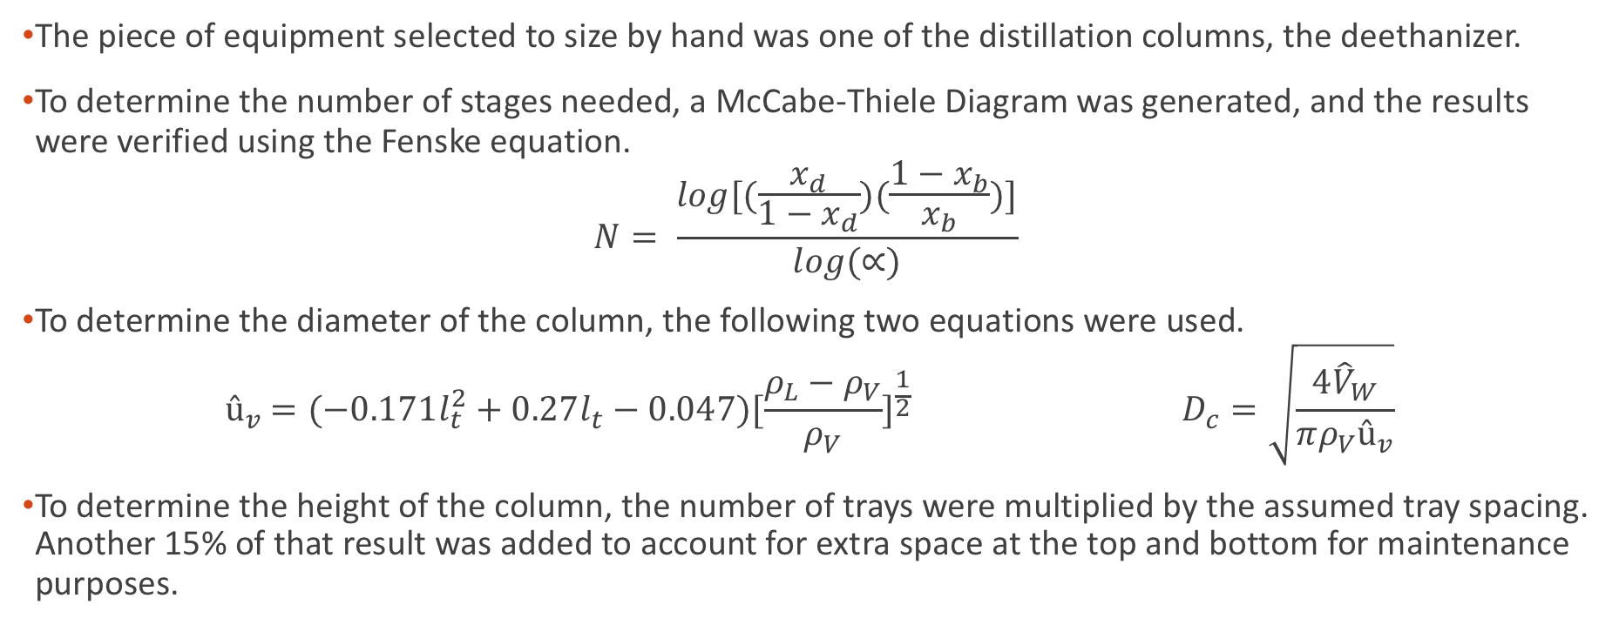
Hand Calculations
The piece of equipment selected to size by hand was one of the distillation columns, the deethanizer.
To determine the number of stages needed, a McCabe-Thiele Diagram was generated, and the results were verified using the Fenske equation.
$$N= \frac{log[(\frac{x_{d}}{1−x_{d}})(\frac{1−x_{b}}{x_{b}})]}{log(∝)}$$
To determine the diameter of the column, the following two equations were used.
$${ û}_{v} =(−0.171l_{t}^{2}+0.27l_{t}−0.047)[\frac{ρ_{L}−ρ_{V}}{ρ_{V}}]^{\frac{1}{2}} D_{c}=\sqrt{\frac{4{\hat{V}}_{W}}{πρ_{V}û_{v}}}$$
To determine the height of the column, the number of trays were multiplied by the assumed tray spacing. Another 15% of that result was added to account for extra space at the top and bottom for maintenance purposes.

Slide 21

Hand Calculations vs. Aspen Simulation
Variable | Hand | Aspen
Stages | 62 | 60
Height (ft) | 142.7 | 178
Diameter (ft) | 7.77 | 5.5

Slide 22
Preliminary Utilities
Name | Type | Usage | Units
Electricity | Power | 78,353.6 | kW
Cooling Water | Water | 8,924.7 | MT/hr
R1270 (Propylene) | Refrigerant | 42,730.9 | MT/hr
Ethylene | Refrigerant | 5,586.4 | MT/hr
Steam (261.1 psig to 493.1 psig) | High Pressure Steam | 23.3 | MT/hr

Slide 23
References
^{[1]}Peng Tian, Yingxu Wei, Mao Ye, and Zhongmin Liu. Methanol to Olefins (MTO): From Fundamentals.
^{[2]}Gimre, S. (n.d.). Doing It Differently. http://www.cewindia.com/steve_gimre_guestcolumn.html
^{[3]}Raghavan, R. (2018). India ’ s Expanding Chemical Industry. December, 49–56.
^{[4]}Presentation By Mr. Janardhanan- SABIC. (n.d.).
^{[5]}Report, I. A., Derivatives, B., & Acid, A. (2020). Global Methanol Market is estimated to reach. 1–4.
^{[6]}Size, M. M., Analysis, T., By, R., Acid, A., Region, B., Type, C. L., & Insights, I. (2020). Methanol Market Size , Share , Analysis | Industry Research Report , 2025 Methanol Market Size , Share , Analysis | Industry Research Report , 2025. 1–6.
^{[7]}Global Methanol Pricing Comparison. (2015). 2014.
^{[8]}Chen, J. Q., Bozzano, A., Glover, B., Fuglerud, T., & Kvisle, S. (2005). Recent advancements in ethylene and propylene production using the UOP/Hydro MTO process. Catalysis Today, 106(1–4), 103–107. https://doi.org/10.1016/j.cattod.2005.07.178
^{[9]}Jasper, S., & El-Halwagi, M. M. (2015). A techno-economic comparison between two methanol-to-propylene processes. Processes, 3(3), 684–698. https://doi.org/10.3390/pr3030684
^{[10]}Soundararajan, S., Dalai, A. K., & Berruti, F. (2001). Modeling of methanol to olefins (MTO) process in a circulating fluidized bed reactor. Fuelfile:///C:/Users/0bsolete/Downloads/3-S2.0-B9781437735147100030-Main.Pdf, 80(8), 1187–1197. https://doi.org/10.1016/S0016-2361(00)00182-4
^{[11]}Speight, James G. “Fischer-Tropsch Synthesis.” Fischer-Tropsch Synthesis - an Overview | ScienceDirect Topics, 2014, www.sciencedirect.com/topics/engineering/fischer-tropsch-synthesis.
^{[12]}A.Vandewalle, Laurien, and Kevin M.Van Geem. “New Trends in Olefin Production.” Engineering, Elsevier, 12 May 2017, reader.elsevier.com/reader/sd/pii/S2095809917302965?token=98140415E56F121CD74E11824DDB2F773B5BF4F6DDC445DE969630AF4FD8BC313672B48F1F1D35BEC8CAA5DF3F95C5D1.
^{[13]}Funk, G. A., Myers, D., & Vora, B. (2013). A different game plan. Hydrocarbon Engineering, December, 1–4. http://www.uop.com/wp-content/uploads/2013/12/Methanol-to-Olefins-Technology_Hydrocarbon-Engineering-Dec-2013.pdf
^{[14]}Tian, P., Wei, Y., Ye, M., & Liu, Z. (2015). Methanol to olefins (MTO): From fundamentals to commercialization. ACS Catalysis, 5(3), 1922–1938. https://doi.org/10.1021/acscatal.5b00007
^{[15]}Posch, W. (2011). Polyolefins. Applied Plastics Engineering Handbook, 23–48. https://doi.org/10.1016/B978-1-4377-3514-7.10003-0

Slide 24
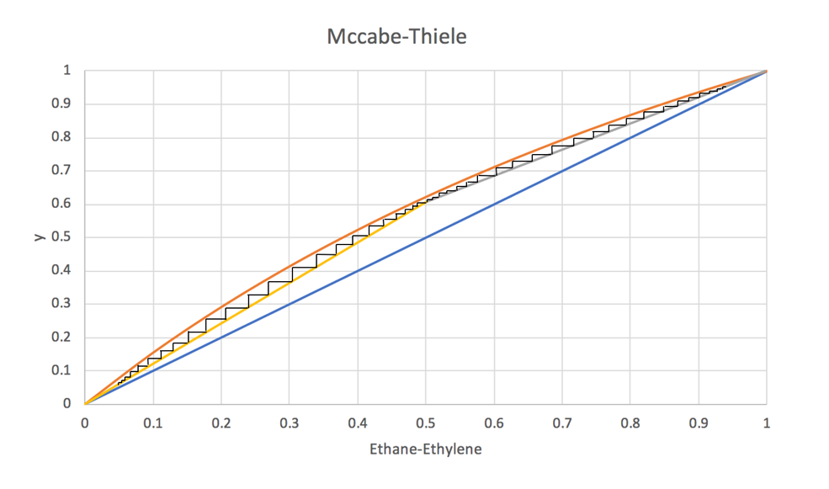
Supplemental Slides
McCabe-Thiele Diagram

