Slide 1

Para-xylene Production Through Methylation of Toluene
Mentor: Adam Brostow
Authored by: Mahamat Abdraman, James Fell, Rongwei Lin, William Rawson
March 3, 2020

Slide 2
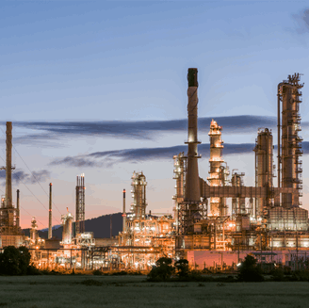
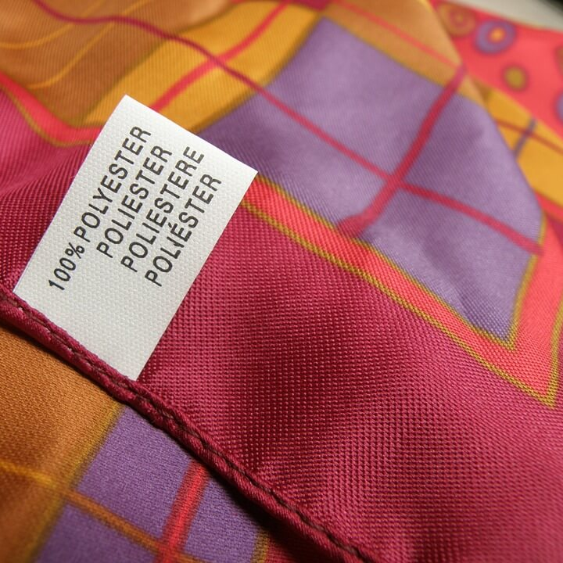
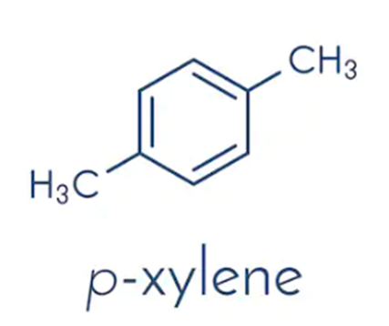

Introduction
[1]
[2]
[3]
What industry is para-xylene produced?
Petrochemical Industry
Para-xylene is used as a building block in the manufacture of chemicals sought after in the plastic industry, such as terephthalic acid (TPA), purified terephthalic acid (PTA), and dimethyl-terephthalate (DMT).

Slide 3
DESIGN BASIS
Methanol, DTBB & TBB
Reformed Naphtha Feed
Paraxylene Product
141 US tons/hr MeOH
335‬ lb/hr of DTBB
118‬ lb/hr of TBB
1683 US tons/hr
27.8% T, 23.6% C9+, 15.2% MX, 10.1% B, 8.9% OX, 6.8% PX, 6.6% EB, and 1% C₃H₈
6.9 US tons/hr (Methylation Process)
99.5% PX and 0.5% T
Plant Size
Location of Plant
Raw Materials
Dalian, China
4.5 MMTPA
Methanol
Reformed Naphtha Feed
DTBB and TBB
[4], [5], [6]

Slide 4
BFD with MATERIAL BALANCE
S1
Toluene
M
W
BTX
Toluene/Methanol
Pre-treatment
Methanol
Toluene
Methanol
Toluene
419047 kg/h
S3
S4
Alkylation Reactor
S5
S2
672664 kg/h
Methanol
547216 kg/h
672664 kg/h
128169 kg/h
Methanol
Toluene
S13
125447 kg/h
M
W
Methanol
(to recycle)
S6
Methanol Column
S7
PX
OX
Benzene
OX, Benzene
S18
74682 kg/h
89591 kg/h
M
W
BTX
2590 kg/h
S8
Toluene
(to recycle)
PX Column
Output Water
465167kg/h
S5
Decanting Vessel
72091 kg/h
122857 kg/h
S17
672664 kg/h
S12
S19
PX product
Output Benzene
Solvent(DTBB,TBB)
12357 kg/h
S15
375973 kg/h
S10
6224 kg/h
Reactive Distillation
M[=] methanol
W[=] water
BT[=]benzene, toluene
X[=] xylenes
DTBB[=]di-tert-butylbenzene
TBB[=]tert-butylbenzene
TBMX[=]tert-butyl m-xylene
BTX
Toluene
Xylenes
Output xylenes
S9
Benzene Column
S11
Toluene Column
S14
597982 kg/h
591757 kg/h
468900 kg/h
S16
OX,PX,TBB,DTBB,TBMX
16090 kg/h

Slide 5
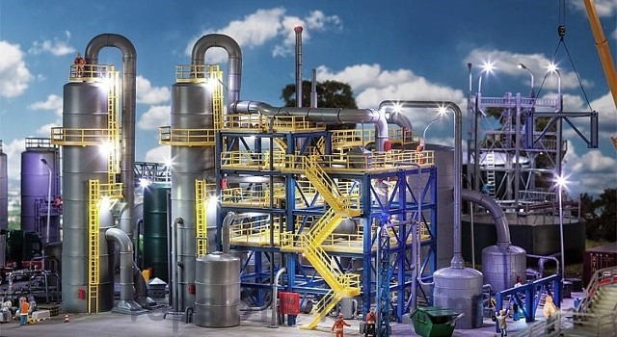
UPDATES FROM 1st PRESENTATION
Methanol Conversion : from 100% to 90%
Para-xylene purity reduced from 99.9% to 99.5%
Specialized scope for a detailed mass balance and simulation around the toluene methylation box
Columns outside the methylation unit were not simulated
The flash drum was removed due to the assumption made about no side reactions producing gaseous hydrocarbons in the reactor
[7]

Slide 6
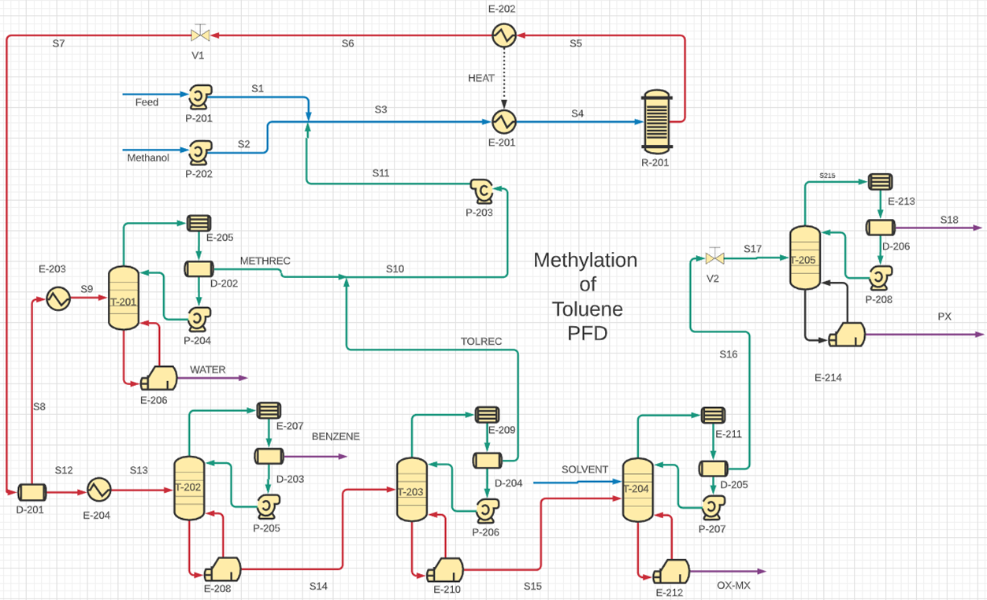
PFD

Slide 7
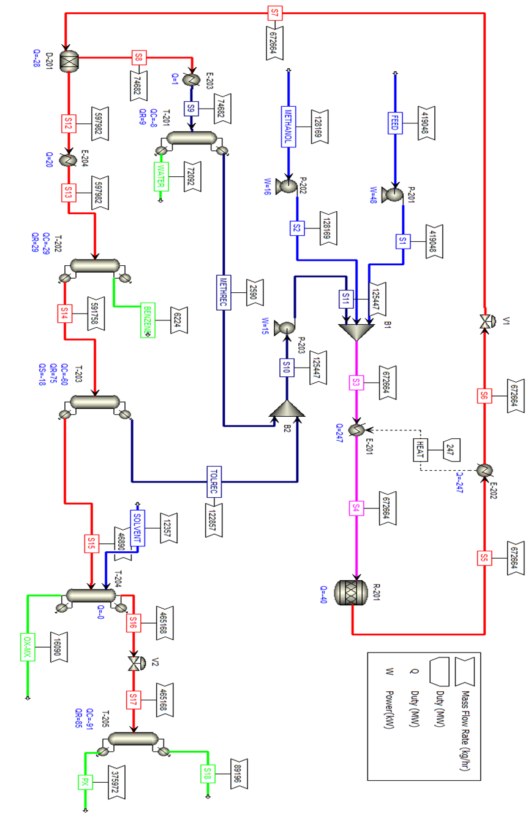
Aspen + Assumptions
90% conversion of methanol in the reactor
100% separation of water and methanol from the rest of the effluent in the decanter
Total heat integration from the effluent not shown in the simulation

Slide 8
Equipment sizing and description and material
P-201 | Centrifugal Pump | Fluid head:35m | Carbon Steel | P-201 increases the pressure of the feed to 4 bar and pumps the feed to S1.
 |  | P:48kW
P-202 | Centrifugal Pump | Fluid head:39m | Carbon Steel | P-202 increases the pressure of the methanol feed to 4 bar and pumps the methanol to S2.
 |  | P:16 kW
P-203 | Centrifugal Pump | Fluid head:37m | Carbon Steel | P-203 increases the pressure of the recycle stream to 4 bar and pumps the recycle to be mixed with S1 and S2
 |  | P:15 kW
R-201 | Packed Bed Reactor | V:141180L | Stainless Steel | This is a packed bed alkylation reactor that converts toluene into paraxylene at a pressure of 4 bar and a temperature of 525 ºC.
 |  | D:7m
 |  | L:4m(tangent/tangent)
D-201 | Decanter | V:88805L | Carbon Steel | D-201 separates the aqueous and organic phases of S7. S7 contains a mixture of water and immiscible non-polar organic compounds such as toluene and xylene.
 |  | D:3m
 |  | L:10m(tangent/tangent)
T-201-tower | Distillation Column | D:11m | Carbon Steel | The rich water stream from Decanter D-201 contains a large amount of methanol. This methanol will be separated and recycled back to the reactor. The distillation column T-201 is used for this purpose.
 |  | L:22m
 |  | Sieve trays:25
T-202-tower | Distillation Column | D:18.5m | Carbon Steel | T-202 separates benzene from a stream rich in toluene and xylenes.
 |  | L:37m
 |  | Sieve trays:50
T-203-tower | Distillation Column | D:15.5m | Carbon Steel | T-203 separates toluene from a stream rich in xylenes.
 |  | L:31m
 |  | Sieve trays:40
T-204-tower | Reactive Distillation Column | V:77237L | Carbon Steel | T-204 reacts DTBB and TBB solvents with m-xylene to produce a tert-butyl-m-xylene which has a different boiling point than p-xylene which allows it to be separated out in the column.
 |  | D:3m
 |  | L:10m(tangent/tangent)

Slide 9
Equipment sizing and description and material
T-205-tower | Distillation Column | D:9m | Carbon Steel | T-205 separates p-xylene (our product) from a stream rich in toluene and some benzene.
 |  | L:18m
 |  | Sieve trays:19
D-202 | Horizontal Reflux Drum | V:4270L | Carbon Steel | A temporary drum that collects the condensate from the condensor E-205.
 |  | D:1.2
 |  | L:4m(tangent/tangent)
D-203 | Horizontal Reflux Drum | V:36296L | Carbon Steel | A temporary drum that collects the condensate from the condensor E-207.
 |  | D:2.4
 |  | L:7.8m(tangent/tangent)
D-204 | Horizontal Reflux Drum | V:82141L | Carbon Steel | A temporary drum that collects the condensate from the condensor E-209.
 |  | D:3m
 |  | L:10m(tangent/tangent)
D-205 | Horizontal Reflux Drum | N/A | Carbon Steel | A temporary drum that collects the condensate from the condenser E-211.
D-206 | Horizontal Reflux Drum | V:123299L | Carbon Steel | A temporary drum that collects the condensate from the condenser E-213.
 |  | D:3.7m
 |  | L:11.7m(tangent/tangent)
P-204 | Centrifugal Reflux Pump | Fluid head:25m | Carbon Steel | Draws the liquid condensate from the reflux drum D-202 and sends it back to the top tray of T-201 as a reflux.
 |  | P:11kW
P-205 | Centrifugal Reflux Pump | Fluid head:28m | Carbon Steel | Draws the liquid condensate from the reflux drum D-203 and sends it back to the top tray of T-202 as a reflux.
 |  | P:16 kW
9

Slide 10
Equipment sizing and description and material
P-206 | Centrifugal Reflux Pump | Fluid head:29m | Carbon Steel | Draws the liquid condensate from the reflux drum D-204 and sends it back to the top tray of T-203 as a reflux.
 |  | P:12 kW
P-207 | Centrifugal Reflux Pump | N/A | Carbon Steel | Draws the liquid condensate from the reflux drum D-205 and sends it back to the top tray of T-204 as a reflux.
P-208 | Centrifugal Reflux Pump | Fluid head:31 | Carbon Steel | Draws the liquid condensate from the reflux drum D-206 and sends it back to the top tray of T-205 as a reflux.
 |  | P:23kW
E-205 | TEMA Shell and Tube HE | Area:527sqm | Stainless Steel | Condenses the vapor distillate in the column T-201 to a liquid.
 |  | Q: -8.362MW
E-207 | TEMA Shell and Tube HE | Area:634sqm | Stainless Steel | Condenses the vapor distillate in the column T-202 to a liquid.
 |  | Q: -28.722MW
E-209 | TEMA Shell and Tube HE | Area:1073sqm | Stainless Steel | Condenses the vapor distillate in the column T-203 to a liquid.
 |  | Q: -59.592MW
E-211 | TEMA Shell and Tube HE | N/A | Stainless Steel | Condenses the vapor distillate in the column T-204 to a liquid.
E-213 | TEMA Shell and Tube HE | Area:1290sqm | Stainless Steel | Condenses the vapor distillate in the column T-205 to a liquid.
 |  | Q: -87.247MW
E-206 | Kettle Reboiler | Area:431sqm | Carbon Steel | The reboiler heats the liquid in the bottom of the distillation column T-201 to 106.5 ºC and provides a heat source for the operating temperature of the column.
 |  | Q: 8.6MW
10

Slide 11
Equipment sizing and description and material
E-208 | Kettle Reboiler | Area:1975sqm | Carbon Steel | The reboiler heats the liquid in the bottom of the distillation column T-202 to 156.1 ºC and provides a heat souce for the operating temperature of the column.
 |  | Q: 29MW
E-210 | Kettle Reboiler | Area:7178sqm | Carbon Steel | The reboiler heats the liquid in the bottom of the distillation column T-203 to 163.0 ºC and provides a heat source for the operating temperature of the column.
 |  | Q: 75MW
E-212 | Kettle Reboiler | N/A | Carbon Steel | The reboiler heats the liquid in the bottom of the distillation column T-204 to 162.9 ºC and provides a heat source for the operating temperature of the column.
E-214 | Kettle Reboiler | Area:3155sqm | Carbon Steel | The reboiler heats the liquid in the bottom of the distillation column T-205 to 144.8 ºC and provides a heat source for the operating temperature of the column.
 |  | Q: 80MW
E-201 | TEMA Shell and Tube HE | Area:1392 sqm | Stainless Steel | Increases the temperature of the reactor feed to 445 ºC.
 |  | Q: 247MW
E-202 | TEMA Shell and Tube HE | Area:1392 sqm | Stainless Steel | Cools down the reactor effluent stream S5 to 49 ºC.
 |  | Q: -247MW
E-203 | TEMA Shell and Tube HE | Area:18sqm | Carbon Steel | Increases the temperature of S8 to 102 ºC.
 |  | Q: 1MW
E-204 | TEMA Shell and Tube HE | Area:825 sqm | Carbon Steel | Increases the temperature of S12 to 150 ºC.
 |  | Q: 20MW
11

Slide 12
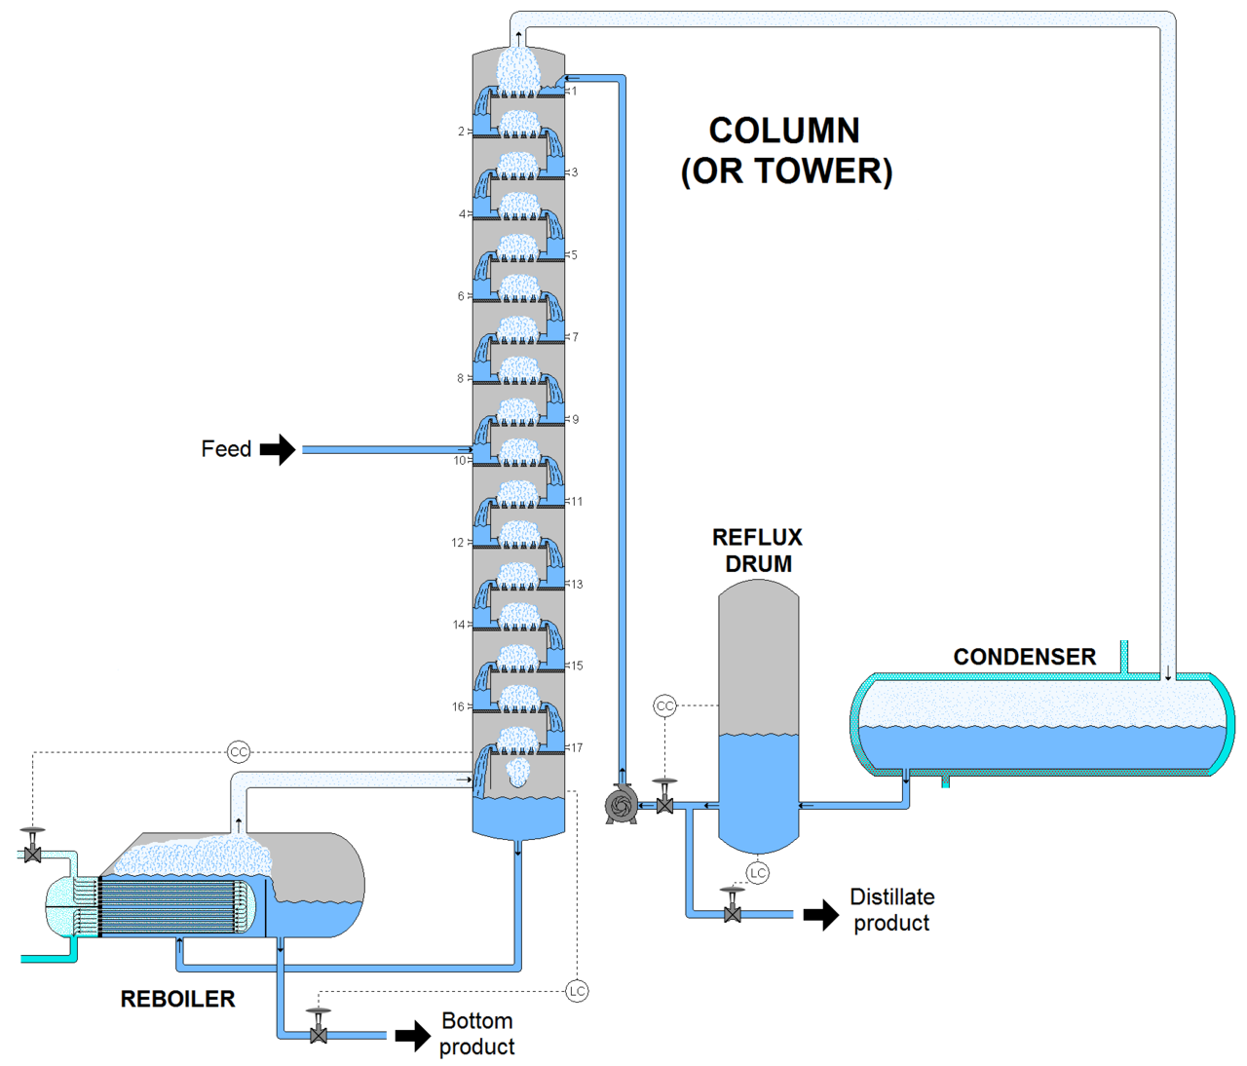
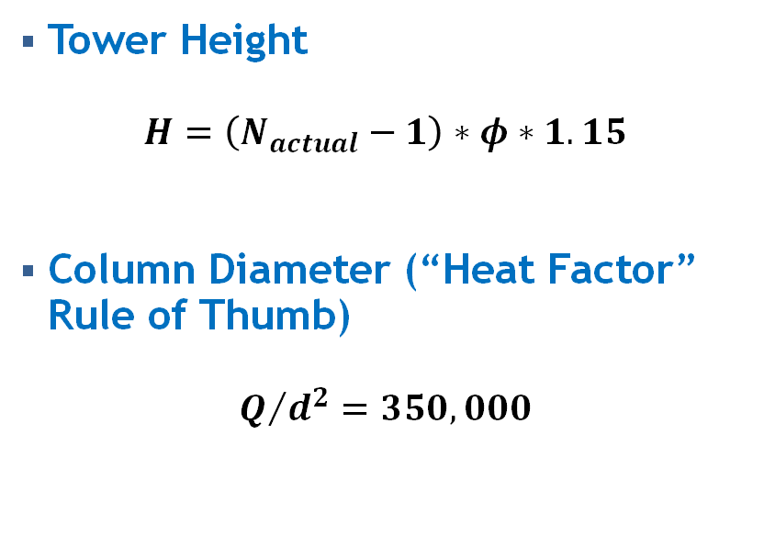
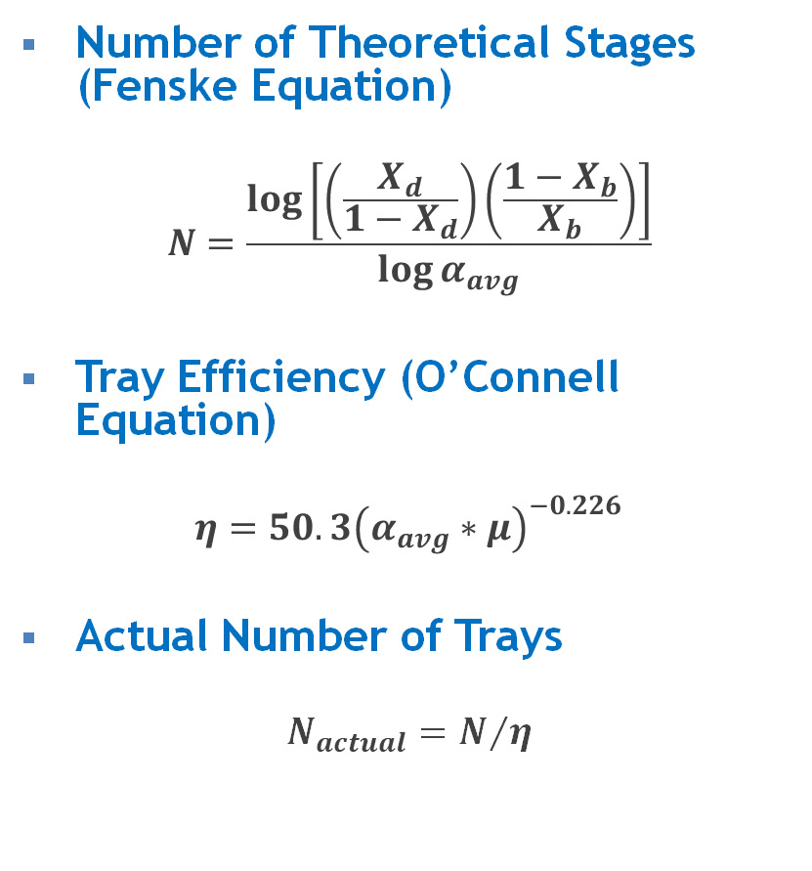
Hand Calculations
Number of Theoretical Stages (Fenske Equation)
$$N=\frac{\log\left[\left(\frac{X_{d}}{1−X_{d}}\right)\left(\frac{1−X_{b}}{X_{b}}\right)\right]}{\log{α_{avg}}}$$
Tray Efficiency (O’Connell Equation)
$$η=50.3{\left(α_{avg}∗μ\right)}^{−0.226}$$
Actual Number of Trays
$$N_{actual}=N/η$$
[8]
Tower Height
$$H=\left(N_{actual}−1\right)∗φ∗1.15$$
Column Diameter (“Heat Factor” Rule of Thumb)
$$Q/{d^{2}=350,000}$$
This Photo by Unknown Author is licensed under CC BY-SA

Slide 13
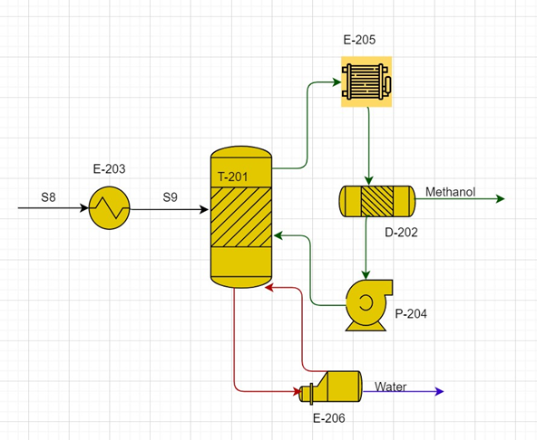
Sizing Comparison of Methanol Column
Parameters | Hand Calculated | ASPEN v8.4
Number of Trays | 11 | 19
Height of the Column (ft) | 32.2 | 41.4
Diameter of the Column (ft) | 9.17 | 5.64

Slide 14
Preliminary Utilities Demand
Name​ | Fluid​ | Rate​ | Rate Units​
Electricity​ | Power​ | 121​ | kW​
Cooling Water​ | Water​ | 38,485,930​ | lb/hr​
LP Steam​ | Steam​ | 33,335​ | lb/hr​
MP Steam | Steam​ | 976,089 | lb/hr​
Input and output mass flowrates of the process to compare against utilities
Input | BTX, Methanol, Solvent | 1,233,647 | lb/hr
Output | Water, BTX, TBB,DTBB, TBMX | 1,233,647 | lb/hr

Slide 15
References
Bloomberg. “Boosted Output at Vietnam's Biggest Oil Refinery After Defects Fixed.” RIGZONE Empowering People in Oil and Gas, Rigzone.com, 7 Aug. 2018, www.rigzone.com/news/wire/boosted_output_at_vietnams_biggest_oil_refinery_after_defects_fixed-07-aug-2018-156556-article/.
“Para-Xylene (p-Xylene) Aromatic Hydrocarbon Molecule. Skeletal Formula.” Paraxylene Pxylene Aromatic Hydrocarbon Molecule Skeletal Stock Vector (Royalty Free) 1092240059, www.shutterstock.com/image-vector/paraxylene-pxylene-aromatic-hydrocarbon-molecule-skeletal-1092240059.
Kiron, Mazharul Islam. “Polyester Fiber: Characteristics of Polyester Fiber: Properties of Polyester Fiber: Uses of Polyester Fiber.” Textile Learner: One Stop Solution for Textiles, textilelearner.blogspot.com/2011/07/polyester-fiber-characteristics-of_11.html.
“Paraxylene (PX) Uses and Market Data.” Icis, www.icis.com/explore/resources/news/2007/11/05/9076062/paraxylene-px-uses-and-market-data/.
“Purified Terephthalic Acid (PTA) Production and Market.” Plastics Insight, www.plasticsinsight.com/resin-intelligence/resin-prices/purified-terephthalic-acid-pta/.
Liu, Jing, et al. “Intensified p-Xylene Production Process through Toluene and Methanol Alkylation.” Industrial & Engineering Chemistry Research, vol. 57, no. 38, 2018, pp. 12829–12841., doi:10.1021/acs.iecr.8b00681.
https://www.topslotsntrains.com/topslotsntrains/final.asp?ref=Faller-130175-OO/HO-Scale-Model-Kit-CHEMICAL-PLANT-&id=16244&manufacturer=%27Faller%20Kits%27
“Fractionating Column.” Wikipedia, Wikimedia Foundation, 2 Mar. 2020, en.wikipedia.org/wiki/Fractionating column.

Slide 16
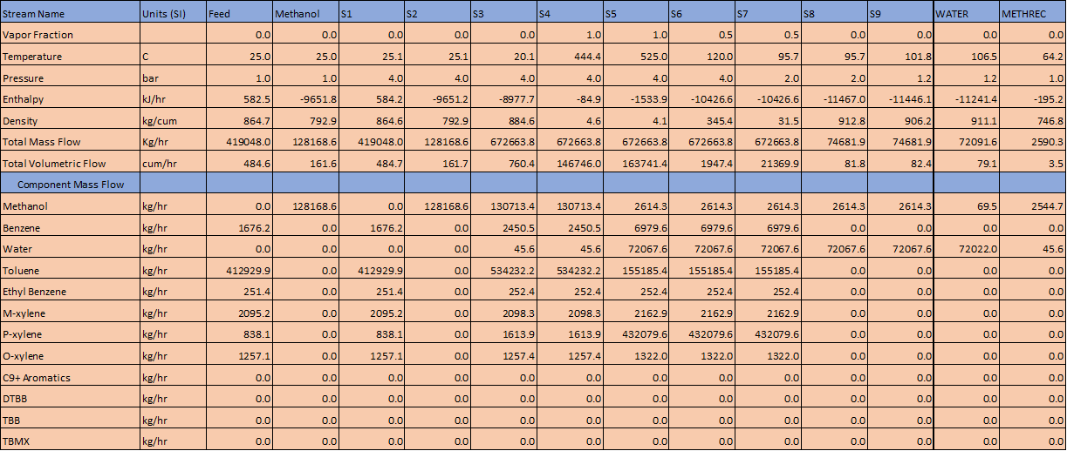
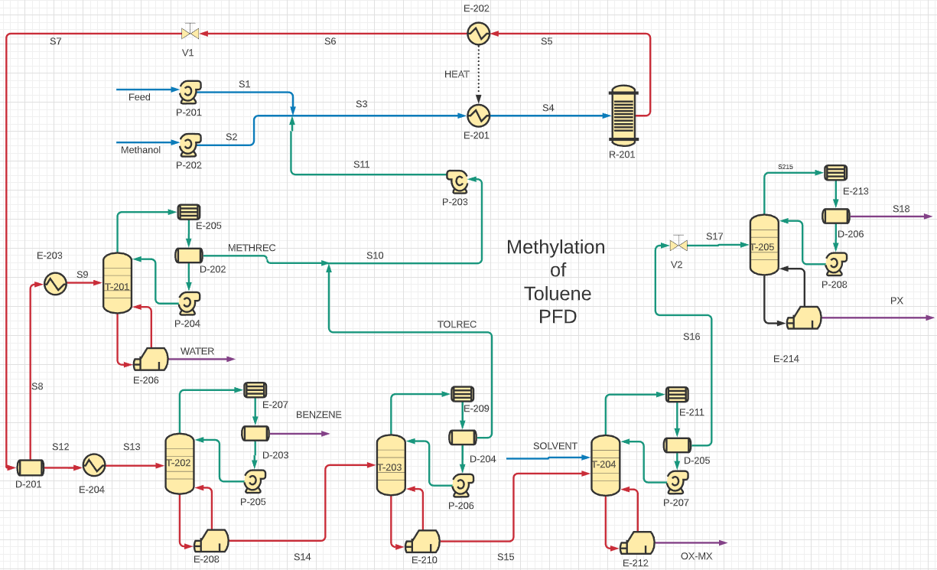
PFD & Material Balance - Section 1

Slide 17
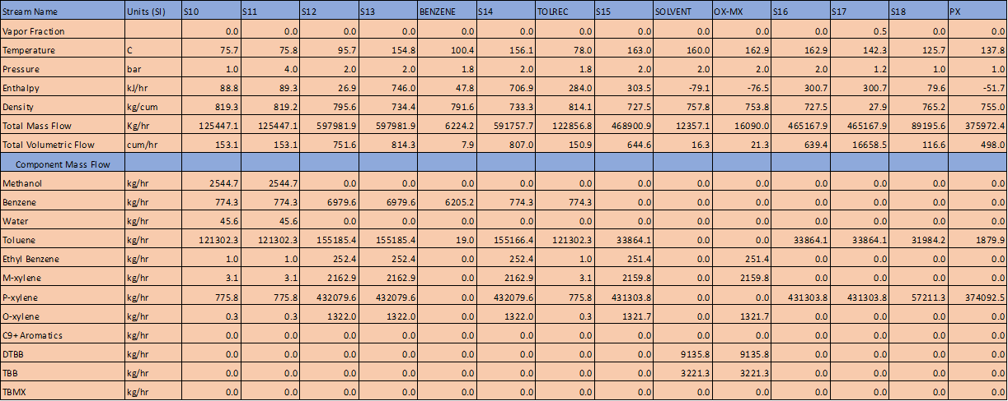
PFD & Material Balance - Section 2

Slide 18
PFD & Material Balance - Section 3

Slide 19
PFD & Material Balance - Section 4

