Slide 1
Human Waste to Renewable Diesel Project 2
By:​
Gewargis Garmoos​
Marvl Odeesh ​
Eddie Salgado​
Michael Stacy​
​
Mentor:​
Jerry Palmer
Notes:
Mike

Slide 2
Changes Made
1
BFD
PFD
Producing renewable Diesel instead of bio Diesel
Plant to be located next to refinery
Producing gasoline as well
Plug flow reactor instead of 3 batch reactors
Notes:
Mike

Slide 3
Design Basis
2
Table 9: Design Basis for Plant
Description | Number
Biodiesel Purity | 99%
Operation Time | 330 Days
Plant Location | Lagos Nigeria
Raw Material Composition | Waste
Production Rate Renewable Diesel b. Fuel Gas c. Biochar | (pounds per year) 3,520,000 1,500,000 7,000,000
Production Rate Conversions Renewable Diesel b. Fuel Gas c. Biochar | 500,000 gallons per year 2,650,000 m³ per year 7,000,000 pounds per year
Table 10: Design Basis for Input Feed
Description | Number
Average Human Waste | 320 pounds per year [19]
Feasible Product | .1% of waste is usable [6]
Population of Lagos | 11,000,000 people [18]
Notes:
Mike

Slide 4
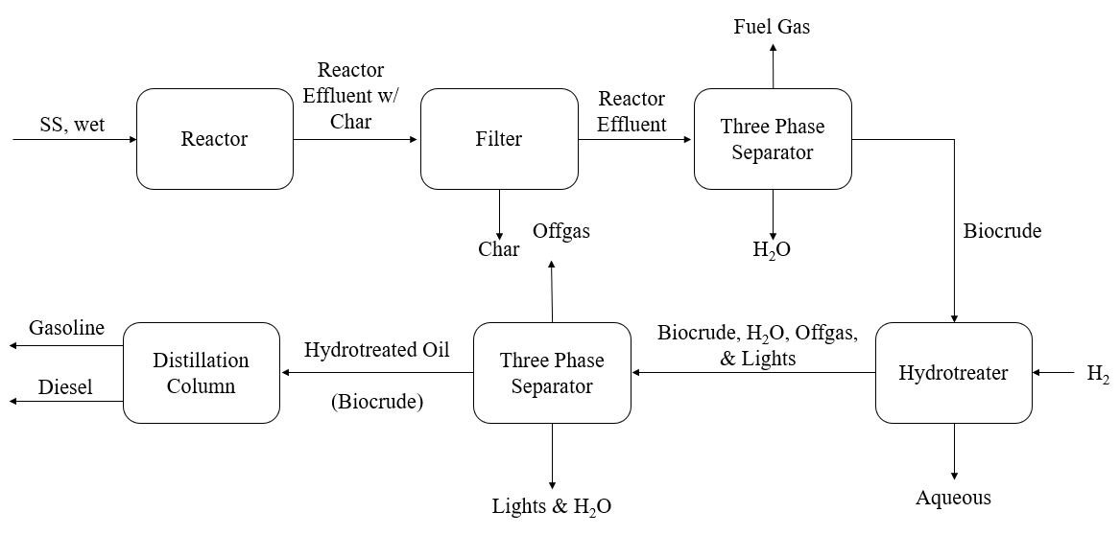
BFD
3
Notes:
Marv

Slide 5
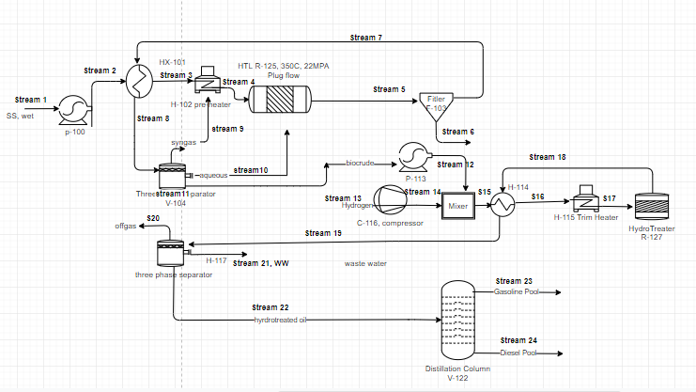
PFD
4
Notes:
Eddie

Slide 6
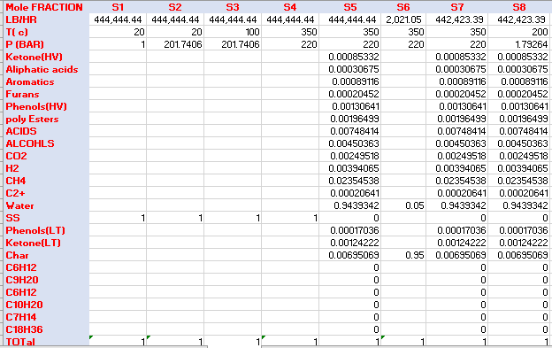
Material Balance
5
Notes:
Eddie

Slide 7
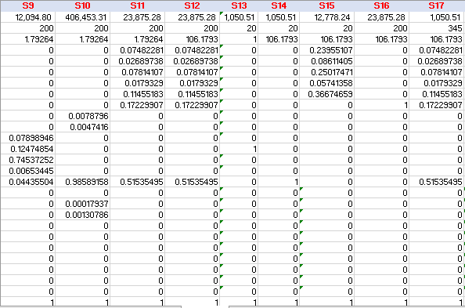
Material Balance
6

Slide 8
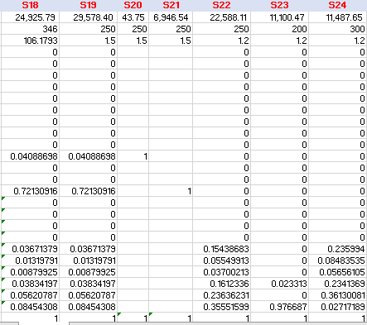
Material Balance
7
Notes:
Eddie

Slide 9
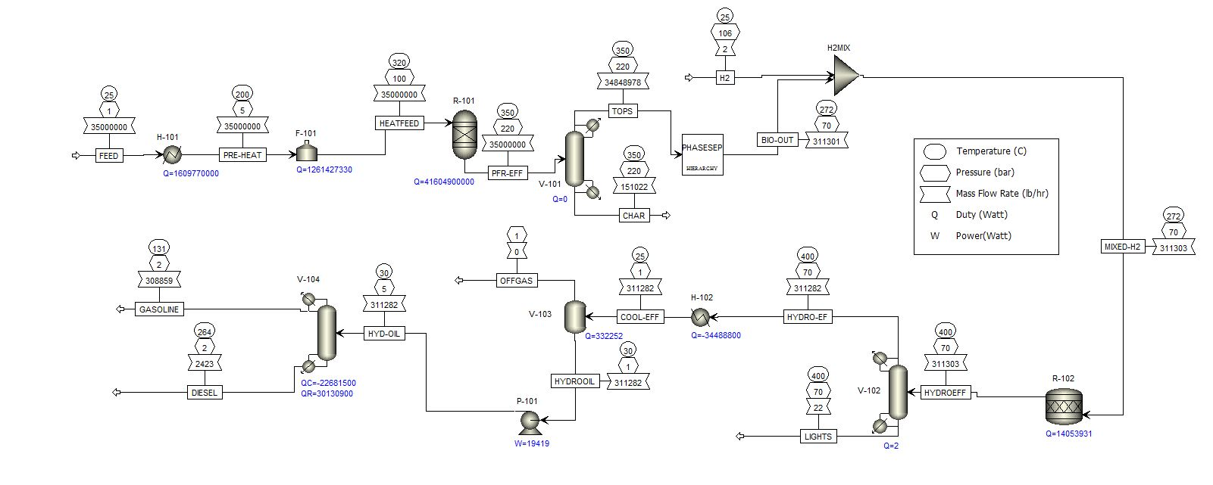
Aspen
8
Notes:
Geore

Slide 10
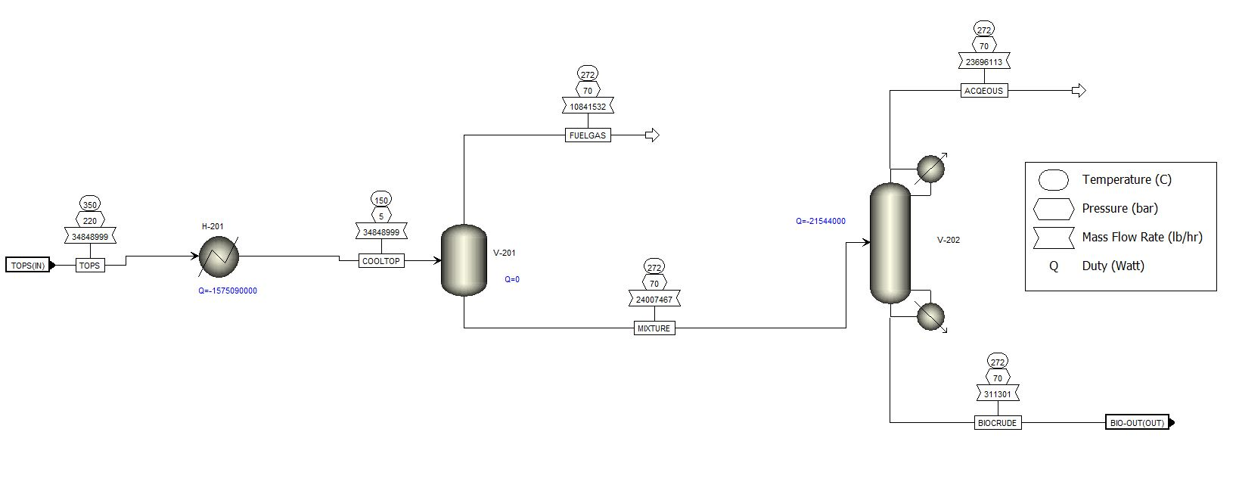
Aspen
9

Slide 11
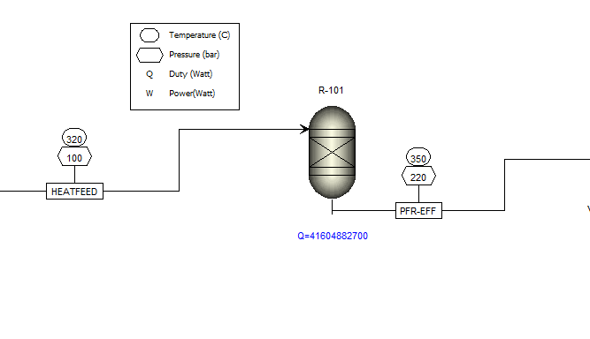
Aspen
10
Components
H2O, H2, Co2, CH4, C2H4, C3H6O-1, C9H18O2, C8H10-4, C4 H4O, C7H8O2-E1, C18H34O2, C6H8O, C2H4O3-D1, CH4O, C6H6O, C
Components
Human waste

Slide 12
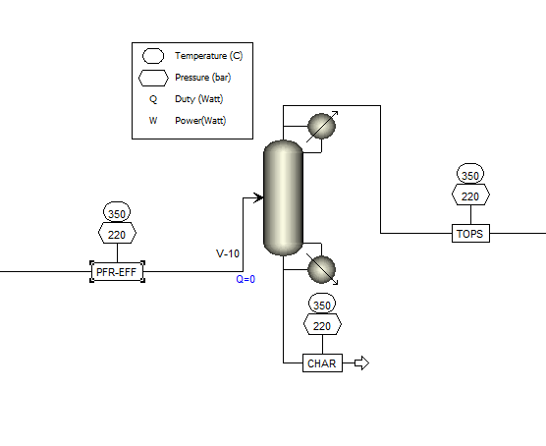
Aspen
11
Components
H2O, H2, Co2, CH4, C2H4, C3H6O-1, C9H18O2, C8H10-4, C4 H4O, C7H8O2-E1, C18H34O2, C6H8O, C2H4O3-D1, CH4O, C6H6O
Components
H2O, H2, Co2, CH4, C2H4, C3H6O-1, C9H18O2, C8H10-4, C4 H4O, C7H8O2-E1, C18H34O2, C6H8O, C2H4O3-D1, CH4O, C6H6O, C
Components
C

Slide 13
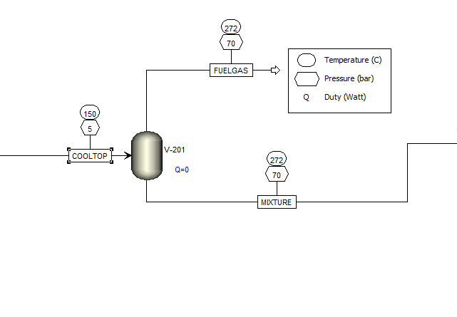
Aspen
12
Components
H2O, H2, Co2, CH4, C2H4, C3H6O-1, C9H18O2, C8H10-4, C4 H4O, C7H8O2-E1, C18H34O2, C6H8O, C2H4O3-D1, CH4O, C6H6O
Components
H2O, H2, Co2, CH4, C2H4, C3H6O-1, C9H18O2, C8H10-4, C4 H4O, C7H8O2-E1, C18H34O2, C6H8O, C2H4O3-D1, CH4O, C6H6O
Components
H2O, H2, Co2, CH4, C2H4, C3H6O-1, C9H18O2, C8H10-4, C4 H4O, C7H8O2-E1, C18H34O2, C6H8O, C2H4O3-D1, CH4O, C6H6O

Slide 14
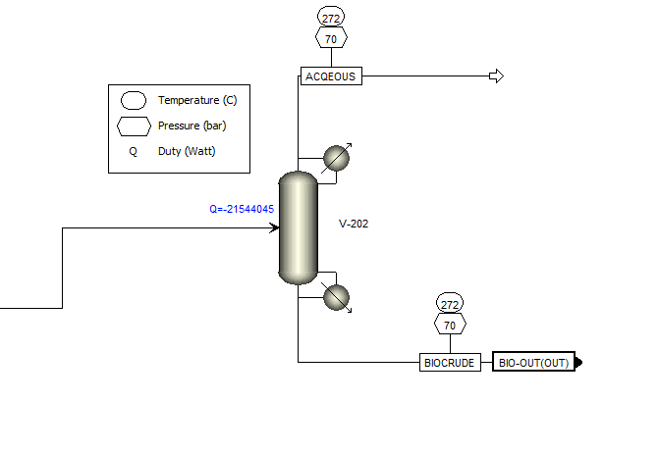
Aspen
13
Components
H2O, H2, Co2, CH4, C3H6O-1, C6H8O, C2H4O3-D1, CH4O, C6H6O
Components
H2O, H2, Co2, CH4, C2H4, C3H6O-1, C9H18O2, C8H10-4, C4 H4O, C7H8O2-E1, C18H34O2, C6H8O, C2H4O3-D1, CH4O, C6H6O
Components
C2H4, C9H18O2, C8H10-4, C4 H4O, C7H8O2-E1, C18H34O2, C6H8O

Slide 15
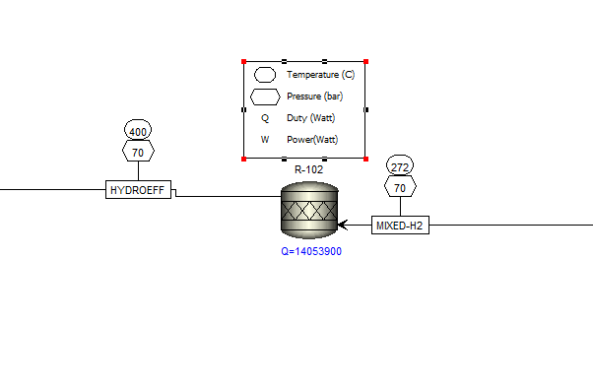
Aspen
14
Components
H2O, C2H4, C9H18O2, C8H10-4, C4 H4O, C7H8O2-E1, C18H34O2, C6H8O, C6H12-1, C9H20-1, C7H14-1
Components
C2H4, C9H18O2, C8H10-4, C4 H4O, C7H8O2-E1, C18H34O2, C6H8O, H2

Slide 16
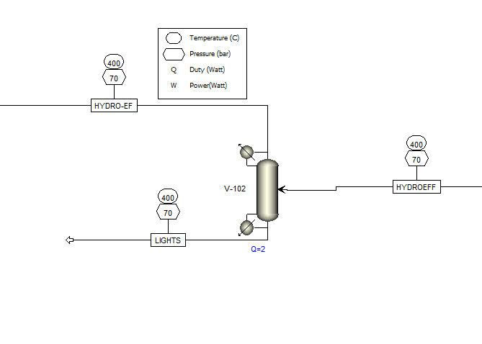
Aspen
15
Components
C2H4, C9H18O2, C8H10-4, C4 H4O, C7H8O2-E1, C18H34O2, C6H8O, C9H20-1, C7H14-1
Components
H2O, C2H4, C9H18O2, C8H10-4, C4 H4O, C7H8O2-E1, C18H34O2, C6H8O, C6H12-1, C9H20-1, C7H14-1
Components
H2O, C6H12-1

Slide 17
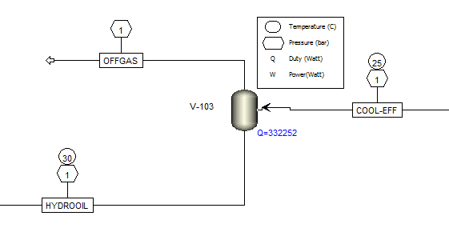
Aspen
16
Components
C2H4, C9H18O2, C8H10-4, C4 H4O, C7H8O2-E1, C18H34O2, C6H8O, C9H20-1, C7H14-1
Components
C2H4, C9H18O2, C8H10-4, C4 H4O, C7H8O2-E1, C18H34O2, C6H8O, C9H20-1, C7H14-1

Slide 18
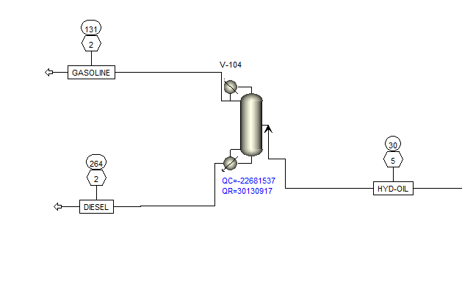
Aspen
17
Components
C2H4, C9H18O2, C8H10-4, C4 H4O, C7H8O2-E1, C18H34O2, C6H8O, C9H20-1, C7H14-1
Components
C2H4, C9H18O2, C8H10-4, C4 H4O, C7H8O2-E1, C18H34O2, C6H8O, C9H20-1, C7H14-1
Components
C2H4, C9H18O2, C8H10-4, C4 H4O, C7H8O2-E1, C18H34O2, C6H8O, C9H20-1, C7H14-1
Notes:
George

Slide 19
Equipment
18
Table 20: Equipment Sizing
Unit | Equipment | Size/Power | Material
H-101 | Shell & tube heat exchanger | Duty: 3081.9 MW | Carbon Steel (A285)
F-101 | Fired heater | Duty: 210.7 MW | Carbon Steel (A285)
R-101 | Plug flow Reactor | Duty: 41604.8 MW | Carbon Steel (A285)
V-101 | Solid filter |  | Carbon Steel (A285)
H-201 | Shell & tube heat exchanger | 1575 MW | Carbon Steel (A285)
V-201 | KO Drum | Tangent to Tangent Height: 6.2 m, Diameter: 23 m | Carbon Steel (A285)
V-202 | Decanter | Tangent to Tangent Height: 27.7 m, Diameter: 9.2 m | Carbon Steel (A285)
R-102 | Plug flow Reactor | Duty: 14 MW | Stainless Steel (304)
V-102 | Decanter |  | Carbon Steel (A285)
H-102 | Shell & tube heat exchanger | Duty: 34.4 MW | Carbon Steel (A285)
V-103 | KO Drum | Tangent to Tangent Height: 6.4 m, Diameter 2.1 m | Carbon Steel (A285)
P-101 | Centrifugal Pump | Fluid Head: 43 m | Carbon Steel (A285)
V-104 | Distillation Column | Tangent to tangent Height: 89 m, Diameter: 48.6 m | Carbon Steel (A285)
Notes:
Marv

Slide 20
Utilities
19
Table 25: Utilities of Electricity, Cooling Water, and Fuel Gas
Description | Type | Rate | Unit | Cost/unit | Units | Cost/hour
Electricity |  | 173.6 | KW/hr | 0.08 | USD/KW | 13.4
Cooling water | Water | 33.4 | MGAL/hr | 120.00 | USD/MGal | 4007.6
*Fuel Gas | gas | 1261.4 | MW/hr | 12.84 | USD/ MW | 16204
Based on United States Gulf Coast
Notes:
Marv

Slide 21

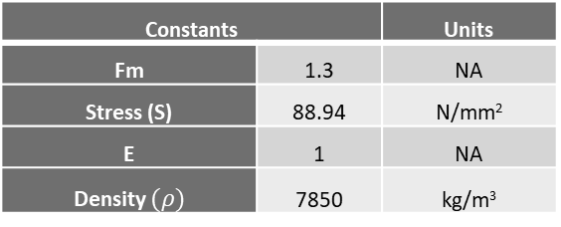

Hand Calculations
20
Relative Volatility:
$α_{avg}= \sqrt{LK/HK}$
$α_{avg}= 1.16$
Fenske Equation
$NT=\frac{\log{[\left(\frac{LK}{HK}\right)\left(\frac{HK}{LK}\right)}] }{\log{α_{avg}}}$
$NT=15$
50% Tray Efficiency
$NA=30$
Height:
$H=NA∗TS$
$H=18.29 m$
Wall Thickness
$$Tw=\frac{(P)(D)}{2\left(S\right)\left(E\right)−1.0(P)}$$
$Tw= .00086 m$
Mass of Shell
$Mshell= π\left(D\right)\left(H\right)\left(Tw\right)\left(ρ\right)$
$Mshell= 589.21 kg$
 |  | Henrys Law | Units | Mole Fraction
Heavy Key | Oleic Acid | 0.08 | mol/kg*bar | 0.75
Light Key | 1-Octadecene | 0.11 | mol/kg*bar | 0.25
Constants |  | Units
Fm | 1.3 | NA
Stress (S) | 88.94 | N/mm²
E | 1 | NA
Density $(ρ)$ | 7850 | kg/m³
Distillation Column Inputs |  | Units
Diameter (D) | 1.52 | m
Height (H) | 18.29 | m
Pressure (P) | 100000 | N/m
Tray Spacing (TS) | 0.61 | m
Notes:
Mike

Slide 22
Hand Calculations vs Aspen
21
Table 24: Comparison Between Aspen Sizing of Distillation column and Hand Calculation
 | Aspen | Hand | % Error
Tangent to Tangent Height | 89.0 m | 18.9 m | 78.7
Diameter | 4.86 m | 1.59 m | 67.3
Notes:
Mike

Slide 23
Thank you

