Slide 1

Para-xylene Production Through Methylation of Toluene
Mentor: Adam Brostow
Authored by: Mahamat Abdraman, James Fell, Rongwei Lin, William Rawson
March 31, 2020

Slide 2
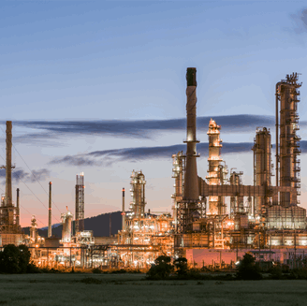
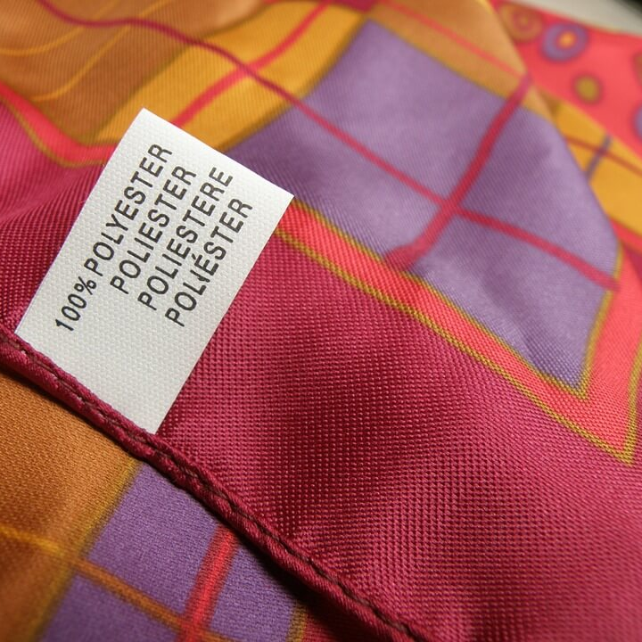
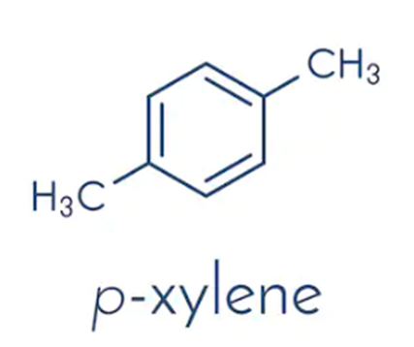

Introduction
[1]
[2]
[3]
What industry is para-xylene produced?
Petrochemical Industry
Para-xylene is used as a building block in the manufacture of chemicals sought after in the plastic industry, such as terephthalic acid (TPA), purified terephthalic acid (PTA), and dimethyl-terephthalate (DMT).

Slide 3
Overall Process Outline
METHANOL
METHANOL
WATER
TOLUENE ALKYLATION REACTOR
DECANTER
METHANOL COLUMN
FEED
METHANOL
WATER
BENZENE
TOLUENE
XYLENES
WATER
BENZENE
TOLUENE
Undesired Aromatics
DTBB
TBB
O-XYLENE
M-XYLENE
BENZENE
BENZENE
COLUMN
TOLUENE
COLUMN
XYLENES
PROCESSING
UNIT
TOLUENE
XYLENES
TOLUENE
XYLENES
XYLENES
P-XYLENE

Slide 4

Environmental Analysis
[2]
Paraxylene, Metaxylene, Orthoxylene
Short-term aquatic hazard, EPA limits the concentration of xylenes in a water discharge to be 100 μg/L [1].
Benzene
Short-term and long-term aquatic hazard, EPA limits the concentration of xylenes in a water discharge to be 5 μg/L [1].
Toluene
Short-term and long-term aquatic hazard, EPA limits the concentration of xylenes in a water discharge to be 100 μg/L [1].
Ethylbenzene
EPA limits the concentration of xylenes in a water discharge to be 100 μg/L [1].

Slide 5

Safety Analysis
[3]

Slide 6
Process Safety Concerns
Process | Main Safety Concerns & Proposed Hazard Mitigation
Packed Bed Reactor | Temperature of the reactor goes too high and reaches the autoignition temperature of the flammable chemicals. Flammable and toxic gases leak from pipes into the environment.
 | Very accurate temperature controllers, emergency air cooling, and double sensors for accuracy. Air monitoring, proper ventilation, and removal of ignition sources from the area of potential leaks.
Benzene Column | Flammable and toxic gases leak from pipes into the environment.
 | Air monitoring, proper ventilation, and removal of ignition sources from the area of potential leaks.
Toluene Column | Flammable and toxic gases leak from pipes into the environment.
 | Air monitoring, proper ventilation, and removal of ignition sources from the area of potential leaks.
Reactive Distillation Column | Flammable and toxic gases leak from pipes into the environment.
 | Air monitoring, proper ventilation, and removal of ignition sources from the area of potential leaks.
Paraxylene Column | Flammable and toxic gases leak from pipes into the environment.
 | Air monitoring, proper ventilation, and removal of ignition sources from the area of potential leaks.

Slide 7
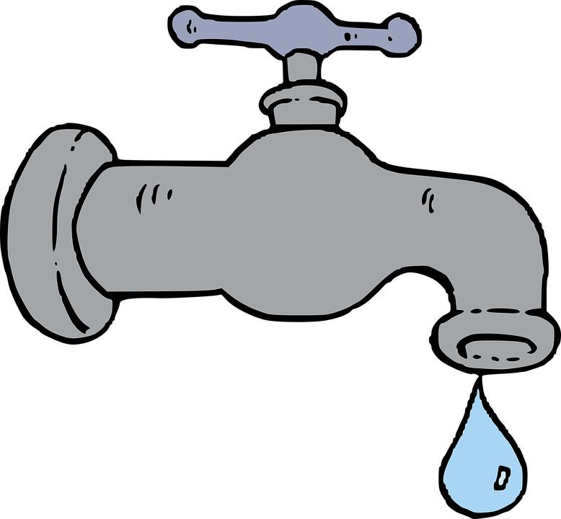
Process Controls
Control Objectives:
Safety
Quality
Smooth Operation and Production rate [4]
Operational Constrains [5]
Process Cost Minimization
Control Strategy:
Feedback Control
Feedforward Control
Cascade Control
Ratio Control

Slide 8
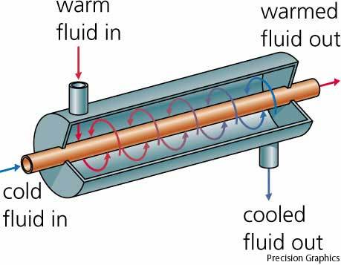
Process Controls (cont.)
Critical Process Parameters
Heat Exchanger: Temperature
Reactor: Temperature, Composition and Production rate
Columns: Temperature, Pressure, Level and Composition
Decanter and Drums: Level
Key manipulated variables
Coolant/Steam flow rates
Distillate/Bottoms flow rates
Reflux flow rate
Feed flow rates
Reactor affluent flow rate
This Photo by Unknown Author is licensed under CC BY-SA

Slide 9
Methanol Distillation Column Controls
Equipment | Tag | Controlled Variable | Control element | Manipulated Variable | Disturbances | Control Logic
 |  |  | Valve on reboiler steam stream | Reboiler steam flow rate | Drop in reboiler steam pressure | Feedforward
 |  | Temperature |  |  |  | Control
Methanol Column | T-201 |  | Valve on bottom stream | Flow rate of bottom stream | Feed flowrates | Feedback
 |  | Level |  |  |  | Control
 |  |  | Valve on Condenser CW stream | Condenser Cooling water flow rate | Column pressure drop | Feedback
 |  | Pressure |  |  |  | Control
 |  |  | Valve on reflux stream | Reflux flow rate | Feed composition upsets | Cascade
 |  | Composition |  |  |  | Control
Column Reflux Drum | D-202 | Level | Valve on Distillate Stream | Distillate | Feed flowrates | Feedback
 |  |  |  | Flow rate |  | Control

Slide 10
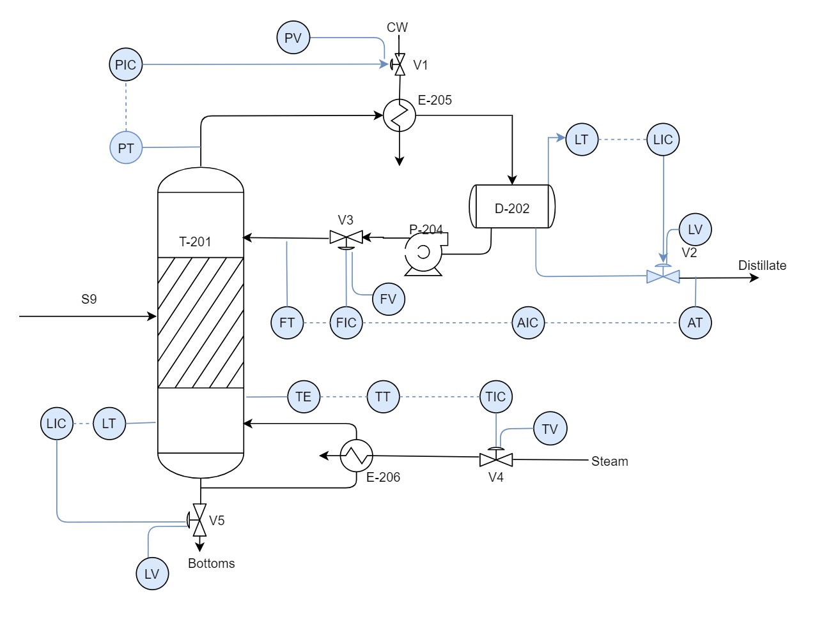
Process Control Scheme before HAZOP

Slide 11
HAZOP ANALYIS HAZOP Analysis of Methanol Distillation Column (T-201)
Vessel: Methanol Distillation Column(T-201)
Intention: Separates a mixture of Methanol and Water at 1.2bar and 102 °C
Guide Word | Deviation | Cause | Consequences | Action
Line: Bottoms stream
NO | Flow | Pipe blockage/leakage | Column dry out | Install alarms
 |  | Control valve closed | No operation | Schedule maintenance
 |  |  | No product | Shut down
LESS | Flow | Pipe partially plagued | Column level decreases | Install low level alarm
 |  | Control valves failure | Column dry out | Perform maintenance on equipment
 |  |  | Poor product quality | Adjust flow
MORE | Flow | Valve is fully open | Increases in level | high level alarm Schedule maintenance
 |  | Control valves failure | Column flooding | Adjust flow
 |  |  | Lower temperature
 |  |  | Poor separation

Slide 12
HAZOP ANALYIS (cont.)
Vessel: Condenser (E-205)
Intention: condenses vapor fluid from top
Guide Word | Deviation | Cause | Consequences | Action
Line: Coolant stream
NO | Coolant Flow | Valve fully closed | Loss of pressure control in column | Install Alarms
 |  | Pipe burst | No condensing | Automatic shut down
LESS | Flow | Coolant Pipe blockage and/or leakage | Low pressure in column | Install low alarms
 |  | Valve partially open | Ineffective condensing | Investigate equipment
 |  |  |  | Increase coolant flow
MORE | Flow | Control system failure | High pressure in column | Install high alarms
 |  | Valve fully open | Condenser damage | Repair equipment
 |  |  |  | Adjust flow

Slide 13
HAZOP ANALYIS (cont.)
Vessel: Reflux drum (D-202)
Intention: Separates the reflux and distillate streams
Guide Word |  | Deviation |  | Cause |  | Consequences |  | Action
Line: Distillate stream
NO | Flow | Flow | Control valve fail | Control valve fail | Loss of pressure control in column | Loss of pressure control in column | Install Alarms | Install Alarms
 |  |  | Pipe burst | Pipe burst |  |  | Automatic shut down | Automatic shut down
LESS | Flow | Flow | Valve partially open | Valve partially open | Low drum level | Low drum level | Install low level alarms | Install low level alarms
 |  |  | Pipe blockage and/or leakage | Pipe blockage and/or leakage | Reflux drum dry out | Reflux drum dry out | Schedule maintenance | Schedule maintenance
 |  |  |  |  | Low quality product | Low quality product | Increase flow | Increase flow
MORE | Flow | Flow | Valve close fails | Valve close fails | High drum level | High drum level | Install high level alarms | Install high level alarms
 |  |  | Control system failure | Control system failure | Reflux drum overfill | Reflux drum overfill | Schedule maintenance | Schedule maintenance
 |  |  |  |  | Off specs. product | Off specs. product | Decrease flow | Decrease flow
REVERSE | Flow | Flow | Pipe blockage | Pipe blockage | Backflow of fluid | Backflow of fluid | Install flow alarms | Install flow alarms
 |  |  | Reflux/Distillate control valve failure | Reflux/Distillate control valve failure | Reflux drum damage | Reflux drum damage | Check valves | Check valves
 |  |  |  |  | Poor composition | Poor composition | Schedule maintenance | Schedule maintenance
 |  |  |  |  |  |  | Shut down | Shut down

Slide 14
HAZOP ANALYIS (cont.)
Vessel: Reboiler (E-206)
Intention: Boils fluid mixture at the bottom of column
Guide Word | Deviation | Cause | Consequences | Action
Line: Hot fluid stream (steam)
NO | Steam Flow | Pipe clogged or burst | No Bottoms | Install alarms and sensors
 |  | Control valve failure | Loss of temperature control | Automatic shut down
LESS | Steam Flow | Pipe partially clogged/leaked | Low temperature in column | Install low alarms and sensors
 |  | Valve open fail | Poor separation | Repair equipment
 |  | Less steam pressure |  | More steam pressure
MORE | Steam Flow | Valve fully open | High column temperature | Install high alarms and sensors
 |  | More steam pressure | Reboiler damage | Shut down and repair

Slide 15
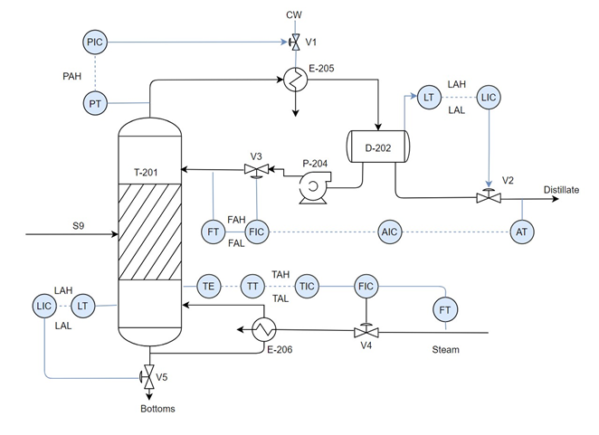
Process Control Scheme after HAZOP
Tag | Controlled Variable | Set Point | Lower Limit | Upper Limit | Manipulated Variable
 | Level | 80% by volume | 30% by volume | 90% by volume | Bottoms flowrate
 | Temperature | 102 °C | 90 °C | 110 °C | Steam flowrate
T-201 | Pressure | 1.5 bars | 1 bar | 2 bars | Coolant flowrate
 | Composition | 99% | 98% | 100% | Reflux flowrate
D-202 | Level | 70% by volume | 20% by volume | 80% by volume | Distillate flowrate

Slide 16

Economic Analysis
Scope Includes:
Total Capital Costs
Variables Cost of Production
Fixed Cost of Production
NPV, ROI, Simple Payback Period
Revenues, Profits

Slide 17
Total Capital Cost Estimates
Costs Percentages of ISBL $MM
ISBL Capital Cost | - | 38.28
OSBL Capital Cost | 40 | 15.31
Engineering Cost | 20 | 7.66
Contingency | 30 | 11.48
Working Capital | 15 | 5.74
Total Fixed Capital Cost | - | 78.48

Slide 18
ISBL Distribution
*High costs for the benzene section come from the benzene tower being the biggest in the process at 50 sieve trays at a diameter of 18.5 meters.
Notes:
This is the ISBL distribution of our process. As you can see the biggest cost for our process comes from the benzene tower section. The high costs for the benzene section are because the tower needs 50 sieve trays at a diameter of 18.5 meters. This makes it the biggest distillation tower in whole process.

Slide 19
Variable Costs of Production
Costs | $MM/yr
By-products | 42.13
Total Raw Materials | 2019.68
Consumables | 2.58
Utilities | 79.55
Variable Cost of Production | 2,057.09
By-products:
Raw Materials:
Consumables:
Utilities:
Benzene, OX
Naphtha, Methanol
DTBB, TBB
LP/MP Steam (76$MM) , Cooling Water (3 $MM), Electricity (0.1 $MM)

Slide 21
Fixed Costs of Production
Worker Compensation
Costs | $M/yr
Labor | 432.00
Supervision (25% of labor) | 108.00
Direct Overhead (45% of labor) | 243.00
*The labor is calculated at 3 shifts, 4.8 operators per shift, at $30,000/yr
Maintenance and Overhead Expense
Costs | $M/yr
Maintenance (3% of ISBL) | 2,354.26
Plant Overhead (65% of labor and maintenance) | 2,039.22
Tax and Insurance (2% of fixed capital) | 1,569.51
Total Fixed Cost of Production | 6,745.99 ($M/yr) or 6.75 ($MM/yr)

Slide 23
- 7-year MACRS recovery term - 2 Year construction period - 20-year plant life - Interest Rate 8% - Tax Rate 25% - DCFROR = 99%
NPV
10-year NPV
$MM/yr 2,530.00
20-year NPV
$MM/yr 3,467.30

Slide 24
Net Present Value for 7-year MACRS Recovery Term

Slide 25
Sensitivity Analysis

Slide 26
Sensitivity Analysis

Slide 27
Sensitivity Analysis

Slide 28
ROI and Simple Payback Period
Total ROI = 1,391%
Simple Payback Period: 0.1 years

Slide 29
Revenues and Profits
3,158.16 $MM/yr
2,066.42 $MM/yr
1,091.75 $MM/yr
Total Product Revenues from Para-xylene
Cash Cost of Production (FCOP+VCOP)
Gross Profit

Slide 30
Economic Summary
Scope Includes:
Total Capital Costs
Variables Cost of Production
Fixed Cost of Production
NPV, ROI, Simple Payback Period
Revenues, Profits
78.48 $MM
2,057.09 $MM/yr
6.75 $MM/yr
20-year NPV = 3,467.30 $MM/yr
Simple Payback Period = 0.1 years
Revenue = 3,158.16 $MM/yr
Gross Profits = 1,091.75 $MM/yr

Slide 31
References
[1] - “2005 Remediation General Permit Fact Sheet Excerpts.” EPA, 2005, www3.epa.gov/region1/npdes/remediation/RGP2010_FactSheet_AttachmentA.pdf.
[2] - https://www.kindpng.com/picc/m/34-343914_hazard-symbol-warning-sign-clip-art-nuclear-toxic.png
[3] - https://us.123rf.com/450wm/arcady31/arcady311410/arcady31141000027/32561215-stock-vector-safety-first-sign.jpg?ver=6
[4] Seborg, Dale E. Process Dynamics and Control. John Wiley & Sons, 2011.
[5] Towler, Gavin P., and R. K. Sinnott. Chemical Engineering Design: Principles, Practice and Economics of Plant and Process Design. Butterworth-Heinemann, 2013.

