Slide 1
Purification of Shale Gas With The Intent to Liquify
Erick Yspango
Tariq Hannoun
Diego Martinez

Slide 2
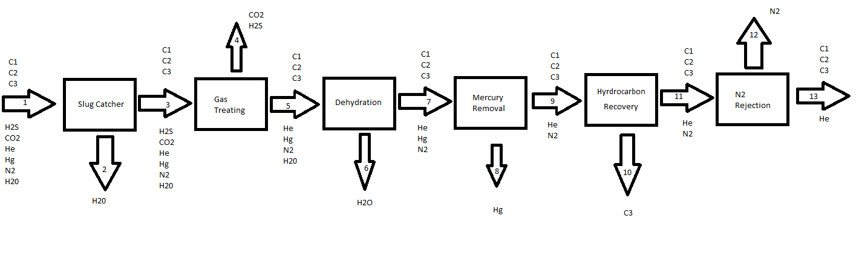
Overall Process Outline

Slide 3
Final Product Streams
Main product stream is 990 million cubic feet of treated shale gas with a composition of:
85.76% Methane
11.32% Ethane
2.86% c3+
500 ppm Helium
Trace (<1 ppb): Hg, CO2, H2S, N2, H20
Additional product streams:
Waste water (requires mercury removal)
NGL C3+ stream

Slide 4
Environmental Analysis
Gas emissions:
Removing H2S
Claus Sulfur recovery
Furnace combustion emission
Carbon monoxide
NOx
Removing N2
Liquid emissions:
Mercury in wastewater lines from the slug catcher, acid gas treatment and dehydration sections.

Slide 5
Safety Analysis
Methane- High levels of methane can reduce the amount of oxygen breathed from the air. This can result in mood changes, slurred speech, vision problems, memory loss, nausea, vomiting, facial flushing and headache.
Ethane- Same symptoms as methane with the addition of a highly flammable gas and dangerous fire hazard.
Propane - Exposure to propane gas include headaches, dizziness, disorientation, nausea and fatigue.
All 3 main gases(Methane, Ethane, Propane) have the potential at high concentrations to displace oxygen in the air.
Hydrogen Sulfide- Inhalation of high concentrations of hydrogen sulfide can produce extremely rapid unconsciousness and death.
Mercury- Metallic mercury mainly causes health effects when inhaled as a vapor where it can be absorbed through the lungs. Symptoms of prolonged and/or acute exposures include: tremors. emotional changes (such as mood swings, irritability, nervousness, excessive shyness).
Liquid Nitrogen- Direct contact can freeze the skin causing frostbite and cold burns.
Carbon Dioxide- Symptoms of mild CO2 exposure may include headache and drowsiness.

Slide 6
Process Safety Concerns
Process | Main Safety Concerns
Slug Catcher | Leakage from main pipeline containing shale gas. Contains high levels of methane.
Gas Treating | Exposure of high levels of Hydrogen Sulfide exit stream
Dehydration | Exposure to levels of ethylene glycol concentrations higher than 80 ppm results in intolerable respiratory discomfort and cough.

Slide 7
Process Safety Concern
Process | Main Concern
Mercury Removal | Exposure to Mercury
Hydrogen Recovery
Nitrogen Rejection | Very low temperatures leading to cryogenic distillation.

Slide 8
Process Controls (General)
Critical controlled variables…
-Amine absorber : Temperature; Conversion
-Column: Temperature;Pressure; Level; Purity
-Flash Drum: Temperature;Level
-Heat Exchanger: Temperature
Key manipulated variables
- Heat Duties
-Reflux/boil-up ratios
-Distillate/bottoms flow rates
-Flow rate of material in tube

Slide 9
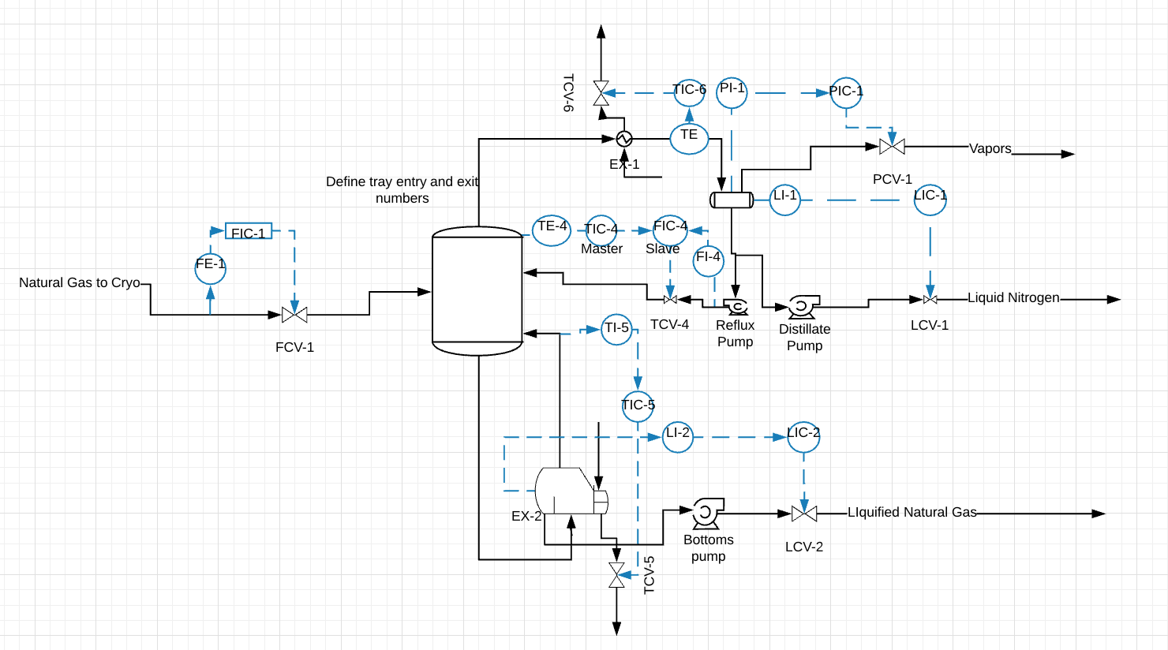
Detailed Process Control (Cryogenic Distillation)

Slide 10
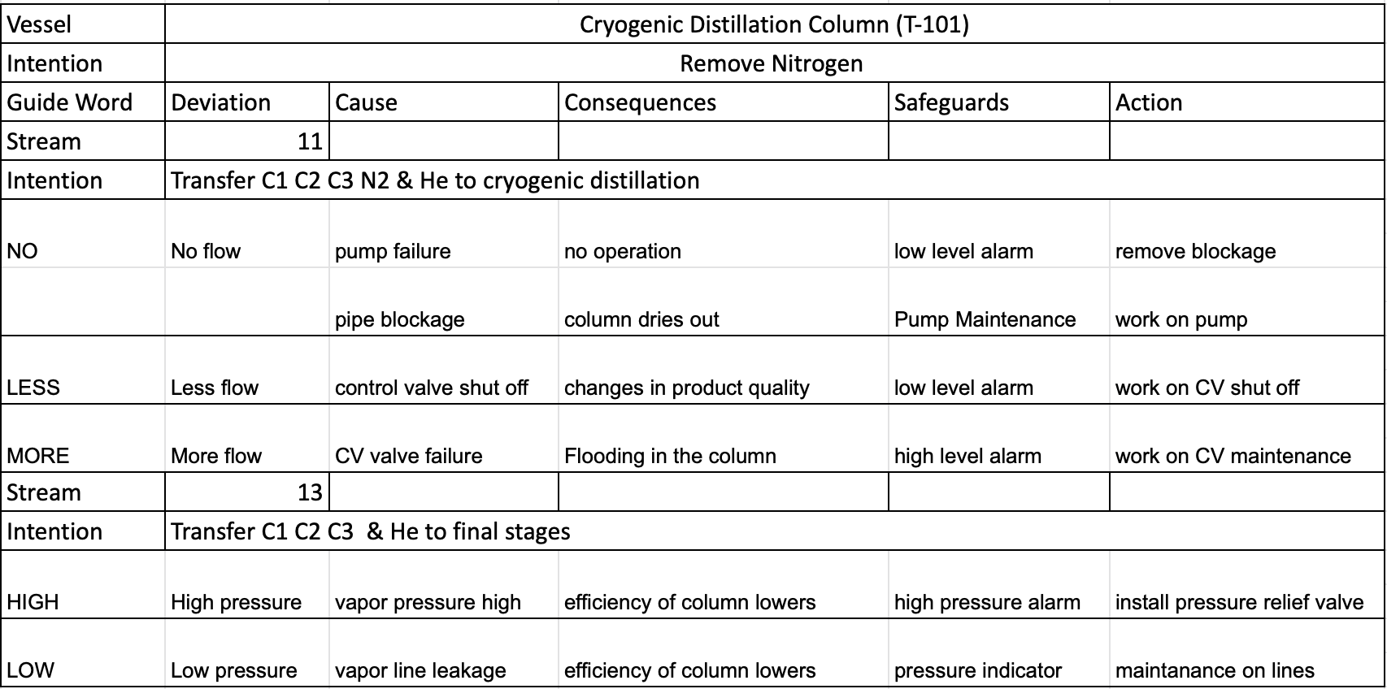
HAZOP

Slide 11
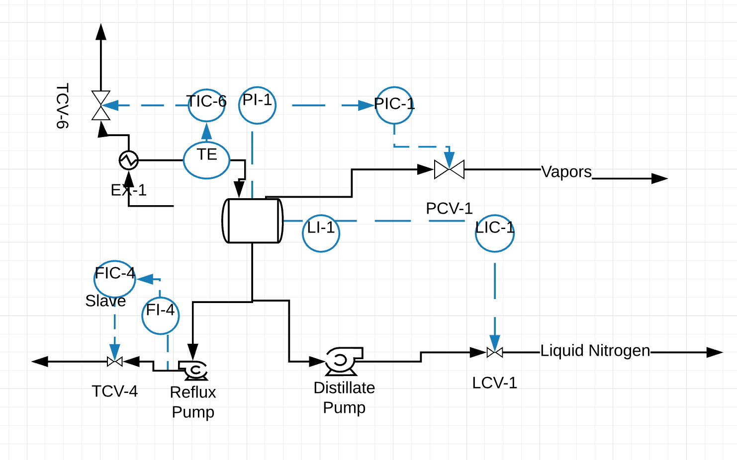
Process Control (Flash Drum)
Control Variables
Temperature, Level
Manipulated Variables
Flow Level
Max Temp- 144 Celsius
Min Temp- 116 Celsius
Flash Drum

Slide 12
Process Controls
Slug Catcher -Temperature
Min- 147 Fahrenheit
Optimum- 167 Fahrenheit
Maximum- 195 Fahrenheit
Gas Treating- Pressure
Min- 800 psi
Optimum- 1000 psi
Maximum- 1100 psi
Dehydration- Temperature
Min- 110 Fahrenheit
Optimum- 119.8 Fahrenheit
Maximum- 125 Fahrenheit
Mercury Removal - NA
Hydrocarbon Recovery - NA by vendor
Nitrogen Rejection - Temperature
Min- -243 Fahrenheit
Optimum- -184 Fahrenheit
Maximum- -175 Fahrenheit

Slide 13
Economic Analysis

Slide 14
Capital Cost Estimates
Total Capital Cost
Equipment Cost (USD) | 18.5 million
Installation Cost (USD) | 28.4 million
ISBL (USD) | 46.9 million
OSBL (USD) | 18.7 million
Engineering Cost (USD) | 6.5 million
Contingency Cost (USD) | 6.5 million
Fixed Capital Investment (USD) | 78.8 million
Working Capital Cost (USD) | 11.8 million
Total Capital Cost (USD) | 90.7 million

Slide 15
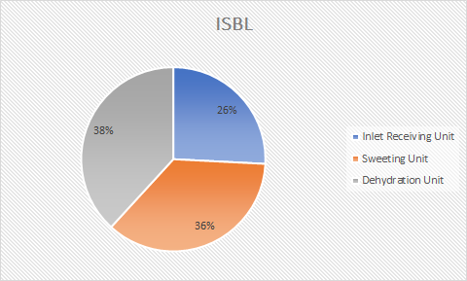
ISBL Cost Analysis

Slide 16
Operating Cost Estimates
Heating Utilities | 50.84 million USD per year
Cooling Utilities | 0.674 million USD per year
Total Utilities | 51.51 million USD per year

Slide 17
Revenue Estimates
Revenue of LNG has of now, it is still not the final figure
18.7 million USD per year
Base of Japon import price of 9.895 USD/MMBTU which was for February 2020. [1]

Slide 18
Raw Material Cost
The Cost of Marcellus Shale gas from the well head was priced at 1.80 USD/MMBTU [2]
Raw material cost is 3.5 million per year
This is based on data found from 08-Jan-2020

Slide 19
Economic Summary
Total Capital Cost = 90.6 million USD
Total Operating Cost = 51.51 million USD per year
Total Revenues = 18.6 million USD per year
Raw Material Cost = 3.5 million USD per year

Slide 20
Future Work
Still working on NPV, simple back period, sensitivity analysis and DCROR.
Operation cost will change.

Slide 21
References
[1] “US Natural Gas Production Edges Back from Highs as Low Prices Weigh on Drilling.” US Natural Gas Production Edges Back from Highs as Low Prices Weigh on Drilling | S&P Global Platts, 8 Jan. 2020, www.spglobal.com/platts/en/market-insights/latest-news/natural-gas/010820-us-natural-gas-production-edges-back-from-highs-as-low-prices-weigh-on-drilling.
[2] “Japan Liquefied Natural Gas Import Price:” YCharts, ycharts.com/indicators/japan_liquefied_natural_gas_import_price.

