Slide 1
Hydrogen Production from Methane
Erica Caruso
Courteney Fabbri
Maurice Smith
Anne Serban

Slide 2
Topics Covered

Slide 3
Topics Covered
Brief Overview of Process
Previous Issues and Concerns
Safety and Environmental Analysis
Process Controls
Revised Economic Analysis
Pinch Analysis
Transportation Logistics
Notes:
Anne

Slide 4
Brief Overview

Slide 5
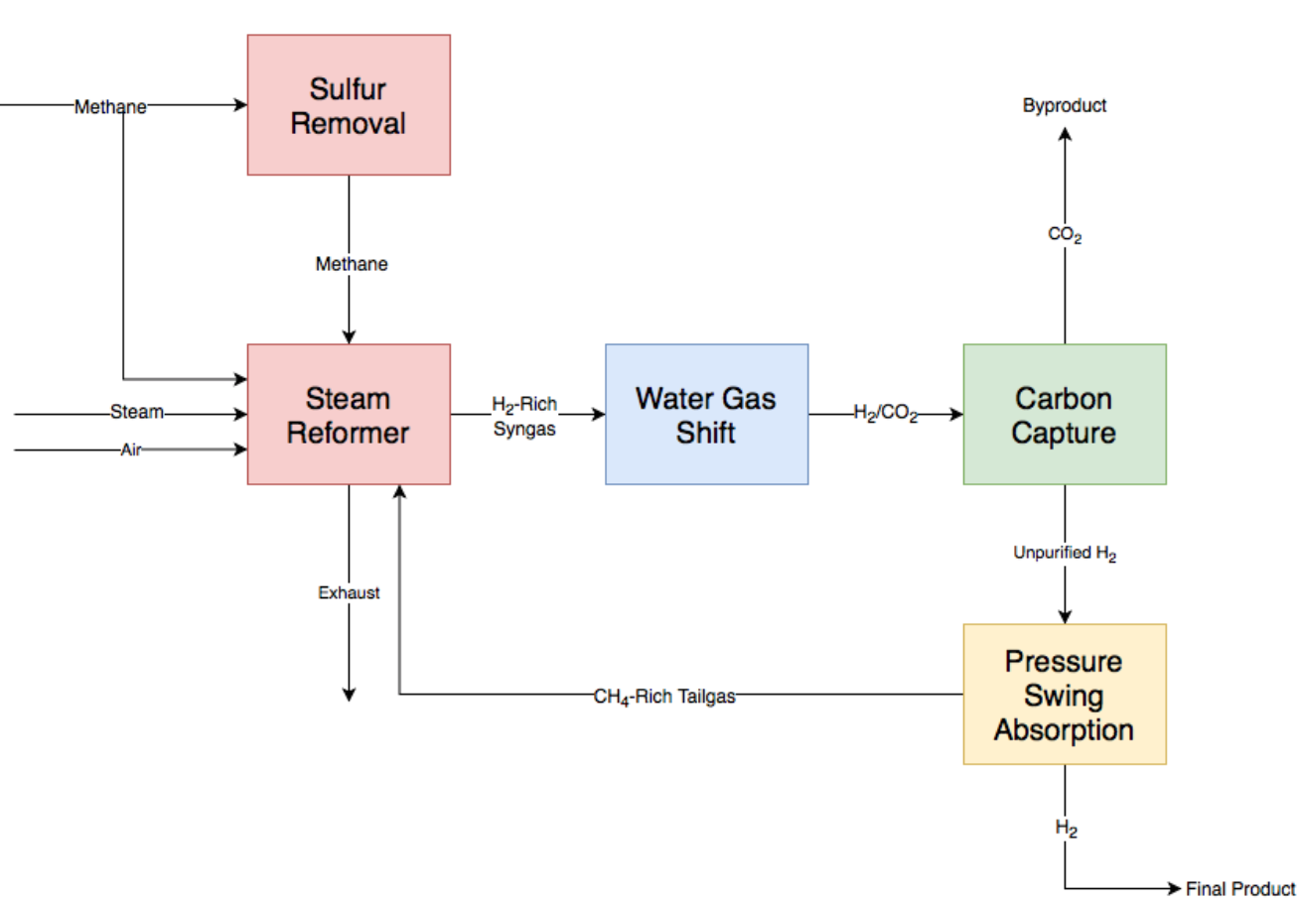
Overall Process Outline: BFD
Notes:
Anne

Slide 6
Final Feed and Product Streams
Feed/raw material consumption:
High pressure steam: 2,500 lb/hr
Pipeline natural gas: 28,000 SCFH
Hydrogen production: 33 barrels/hr
High pressure steam production: 2,300 lb/hr
Notes:
Anne

Slide 7
Previous Concerns

Slide 8
Previous Concerns: General
Centrifugal compressor
Changed from air compressor to natural gas compressor
On-site desulfurization
German pipeline gas cannot exceed 3.6 ppm H₂S ^{[1]}
3.6 ppm SO₂ produced and removed via FeO pellets
H₂O recovery in water gas shift section
32% untreated feed water recovered
Notes:
Courteney

Slide 9
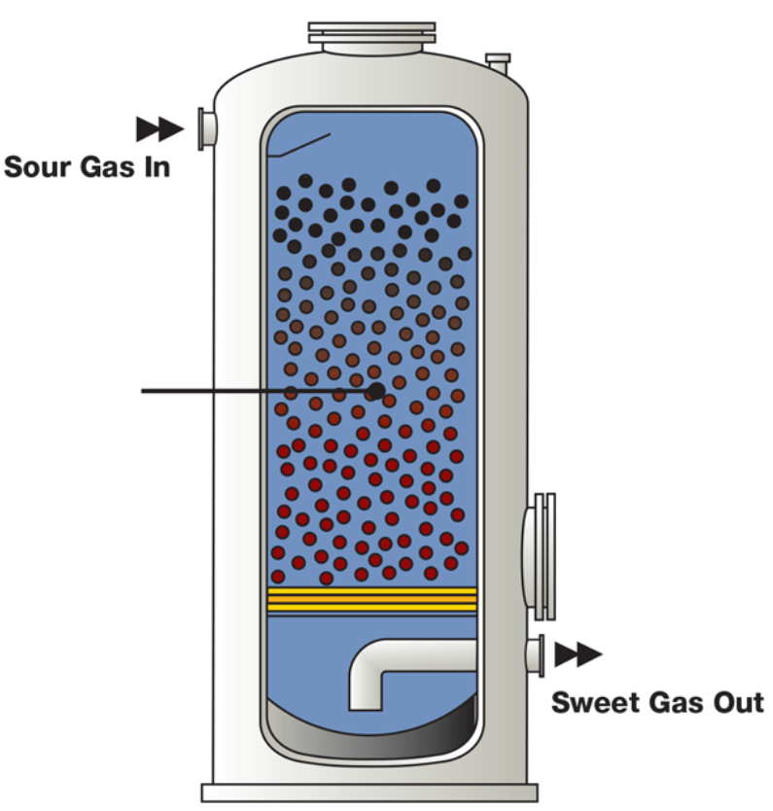
Added Equipment
New process equipment
SMR section
C-101: Natural gas compressor
VLV-101: Pressure reducing valve
E-101: Waste heat steam generator
On-site desulfurization section
R-101: Oxidizer
V-101: Packed column absorber
Water gas shift section
V-102: Knock-out drum
V-103: Condensate tank
P-102: Dirty water pump
FeO catalyst
“SULFATRAP” Gas Sweetening ^{[11]}
Notes:
Courteney

Slide 10
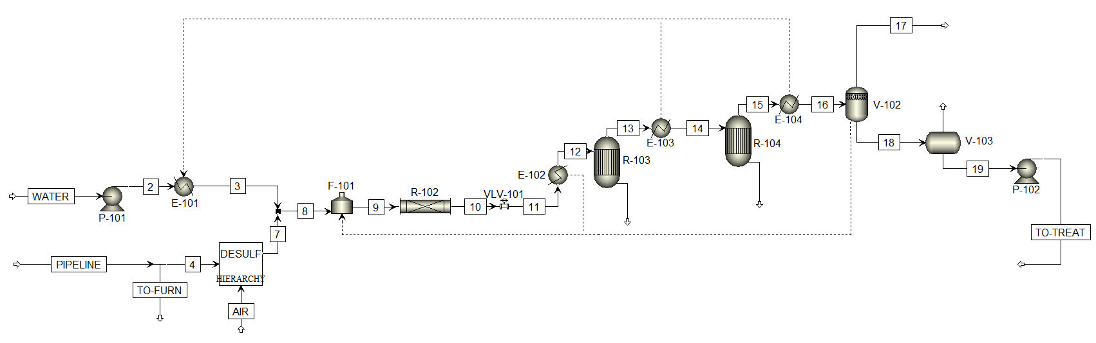
Updated Equipment: SMR and WGS
V-102:
Knock-out
drum
V-103:
Condensate tank
E-101:
Waste heat boiler/steam generator
P-101:
Centrifugal single-stage pump
VLV-101: Pressure reducing valve
On-site Desulfurization DESULF
Hierarchy
P-102:
Centrifugal single-stage pump
Notes:
Courteney

Slide 11
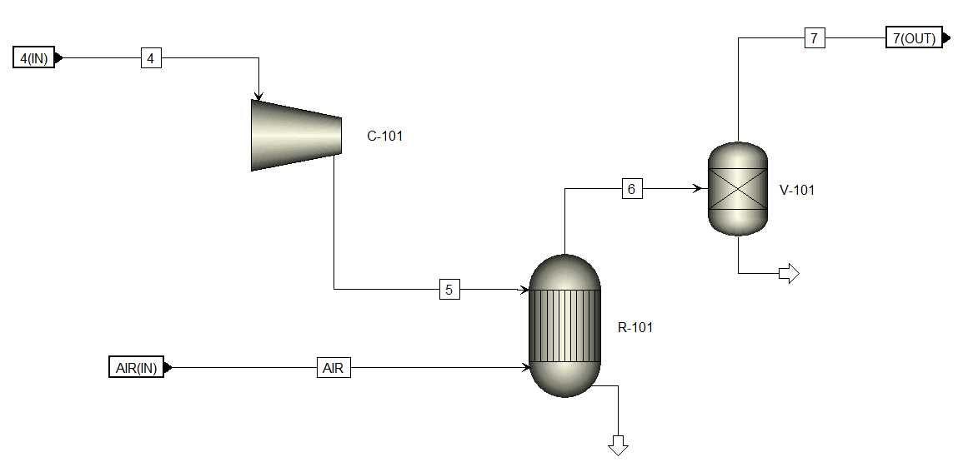
Updated Process Features: Natural Gas Sweetening/DESULF Hierarchy
C-101: Natural gas centrifugal compressor
R-102: Packed sulfur absorber
R-101: Catalytic oxidizer
Notes:
Courteney

Slide 12
Added Equipment
New process equipment
PSA section
K-101: Feed to PSA Compressor
K-102: Mid-Stage PSA Compressor
Pressurization before Storage
K-103: Compressed Hydrogen Compressor
Carbon Capture Section
E-104: Heat Exchanger for Heat Integration
E-105: Heat Exchanger for Cooling Recycle
Notes:
Maurice

Slide 13
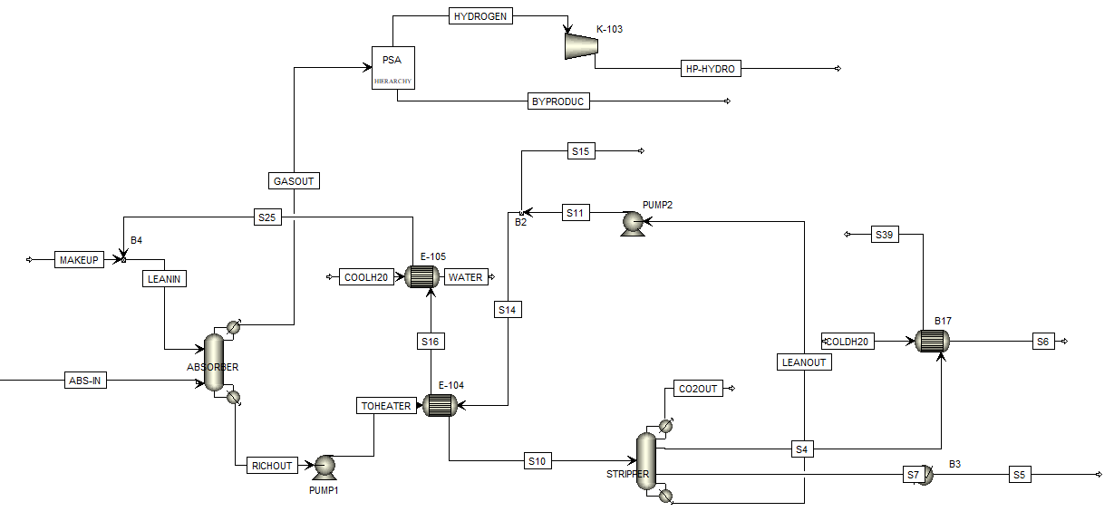
Updated Equipment: PSA and Carbon Capture
Notes:
Maurice

Slide 14
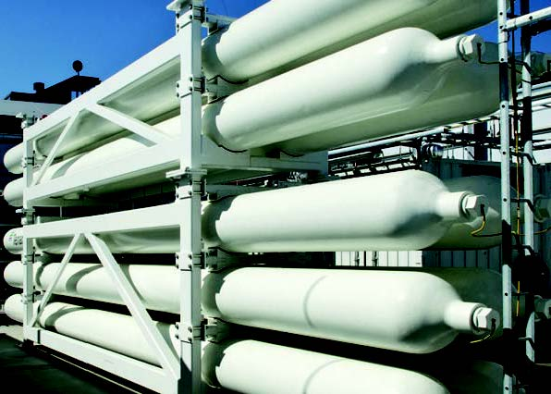
Previous Concerns: Storage
Pressure requirements for storage
45 Bar
Hydrogen pickup
Every 2-3 Days
Additional 20% storage
MEA Storage
Delivered every 30 days
Pressure Vessels for Hydrogen ^{[13]}
Notes:
Maurice

Slide 15
Process Controls

Slide 16
Process Controls (General)
Controlled Variables
Reactors: Temperature, Pressure, Conversions
Vessels: Level, Pressure, Purities
Manipulated Variables
Outlet flow, Fuel flow rate, Inlet flow
Notes:
Erica

Slide 17
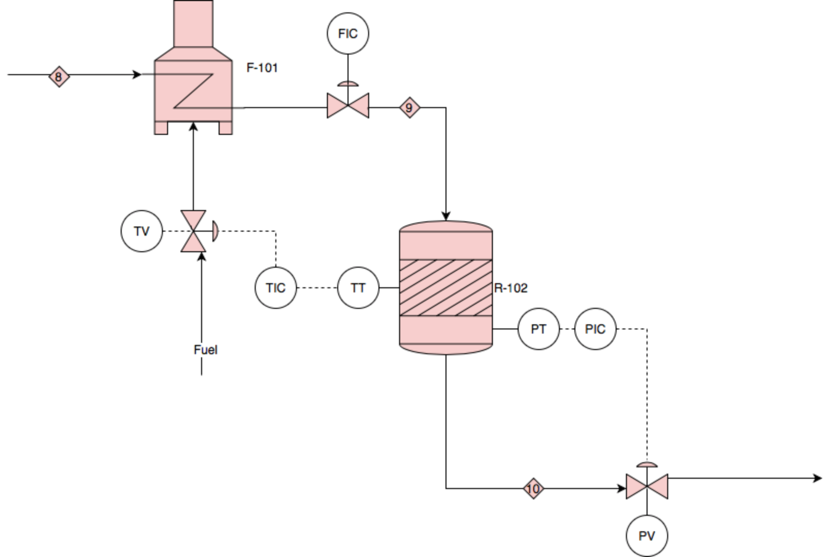
Detailed Process Control: Primary Reformer
Controlled Variables
Temperature and Pressure
Manipulated Variables
Flow and Level
Temp Range: 1400°F-1600°F
Optimum: 1470°F
Notes:
Erica

Slide 18
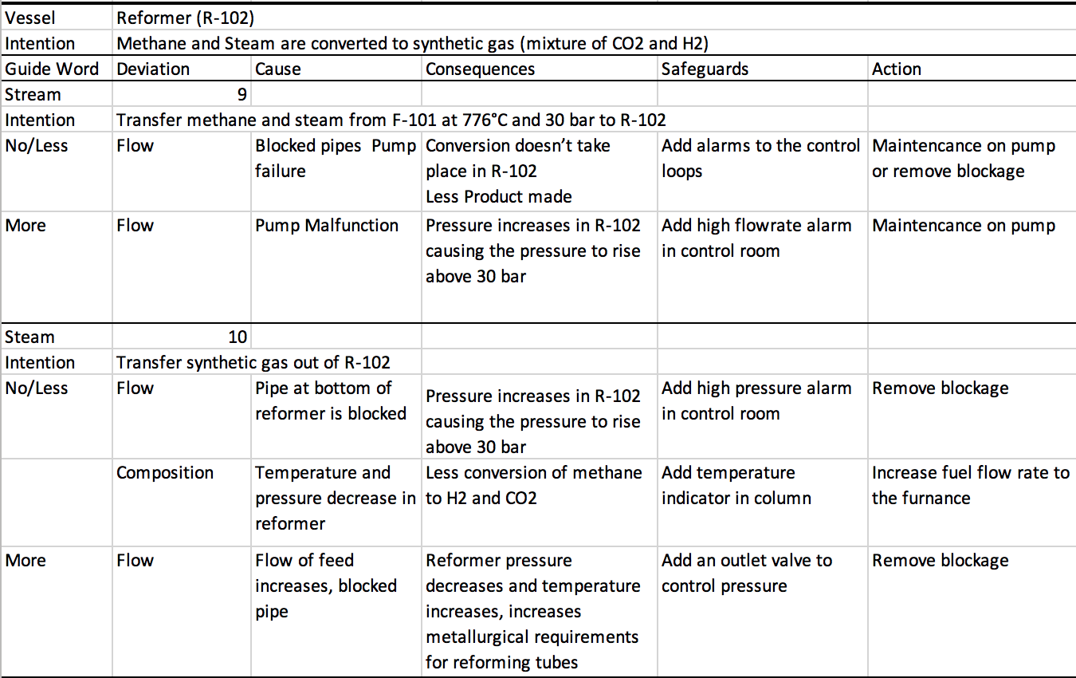
HAZOP
Notes:
Erica

Slide 19
Environmental and Safety Concerns

Slide 20

Environmental Analysis
Hazardous gases:
CO₂, CO, H₂S, SO₂
CO₂: Regulated through EU Emissions Trading System Cap
Directive of the European Parliament and Council on
Industrial Emissions Standards^{[2]}
CO₂: 1.82 Billion allowance cap/year (Germany)
CO: 44 ppm
H₂S: Minimum rate of desulfurization is 93%
SO₂: 19 ppm
NO_{X}: 280 ppm
European Commission Logo ^{[12]}
Notes:
Anne

Slide 21
Environmental Analysis
Average hazardous gas emittance:
CO₂: 360 ppm
CO: 14 ppm < 44 ppm emission standard
H₂S: 99% rate of desulfurization > 93% minimum rate
SO₂: ~1 ppm < 19 ppm emission standard
NO_{x} = ~0.04 ppm << 280 ppm
European Commission Logo ^{[12]}
Notes:
Anne

Slide 22
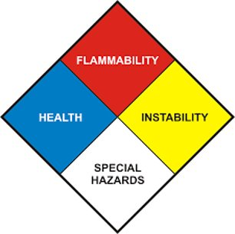
Safety Analysis ^{[5] - [10]}
Respiratory diseases can be caused by prolonged exposure to H₂S, SO₂ and NO_{x}
CO and H₂S are highly flammable and toxic.
NO_{x} is fatal if inhaled; it corrodes skin and damages eyes.
Repeated expose to CO can cause damage to various organs.
Prolonged exposure to CO₂ may cause suffocation.
Repeated exposure to MEA can cause liver and kidney damage.
NFPA Diamond [15]
Notes:
Anne

Slide 23
Process Safety Concerns
Process | Main Safety Concerns
Sulfur Removal Process | Formation of metal oxide fumes when FeO pellets decompose
Steam Reformer | Reformer operates at very high temperature and pressure; Catalyst is harmful if inhaled
Water Gas Shift | Reactors operate at high temperatures
Carbon Capture | Loss of MEA from system due to leaks in pipes or units
Pressure Swing Absorption | Potentially high operating pressure
Notes:
Anne

Slide 24
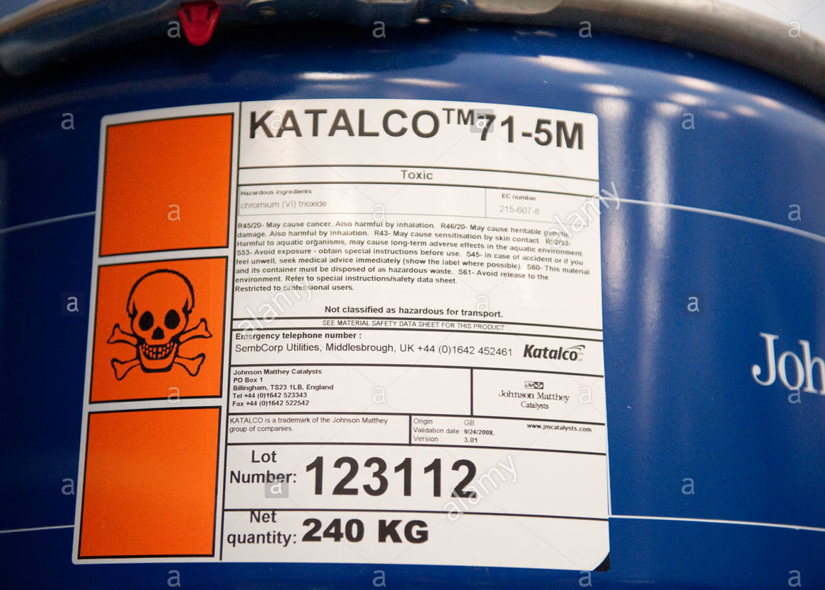
Process Safety Concerns
Nickel Ceramic catalyst pellets for reformer tubes^{[14]}
Notes:
Anne (this is our reformer tube catalyst, Nickel Ceramic Pellets)

Slide 25
Economic Analysis

Slide 26
Capital Cost Estimates
CAPITAL COSTS (CC)
 | Cost ($MM)
Inside Battery Limits (ISBL) | 28.28
Off-site Battery Limit (OSBL) | 8.48 | 30% of ISBL
Contingency | 3.68 | 10% (ISBL + OSBL)
Engineering Procurement & Construction Costs (EPC) | 7.35 | 20% (ISBL + OSBL)
Fixed Capital Costs (FCC) | 47.8 | ISBL + OSBL + Contingency + EPC
Working Capital Costs | 7.17 | 15% FCC
Total CC | 55
Notes:
Courteney

Slide 27
ISBL Cost Analysis
-Purchasing and shipping costs of equipment:
-Desulfurization and Reaction section installed cost: $7.55MM
-Carbon Capture and Pressure Swing Adsorption cost : $20.6MM
-Land costs:
-5 acres of land: $350M (Weinheim, Germany)
-Infrastructure
-Cooling tower: $176M
-Bullets for storage: $8.86MM
-MEA Storage : $328M
-Piping (included in equipment)
-Catalysts, and any other material needed:
-Initial fill cost: $1.14MM
-Two stage ion-exchange water treatment: $17.8M/year
Notes:
Courteney

Slide 28
ISBL Cost Analysis
Notes:
Courteney

Slide 29
Operating Cost Estimates
COLD:
-Boiler feed water: $9M/year
-Cooling water: $8M/year
HOT:
-Split methane feed stream used in SMR furnace: $170M/year
-Rest of fuel gas utilities: $72M/year
-HP Steam makeup: $26M/year
Pressure changers:
-Electricity: $470M/year

Slide 30
Operating Cost Estimates
Heating Duties = $268M/year
Cooling Duties = $17M/year
Electricity = $470M/year
Total Operating Costs = $755M / year
Notes:
Courteney

Slide 31
Revenue Estimates
Revenue from Hydrogen: $18MM/year
Current price of hydrogen in Germany: $11-$13/kg ^{[3]}
≈ $65-$75/barrel
Producing 150,000 kg/year ≈ 260,000 barrels/year
Process Recovery Revenue:
HP steam from BFW: $211M
Germany’s 2030 Climate Action Package
Germany National Hydrogen Strategy ^{[4]} : $335M
Total Revenue = $18.6MM/year
Notes:
Courteney

Slide 32
Variable Cost of Production (VCOP)
Raw materials:
-Pipeline gas: $680M
-Untreated water: $16M
Utilities:
- $755M / year
Consumables:
-Initial fill costs (catalyst, packing, MEA): $1.14MM
Effluent disposal:
-CO2 Credits = $47M/year
Total VCOP = $2.64MM/year
Notes:
Erica

Slide 33
Variable Cost of Production (VCOP)
Notes:
Erica

Slide 34
Raw Materials Cost
Notes:
Erica

Slide 35
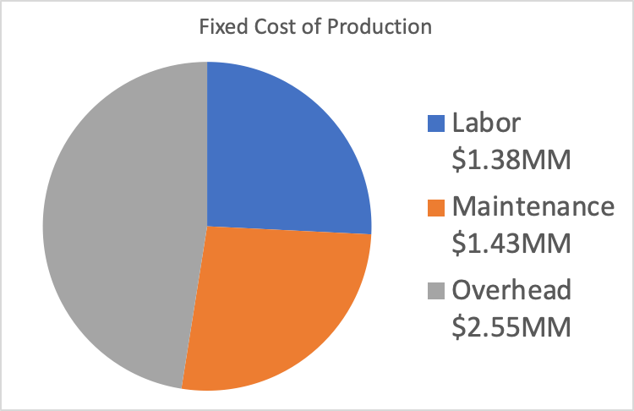
Fixed Cost of Production (FCOP)
-Labor includes salaries of employees and managers.
-Maintenance is average, expected plant maintenance
-Overhead are the costs associated with insurance, additional maintenance costs, and maintaining compliance.
Notes:
Erica – This is not fixed cost of production

Slide 36
Net Present Value (NPV) [7-Year MACRS]
NPV 10 Years : $-4.07MM
20 Years : $6.46MM
*Tax rate assumed 35%
Notes:
Maurice

Slide 37
Net Present Value (NPV) [5-Year MACRS]
NPV 10 Years : $-3.28MM
20 Years : $7.25MM
*Tax rate assumed 35%
Notes:
Maurice

Slide 38
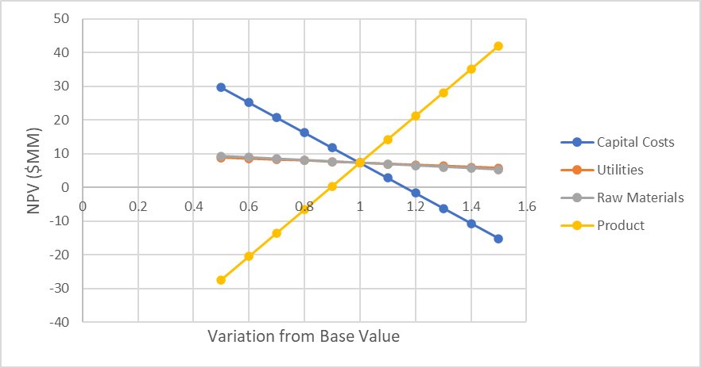
Sensitivity Analysis
Notes:
Maurice

Slide 39
Economic Summary
Total Capital Cost: $55MM
Total Operating Cost: $755M
Total Revenues: $18.6MM
NPV after 20 years: $7.25MM
Notes:
Maurice

Slide 40
Future Work
Improve Economics
- Produce larger quantity of hydrogen
- Supply other markets
-Ammonia
- Pay Cash for capital costs
- Avoids interest on equipment costs
- Consider alternatives to hydrogen storage
- Underground storage
Notes:
Maurice

Slide 41
Future Work
More in-depth market analysis
-Determine if there is an opportunity to increase the amount of hydrogen produced
Improving the carbon capture process in order to increase credits from government
Look to sell our carbon dioxide to another process company looking to make methanol from it
Notes:
Maurice

Slide 42
References
[1] https://ec.europa.eu/energy/intelligent/projects/sites/iee-projects/files/projects/documents/redubar_a_register_of_all_gas_regulations.pdf.
[2] https://eur-lex.europa.eu/legal-content/EN/TXT/?uri=CELEX:32010L0075
[3] https://www.reuters.com/article/us-energy-eworld/germanys-ewe-to-test-supplying-hydrogen-for-transport-industry-idUSKBN2041X8
[4] https://www.rechargenews.com/transition/minister-germany-should-start-world-s-first-green-hydrogen-tender-next-year/2-1-758073
Notes:
Maurice

Slide 43
References for Safety Analysis
[5] https://www.airgas.com/msds/001013.pdf (CO₂)
[6] https://www.airgas.com/msds/001014.pdf (CO)
[7] https://www.airgas.com/msds/001039.pdf (NO)
[8] https://www.airgas.com/msds/001041.pdf (NO₂)
[9] https://www.airgas.com/msds/001029.pdf (H₂S)
[10]http://msdssearch.dow.com/PublishedLiteratureDOWCOM/dh_0044/0901b80380044789.pdf?filepath=amines/pdfs/noreg/111-01388.pdf&fromPage=GetDoc (MEA)
[15] https://cleanroom.byu.edu/NFPA

Slide 44
References for Pictures
[11] https://www.chemicalproductsokc.com/sulfurtrap-h2s-removal-gas/
[12] https://en.wikipedia.org/wiki/European_Commission#/media/File:European_Commission.svg
[13] https://www.tenaris.com/en/products-and-services/industrial-and-mechanical/gas-cylinders-and-large-vessels

Slide 45
Questions?

