Slide 1
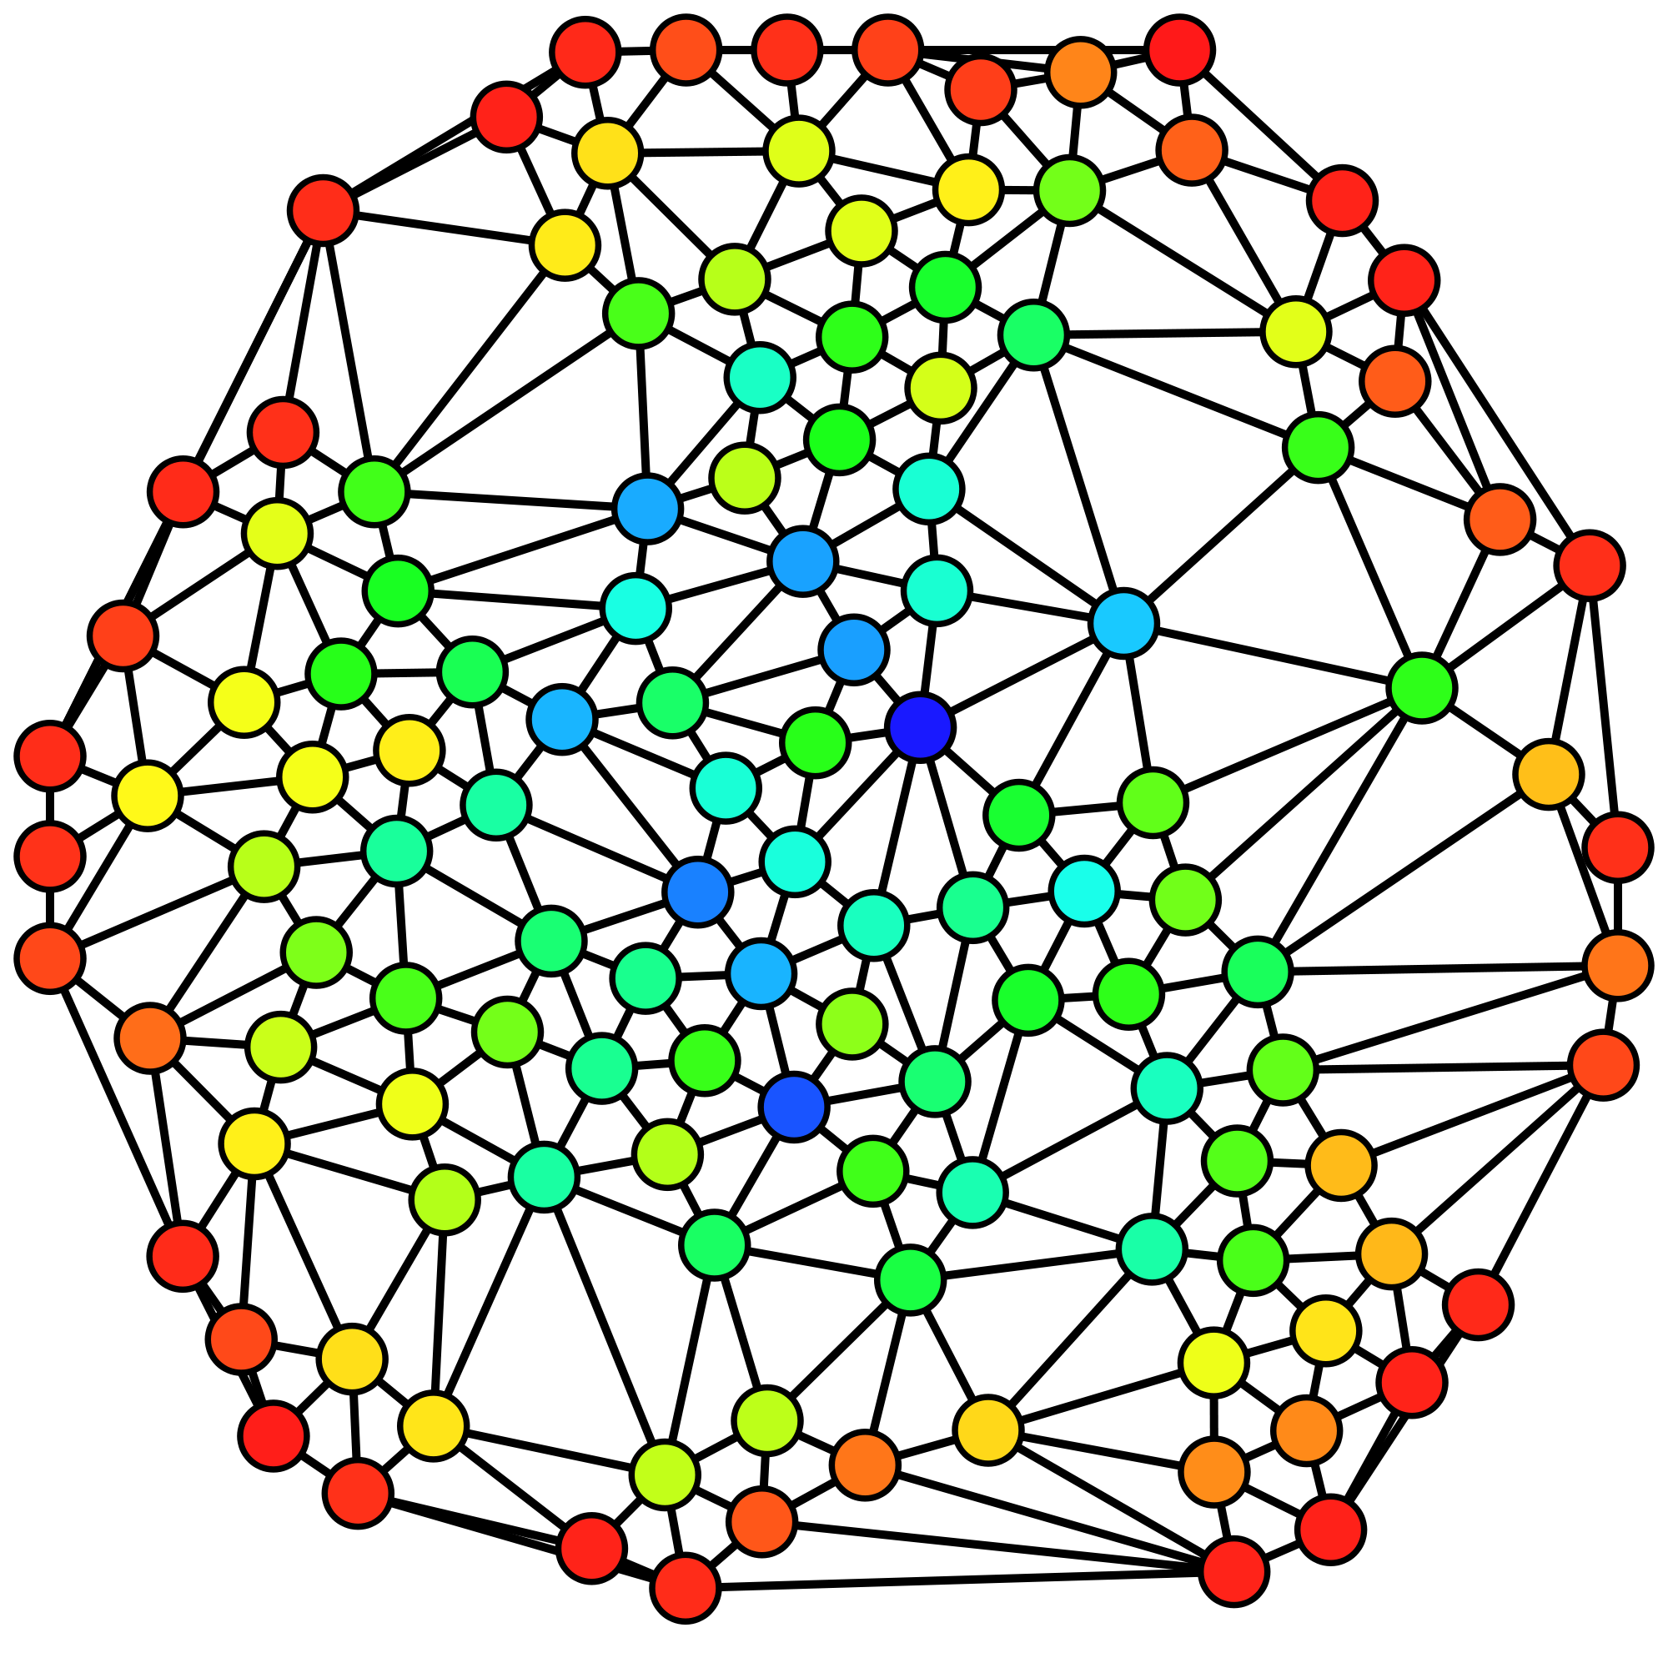
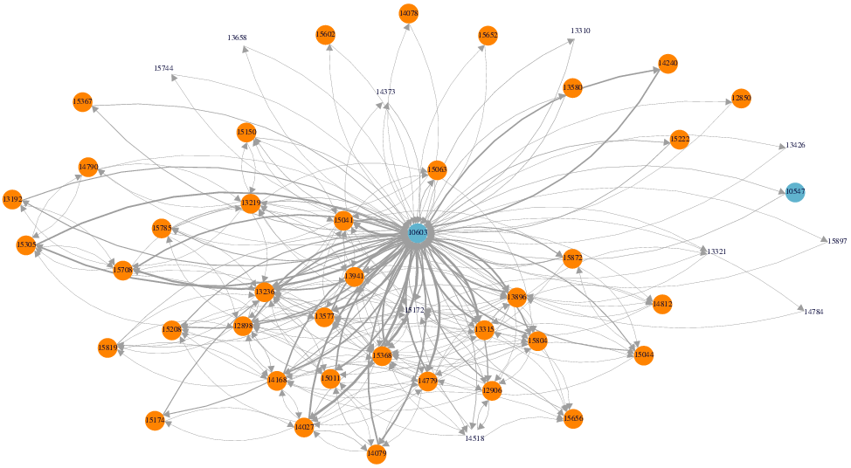
NETWORK ANALYSIS
İrem Ergün
Elif Şahin
Batuhan Tüter

Slide 2

OUTLINE
Acquiring data
Creating a graph network from the given data
Analysis on that network
Visualizing the results via a web application
The whole picture: A web application for applying graph analysis on a given data and visualizing the analysis results

Slide 3



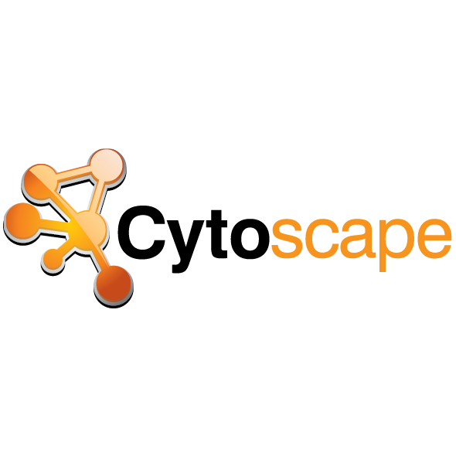


TECHNICAL TOOLS
Java API for creating the graph network and making analysis
for creating a complete web application
for graph visualization
for creating charts to show the analysis results
for Rest Service

Slide 4
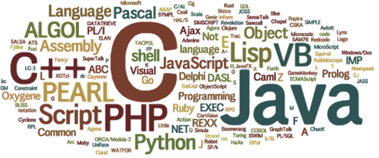

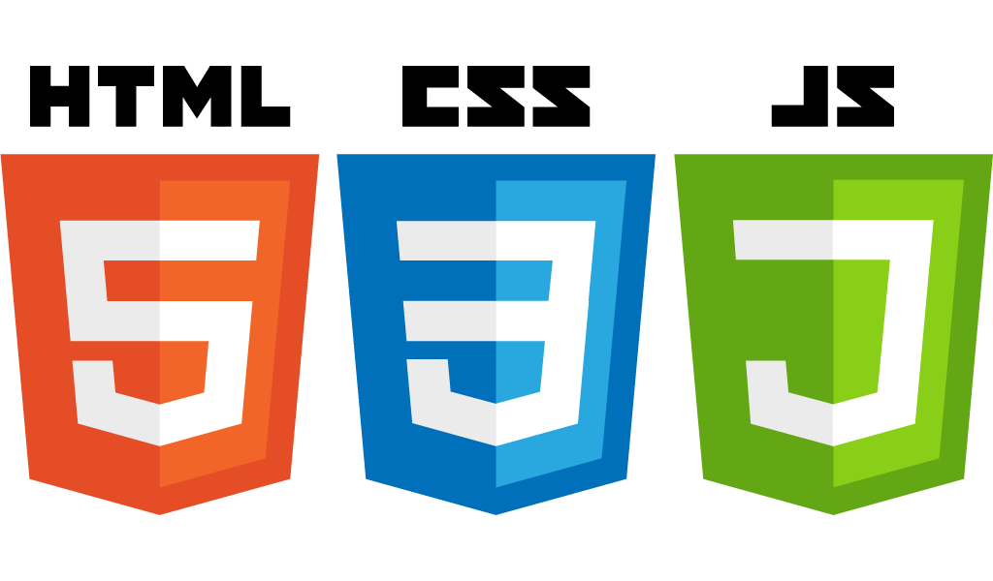

PROGRAMMING LANGUAGES USED
QL for querying the Neo4j database
for client side functionality
for back-end development

Slide 5
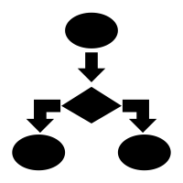
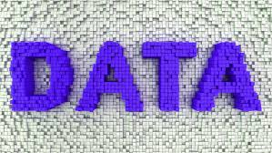
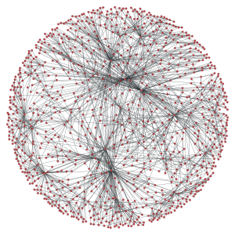


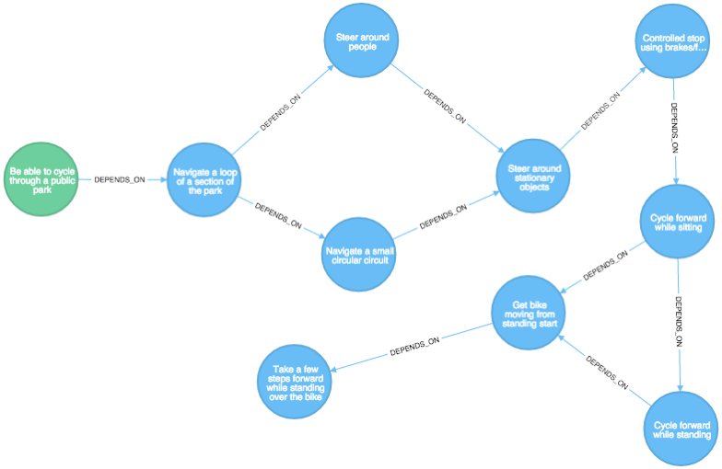
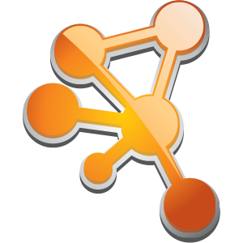
WORK FLOW
Turn into DB
Query
Send to front-end
Visualize the Results

Slide 6


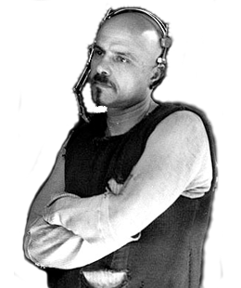
NEO4J
=
+
Graph Database
Cypher

Slide 7
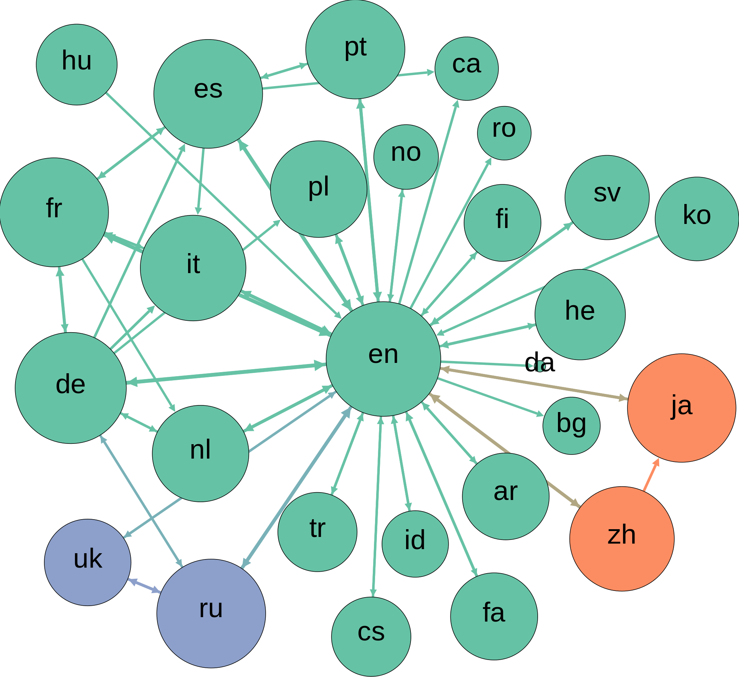
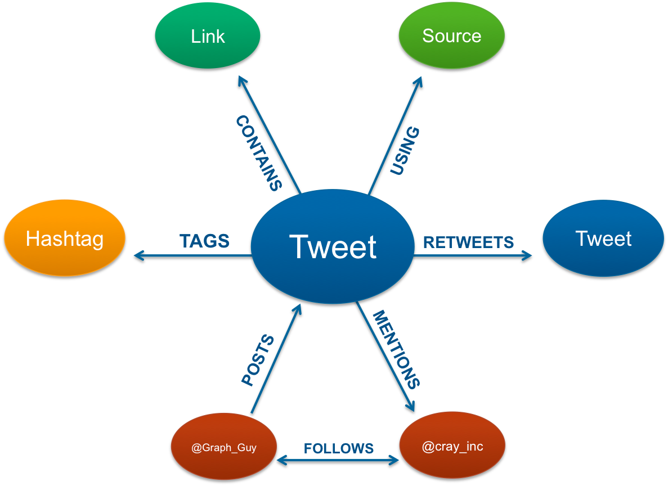
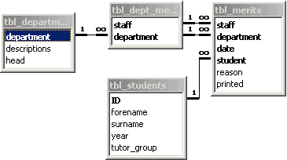
OVERVIEW OF GRAPH DATABASES
VS
Relational Data Model
Graph Data Model
-Facebook
-Twitter
-And many more...

Slide 8
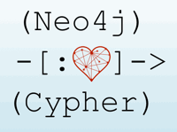
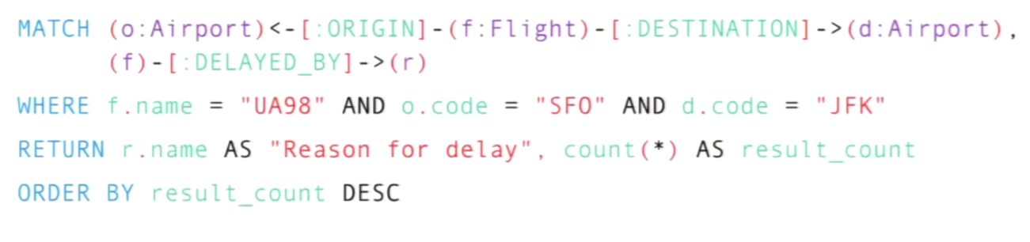
CYPHER
A Query Language for Neo4j, aims to make querying simple

Slide 9
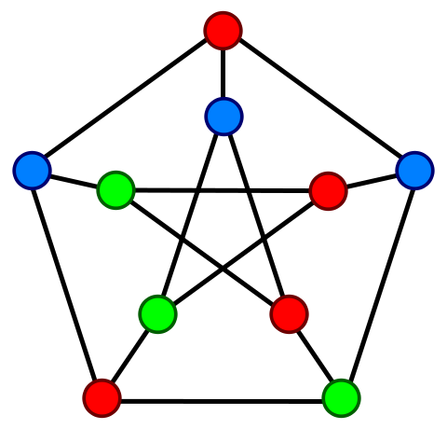
GRAPH ANALYSIS ALGORITHMS
Node Analysis
Shortest Path Analysis
Centrality Measures
-Degree Centrality: Number of connections that a node has in the the network.
-Betweenness Centrality: Number of shortest paths between two other members in the network on which a given node appears.
-Closeness Centrality: Nodes with high closeness centality are often highly connected within clusters in the graph, but not necessarily highly connected outside of the cluster.
-Pagerank:The size of each node is proportional to the number and size of the other nodes pointing to it in the network.

Slide 10

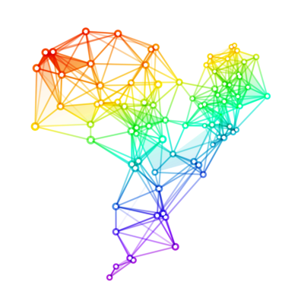
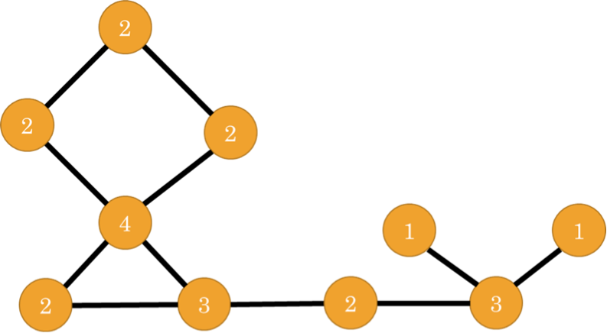
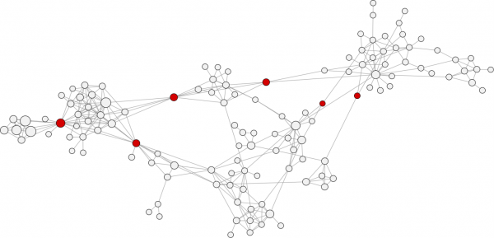
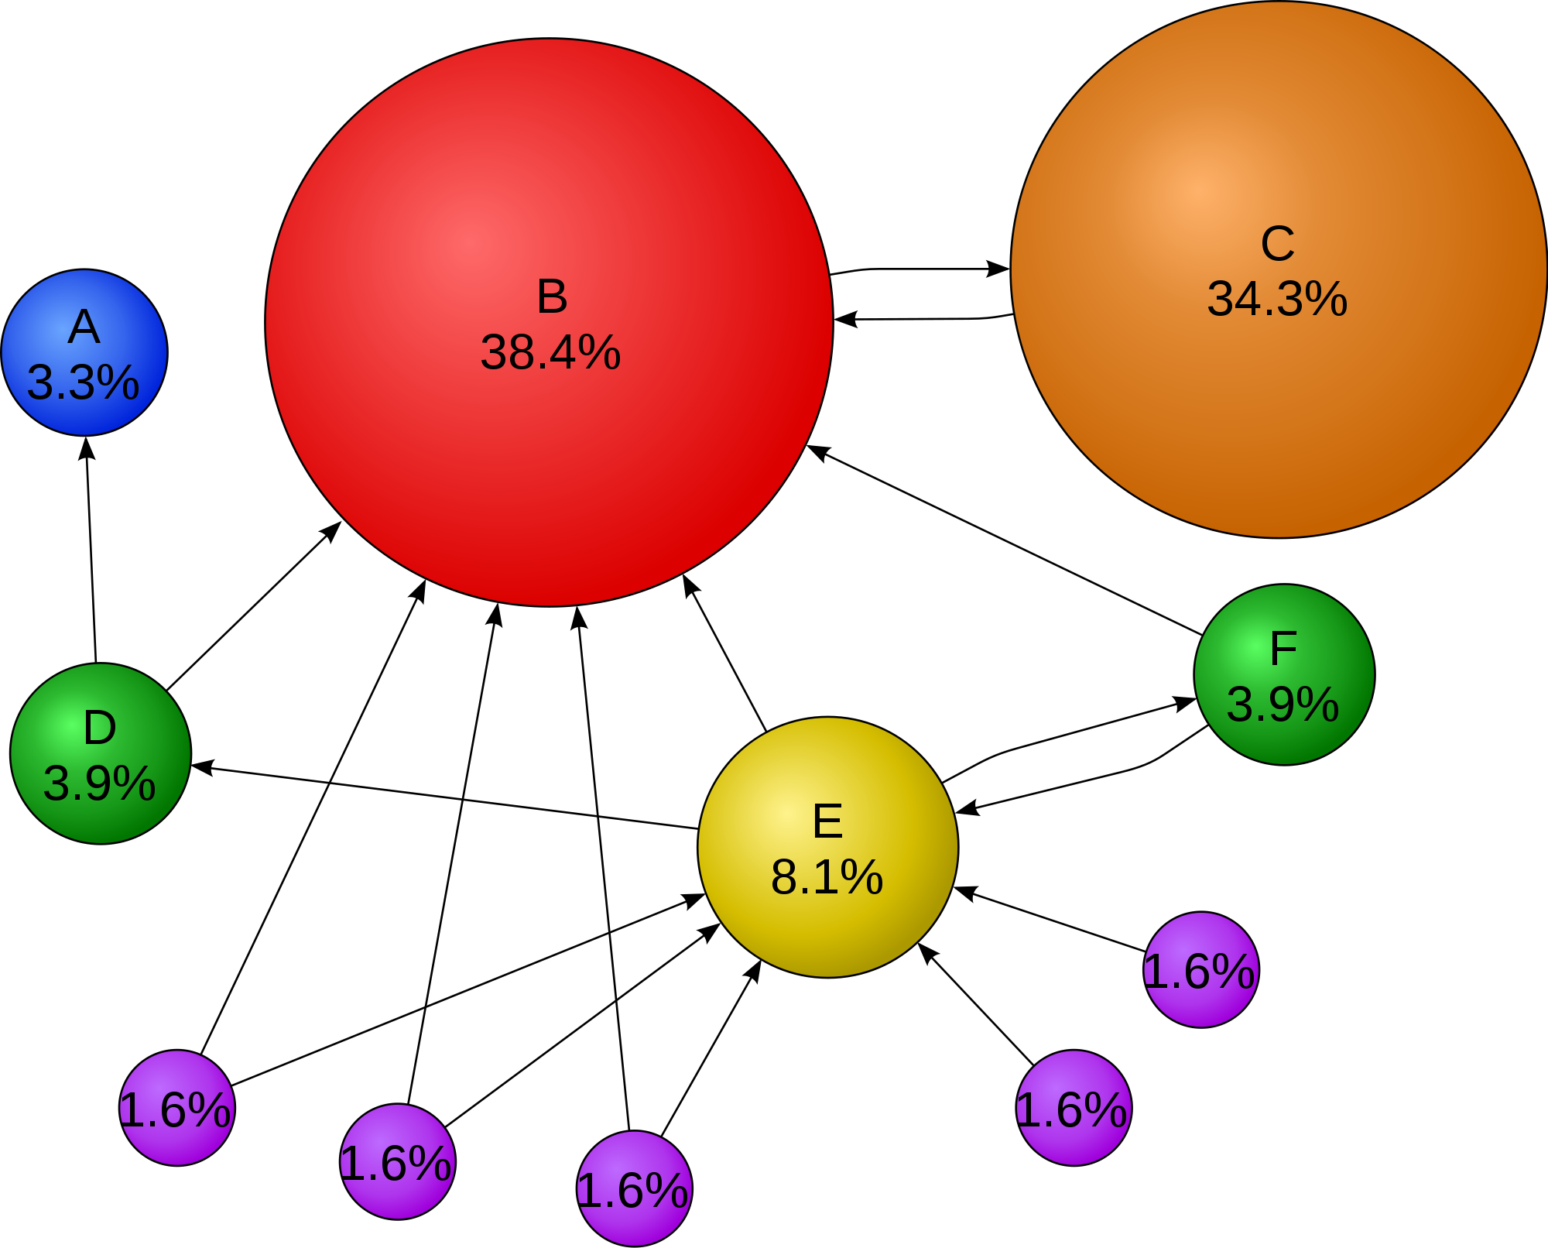
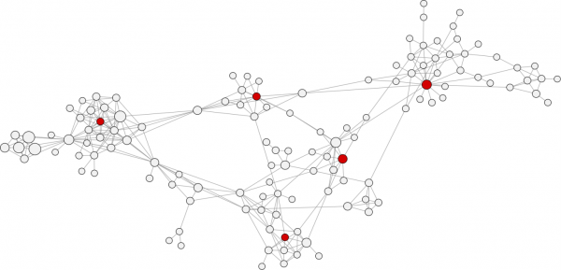
CENTRALITY MEASURES
Degree Centrality
Betweeness Centrality
Pagerank
Closeness Centrality

Slide 11




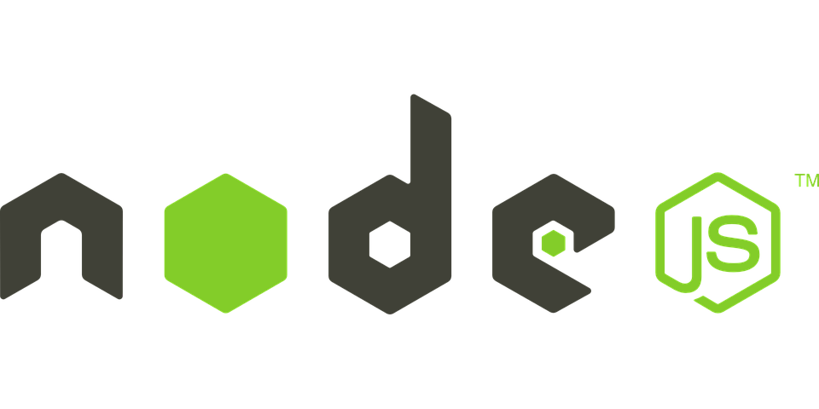
JHIPSTER
Easily build a web application
on the server side
on the client side
Includes:
  (A package manager for the web)
  (A scaffolding tool for web)
  (A javascript task runner to automate tasks)
  (A runtime environment to develop server-side web applications)

Slide 12

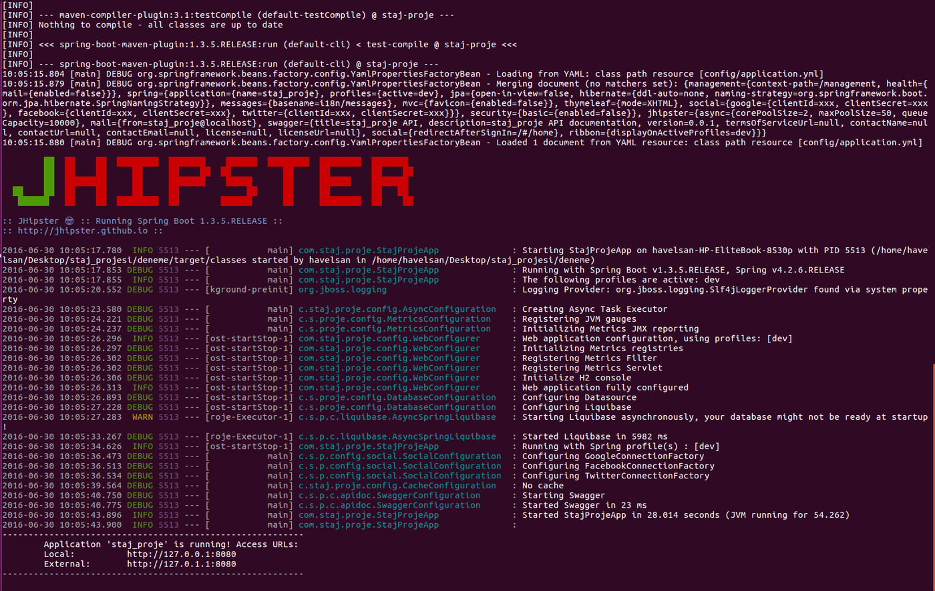
How to start the application

Slide 13
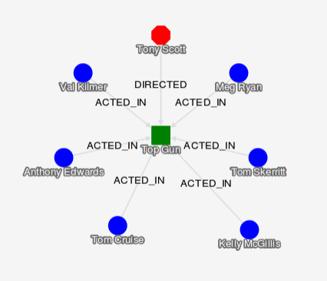
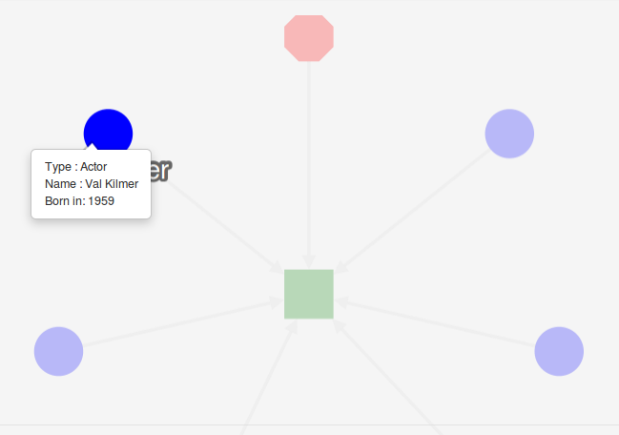
CYTOSCAPE.JS
A javascript library to visualize graphs

Slide 14
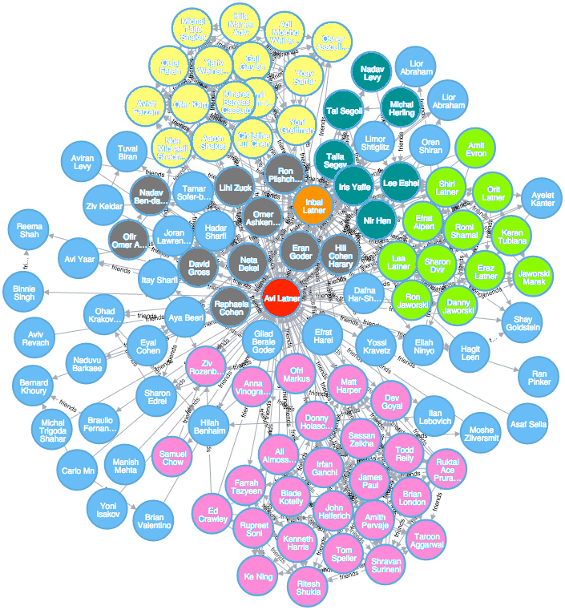
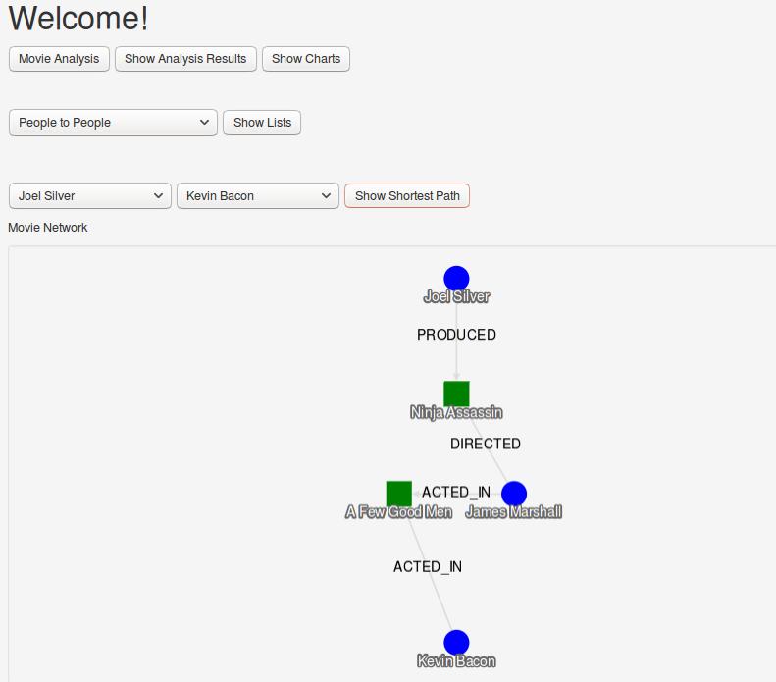
Graph Analysis Example

Slide 15
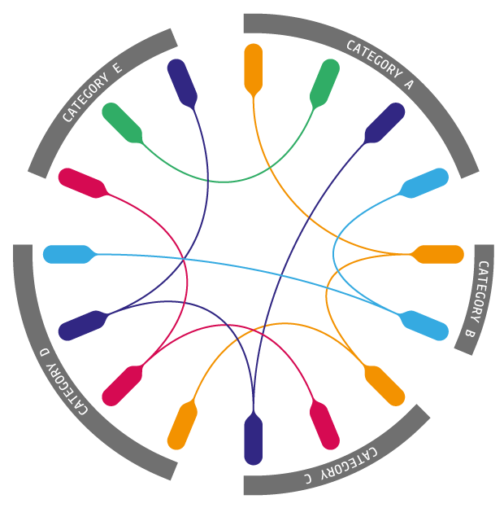
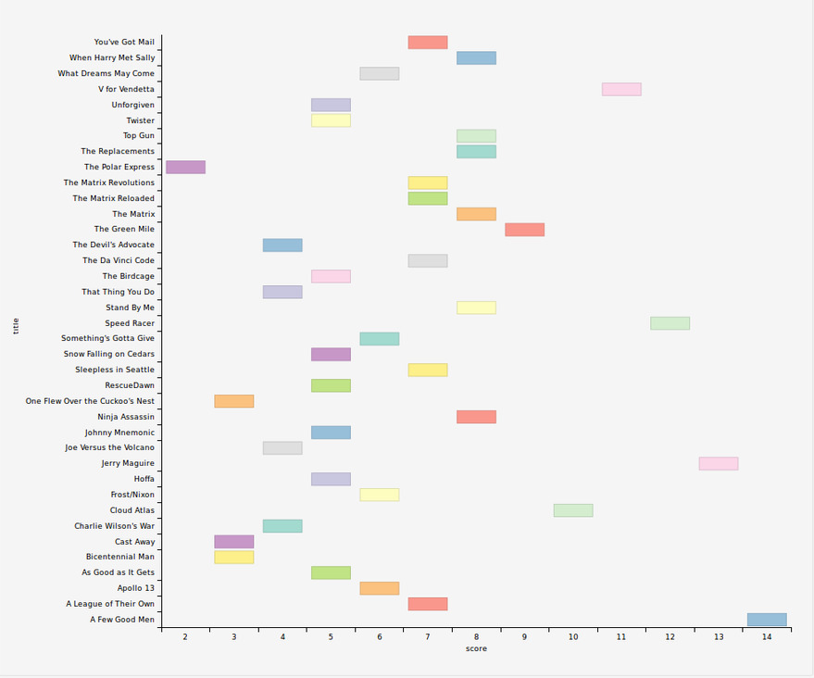
DIMPLE
D3.js based javascript library for chart visualization

Slide 16

WHAT IS NEXT?
Portable:
  Can be used for analyzing and visualizing ego networks
  Different algorithms can be implemented easily
Can be modified to become scalable
Machine Learning

Slide 17


QUESTIONS
Thank you for your attention.

