Slide 1

Network Analysis

Slide 2
What we did?
An interface that will make network analysis easier.
Used tools:
-Neo4j Java API
-Spring Boot for Rest Service
-JHipster for UI and implementing Cytoscape
Programming Languages Used:
-Cypher QL
-JavaScript
-Java

Slide 3


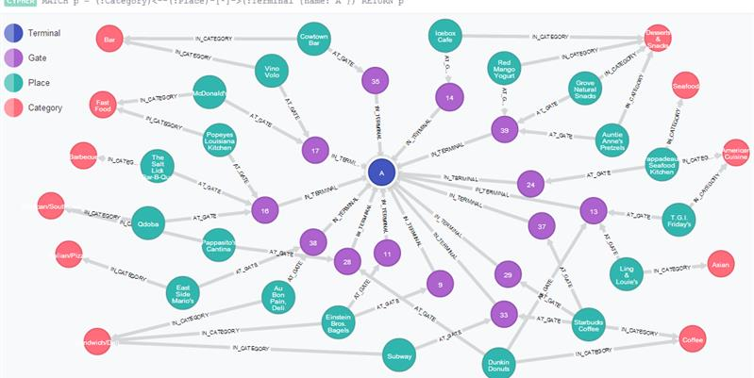

=
Graph Database
+
Cypher

Slide 4
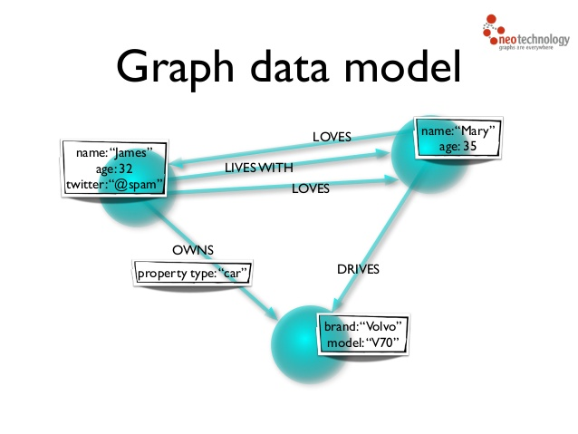
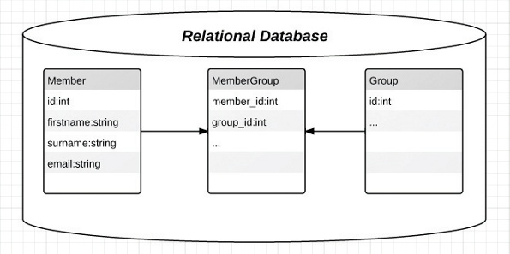
What is Graph Database
VS
Pretty much every old-school
company/individual

Slide 5
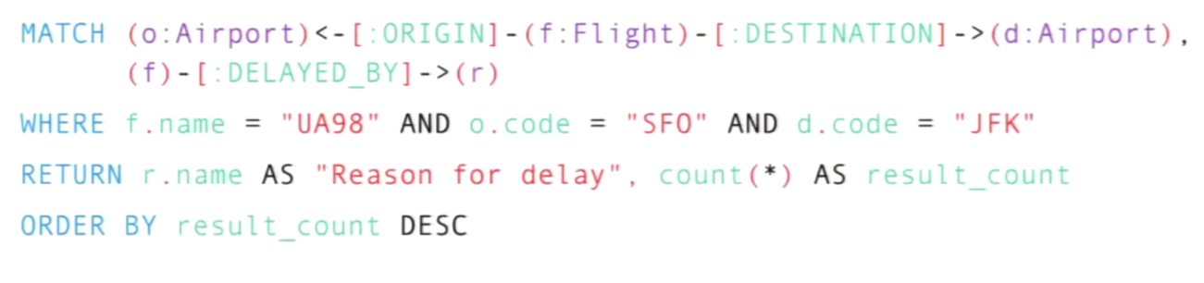
What is Cypher?
A Query Language for Neo4j, aims to make querying simple

Slide 6
Algorithms
Node Analysis
Shortest Path Analysis
Centrality Measures
-Degree Centrality: Number of connections that a node has in the the network.
-Betweenness Centrality: Number of shortest paths between two other members in the network on which a given node appears.
-Closeness Centrality: Nodes with high closeness centality are often highly connected within clusters in the graph, but not necessarily highly connected outside of the cluster.
-Pagerank:The size of each node is proportional to the number and size of the other nodes pointing to it in the network.

Slide 7
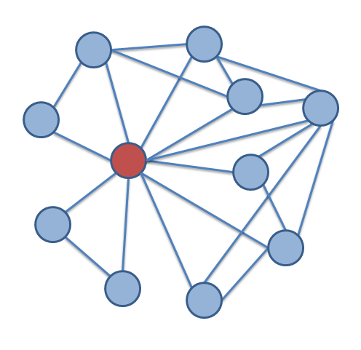
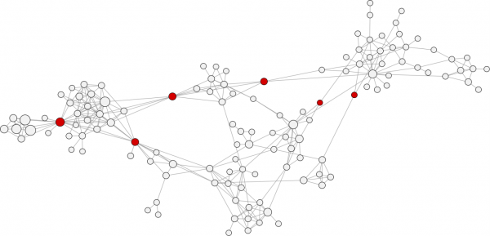
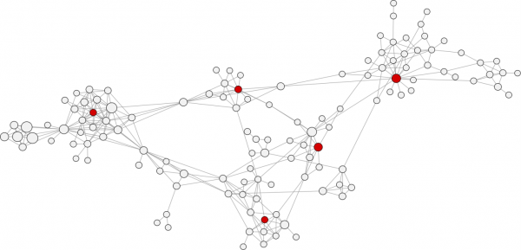
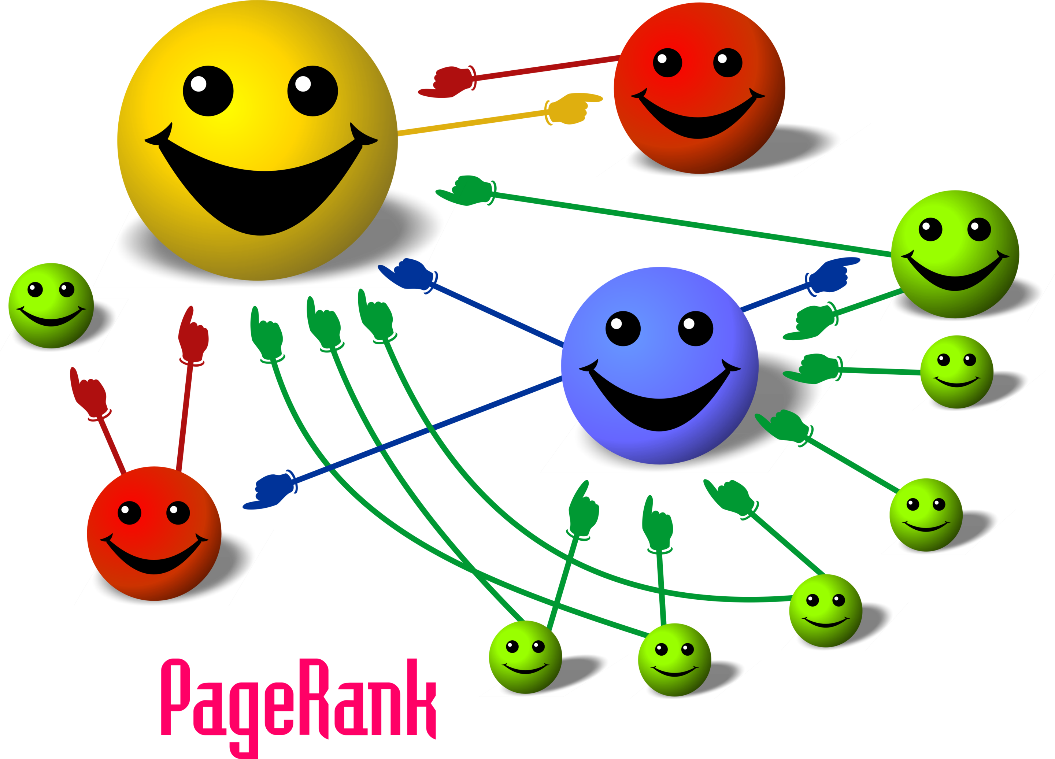
Centrality Measures
Betweenness Centrality
Degree Centrality
Closeness Centrality

