Slide 1
A Simple Look into Frida
Liu Baozheng

Slide 2
Outline
What is Frida?
Four Core Features
Installation
Basic Uasge
Mode of Operations
Advanced Topics

Slide 3
What is Frida?
Dynamic instrumentation toolkit by injecting
JavaScript Snippets
Library
Suitable for
reverse-engineering
programmable debugging
dynamic instrumentation
…
Author: @oleavr

Slide 4
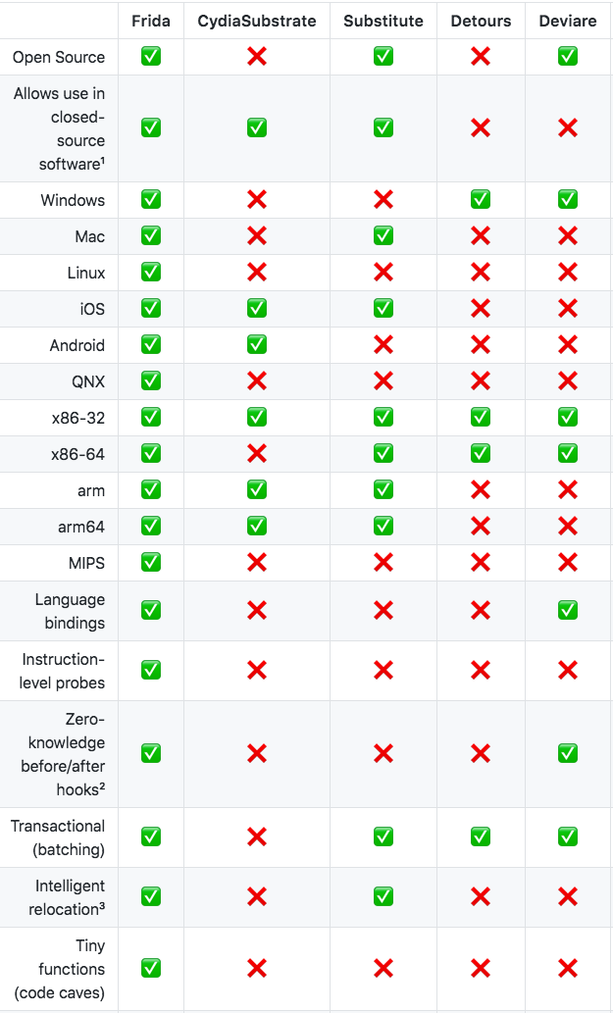
Four Core Features
Scriptable
Execute your own debug scripts inside another process
Edit, hit save, and instantly see the results
All without compilation steps or program restarts
Portable
Platform: Windows, macOS, GNU/Linux, iOS, Android, and QNX
Binding: Node.js, Python, Swift, .NET, Qt/Qml, C
Free
Freedom, GPL
Battle-tested
comprehensive test-suite
NowSecure is using Frida to do fast, deep analysis of mobile apps at scale.

Slide 5
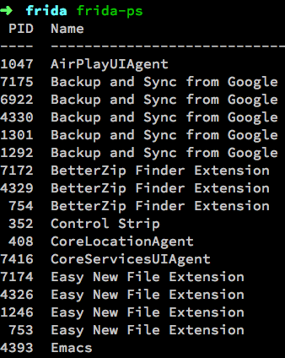
Installation
Prebuilt binary
pip install --user frida # CLI tools and Python bindings
npm install frida # Node.js bindings
Build own Binary
From source cide
Test
As right shows

Slide 6
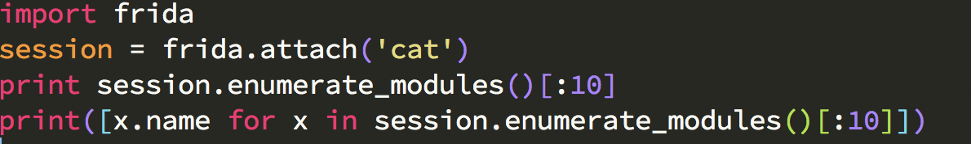
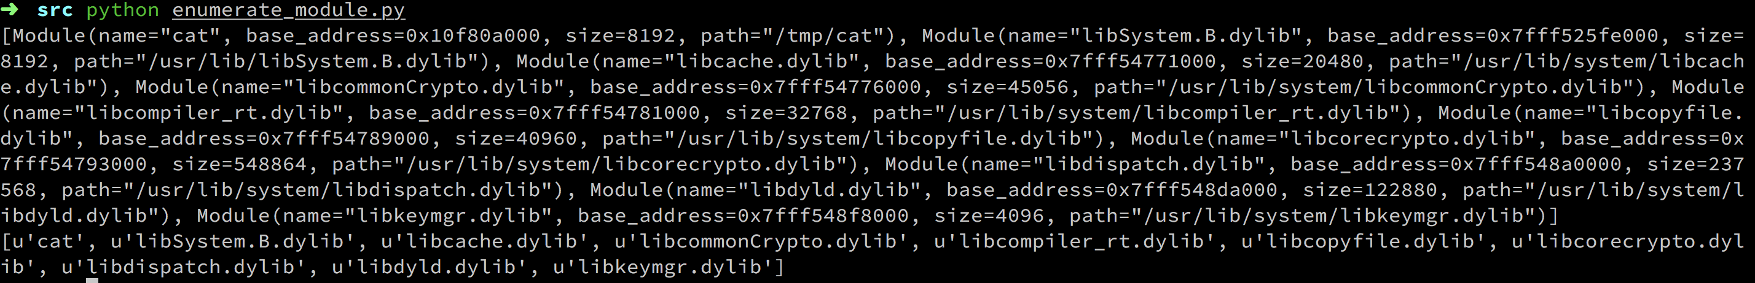
Basic Usage
Enumerating Modules

Slide 7
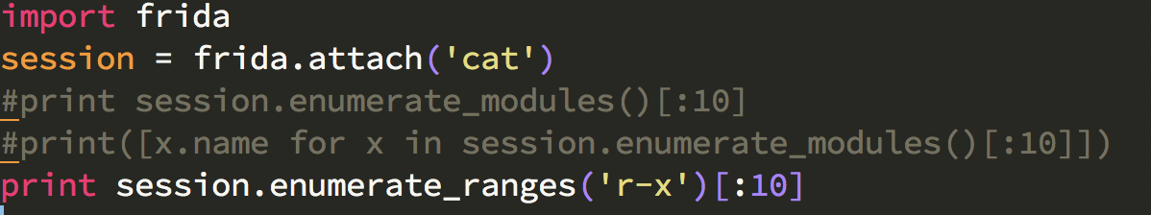
Basic Usage
Enumerating Memory Ranges

Slide 8
Basic Usage
Read/Write bytes
read_bytes(address, n)
write_bytes(address, data)

Slide 9
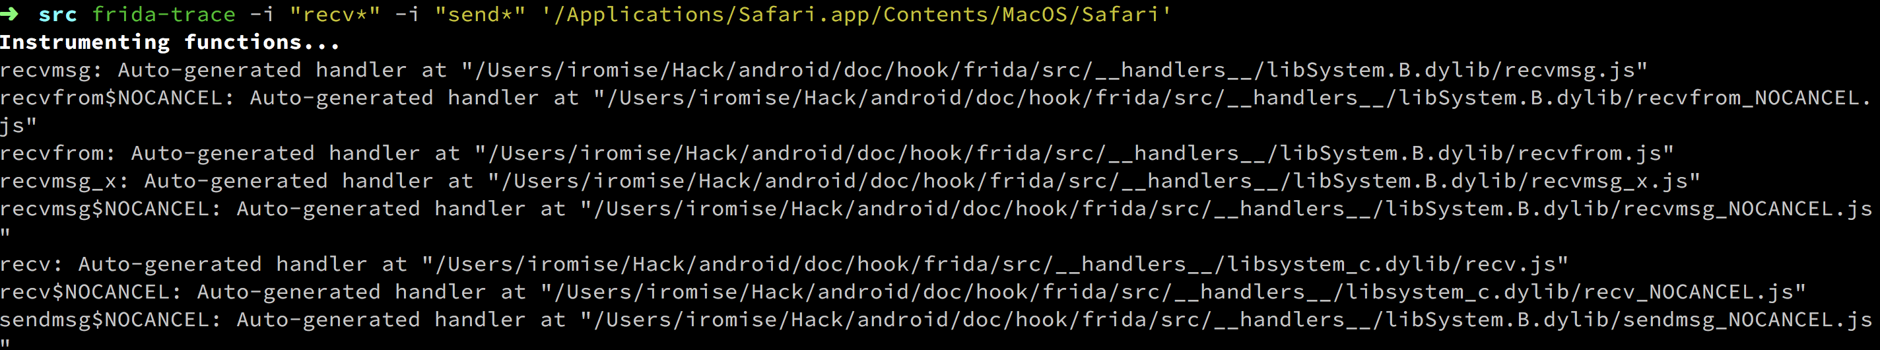
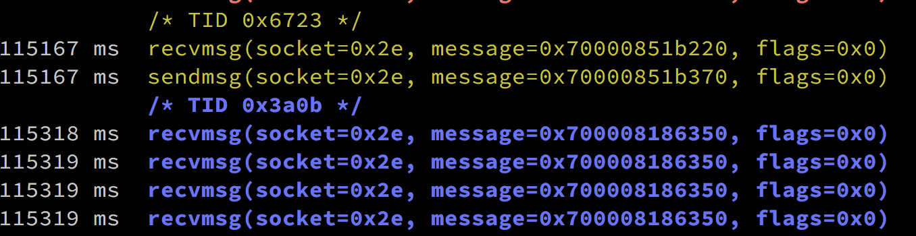
Basic Usage
Trace recv* and send* APIs in Safari
frida-trace -i "recv*" -i "send*" Safari

Slide 10
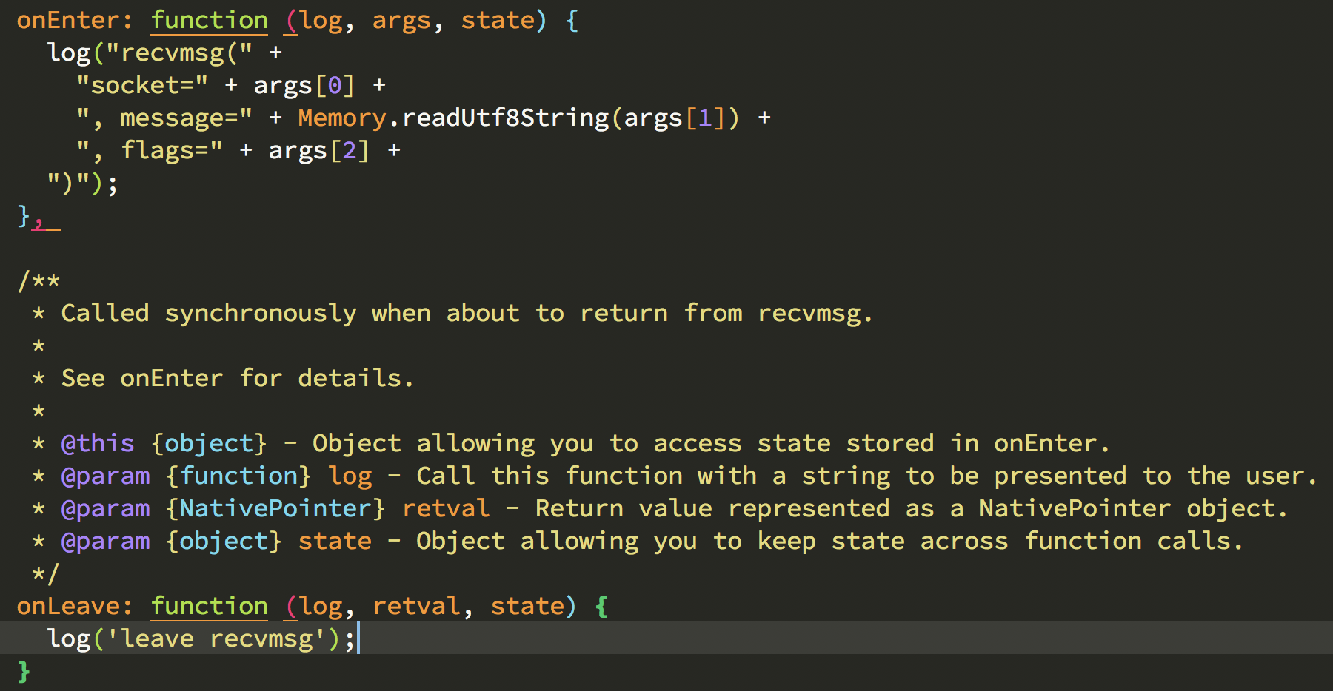
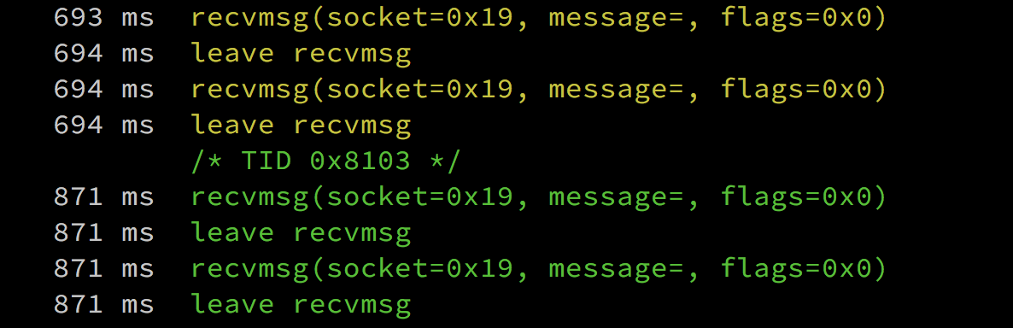
Basic Usage
have a look at the generated recvmsg.js (__handlers__/libSystem.B.dylib)

Slide 11
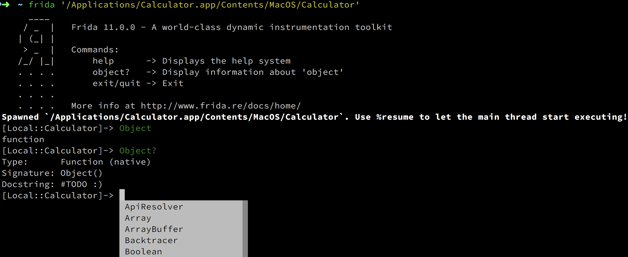
Basic Usage
Frida-Cli

Slide 12
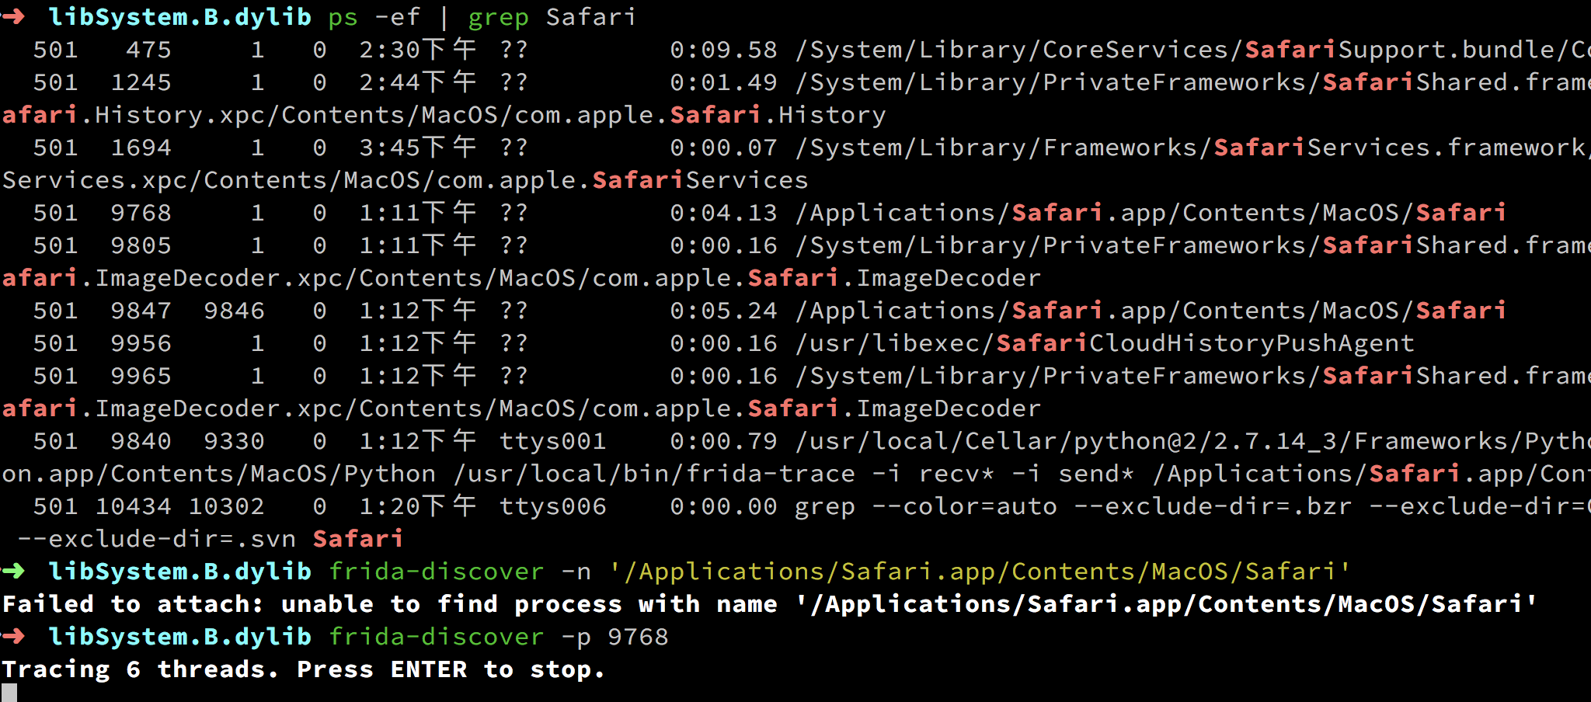
Basic Usage

Slide 13
Advanced Usage
Operation mode
Gadget
Hacking
Detect Frida and Anti-Frida
Application
For CTF
For Fun
For Develop
For Security

