Slide 1

Green Pace
Security Policy Presentation
Developer: Brad Jackson

Slide 2

OVERVIEW: DEFENSE IN DEPTH
Software development at Green Pace lacked a deep-seated implementation of security principles. These principles are required to ensure application development is uniformly defined, implemented, governed, and maintained over time to enable defense in depth.

Slide 3
THREATS MATRIX
Likely (Short Term) STD-005-CPP STD-007-CPP STD-010-CPP | Priority STD-002-CPP STD-004-CPP
Low priority STD-001-CPP STD-006-CPP STD-008-CPP STD-009-CPP | Unlikely (Long Term) STD-003-CPP

Slide 4
10 PRINCIPLES
Validate Input Data
STD-004-CPP
STD-006-CPP
Heed Compiler Warnings
STD-001-CPP
STD-002-CPP
STD-005-CPP
STD-006-CPP
STD-008-CPP
Architect and Design for Security Policies
STD-007-CPP
Keep It Simple
STD-008-CPP
Default Deny
STD-009-CPP
Adhere to the Principle of Least Privilege
STD-009-CPP
Sanitize Data Sent to Other Systems
STD-004-CPP
STD-007-CPP
Practice Defense in Depth
Use Effective Quality Assurance Techniques
STD-003-CPP
STD-004-CPP
STD-005-CPP
STD-006-CPP
STD-007-CPP
STD-008-CPP
STD-010-CPP
Adopt a Secure Coding Standard
STD-004-CPP
STD-009-CPP
STD-010-CPP

Slide 5
CODING STANDARDS
Higher Priority (P18) > Lower Priority (P1)
Based on Severity, Likelihood and Remediation Cost
Rule | Severity | Likelihood | Remediation Cost | Priority | Level
STD-001-CPP | Low | Unlikely | Low | P3 | L3
STD-002-CPP | High | Probable | Medium | P12 | L1
STD-003-CPP | High | Unlikely | Medium | P6 | L2
STD-004-CPP | High | Probable | Medium | P12 | L1
STD-005-CPP | High | Likely | Medium | P18 | L1
STD-006-CPP | Low | Unlikely | High | P1 | L3
STD-007-CPP | Low | Likely | Low | P9 | L2
STD-008-CPP | Medium | Unlikely | Medium | P4 | L3
STD-009-CPP | Medium | Unlikely | Medium | P4 | L3
STD-010-CPP | Low | Likely | Low | P9 | L2

Slide 6
ENCRYPTION POLICIES
Encryption | Summary
Encryption in rest | Encryption in rest protects stored data ranging from local hardware (HDD, SSD,NVMe) storage to cloud assets. Encryption is a requirement for sensitive data to prevent potential attackers from seizing digital assets or private information.
Encryption at flight | Encryption at flight (or encryption in transit) pertains to protecting data transferred between systems. Data is protected in transit by scrambling the data so that, if intercepted, bad actors cannot easily consume it. This is usually implemented using SSL or TLS.
Encryption in use | Encryption in use protects data that is created, edited, or otherwise defined as in-use. Encrypting data in memory slows data processing; however, if an application is dealing with highly sensitive data, this precaution is necessary.

Slide 7
TRIPLE-A POLICIES
Triple-A Framework | Summary
Authentication | Authentication means validating a user’s identity. The simplest form of authentication is using a username and password. In recent years, and depending on the sensitivity of an organization’s information, multiple factors of authentication are used to validate a user’s identity. Time based one-time passwords, access tokens, and biometric credentials are just a few ways of establishing known identity. Authentication is vital to ensure the security of business-critical information.
Authorization | Authorization specifies the access rights and privileges of a user, and are an important part of information security. Authorization determines what a user can and cannot access. Adopting least privilege limits possible leaks of information outside of your organization. New users should only have access to resources they need to access according to their job description or teammates’ access. Users should not have access beyond what is required by their role. The same applies to service accounts and system users. Hijacked accounts become less of a threat when they are unable to access system vitals.
Accounting | Accounting or auditability means ensuring proper and accurate logging is in place. Sensitive data and systems should have a ledger of transactions and user access timestamps. In the event of an incident, the incident response team will then quickly be able to quarantine any related users or applications to prevent a more critical issue. The easiest and most common practice of this is within databases, where virtually all access and transaction can be logged. In the event of a breach, teams can determine exactly who accessed the data and when to isolate it and begin triage.

Slide 8
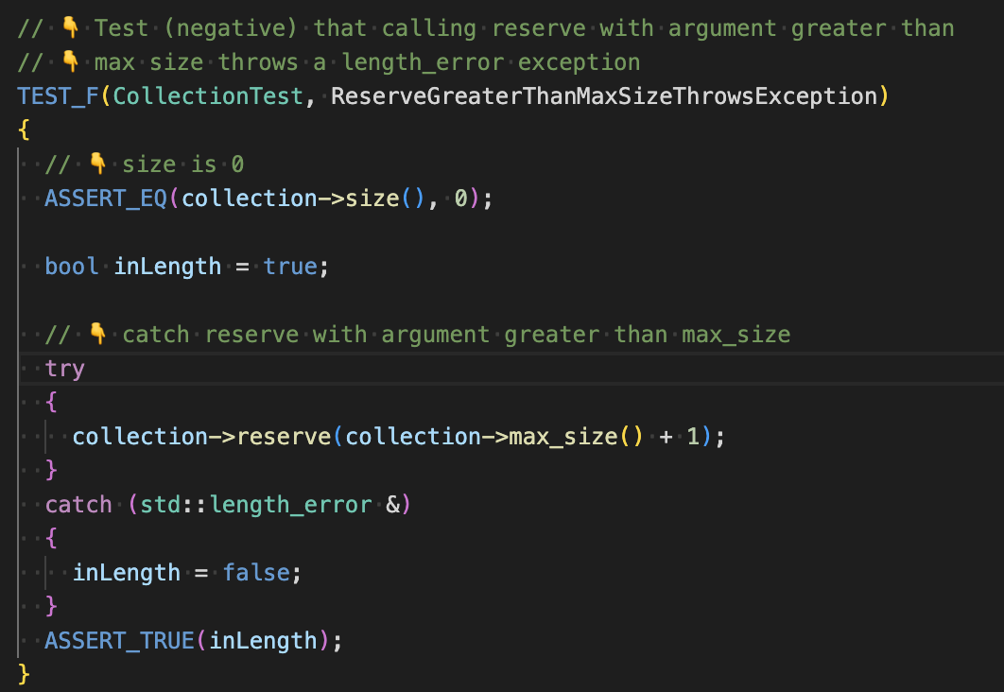
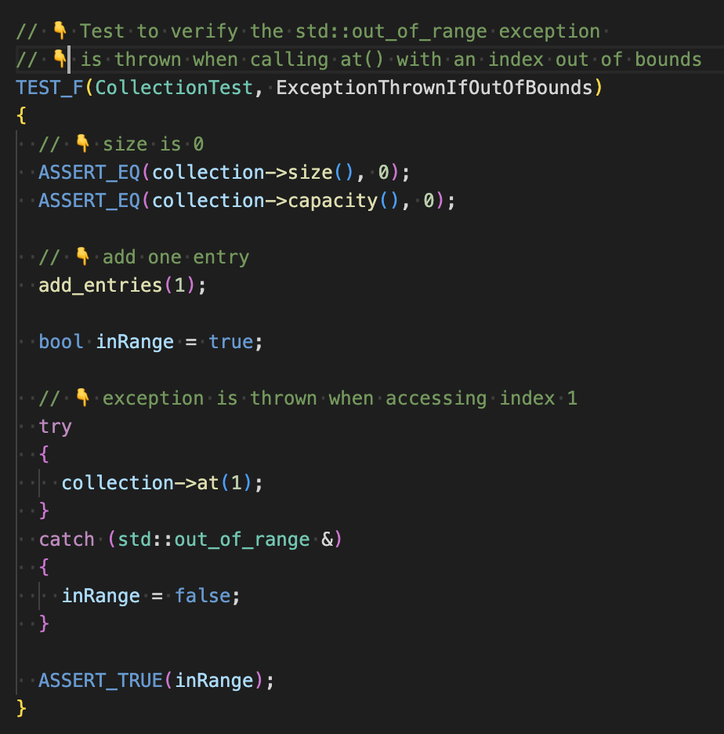
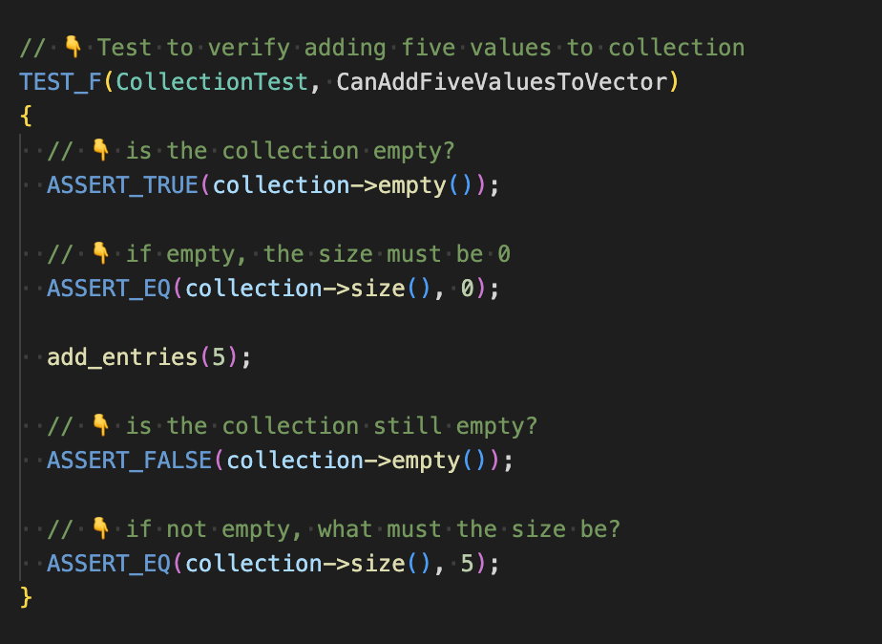
Unit Testing for String Correctness
Coding Standard 3 - String Correctness - STD-003-CPP - Range check element access.

Slide 9

AUTOMATION SUMMARY
Automation should be a part of the build and verify phases of pre-production. Static code scans should be required as well as validation from the development team that testing has been completed. In terms of automation within the CI/CD pipeline, GitOps can be utilized to implement automated code scanning tools when commits are made to internal repositories. Automated gatekeeping processes should prevent applications with known vulnerabilities from being deployed in production until the findings are remediated.

Slide 10
TOOLS
The CI/CD pipeline should be initiated by a Git hook. Scans will be initiated as a result of the webhook. This will add time to the build process; however, it is a fundamental way to assure compliance with common coding standards.
Checkmarx: a Static Application Security Testing (SAST) tool which provides fast and accurate incremental or full scans and gives you the flexibility, accuracy, integrations, and coverage to secure your applications
Cppcheck: a static analysis tool for C/C++ code. It provides unique code analysis to detect bugs and focuses on detecting undefined behaviour and dangerous coding constructs.
Clang: a compiler front end for the C, C++, Objective-C, and Objective-C++ programming languages, as well as the OpenMP, OpenCL, RenderScript, CUDA, and HIP frameworks.

Slide 11
RISKS AND BENEFITS
Risk of waiting
Code debt
Data loss/Loss of customer trust
Financial cost (compliance)
Benefits of early action
Prevent possible damage by prevention
Uniform DiD
Reduce incident response overhead
Example
2012 Sony Pictures Europe Breach
> 1 million users affected
SQL injection attack

Slide 12
RECOMMENDATIONS
Policy is a living document: It should be subjected to regular reviews and updates as gaps are identified.
Third-party validation: Annual checks from an outside source, such as a white hat security firm, will help to give security a real-world test and find possible vulnerabilities.
Create a roadmap for implementing the policies as discussed ASAP

Slide 13
CONCLUSIONS
The phrase “don’t leave security to the end” means that systems should be designed and implemented with security in mind. Security is often overlooked and is acknowledged to be a very complex ecosystem; however, there are well-established and simple guidelines for best practice when it comes to secure architecting and coding. At the lowest level, preventing threats begins at securing business-critical data.

Slide 14
REFERENCES
Checkmarx Ltd. (2022, November 23). CHECKMARX SAST: SCAN WITH EASE AT THE SOURCE CODE LEVEL. Checkmarx.com. Retrieved February 19, 2023, from https://checkmarx.com/cxsast-source-code-scanning
LLVM Developer Group. (n.d.). Getting started: Building and running clang. Clang. Retrieved February 19, 2023, from https://clang.llvm.org/get_started.html
Marjamäki, D. (n.d.). Cppcheck - A tool for static C/C++ code analysis. Cppcheck. Retrieved February 19, 2023, from https://cppcheck.sourceforge.io/

