Slide 1
Search strategy
Method
All SNPs
Step 1:
Family-wise significant single-locus p-value cutoff
Single-locus p-value
Significant SNPs (A)
Non-significant SNPs (B)
Step 2:
two-locus tests
Epistatic search
Conditional search
Simultaneous search
The single-locus p-value cutoff and the corresponding three search situations are used to avoid the domination of a few significant SNPs (A) on interactions, while the marginal effects are accounted for interaction tests in PIAM.

Slide 2
Two-stage strategy
Method
Non-significant SNPs (B)
Stage-1 p-value
p < Stage-1 p-value
p >= Stage-1 p-value
Subset B1
Subset B2
Exhaustive search strategy
This two-stage strategy can be used in the simultaneous search to save computational time but it increases risk of missing loci with small marginal effects. In fact, exhaustive search is already computationally feasible with common computers.
Either Significant strategy
Both Significant strategy

Slide 3
Hypothesis test approach
Method
Logistic regression, likelihood ratio test (model comparison)
log(odds) ~ b0+b1*x1+b2*x2+b3*x3+b4*x4+b5*x5+b6*x6+b7*x7+b8*x8
SNP1 SNP2 SNP1*SNP2 interaction
calculate deviance D_full = -2*ln(likelihood of the full model), and
compare with a submodel, for example:
log(odds) ~ b0+b1*x1+b2*x2+b3*x3+b4*x4
SNP1 SNP2
calculate deviance D_sub = -2*ln(likelihood of the submodel), then
likelihood ratio statistic R = D_sub – D_full
R ~ Chisq (df = df_full – df_sub = 4)
This example is a test for interaction above and over marginal effects, used for the epistatic search.

Slide 4
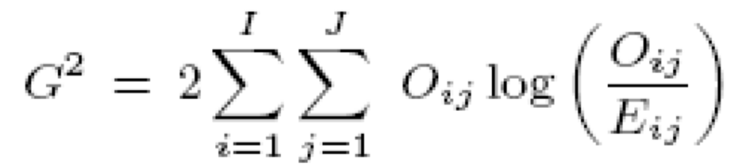
Hypothesis test approach
Method
Test marginal + interaction effects for the simultaneous search
use the full model, calculate D_full,
compare with the null model:
log(odds) ~ b0, D_null
then R = D_null – D_full
= Gsq_full.
This R can be calculated using 2 by 9 contingency table -
test of independence - G-square test, which is equivalent to R.
 | AABB | AaBB | aaBB | AABb | AaBb | AaBb | AAbb | Aabb | aabb
case | f1 | f2 | f3 | f4 | f5 | f6 | f7 | f8 | f9
ctrl | g1 | g2 | g3 | g4 | g5 | g6 | g7 | g8 | g9

Slide 5
Hypothesis test approach
Method
Epistatic search
(situation 2, test for interaction):
log(odds) ~ b0 + SNP1 + SNP2 + interaction D_full
log(odds) ~ b0 + SNP1 + SNP2 D_snp1+snp2
R = D_snp1+snp2 – D_full
Conditional search
(situation 1, test for marginal + interaction effects of SNP2 conditional on SNP1):
log(odds) ~ b0 + SNP1 + SNP2 + interaction D_full
log(odds) ~ b0 + SNP1 D_snp1
R = D_snp1 – D_full = (D_null – Gsq_snp1) – (D_null – Gsq_full)
= Gsq_full – Gsq_snp1
Gsq_snp1: 2 by 3 contingency table - test of independence - G-square test
Simultaneous search
(situation 0, test all effects of SNP1 and SNP2):
log(odds) ~ b0 + SNP1 + SNP2 + interaction D_full
log(odds) ~ b0 D_null
R = D_null – D_full = Gsq_full
Bonferroni correction is used for N multiple tests, in which N is the number of tests for all three search situations.

Slide 6
Approximate statistical distribution
Method
This is used to get the overall observed distribution of the huge number of test statistics (for QQ plots, etc). Predefine very small intervals for the Chi-square statistic or -log10(p), and count the numbers of the statistics within each region during the interaction search. For example,
0.000 - 0.001 n1
0.001 - 0.002 n2
a(t) - b(t) n(t)
69.999 - 70.000 n(m-1)
70.000 - Infinity nm
Then treat them as if there were N values, with n(t) numbers of values equal to a(t).
Length of intervals = 0.001
Ranges: a1 - b1, a2 - b2, …
a(m) is the maximum
n1 + n2 + … + nm = N

