Slide 1
Python Programming
January 2018

Slide 2
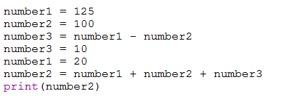
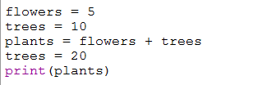
Do Now
P R I M M
Look at these questions and choose the right answer.
Question 1 Question 2
Here is some Python code
Here is some Python code
What would be printed on the screen?
25
15
20
5
What would be printed on the screen?
235
145
130
255
Now discuss in groups of 3 – make a decision and then share your answers

Slide 3
Lesson objectives
Today we are using three new Python keywords:
def
if
else
At the end of this lesson you should be able to
write a function using def
write programs that give different responses depending on what is typed in at the keyboard
Know the difference between = and ==

Slide 4
Activity – 20 minutes
P R I M M
Follow the worksheet Tasks 1 – 3
Check your answers on the answer sheet when you have finished

Slide 5
Activity – Your answers
P R I M M
What would happen if the program used the word Print() instead of print() ?
What would happen if you type “Yes” instead of “yes” or “no” when running the program? (try it and see)
What is def used for?
Why does the program include conversation() at the bottom of the program?
Why do you need a colon : at the end of the if statement and the word else?
What is the difference between = and == ? Both are used in this program.
What would be the difference between running these two lines
answer = input()
answer = input(“Select 1 or 2…”) ?
Why is print(“Goodbye”) a few spaces left of the lines above? What happens if you change this?

Slide 6
Exercises – 20 mins
P R I M M
Now work through the exercises in Task 4 in pairs

Slide 7
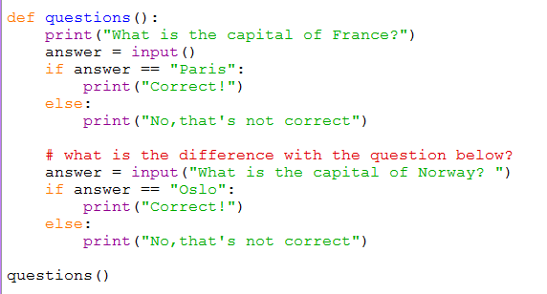
Review
P R I M M
What is the difference between the two questions when they appear on the screen?

Slide 8

Review - answer
P R I M M
In the next lesson we will be writing a quiz.

