Slide 1
Python Programming
Lesson 3: elif
January 2018

Slide 2
Lesson objectives
To understand how to write programs that involve more than two choices
To write a quiz program

Slide 3
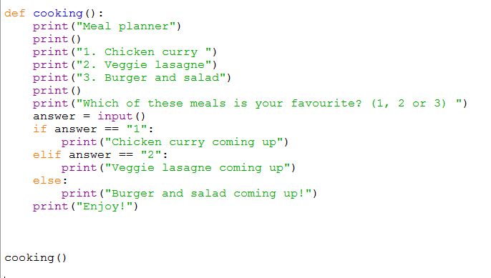
Do Now in Pairs – 5 mins
P R I M M
What does this code do?
Show what you think will be output to the screen.

Slide 4
Tasks in pairs – 15 minutes
P R I M M
On your own:
Download the cooking program and check that it does what you thought it would.
Change the meals to meals that you like and add “None of these as an option”.
Make a new copy of your code and (secretly) add 5 errors to it
Swap programs with your partner.
See if you can find and correct the 5 errors.
Write comments in the program where you found them

Slide 5
Developing a quiz – 30 minutes
P R I M M
Using your Python skills so far you are going to develop a quiz of 5 questions about Geography
First write down 5 questions and 3 possible answers to each
Then write your program
Test all the different options
You will be scored on whether it works, whether you have good questions, and how well it is presented (spacing, grammar etc.)

Slide 6
Example

Slide 7
Review – 10 minutes
P R I M M
Swap computers with another pair and ask them to test your quiz.
Score the quiz as follows:
Give your feedback to the pair you swapped with
 | Amazing | Pretty good | Room for improvement
Does it run without any errors? | 6 | 4 | 2
Do all the questions make sense? | 6 | 4 | 2
Is it well presented? | 6 | 4 | 2
Comments and Total score

