Slide 1
Overview
Theory: Cartesian Control
Theory: Gaze Controller
Introduction to Interfaces for Operational Control
Tutorials (together)
Test code (on your own)

Slide 2
Prerequisites
YARP Ports
iCub_SIM
Acquiring and processing YARP Images
YARP Motor Interfaces (IPositionControl, IEncoders …)
Configuration (Joint) Space Control
You know q (joints set-points), you can control directly the motors
Operational (Cartesian) Space Control
You know x (3D/6D points), you cannot control directly the motors, you have to solve the Inverse Kinematics (IK) problem beforehand.
x
IK
q

Slide 3
The Problem

Slide 4
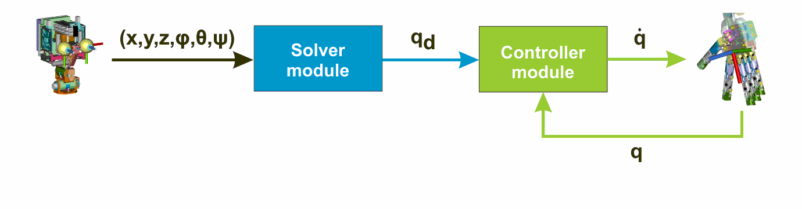
The Cartesian Controller (1/6)
Notes:
task: Morasso, Flash Hogan
joint: Hollerbach
multiple: Paillard, Desmurget

Slide 5
The Cartesian Controller (2/6)
Quick convergence (real-time compliant: < 20 ms)
Scalability
Singularities and joints bound handling
Tasks hierarchy
Complex constraints
Notes:
Andreas Waetcher (IBM)
Work also with fancy ML layers (hybrid as well)

Slide 6
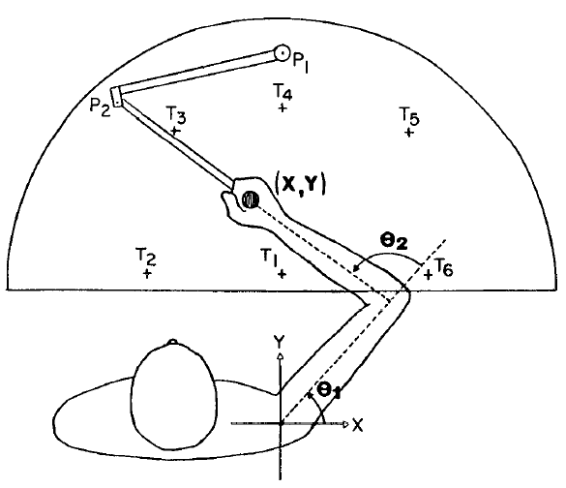
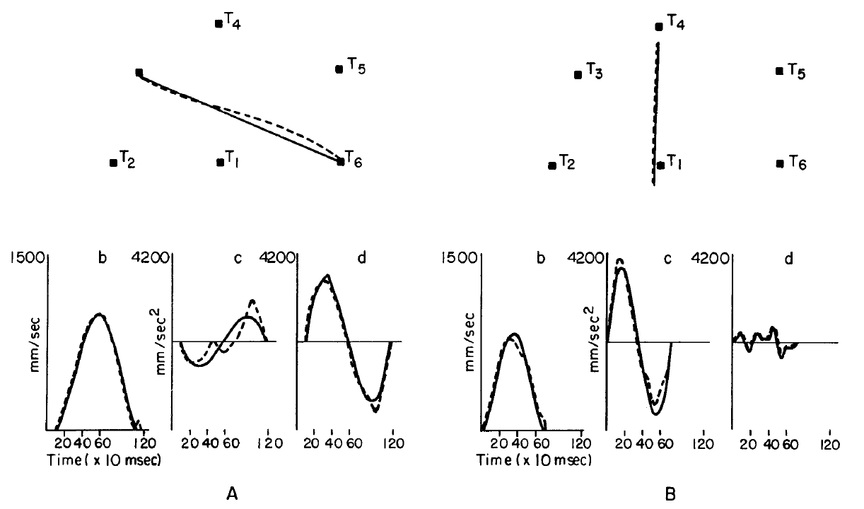
The Cartesian Controller (3/6)
Notes:
Flash Hogan 1985

Slide 7
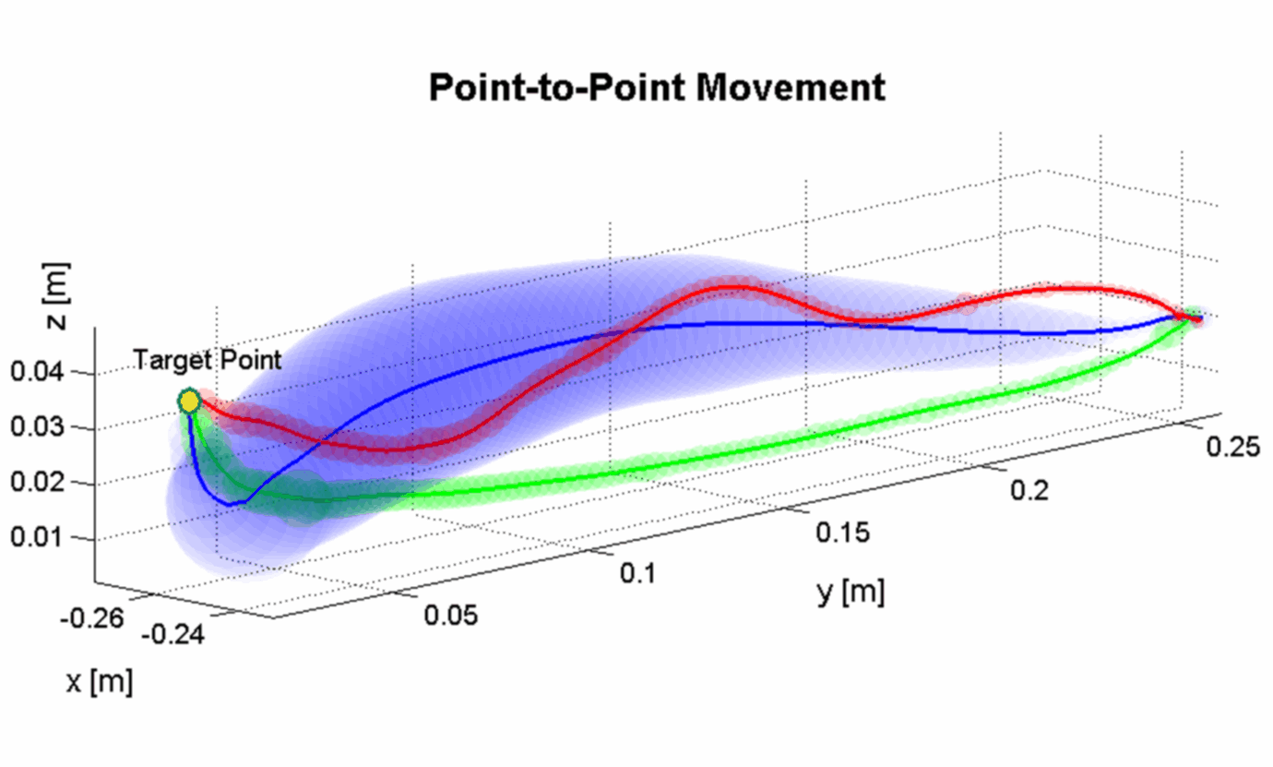
The Cartesian Controller (4/6)
Min-Jerk
DLS
VITE
Notes:
DLS+GPM for the 2nd task (KDL)

Slide 8
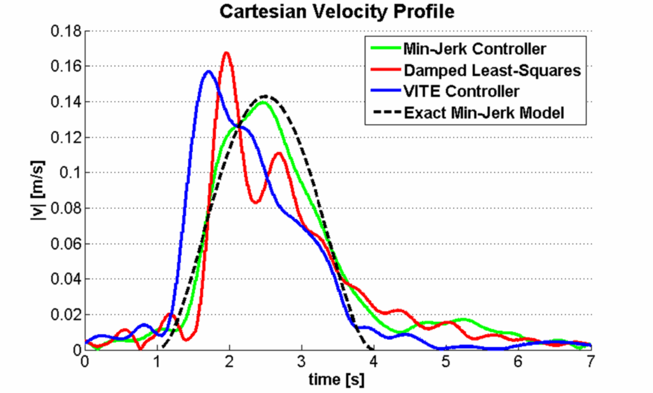
The Cartesian Controller (5/6)
Gain Factors
= 44 %
= 69 %
Min-Jerk
DLS
VITE

Slide 9
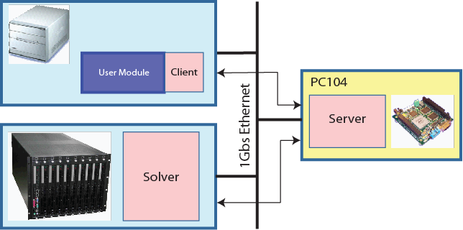
The Cartesian Controller (6/6)

Slide 10
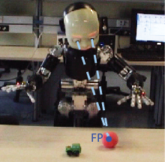
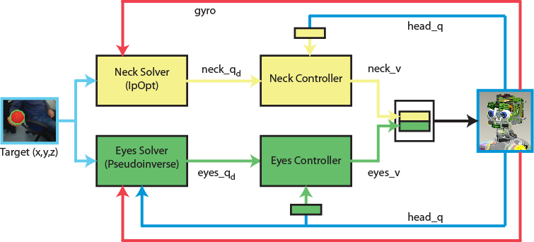
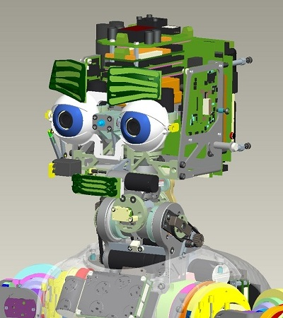
The Gaze Controller (1/3)
Yet another Cartesian Controller: reuse ideas …
Then, apply easy transformations from Cartesian to …
Egocentric angular space
Image planes (mono and stereo)
FP
θ

Slide 11
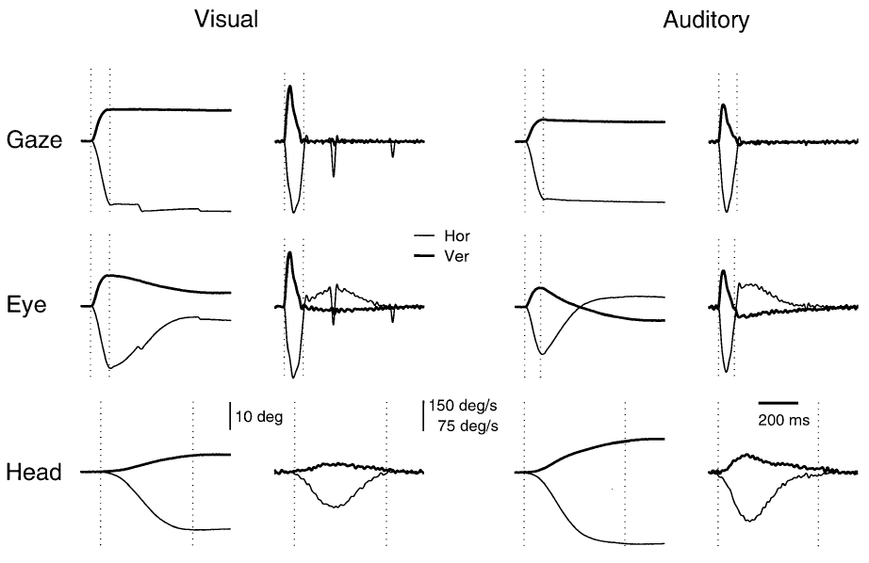
The Gaze Controller (2/3)
Studies on humans …
Notes:
Goossens, Van Opstal 1997

Slide 12
The Gaze Controller (3/3)
Results on iCub …

Slide 13
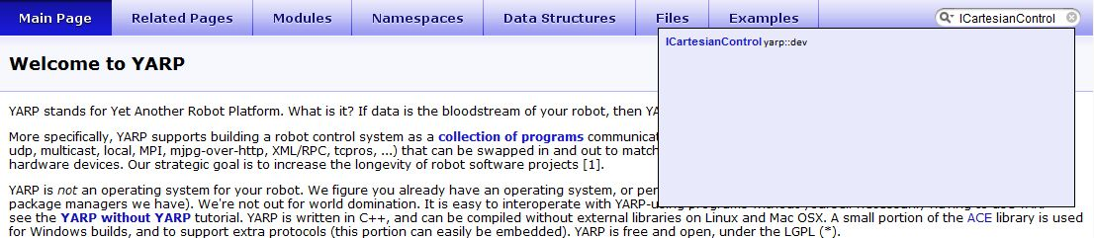
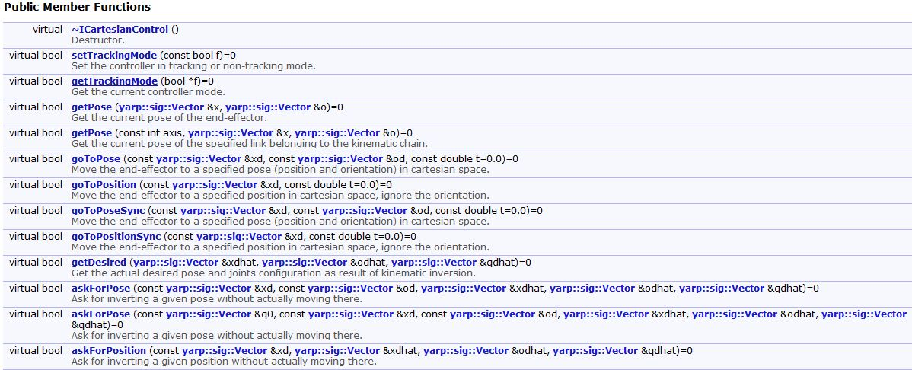
Interfaces Documentation
In the search field: type ICartesianControl/IGazeControl
. . .
Doxygen Documentation

Slide 14
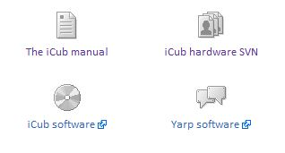
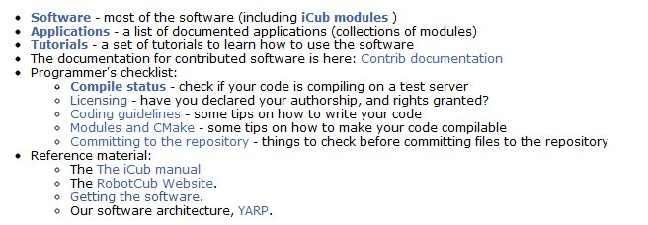
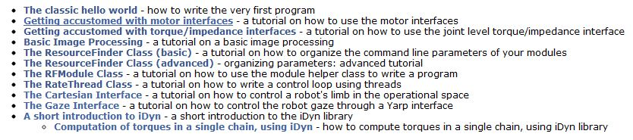
Interfaces Tutorials

Slide 15
Interfaces Communalities (1/3)
OPENING THE CARTESIAN INTERFACE
#include <yarp/dev/all.h>
Property option;
option.put("device","cartesiancontrollerclient");
option.put("remote","/icub/cartesianController/right_arm");
option.put("local","/client/right_arm");
PolyDriver clientCartCtrl(option);
ICartesianControl *icart=NULL;
if (clientCartCtrl.isValid()) {
clientCartCtrl.view(icart);
}

Slide 16
Interfaces Communalities (2/3)
OPENING THE GAZE INTERFACE
#include <yarp/dev/all.h>
Property option;
option.put("device",“gazecontrollerclient");
option.put("remote","/iKinGazeCtrl");
option.put("local","/client/gaze”);
PolyDriver clientGazeCtrl(option);
IGazeControl *igaze=NULL;
if (clientGazeCtrl.isValid()) {
clientGazeCtrl.view(igaze);
}

Slide 17
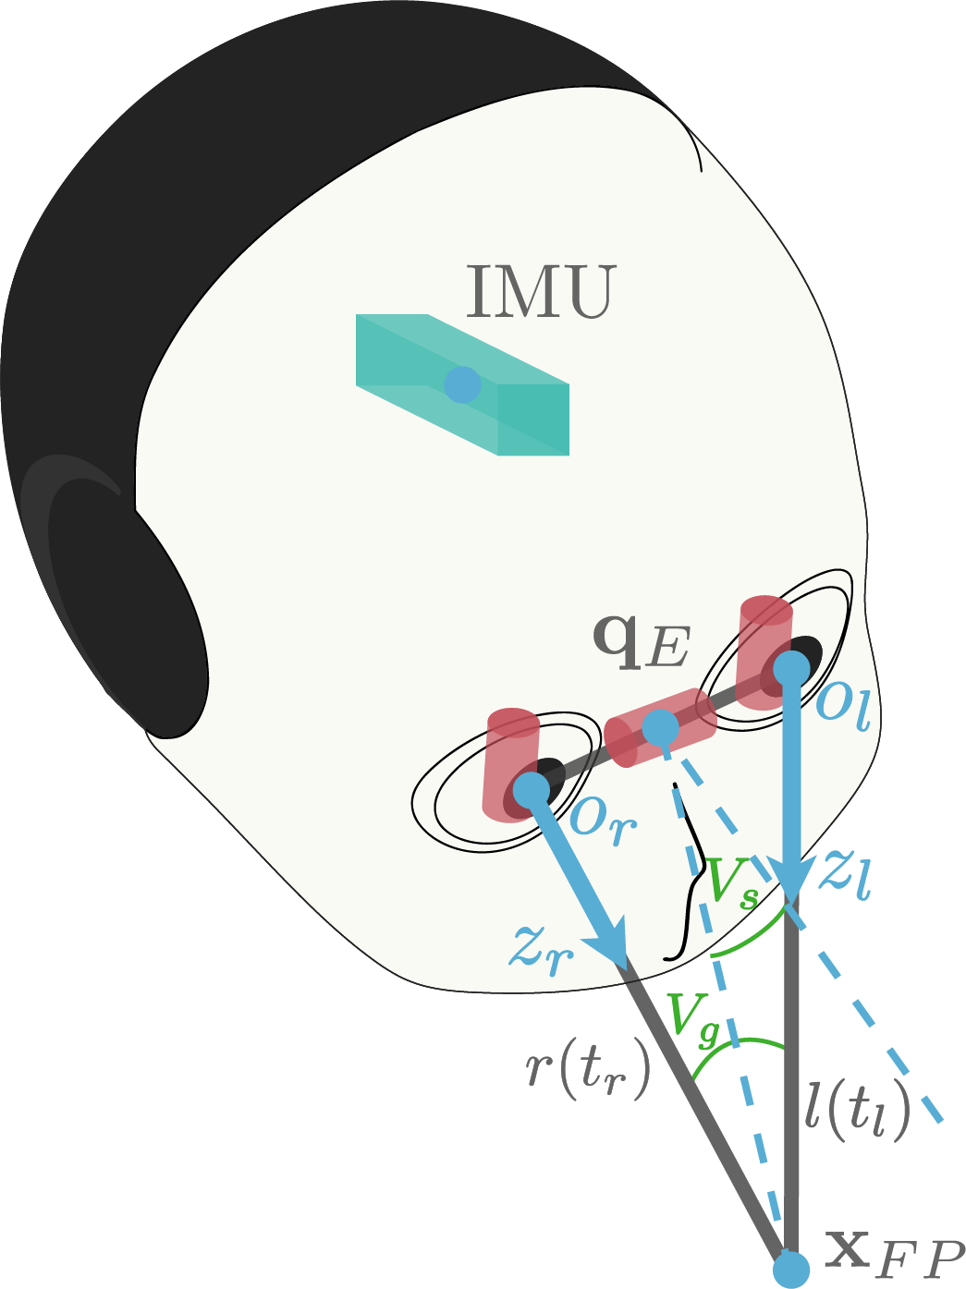
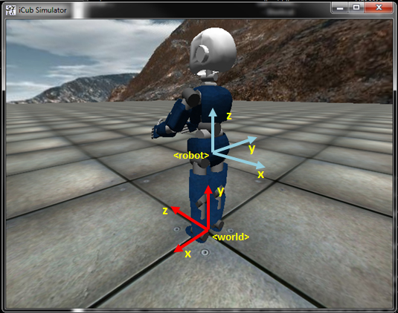
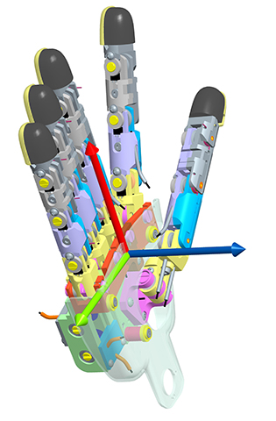
Interfaces Communalities (3/3)
Coordinate Systems

Slide 18
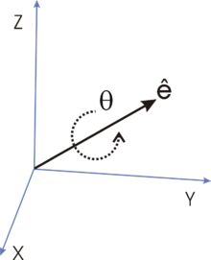



Cartesian Interface (1/7)
Orientation: Axis-Angle
$$r=\left[e_{x} e_{y} e_{z} θ\right]$$
$$\left\|e\right\|=1$$
$$rad$$
TARGET ORIENTATION through DIRECTION COSINE MATRIX
Matrix R(3,3);
// pose x-axis y-axis z-axis
R(0,0)= 0.0; R(0,1)= 1.0; R(0,2)= 0.0; // x-coordinate
R(1,0)= 0.0; R(1,1)= 0.0; R(1,2)=-1.0; // y-coordinate
R(2,0)=-1.0; R(2,1)= 0.0; R(2,2)= 0.0; // z-coordinate
Vector o=ctrl::dcm2axis(R);

Slide 19
Cartesian Interface (2/7)
RETRIEVE CURRENT POSE
Vector x,o;
icart->getPose(x,o);
REACH FOR A TARGET POSE (SEND-AND-FORGET)
icart->goToPose(xd,od);
icart->goToPosition(xd);
REACH FOR A TARGET POSE (WAIT-FOR-REPLY)
icart->goToPoseSync(xd,od);
icart->goToPositionSync(xd);
REACH AND WAIT
icart->goToPoseSync(xd,od);
icart->waitMotionDone();

Slide 20
Cartesian Interface (3/7)
ASK FOR A POSE (without moving)
Vector xdhat,odhat,qdhat;
icart->askForPose(xd,xdhat,odhat,qdhat);
MOVE FASTER/SLOWER
icart->setTrajTime(1.5); // point-to-point trajectory time
REACH WITH GIVEN PRECISION
icart->setInTargetTol(0.001);
KEEP THE POSE ONCE DONE
icart->setTrackingMode(true);

Slide 21
Cartesian Interface (4/7)
ENABLE/DISABLE DOF
Vector curDof;
icart->getDOF(curDof); // [0 0 0 1 1 1 1 1 1 1]
Vector newDof(3);
newDof[0]=1; // torso pitch: 1 => enable
newDof[1]=2; // torso roll: 2 => skip
newDof[2]=1; // torso yaw: 1 => enable
icart->setDOF(newDof,curDof);
GIVE PRIORITY TO REACHING IN POSITION/ORIENTATION
icart->setPosePriority(“position”); // default
icart->setPosePriority(“orientation”);

Slide 22
Cartesian Interface (5/7)
CONTEXT SWITCH
icart->setDOF(newDof1,curDof1); // prepare the context
icart->setTrackingMode(true);
int context_0;
icart->storeContext(&context_0); // latch the context
icart->setDOF(newDof2,curDof2); // perform some actions
icart->goToPose(x,o);
icart->restoreContext(context_0); // retrieve context_0
icart->goToPose(x,o); // perform with context_0

Slide 23
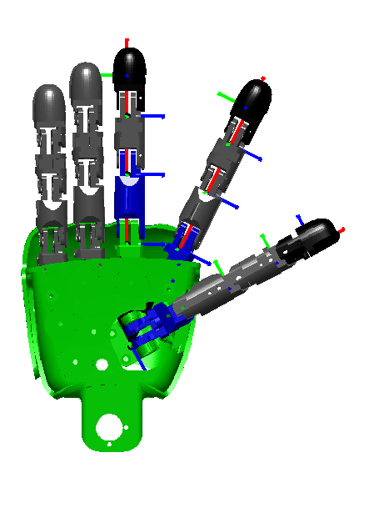
Cartesian Interface (6/7)
DEFINING A DIFFERENT EFFECTOR
iCubFinger finger("right_index");
Vector encs; iencs->getEncoders(encs.data());
Vector joints; finger.getChainJoints(encs,joints);
Matrix tipFrame=finger.getH((M_PI/180.0)*joints);
Vector tip_x=tipFrame.getCol(3);
Vector tip_o=ctrl::dcm2axis(tipFrame);
icart->attachTipFrame(tip_x,tip_o);
icart->getPose(x,o);
icart->goToPose(xd,od);
icart->removeTipFrame();

Slide 24
Cartesian Interface (7/7)
Find out more (e.g. Events Callbacks …):
http://wiki.icub.org/iCub/main/dox/html/icub_cartesian_interface.html
USING THE INTERFACE ALONG WITH THE SIMULATOR
1> iCub_SIM
2> simCartesianControl
3> iKinCartesianSolver --context simCartesianControl --part left_arm
option.put("device","cartesiancontrollerclient");
option.put("remote","/icubSim/cartesianController/left_arm");
option.put("local","/client/right_arm");

Slide 25
Gaze Interface (1/6)
GET CURRENT FIXATION POINT IN CARTESIAN DOMAIN
Vector x;
igaze->getFixationPoint(x);
GET CURRENT FIXATION POINT IN ANGULAR DOMAIN
Vector ang;
igaze->getAngles(ang);
// ang[0] => azimuth [deg]
// ang[1] => elevation [deg]
// ang[2] => vergence [deg]
LOOK AT 3D POINT
igaze->lookAtFixationPoint(xd);
… IN ANGULAR DOMAIN
igaze->lookAtAbsAngles(ang);
igaze->lookAtRelAngles(ang);

Slide 26
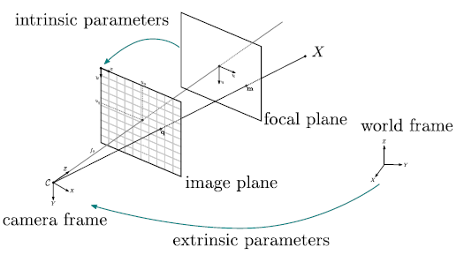
Gaze Interface (2/6)
LOOK AT POINT IN IMAGE DOMAIN

Slide 27
Gaze Interface (3/6)
LOOK AT POINT IN IMAGE DOMAIN
int camSel=0; // 0 => left, 1 => right
Vector px(2);
px[0]=100;
px[1]=50;
double z=1.0;
igaze->lookAtMonoPixel(camSel,px,z);
… EQUIVALENT TO
Vector x;
igaze->get3DPoint(camSel,px,z,x);
igaze->lookAtFixationPoint(x);

Slide 28
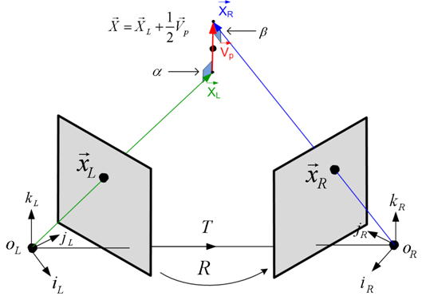
Gaze Interface (4/6)
GEOMETRY OF PIXELS
Vector x;
igaze->get3DPointOnPlane(camSel,px,plane,x);
igaze->get3DPointFromAngles(mode,ang,x);
igaze->triangulate3DPoint(pxl,pxr,x);

Slide 29
Gaze Interface (5/6)
GEOMETRY OF PIXELS
Vector x;
igaze->get3DPointOnPlane(camSel,px,plane,x);
igaze->get3DPointFromAngles(mode,ang,x);
igaze->triangulate3DPoint(pxl,pxr,x);
LOOK AT POINT WITH STEREO APPROACH => LOOPING!
Vector c(2); c[0]=160.0; c[1]=120.0;
bool converged=false;
while (!converged) {
Vector pxl(2),pxr(2);
pxl[0]=...; pxl[1]=...; // retrieve data from vision
pxr[0]=...; pxr[1]=...;
igaze->lookAtStereoPixels(pxl,pxr);
converged=(0.5*(norm(c-pxl)+norm(c-pxr))<5);
}

Slide 30
Gaze Interface (6/6)
Find out more (e.g. Events Callbacks, Fast Saccadic Mode …):
http://wiki.icub.org/iCub/main/dox/html/icub_gaze_interface.html
USING THE INTERFACE ALONG WITH THE SIMULATOR
1> iCub_SIM
2> iKinGazeCtrl --from configSim.ini
option.put("device",“gazecontrollerclient");
option.put("remote","/iKinGazeCtrl”);
option.put("local","/client/right_arm");

Slide 31
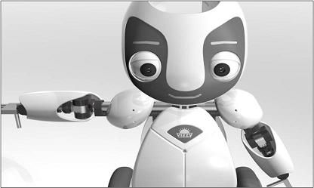
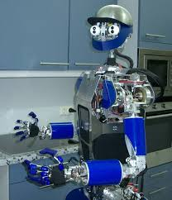
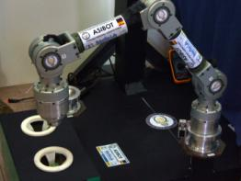
Interfaces Customization
ICartesianControl
IVelocityControl
IEncoders
VIZZY
IControlLimits
ARMAR III
ASIBOT

