Slide 1
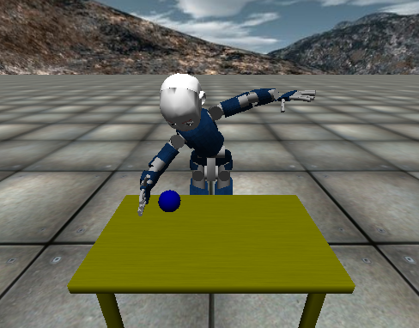
Make It Roll
Activate objects within the simulator: turn on the switch “objects” in the file iCub_parts_activation.ini
Make iCub look down to the table
Detect the blue ball in both images planes
Retrieve the ball position in the Cartesian domain
Ask iCub to reach for the ball and make it roll!
You have to fill in the gaps in the CMake files, main.cpp module so as the application files.
Create a repository on your GitHub account and publish therein your solution.

