Slide 1
Services Used

Slide 2
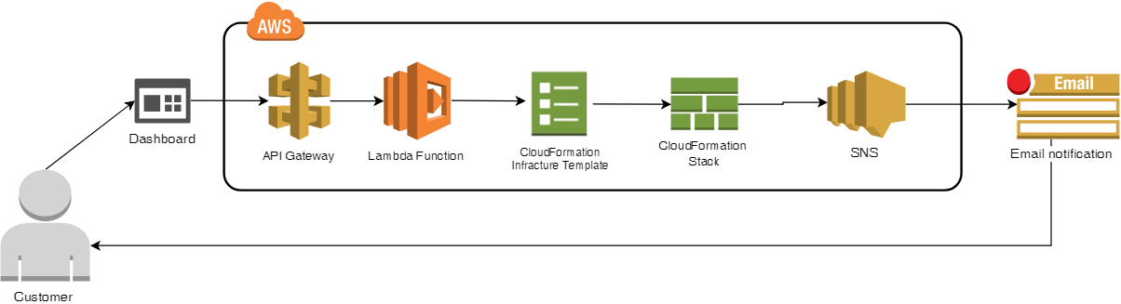
Infrastructure Deployment

Slide 3
API Gateway
Amazon API Gateway is a fully managed service that makes it easy for developers to create, publish, maintain, monitor, and secure APIs at any scale. With a few clicks in the AWS Management Console, you can create REST and WebSocket APIs that act as a “front door” for applications to access data, business logic, or functionality from your backend services, such as workloads running on Amazon Elastic Compute Cloud (Amazon EC2), code running on AWS Lambda, any web application, or real-time communication applications.
API Gateway handles all the tasks involved in accepting and processing up to hundreds of thousands of concurrent API calls, including traffic management, authorization and access control, monitoring, and API version management.

Slide 4
Lambda Function
AWS Lambda is a compute service that lets you run code without provisioning or managing servers. AWS Lambda executes your code only when needed and scales automatically, from a few requests per day to thousands per second. With AWS Lambda, you can run code for virtually any type of application or backend service - all with zero administration. AWS Lambda runs your code on a high-availability compute infrastructure and performs all of the administration of the compute resources, including server and operating system maintenance, capacity provisioning and automatic scaling, code monitoring and logging. All you need to do is supply your code in one of the languages that AWS Lambda supports (currently Node.js, Java, C#, Go and Python).

Slide 5
Virtual Private Cloud
Amazon Virtual Private Cloud (Amazon VPC) lets you provision a logically isolated section of the AWS Cloud where you can launch AWS resources in a virtual network that you define. You have complete control over your virtual networking environment, including selection of your own IP address range, creation of subnets, and configuration of route tables and network gateways. You can use both IPv4 and IPv6 in your VPC for secure and easy access to resources and applications.
You can easily customize the network configuration for your Amazon VPC. You can create a public-facing subnet for your web servers that has access to the Internet, and place your backend systems such as databases or application servers in a private-facing subnet with no Internet access. You can leverage multiple layers of security, including security groups and network access control lists, to help control access to Amazon EC2 instances in each subnet.

Slide 6
EC2 Instance
Amazon Elastic Compute Cloud (Amazon EC2) provides scalable computing capacity in the Amazon Web Services (AWS) cloud. Using Amazon EC2 eliminates your need to invest in hardware up front, so you can develop and deploy applications faster. You can use Amazon EC2 to launch as many or as few virtual servers as you need, configure security and networking, and manage storage. Amazon EC2 enables you to scale up or down to handle changes in requirements or spikes in popularity, reducing your need to forecast traffic.

Slide 7
Simple Notification Service
Amazon Simple Notification Service (SNS) is a highly available, durable, secure, fully managed pub/sub messaging service that enables you to decouple microservices, distributed systems, and serverless applications. Amazon SNS provides topics for high-throughput, push-based, many-to-many messaging. Using Amazon SNS topics, your publisher systems can fan out messages to a large number of subscriber endpoints for parallel processing, including Amazon SQS queues, AWS Lambda functions, and HTTP/S webhooks. Additionally, SNS can be used to fan out notifications to end users using mobile push, SMS, and email.

Slide 8
Elastic Block Store
Amazon Elastic Block Store (Amazon EBS) provides persistent block storage volumes for use with Amazon EC2 instances in the AWS Cloud. Each Amazon EBS volume is automatically replicated within its Availability Zone to protect you from component failure, offering high availability and durability. Amazon EBS volumes offer the consistent and low-latency performance needed to run your workloads. With Amazon EBS, you can scale your usage up or down within minutes – all while paying a low price for only what you provision.

Slide 9
Amazon S3
Amazon Simple Storage Service (Amazon S3) is an object storage service that offers industry-leading scalability, data availability, security, and performance. This means customers of all sizes and industries can use it to store and protect any amount of data for a range of use cases, such as websites, mobile applications, backup and restore, archive, enterprise applications, IoT devices, and big data analytics. Amazon S3 provides easy-to-use management features so you can organize your data and configure finely-tuned access controls to meet your specific business, organizational, and compliance requirements. Amazon S3 is designed for 99.999999999% (11 9's) of durability, and stores data for millions of applications for companies all around the world.

Slide 10
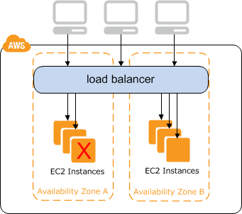
Elastic Load Balancer
Elastic Load Balancing distributes incoming application or network traffic across multiple targets, such as Amazon EC2 instances, containers, and IP addresses, in multiple Availability Zones. Elastic Load Balancing scales your load balancer as traffic to your application changes over time, and can scale to the vast majority of workloads automatically.

Slide 11
Subnets
A VPC spans all the Availability Zones in the region. After creating a VPC, you can add one or more subnets in each Availability Zone. When you create a subnet, you specify the CIDR block for the subnet, which is a subset of the VPC CIDR block. Each subnet must reside entirely within one Availability Zone and cannot span zones. Availability Zones are distinct locations that are engineered to be isolated from failures in other Availability Zones. By launching instances in separate Availability Zones, you can protect your applications from the failure of a single location. We assign a unique ID to each subnet.

Slide 12
Internet Gateway
An internet gateway is a horizontally scaled, redundant, and highly available VPC component that allows communication between instances in your VPC and the internet. It therefore imposes no availability risks or bandwidth constraints on your network traffic.
An internet gateway serves two purposes: to provide a target in your VPC route tables for internet-routable traffic, and to perform network address translation (NAT) for instances that have been assigned public IPv4 addresses.
An internet gateway supports IPv4 and IPv6 traffic.

Slide 13
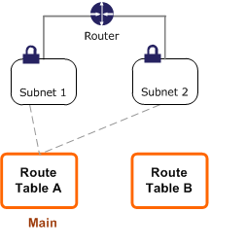
Route Table
A route table contains a set of rules, called routes, that are used to determine where network traffic is directed.
Each subnet in your VPC must be associated with a route table; the table controls the routing for the subnet. A subnet can only be associated with one route table at a time, but you can associate multiple subnets with the same route table.

Slide 14
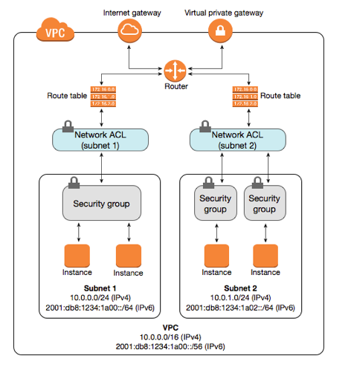
Network ACL
A network access control list (ACL) is an optional layer of security for your VPC that acts as a firewall for controlling traffic in and out of one or more subnets. You might set up network ACLs with rules similar to your security groups in order to add an additional layer of security to your VPC.

Slide 15
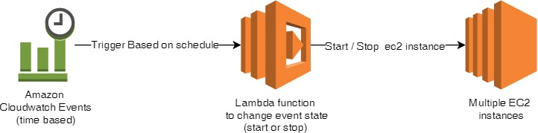
Instance Scheduling

Slide 16
Instance Scheduler
The AWS Instance Scheduler is a simple AWS-provided solution that enables customers to easily configure custom start and stop schedules for their Amazon Elastic Compute Cloud (Amazon EC2) and Amazon Relational Database Service (Amazon RDS) instances. The solution is easy to deploy and can help reduce operational costs for both development and production environments. Customers who use this solution to run instances during regular business hours can save up to 70% compared to running those instances 24 hours a day.

Slide 17
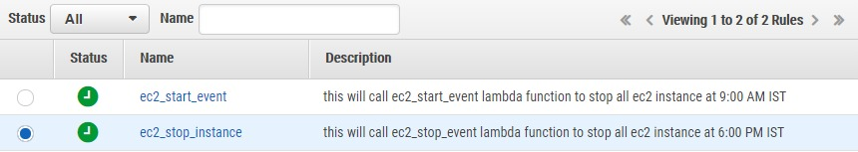
CloudWatch Triggers

Slide 18
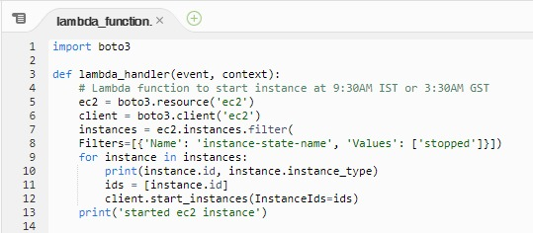
Lambda to start EC2 instance

Slide 19
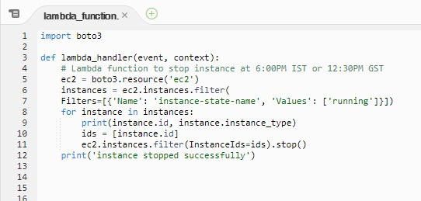
Lambda to stop EC2 instance

Slide 20
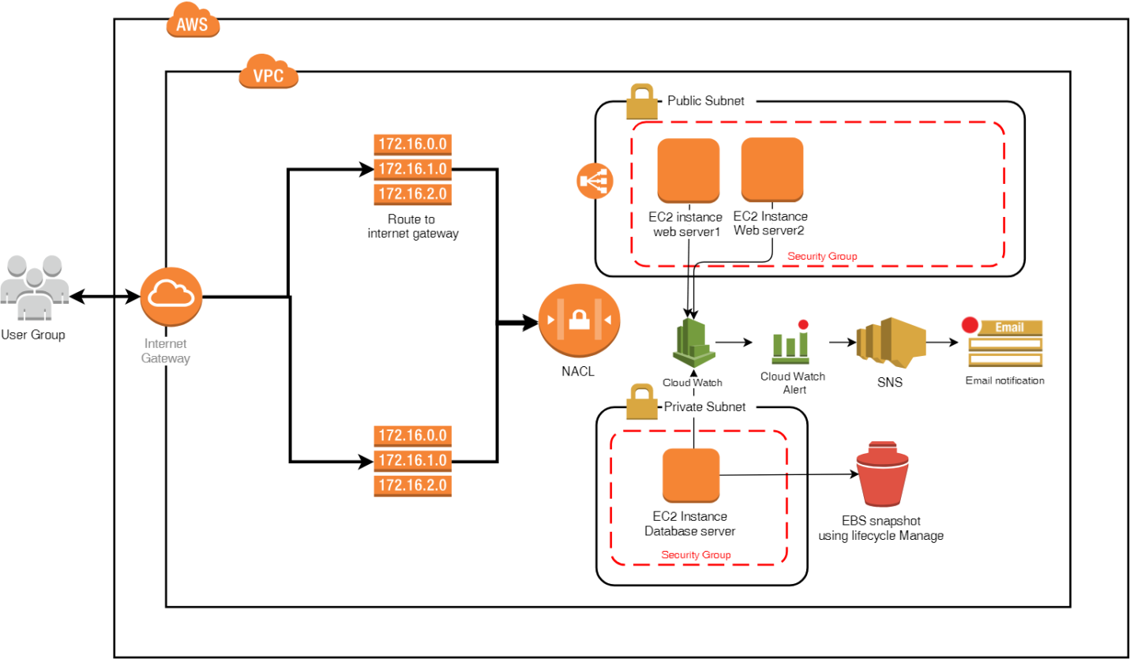
Cloud formation stack deployment

Slide 21
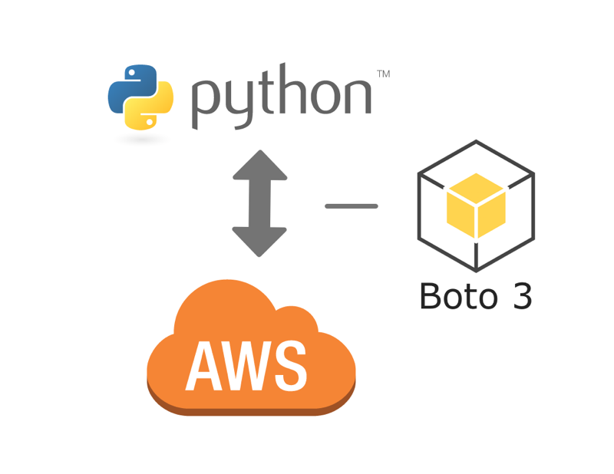
Boto 3 SDK
Boto is the Amazon Web Services (AWS) SDK for Python, which allows Python developers to write software that makes use of Amazon services like S3 and EC2. Boto provides an easy to use, object-oriented API as well as low-level direct service access.

Slide 22
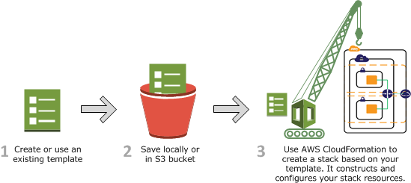
Cloud Formation
AWS CloudFormation provides a common language for you to describe and provision all the infrastructure resources in your cloud environment. CloudFormation allows you to use a simple text file to model and provision, in an automated and secure manner, all the resources needed for your applications across all regions and accounts. This file serves as the single source of truth for your cloud environment.

