Slide 1


Contoso Financial Performance Report - April 2025
Executive Summary
This report provides an overview of Contoso's financial performance for April 2025. The analysis highlights key metrics, identifies areas of strength and concern, and recommends strategies to optimize profitability.

Slide 2

Executive Overview
Net Profit
$1.373 billion
Cost of Goods
$1.376 billion
Return Amount
$41.241 million
Discount
$53.476 million
Total Sales
$3.249 billion
Data prepared using Power BI with DAX and ETL processes.

Slide 3
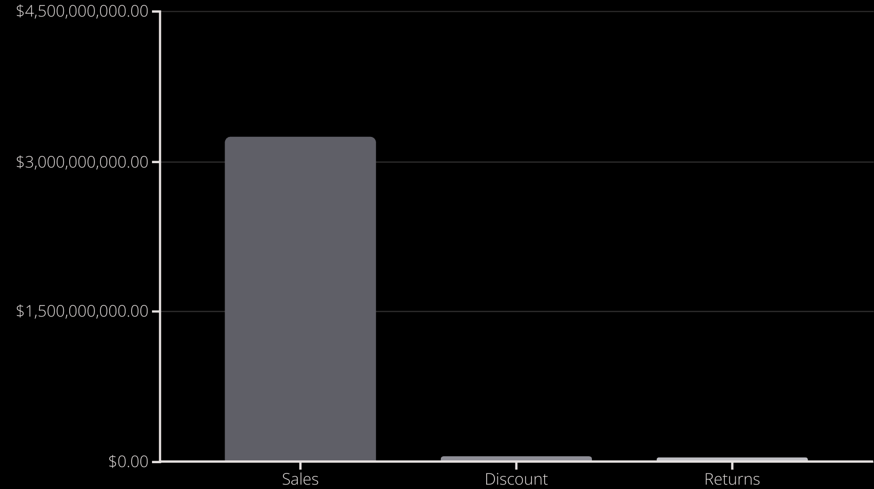
Financial Insights
Total Sales
Discounts & Returns
Contoso achieved strong total sales, reaching $3.249 billion.
High discount and return amounts are concerning, indicating potential issues with pricing or product quality.

Slide 4
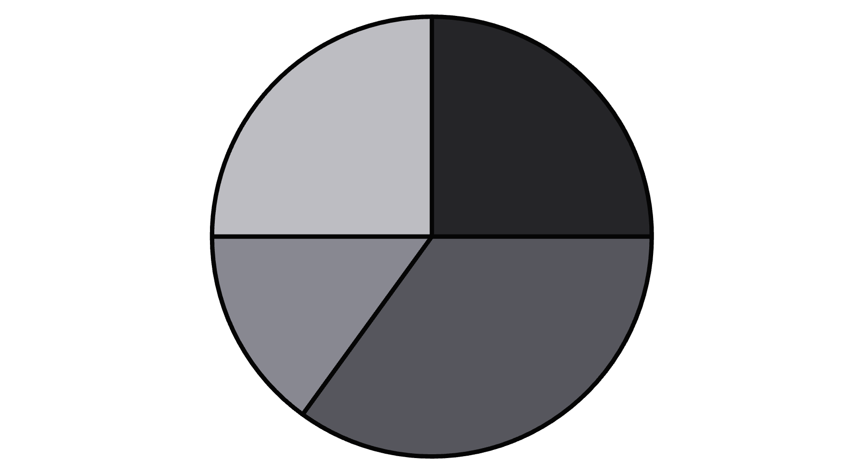
Product Category Review
Cost of Goods
Further Investigation
The consistent cost of goods across categories suggests potential data inconsistency.
A detailed analysis is recommended to identify and rectify the discrepancy.
Category A
Category B
Category C
Category D

Slide 5

Recommendations & Next Steps
1
Review Policies
Reassess discount and return policies to improve profitability and customer satisfaction.
2
Power BI Analysis
Conduct a comprehensive analysis of Contoso's financial data using the Power BI data model to identify key drivers of performance.

Slide 6

Call to Action
Discuss these recommendations and next steps at the upcoming executive meeting.

