Slide 1

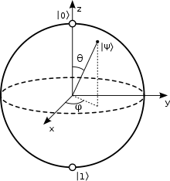
Quantum Machine Learning
Quantum classification with a gentle introduction to
PennyLane + PyTorch integration
QML classification models
Classical vs quantum classification
Class imbalance in quantum
PennyLane meets PyTorch
Wrapping quantum models
in PyTorch layers
PennyLane / PyTorch
seamless integration
Grid search
Quantum vs classical results
Adjusting the threshold
Barriers to quantum classification
PenyLane demo
Secrets revealed in this session:
To look behind the doors of quantum classification!
measurement
Pauli
rotations
Jacob L. Cybulski
Enquanted, Melbourne, Australia
We will assume
some knowledge of
Quantum Computing
ML and Python
11-12 October 2025, QPoland, Fundacja Quantum AI
Creative Commons CC BY-NC-ND

Slide 2
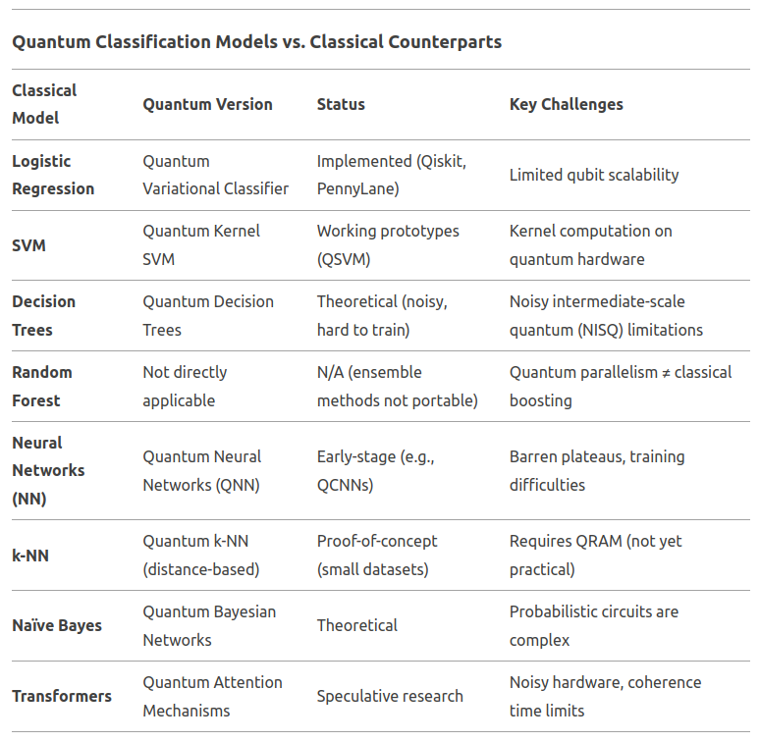
Classical classification /
Quantum classification
Class of a data sample is a group defined by a unique nominal value of one of its attributes. For instance vehicles can be grouped by:
Colour, such as “red”, “yellow” or “green”
Size, e.g. “small”, “medium” or “large”
Classification is the process of classifying data samples based on their attribute values, i.e. deciding what class value should be given to their label attribute, with a view to determine the membership of a sample in a particular group:
Vehicles type, such as “sedan” or “truck”, which can be predicted from other attributes, e.g. size and colour
Classifier is a model predicting the class of a sample, and capable of automating classification of data recorded in the future.
Classical machine learning offers numerous models and algorithms for highly efficient classification. Their quantum counterparts are still in research phase.
Examples where quantum ML outperformed classical ML:
(1) high dimensional feature spaces, (2) dimensionality reduction,
(3) sampling from complex distributions, (4) simulation of chemical properties and reactions, (5) quantum Monte Carlo methods, etc.

Slide 3
Data preparation for classification
Class imbalance and preparation of predictors
SMOTE or Synthetic Minority Oversampling Technique
is one of the most commonly used technique for class oversampling.
SMOTE creates synthetic (not real) data points in the smallest label class. And you can perform SMOTE balancing iteratively for all classes.
However, in some circumstances, some models can easily deal with unbalanced samples.
In which case, by balancing data the model performance may drop!
Always test if sample balancing actually improves the model performance or not.
Weighing data examples (by inverse of class frequency) is an alternative approach in classical ML. In training with weighing, e.g. weights are used to penalise majority class examples.
Due to limited qubit resources, quantum classifiers are sensitive to class imbalance!
Often we have a minority class
(very small) of positive examples (important to us).
In cases of the class imbalance,
we cannot trust accuracy as it can be high even though the most, or all, positive examples are misclassified.
Instead, we can (and should) use a
Cohen kappa statistic, which adjusts accuracy based on the distribution of class values.
Kappa > 0.6
is considered good!
High accuracy but
low kappa is poor!
In cases of class imbalance, some classifiers may produce results biased towards the majority class.
The solution may involve rebalancing data sample by either:
over-sampling the minority class or
under-sampling the majority class.
Balancing of training data may lead to a better model.
However, balancing of test data leads to incorrect accuracy.
It is best to balancing training data and to use the unbalanced data for validation and testing.
All previously mentioned concerns about analysis and preparation of predictors are still applicable to quantum classification.
PyTorch-Ignite, “CohenKappa”,
https://pytorch.org/ignite/generated/ignite.metrics.CohenKappa.html
Imbalanced-learn, “SMOTE”,
https://imbalanced-learn.org/stable/references/generated/imblearn.over_sampling.SMOTE.html

Slide 4
Priors and classification
We then validate the model and let us say we found 50% of negatives and 25% of positives to be misclassified.
Our misclassification rate is: 0.25+0.125=0.375
However, if we deploy the model to work with the population data we can expect a very different result – we need to scale this result to reflect the proportions In the population, i.e. 2:1 (not 1:1).
The new misclassification rate is 1/3+0.25x1/3=0.417
Detection rate of positive cases TP/FN is the same.
The cost of handling negative cases went up.
Another way is to balance all data, for training and validation, but then recalculate validation results.
The class probability distribution in the population is called prior probability (or priors).
Let’s say we have 900 examples, split 2:1 between negative vs positive cases, we are interested in positives.
If we trained a model on this data, it will favour the negative cases, it will over-train on them.
We can resample data (e.g. under-sample the negatives).
Now we have balanced data, better for model training.
Confusion Matrix: Sample
Confusion Matrix: Population
True
No
FP
True
No
TN
FP
Population
Balanced Sample
Misclassification
In the balanced sample
Misclassification
In the population
2/3
2/3
TN
FP
FP
True
Yes
TP
True
Yes
TP
1/3
1/2
1/2
1/2
1/2
1/3
FP
FN
FN
FN
FN
TP
TN
TP
Predicted
No
Predicted
Yes
Predicted
No
Predicted
Yes
TN
No
Yes
No
Yes
No
Yes
No
Yes
Some data mining software can perform these calculations automatically,

Slide 5
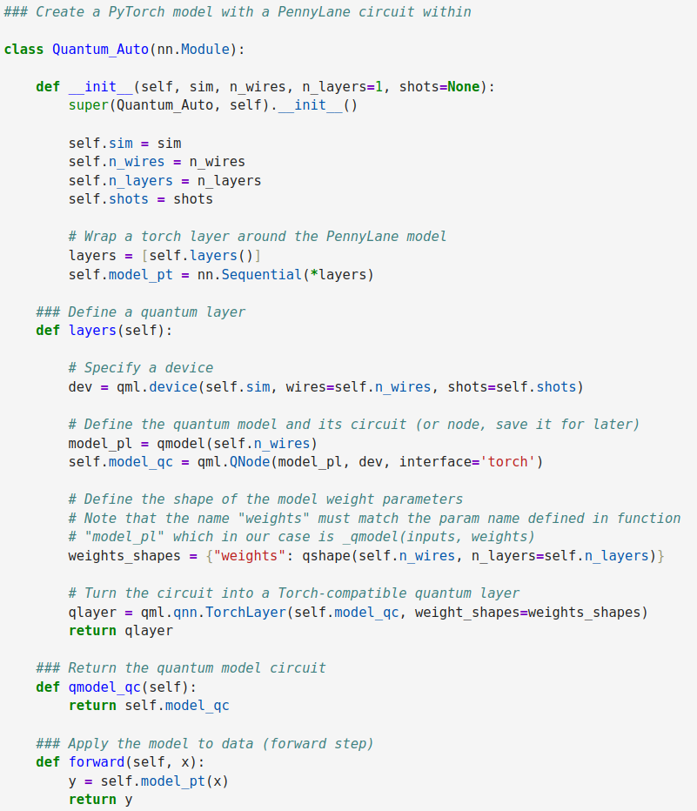
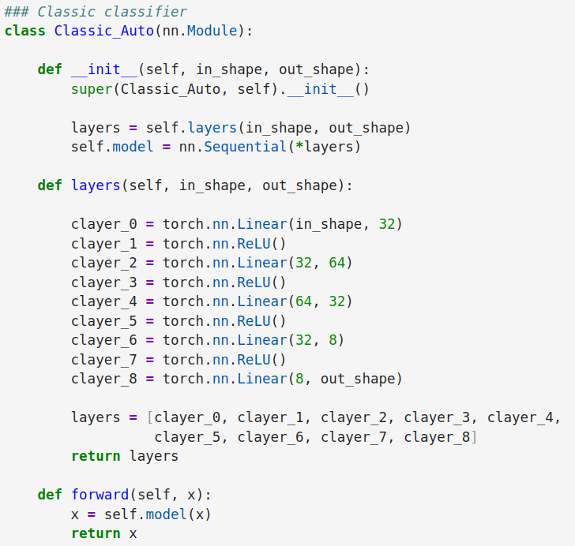
PennyLane / PyTorch
Neural network structure
Both models are designed as PyTorch neural net classes.
Both initialise their model instances by saving the most important parameters (self), and then creating and saving their models (self.model) as sequences of layers.
Both define and create neural network layers. The quantum model’s QNode with its shape details was wrapped in a TorchLayer. The QNode was created with a “torch” interface and a device specified via parameters.
Both models identify the forward function, which provides a method of calculating outputs from inputs.
Pure PyTorch
PyTorch with
PennyLane layer
The structure of a PyTorch classic model is almost identical to that of a PyTorch model with a quantum model as it layer!
What is different is the specification of their layers.

Slide 6
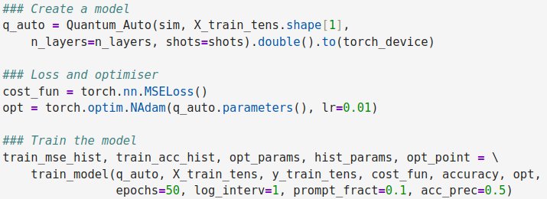
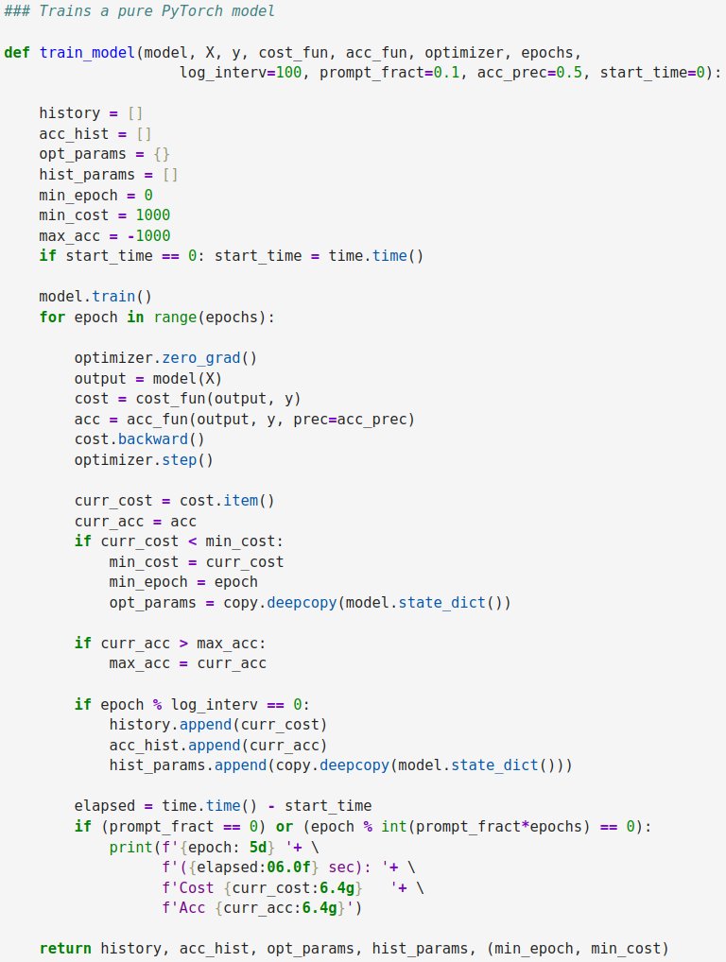

PennyLane / PyTorch
Model training
Invocation of the
PennyLane model training
Both models are trained in the same way.
PyTorch has no knowledge of the two models differences!
The training function receives data (X and y), cost and accuracy calculating functions, the optimiser, the required number of training epochs, and other variables used during the process.
Model training starts with the initialisation of lists to collect training cost and accuracy at each optimisation step.
Then the model training starts.
Training is conducted in a loop utilising gradients in the model weights.
First, the optimiser is instructed to
reinitialise its gradients.
Second, it performs the forward step
by applying the model to data (X) to
receive the model predictions on output.
Third, the predictions are compared
with the expected values (y) and
the cost of differences is calculated.
Fourth, the optimiser takes a backward
step to recalculate all model weights.
Fifth, the optimiser then prepares for
the next optimisation step.
Finally, we collect all performance
indicators and print the partial results.
Training
of Pure PyTorch NN
Training
of PyTorch NN with
a PennyLane layer

Slide 7
In search of the optimum
Grid search
There are two possible ways of exploring multiple parameter values, i.e. with:
  Grid search of parameter values, where for each parameter we supply a list of its possible values and we test the model on all their combinations;
  Random grid search, where test points are generated randomly, each having a combination of (most likely) unique parameter values.
The performance of a quantum classifier depends on the combination of its circuit characteristics, e.g.
  the number of qubits and the number of layers
as well as the optimiser and training process hyper-parameters, e.g.
  the learning rate and the number of epochs
  the optimiser in use, e.g. SGD, RMSprop, Adam
We tune the model by experimenting with all of these training process hyper-parameters.
Trial and error is a possible approach!
However, a systematic approach is always preferred!
For a single parameter, a feasible approach is to construct a loop over a list of hyper-parameter values and then log, chart and review the performance indicators.
Scikit-learn, as well as PyTorch (via skorch), also provides support (via its operators) for the systematic exploration of multiple model parameters in a grid search.
Grid Layout
(16 tests)
Random Layout
(12 tests)
Error
Surface
Unimportant parameter p₂
Unimportant parameter p₂
Important parameter p₁
Important parameter p₁
Scikit Learn, “Tuning the hyper-parameters of an estimator”,
https://scikit-learn.org/stable/modules/grid_search.html
Adrian Tam, “How to Grid Search Hyperparameters for PyTorch Models”,
https://machinelearningmastery.com/how-to-grid-search-hyperparameters-for-pytorch-models/
The collection of parameters may include the more important parameters, which may be better at identifying distinguishing features of the error surface than unimportant parameters.

Slide 8
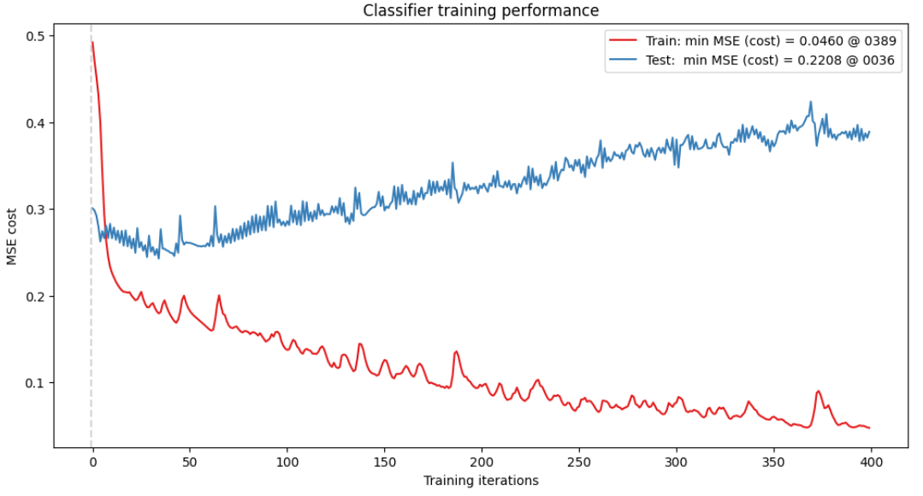
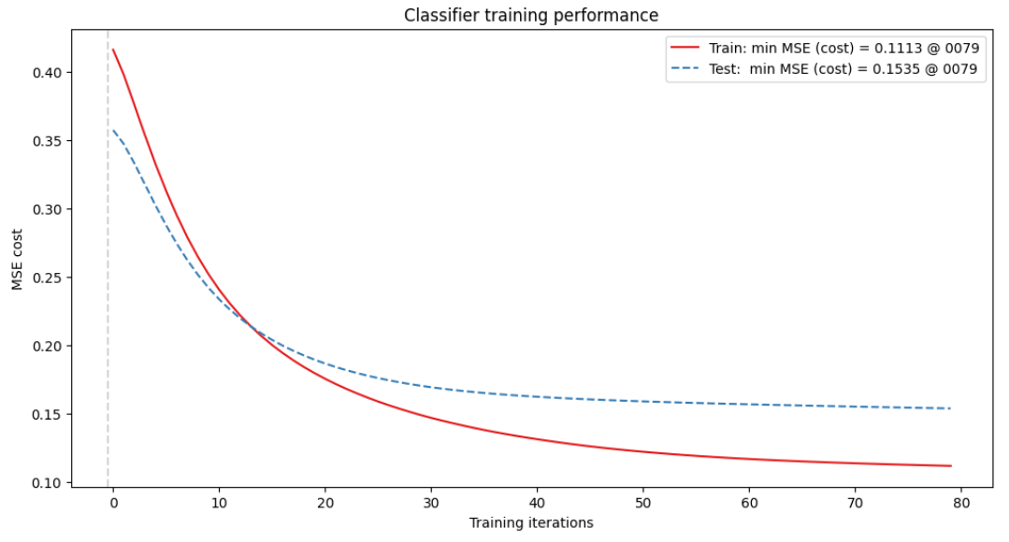
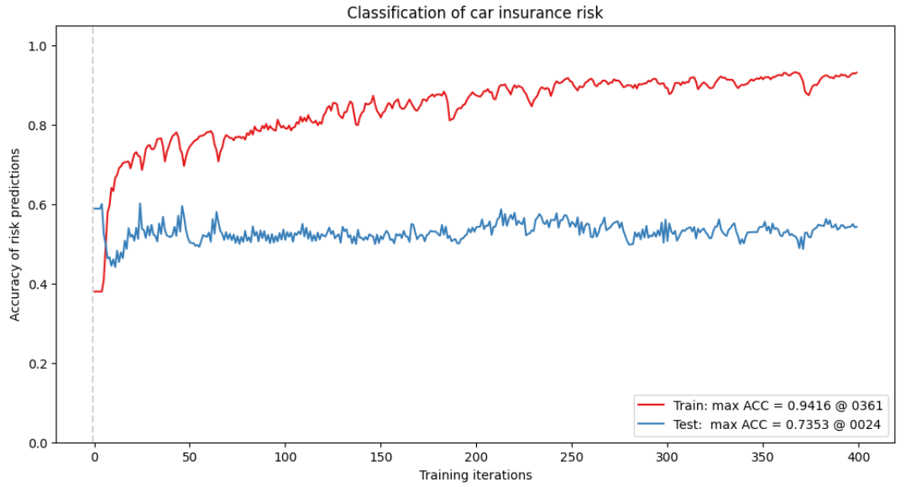
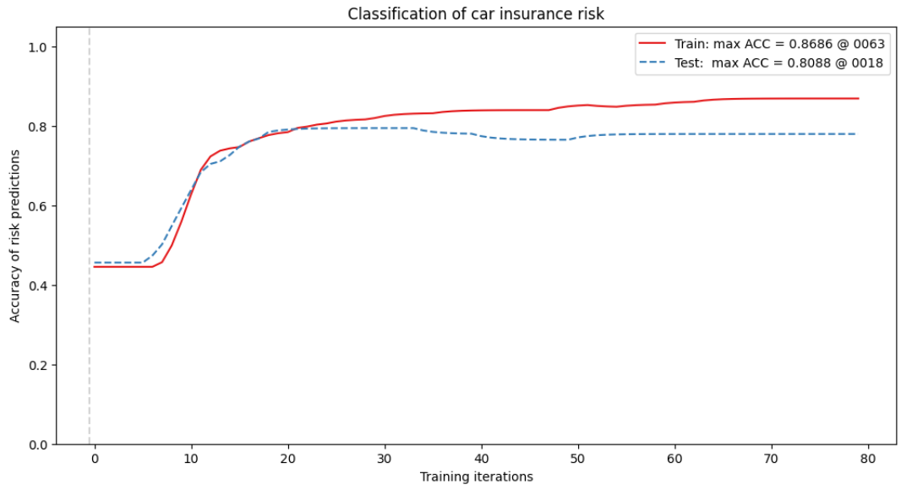
PennyLane / PyTorch
Results
Model scoring and plotting of results is also identical!
As we are training with small data sets, the classical
“plain vanilla” PyTorch
models tend to quickly overtrain.
There is a lot more tuning required of the quantum
model but its plots are
also more beautiful!
Performance plots
from training classical
models look as if they
were produced by a
very nervous but very
successful gambler!
Note that IMHO
if a quantum model on
trivial (not quantised) data
exceeds the performance
of a classical model,
it usually means that you
have not tuned it properly!
Sadly,
this is the case here!
Cost (MSE)
Cost (MSE)
Accuracy
Accuracy
PyTorch with
PennyLane layer
Pure PyTorch

Slide 9
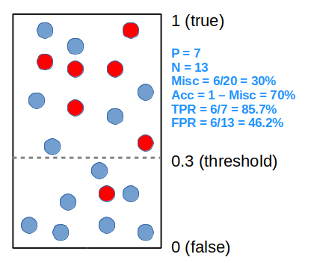
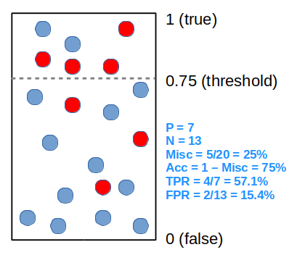
Binomial classification
Adjusting the threshold
Scikit Learn, “Tuning the decision threshold for class prediction”,
https://scikit-learn.org/stable/modules/classification_threshold.html
When a positive class is incorrectly classified it is called false-negative (FN), the incorrectly classified negative class is called false-positive (FP).
The prediction is defined by confidence factors, i.e. when the confidence of a positive class is greater than a certain threshold, (e.g. 0.5), it is concluded that classification is positive, else it is negative.
The threshold can be changed to maximise some performance indicator (e.g. the car is risky).
Assume we have two classes - positive and negative.
When a positive class is correctly classified, it is called true-positive (TP), the negative class is called true-negative (TN).
Consider these 20 data points, classified with different confidence factors from 0 to 1. Depending on the threshold they will be classified differently and the classifier performance will also be different.
We can visualise the classifier performance by plotting an ROC (Receiver Operating Characteristic) chart of all possible pairs of FP rate vs TP rate when varying the threshold (see below). The best classifier has the largest area under the curve (AUC).
0.30 th
(sensitivity)
TPR
0.75 th
AUC: area under the curve
TPR = TP / P
FPR = FP / N
FPR
(1-specificity)

Slide 10
Barriers to quantum classification
Some Problems | Possible Solutions
Poorly chosen embeddings can lead to loss of information or biases. | Avoid simple embeddings for complex data (e.g., basic angle encoding), as they may not capture nonlinear relationships. Consider trainable embeddings (e.g., quantum neural networks).
Quantum models are sensitive to imbalanced data, due to limited qubit resources. | Oversampling or hybrid classical-quantum approaches may be needed.
Since classifiers rely on discrete decision boundaries, barren plateaus can lead to random guessing behaviour. | Regularisation may help (via classical post-processing).
Quantum classifiers can overfit due to limited training data or excessive circuit expressivity. | Use dimensionality reduction (e.g., PCA) before encoding or employ classical regularisation (e.g., dropout in hybrid models).
Quantum classifiers might appear to work well on training data but fail on test data due to quantum-specific artefacts, | Always compare against classical models and their performance (e.g., SVM, neural networks). Quantum advantage is rare!

Slide 11

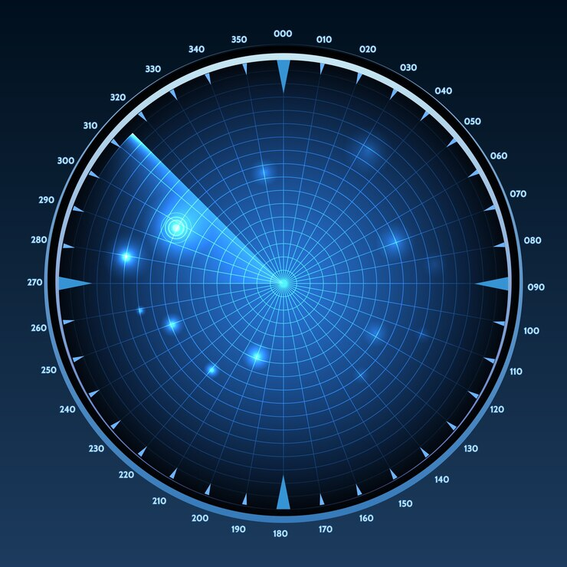
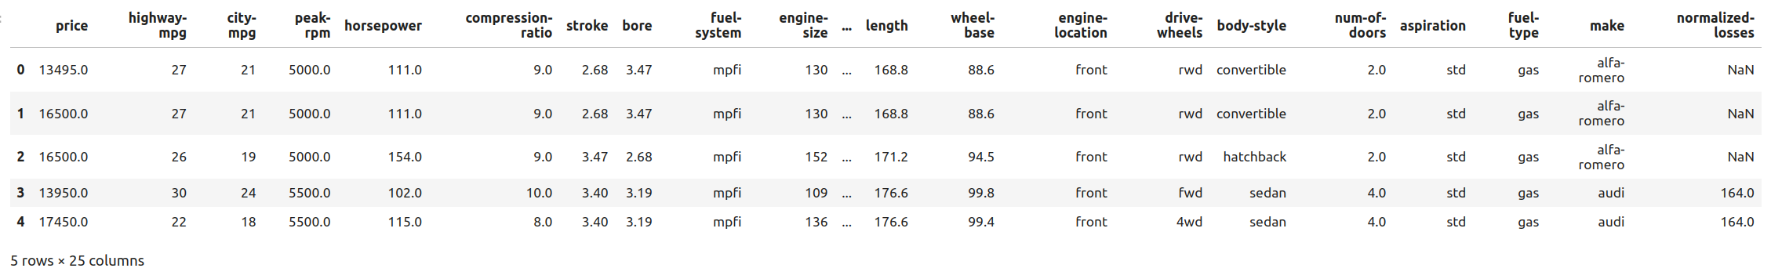
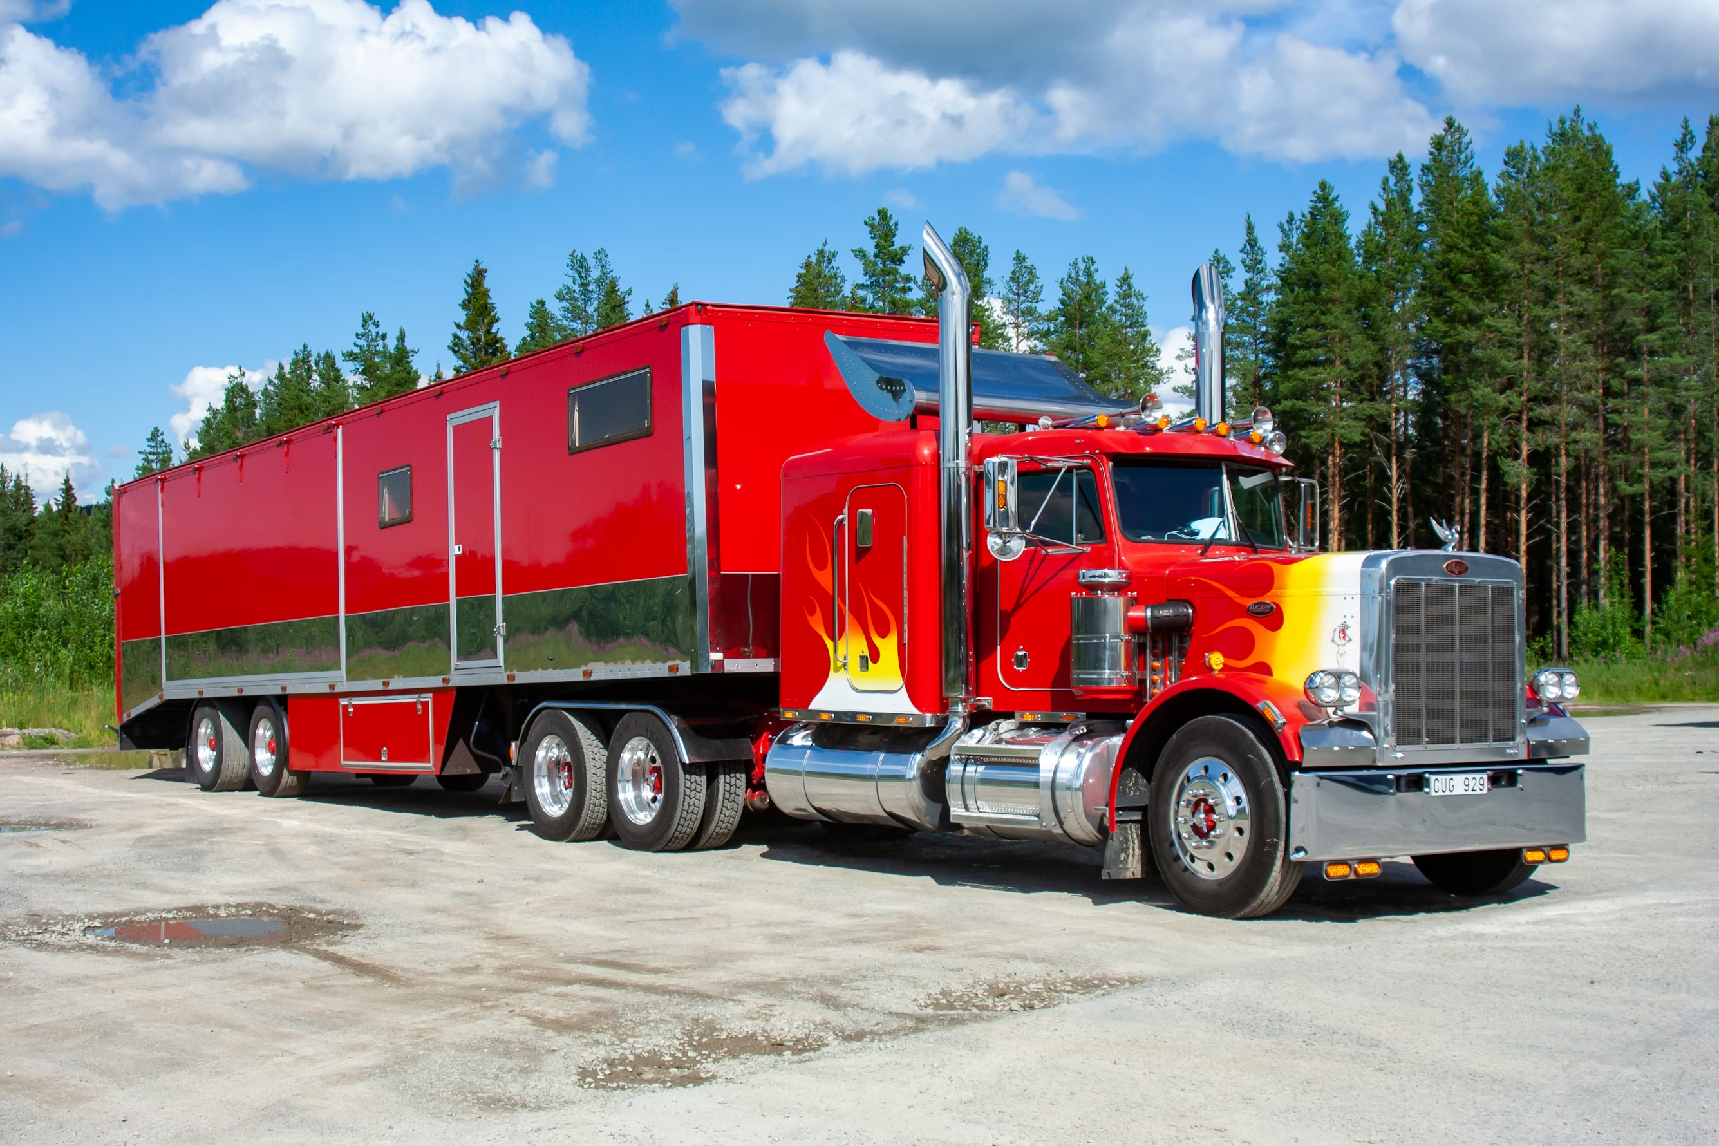

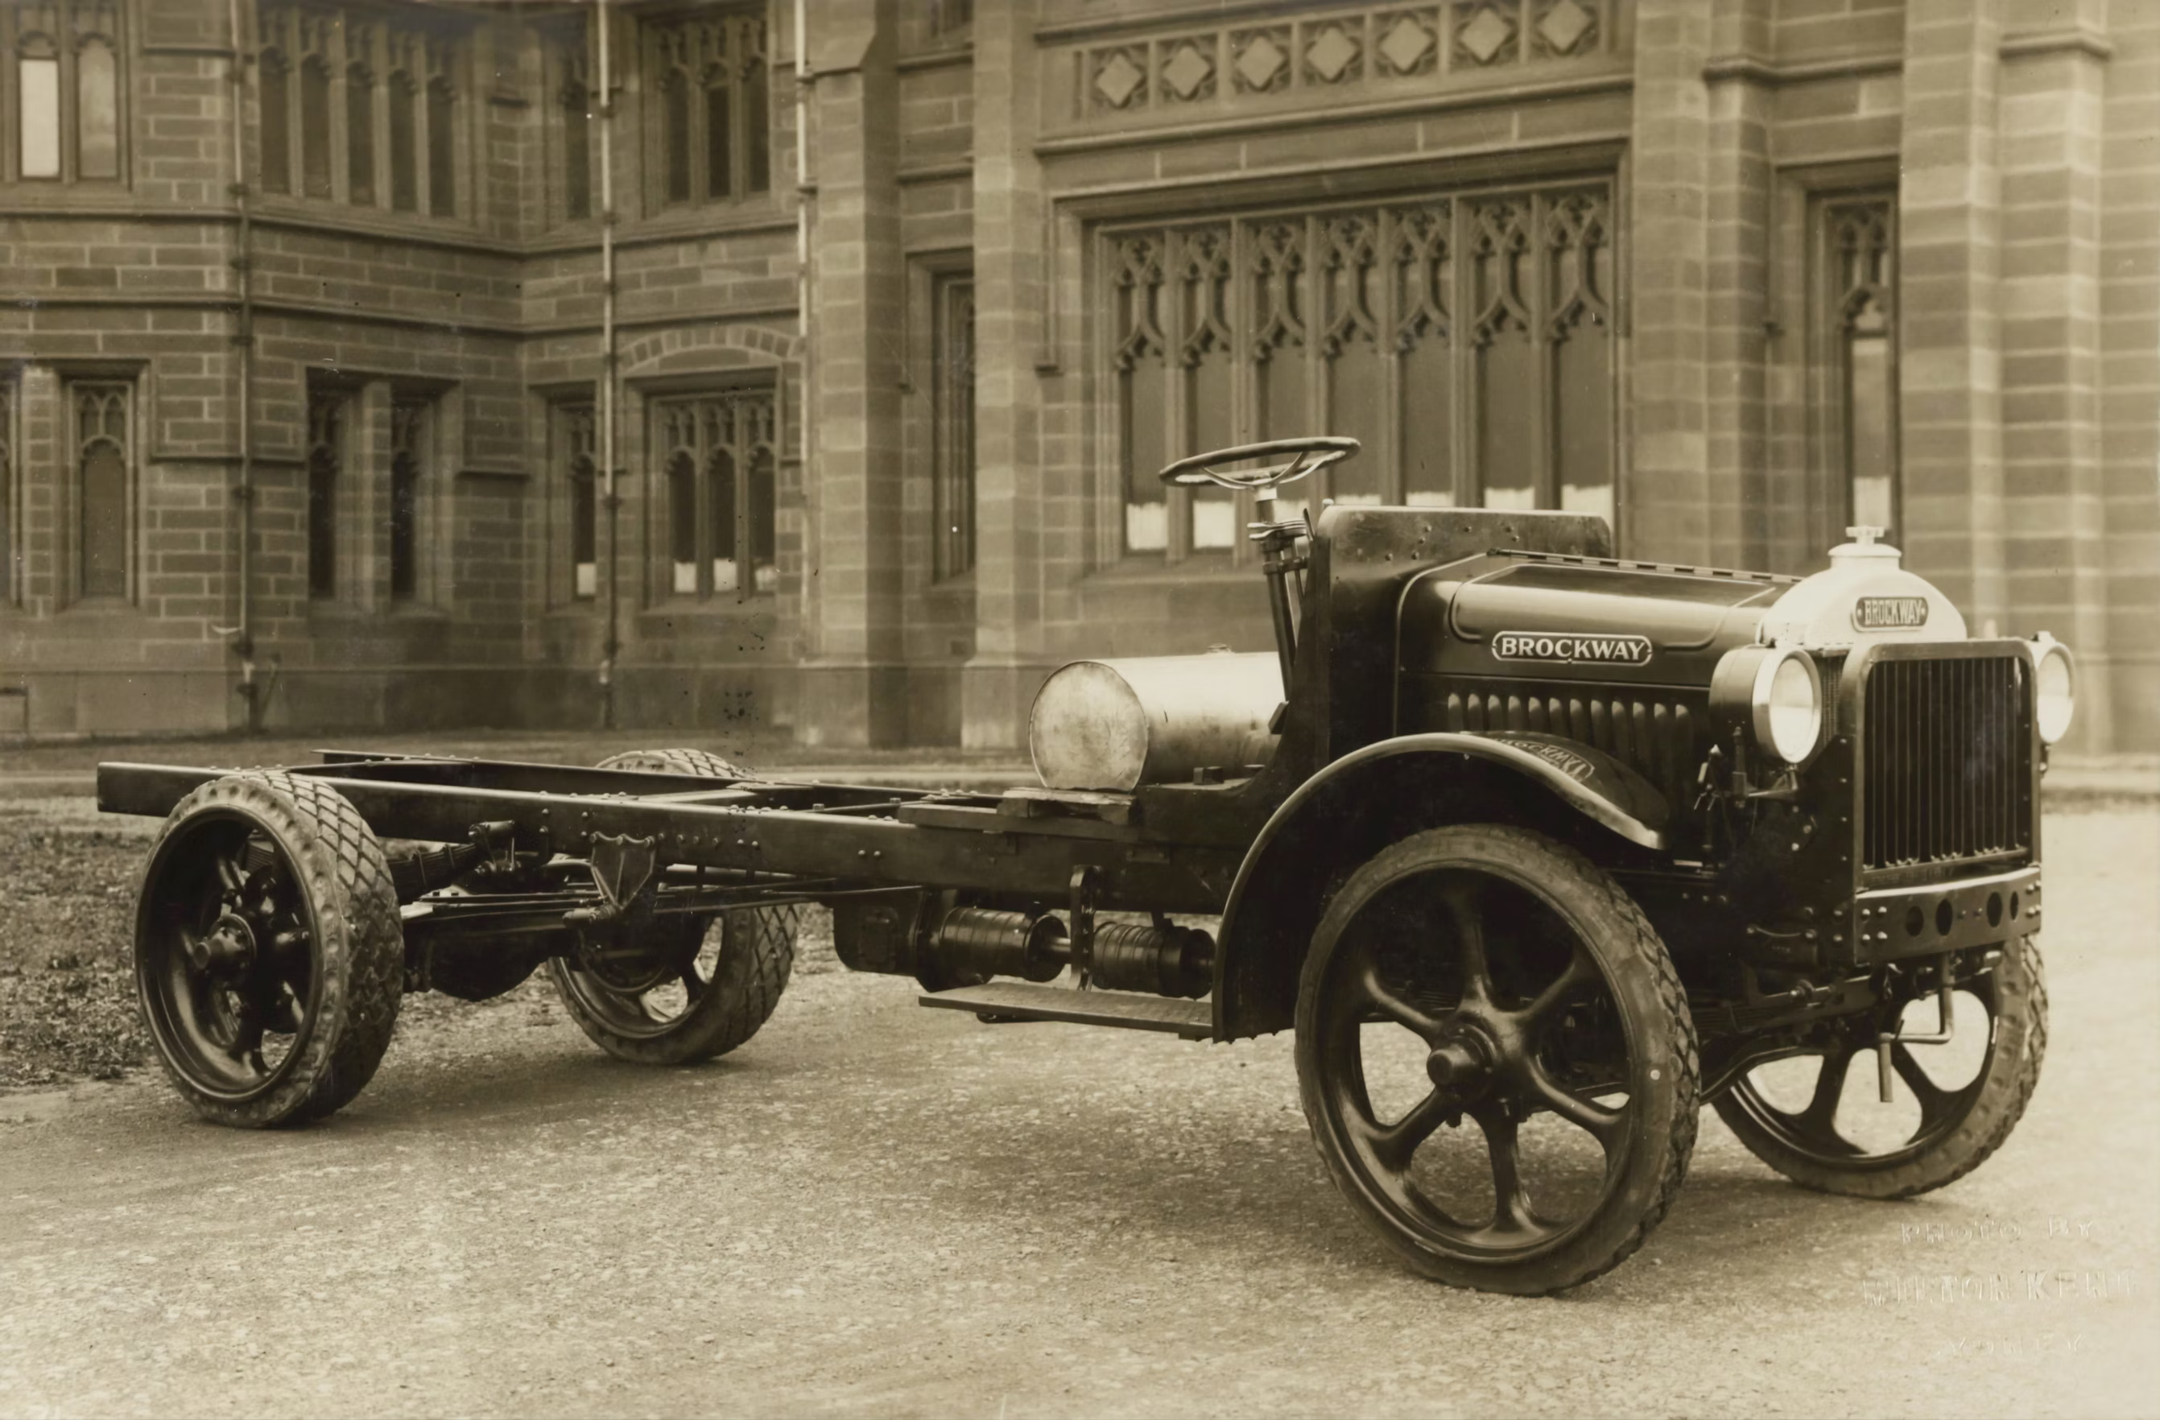
PennyLane Demo
Engineer quantum solutions!
Dataset 2: Sonar
Dataset 1: Automobile risk assessment
PennyLane Demo:
Explore insurance risk data
Consider class order and the need for shuffling
Reduce your data dimensionality (test and compare)
Play with hyper-parameters to improve performance
Apply the best model to new data
Key takeaways:
Quantum modelling is an engineering task
There is more to success than a clever model
Data encoding is (again) crucial to performance
Dimensionality reduction is crucial to performance
Design your model tests – use grid search!
Experiment with the ansatz parameters
Learn from classical ML how to measure accuracy
Think about class imbalance
Once model is trained, you can still improve accuracy!
Image source: Unsplash and Freepik

Slide 12
Thank you!
Photos from Unsplash
Enquanted is being somewhere in-between Enchanted and Entangled
Any questions?
This presentation has been released under the
Creative Commons CC BY-NC-ND license, i.e.
BY: credit must be given to the creator.
NC: Only noncommercial uses of the work are permitted.
ND: No derivatives or adaptations of the work are permitted.

