Slide 1
Ironhack module 2 project
Notes:
Welcome everybody!
At my module 2 presentation at Ironhack
First I will pose my research question.

Slide 2
Ironhack module 2 project
Does international trade correlate with the price farmers get for their goods?

Slide 3
Why this question?
As you all know my roots are on a farm
“ Born between cucumbers and,
raised with bell peppers.”
Notes:
But why that question?
As you all know my roots etc.
I always say: 'Born between etc. ....
The daily fluctuating price of items has always been one of the most important topics that we discussed during dinner when I was young. Most important influence off course is supply and demand, but a lot of the times that was not enough to explain the highs and lows of the prices..... Nobody knows exactly how it worked.
So that's why I want to research the impact of international trade on the price farmers get for their goods.

Slide 4
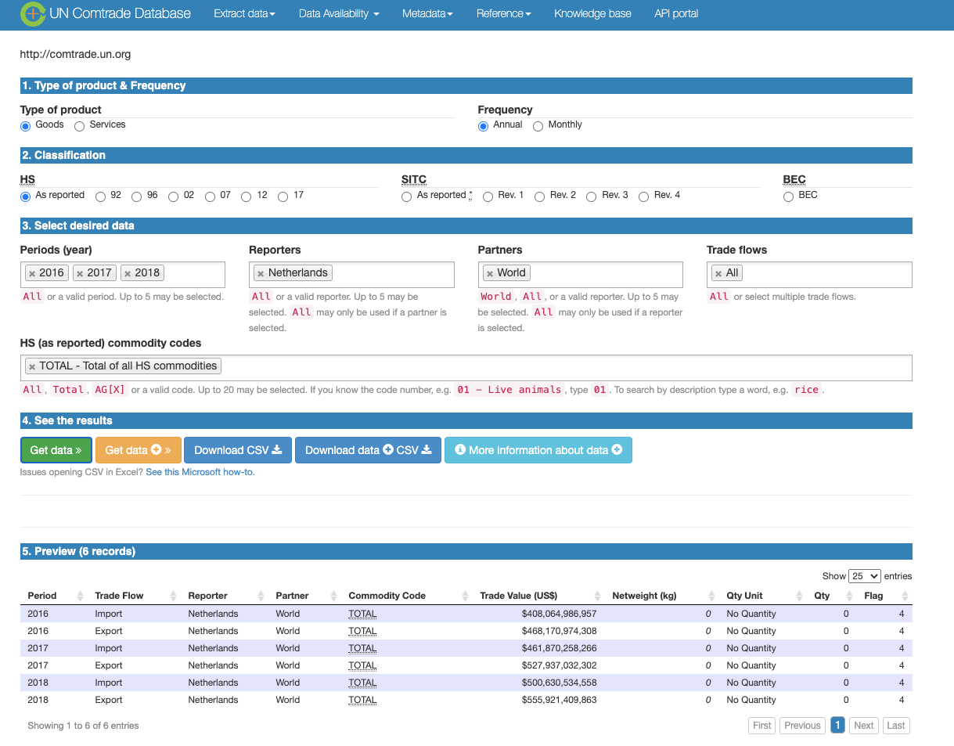
UN Comtrade dataset:
Notes:
Firstly I came to the UN database to look for international trade numbers. There is a huge amount of information on there s

Slide 5
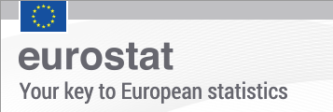
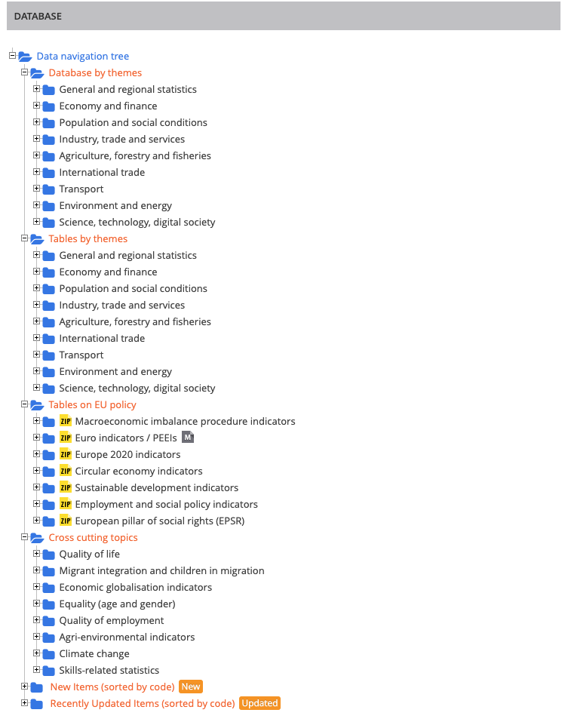
EUROSTAT datasets
Notes:
First I went to the site of the european union to find some international trade numbers for the EU.
As you can see overhere the EU has much more interesting datasets. Maybe you can use some in the future!

Slide 6
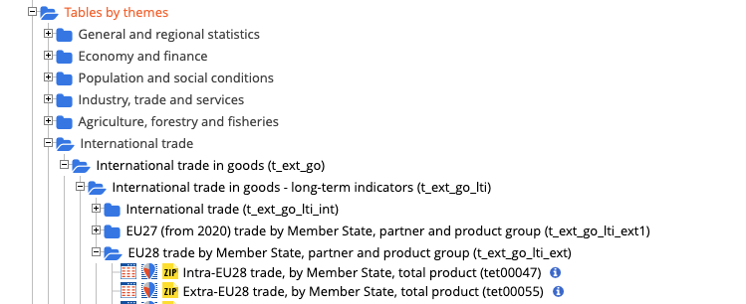
EUROSTAT datasets
Notes:
I decided to start using the datasets of the past ten years (data from 2008 till 2019).
If we quickly plot this together for all EU countries it looks like this.

Slide 7
International Trade of Total EU28 (only extra, so trade of EU28 with the rest of the world)
Notes:
As you can see there is a clear dip in 2009 because of the economic crisis of that moment.
Furthermore we can see that the increase of import and export go more or less hand in hand in the past years.
The orange line at the bottom is the balance between export and import. That is the one that will be used in the rest of this research as this gives a good idea about the total international trade.

Slide 8
International Trade balances of the EU28 members (intra + extra)
Notes:
If we then zoom in to the different countries of the EU and look at the balance lines only the picture looks like this.
For your info. The green line at the top is Germany.
The yellow line at the bottom is the UK.

Slide 9
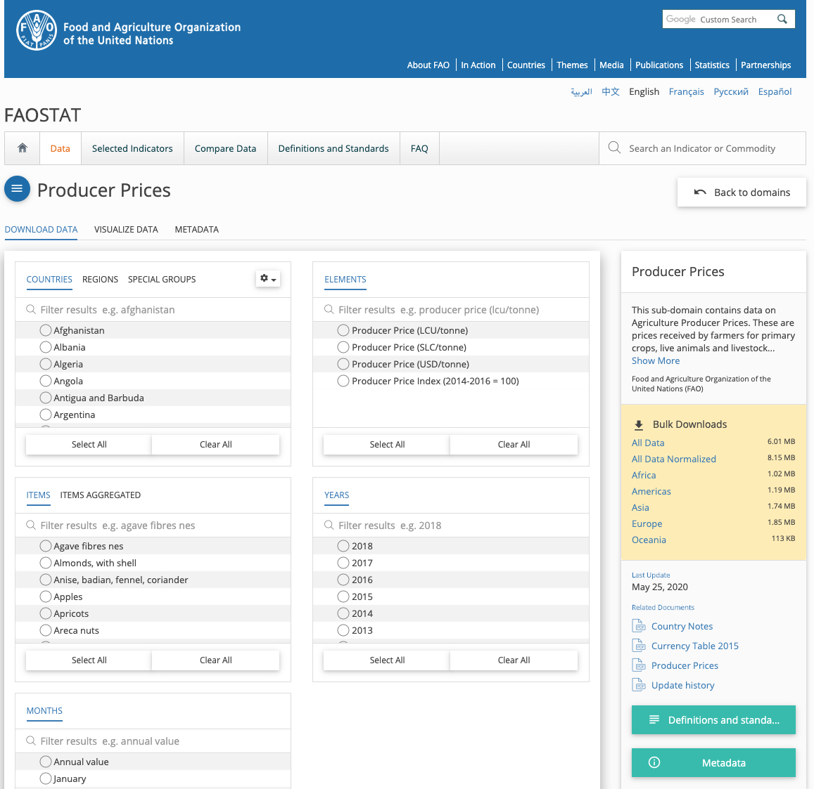
FAOSTAT database
Notes:
Next thing I needed were prices farmers receive for their goods.
The FAO is a UN organisation. FAO stands for Food and Agriculture Organisation. They also have a lot of datasets available and one of them is the producer price dataset which can be downloaded in bulk.

Slide 10
FOASTAT database (producer prices)
Total database of 979720 rows
Took only the lines where the conversion to USD price was done, so the prices are comparable
Then we have information about:
171 countries (Albania – Zimbabwe)
212 different types of items (Apples – Wheat)
28 different years (1991 to 2018)
Notes:
This dataset consist of…
The prices are mentioned in different ways. For example in Local currency.
But a lot are also recalculated to USD. I used this in the rest of the research so the prices are compareable.
This meant I had information about:….

Slide 11
Remarkable insights producer prices dataset:
Highest price in database:
Duck meat out Croatie in 1992: 113149 USD per tonne
Lowest price in database (excluding 0):
Cottonseed out Egypt in 2004: 5.5 USD per tonne
Average price over all rows:
1246.40 USD per tonne, so little over one USD per kg as price for producers worldwide
Notes:
Before we go further I wanted to share some remarkable insights…..

Slide 12
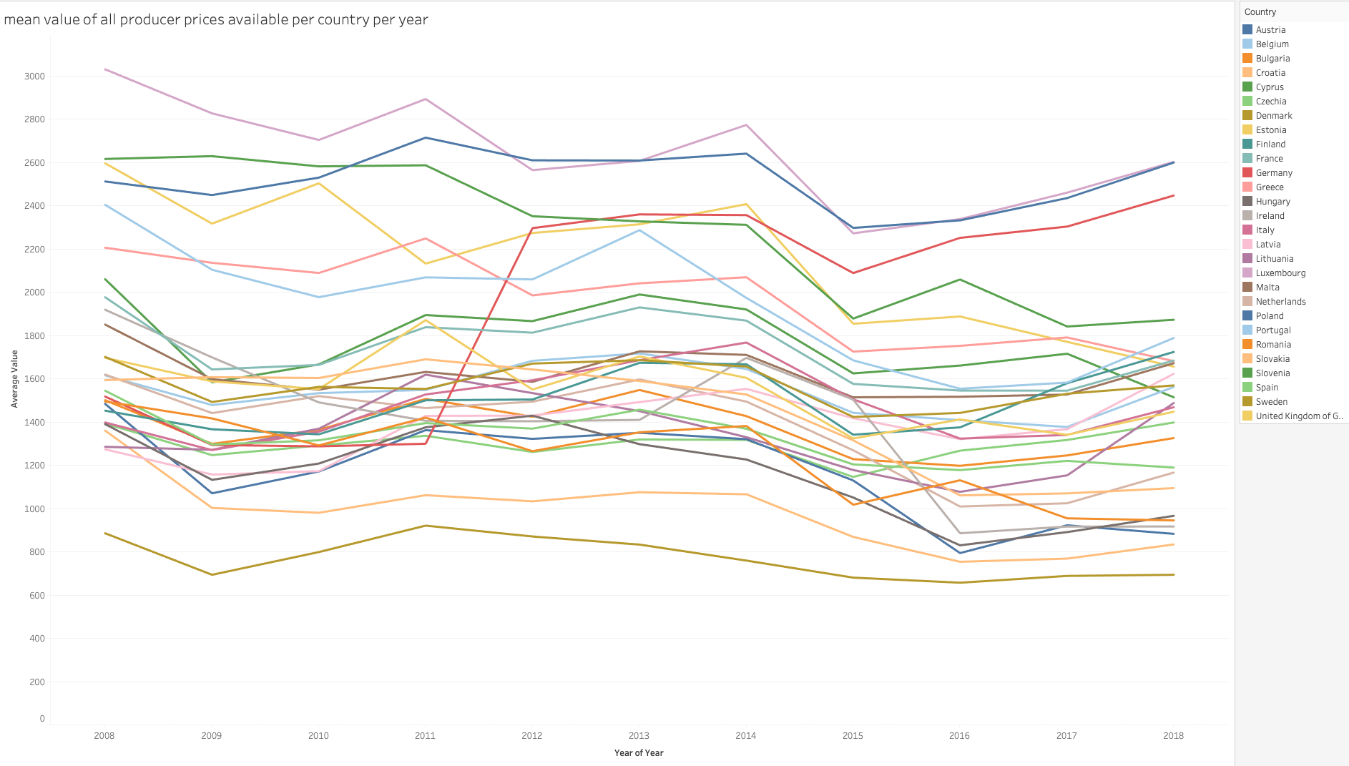
Notes:
Then if we take the mean producer price for all different items in a certain country of the EU and plot them over the years it looks like this.
The black line in the middle is the overall (worldwide) average price I showed you in the previous slide.
This off course does not say that much as different countries produce very different items.

Slide 13
(Not objective) sample that I took:
Apples (very popular fruit grown everywhere in the EU)
Cucumbers (personal interest)
Meat, chicken (to see if meat’s behavior is the same)
Soybeans (as this is truly a global market)
Not grown in big parts of the EU28, but still some big producers like Romania and Italy.
Notes:
To get a better picture I decided to take a (not objective) sample of the following items…

Slide 14
Visual look at possible correlation
Notes:
Then I plotted the international trade balance of the whole EU together with the price development of the four items I choose averaged over all EU countries.
I did that by calculating the percentage change compared to the year before. In that way we get comparable scales of measure.
As we can not see that much on this picture I zoomed in

Slide 15
Visual look at possible correlation
Notes:
Then it looks like this.
I also created a correlation matrix which gives the numbers you can see on the bottom of the slide. The possible correlation between international trade and price is very low as you can see.

Slide 16
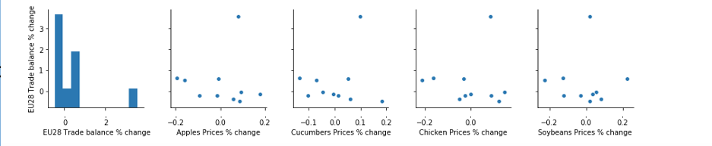
Pairplots:
Three types of correlation hypothosis tests done:
(Pearson’s Correlation Coefficient, Spearman’s Rank Correlation and Kendall’s Rank Correlation)
P-values in the range of 0.381 till 0.995
So quite certain that the values are independent
Notes:
I also made some pairplots and did correlation hypothetisis testing with the three different types of correlation tests that are available.
P-values are in all cases high. So we can be quite certian that the values of international trade and producer price are independent.
To be sure I also looked at some item -country combinations.

Slide 17
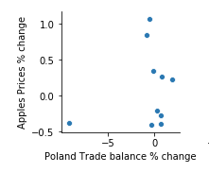
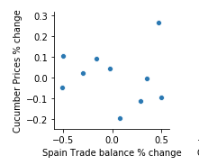
Some item – country connections to see if results are different on country level:
Poland biggest apple producer in EU:
Spain as biggest cucumber producer in EU:
P-values range 0.558 till 0.862
P-values range 0.603 till 0.891
Notes:
Firstly I looked at apples in combination with Poland as Poland is the biggest apple producer in the EU.
As you can see no correlation is found.
Also between cucumbers and Spain no correlation is found.

Slide 18
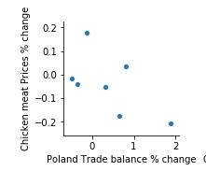
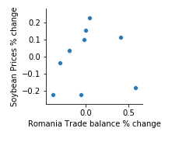
Continuation:
Poland is the biggest chicken meat producer in EU:
Biggest soybean producer in EU is Romania (with the right data):
P-values range 0.149 till 294
P-values range 0.108 till 0.792
Notes:
Poland is also the biggest chicen meat producer in the EU. And Romania is the biggest soybean producer in the EU with the right data available. Italy produces more soybeans, but the prices are not avialable in the FAO database.
In both cases here also no corellation is found.

Slide 19
Conclusion:
Notes:
So what is then the conclusion as it all looks negative.

Slide 20

Conclusion:
Notes:
The first part of my conclusion is that I need to go back to the kitchen table with my family to discuss the topic of producer prices even more....

Slide 21
Conclusion:
No evidence found that there is any correlation between prices farmers receive for their goods and the balance of international trade in the EU or on country level.
Notes:
As I have not found any evidence of my idea that the balance of international trade could correlate with the prices farmers receive.

Slide 22
Questions?
Notes:
Thank you very much for your attention and
Does anybody has any questions?

