Slide 1
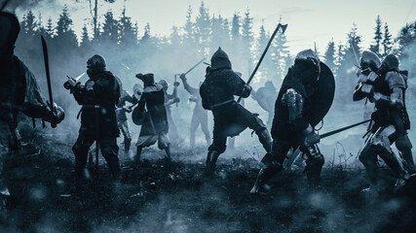
The Great Python Battle Begins!
Diogo, Lokesh, Mara, Shyam

Slide 2
Welcome to the Kingdom&Queendom of Pythonia!
Today’s War: VIKINGS vs SAXONS
OOP: turning chaos into reusable glory since the dawn of classes.
Classes - like blueprints – define what kind of warriors we can create
Objects - actual soldiers – the living, breathing instances born from blueprint
Properties - their traits – like health, strength, or name
Methods - their actions – what they can do, like attack or receive damage

Slide 3
Creating the Parent Class – SOLDIER
class Soldier:
def __init__(self, health, strength):
self.health = health
self.strength = strength
def attack(self):
return self.strength
def receiveDamage(self, damage):
self.health -= damage
Every warrior starts as a Soldier!
carries health & strength as attributes
knows how to hit, knows how to get hurt
Methods:
  attack(): returns strength
  receiveDamage(damage): subtracts health
This is the backbone of our army!

Slide 4
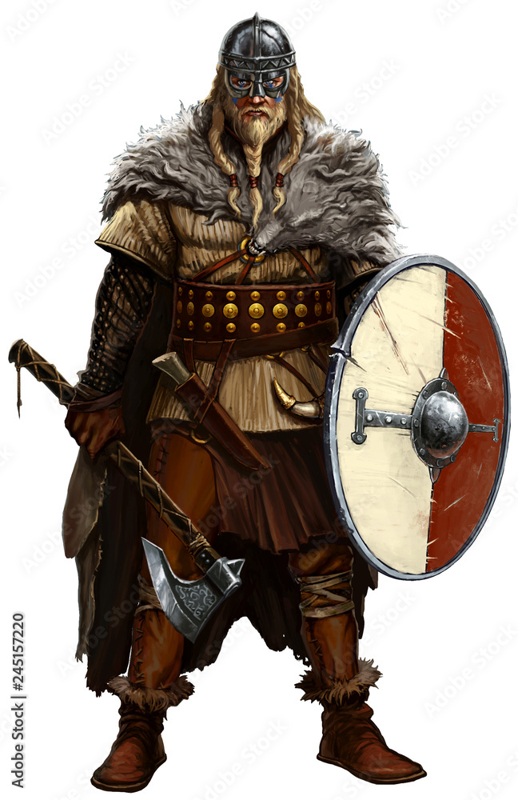
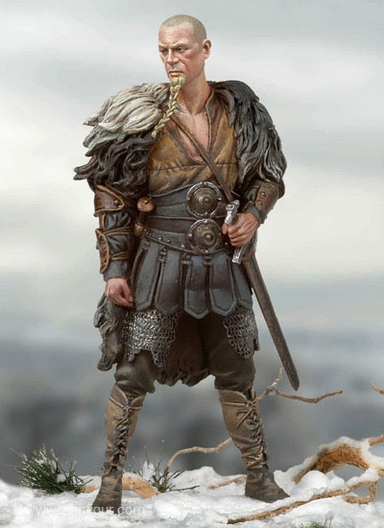
Inheritance – one playbook, many players
Definition: A child class gets all properties and methods from the parent class
Benefit: No need to rewrite the same code!
→ inherit attributes (health & strength) and attack() from Soldier, but reimplement receiveDamage() differently.
That’s inheritance, Python-style!
SOLDIER

Slide 5
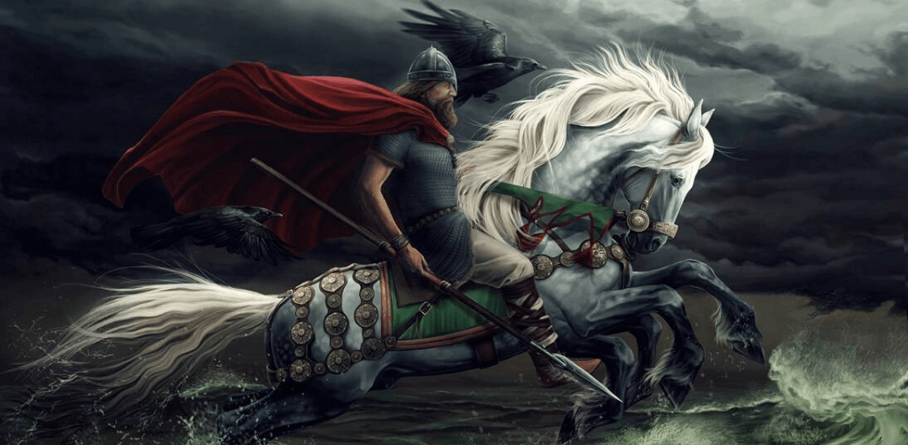
Creating the first Child Class – VIKINGS
Meet the mighty Viking!
He inherits from Soldier but adds:
  A name
  A mighty cry: 'Odin Owns You All!'
  Reports damage with drama
He calls his father (Soldier) to handle damage using super().
class Viking(Soldier):
def __init__(self, name, health, strength):
super().__init__(health, strength)
self.name = name
def battleCry(self):
return "Odin Owns You All!"
def receiveDamage(self, damage):
self.health -= damage
if self.health > 0:
return f"{self.name} has received {damage} points of damage"
else:
return f"{self.name} has died in act of combat"
“ODIN OWNS YOU ALL!”

Slide 6
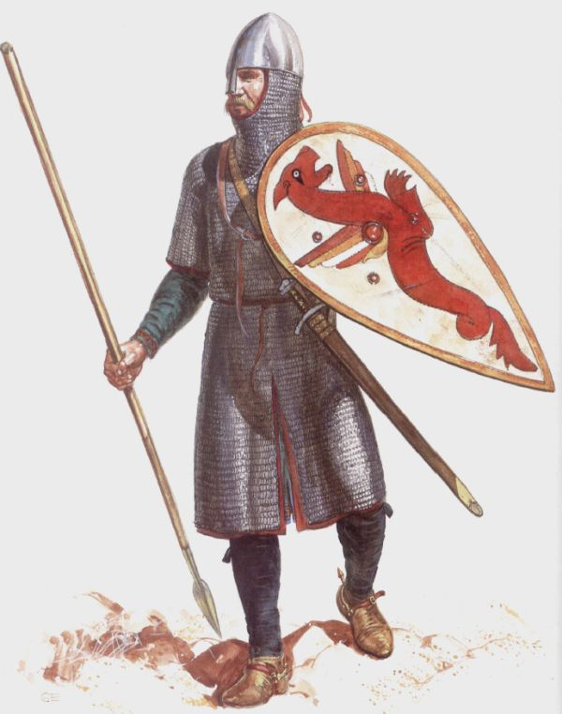
Creating second Child Class – SAXON
Meet The Stoic Fighter
Saxons are like Soldiers, but anonymous but resilient.
They fight bravely but fall easily...
inheritance (health, strength, attack)
Their message: 'A Saxon has died in combat.'
class Saxon(Soldier):
def __init__(self, health, strength):
super().__init__(health, strength)
def receiveDamage(self, damage):
self.health -= damage
if self.health > 0:
return f"A Saxon has received {damage} points of damage"
else:
return f"A Saxon has died in combat"

Slide 7
The War Class Rises
class War():
def __init__(self):
self.vikingArmy = []
self.saxonArmy = []
def addViking(self, viking):
self.vikingArmy.append(viking)
def addSaxon(self, saxon):
self.saxonArmy.append(saxon)
From the ashes of the battlefield, Pythonia united under one structure — the War class!
It gathers both Viking and Saxon armies, preparing them for battle

Slide 8
The Battle Unfolds
def saxonAttack(self):
if not self.saxonArmy or not self.vikingArmy:
return None
attacking_saxon = random.choice(self.saxonArmy)
attacked_viking = random.choice(self.vikingArmy)
result = attacked_viking.receiveDamage(attacking_saxon.attack())
if attacked_viking.health <= 0:
self.vikingArmy.remove(attacked_viking)
return result
def vikingAttack(self):
if not self.vikingArmy or not self.saxonArmy:
return None
attacking_viking = random.choice(self.vikingArmy)
attacked_saxon = random.choice(self.saxonArmy)
result = attacked_saxon.receiveDamage(attacking_viking.attack())
if attacked_saxon.health <= 0:
self.saxonArmy.remove(attacked_saxon)
return result
Now the real war begins!
A Viking and a Saxon are chosen at random to face each other in combat
Vikings strike first and Saxon receive damage equal to Viking strength
if Saxon is at loss of health, they are removed from the battlefield!
…and now… the Saxons are in attack!

Slide 9
The Fate of Pythonia
At last, the War class decides who remains standing
After countless loops, the screen flashes:
No Saxons left → Vikings Win
or
No Vikings left → Saxons Win
or
Both armies alive → Battle Continues
def showStatus(self):
if len(self.saxonArmy) == 0:
return "Vikings have won the war of the century!"
elif len(self.vikingArmy) == 0:
return "Saxons have fought for their lives and survive another day..."
else:
return "Vikings and Saxons are still in the thick of battle."
pass

Slide 10
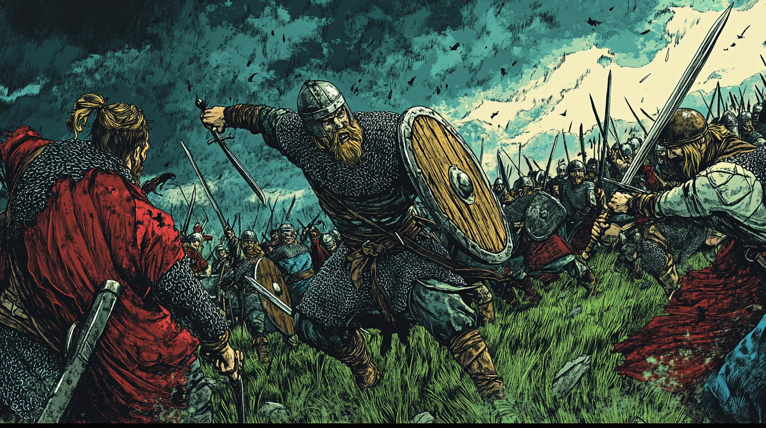
… may our next battle raise no errors!

Slide 11
Summary
Concept | Explanation | Example
Class | Blueprint for objects | class Soldier:
Object | instance of a class | def __init__(self, health, strength):
Inheritance | child gets parent’s features | super().__init__(health, strength)
super() | call parent’s methods | super().__init__(health, strength)
method override | child challenges parent’s method | def receiveDamage(self, damage):

Slide 12

I’LL SEE YOU IN VALHALLA!

