Slide 1



Mini Project
Vikings War
Done and presented by:
Gabriele Sanches
Javier Garcia
Sergei Volkov
Julia Parnis

Slide 2


Project Overview:
  This project simulates a battle between Vikings and Saxons.
  It demonstrates Object-Oriented Programming (OOP) concepts such as:
    Classes and Inheritance
    Encapsulation of behavior and attributes
    Interaction between objects through methods
    Randomized battle simulation using the random module

Slide 3

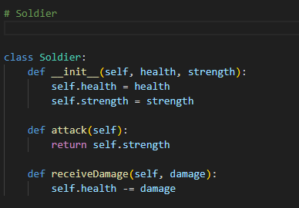
Soldiers
  The Soldier class is the base class for all warriors. It’s the blueprint of our code and where we define all the attributes that will be inherited.
  Attributes:
- health: represents the soldier's life points
- strength: represents the attack power
  Methods:
- attack(): returns the soldier's strength value
- receiveDamage(damage): decreases health by the given damage value

Slide 4
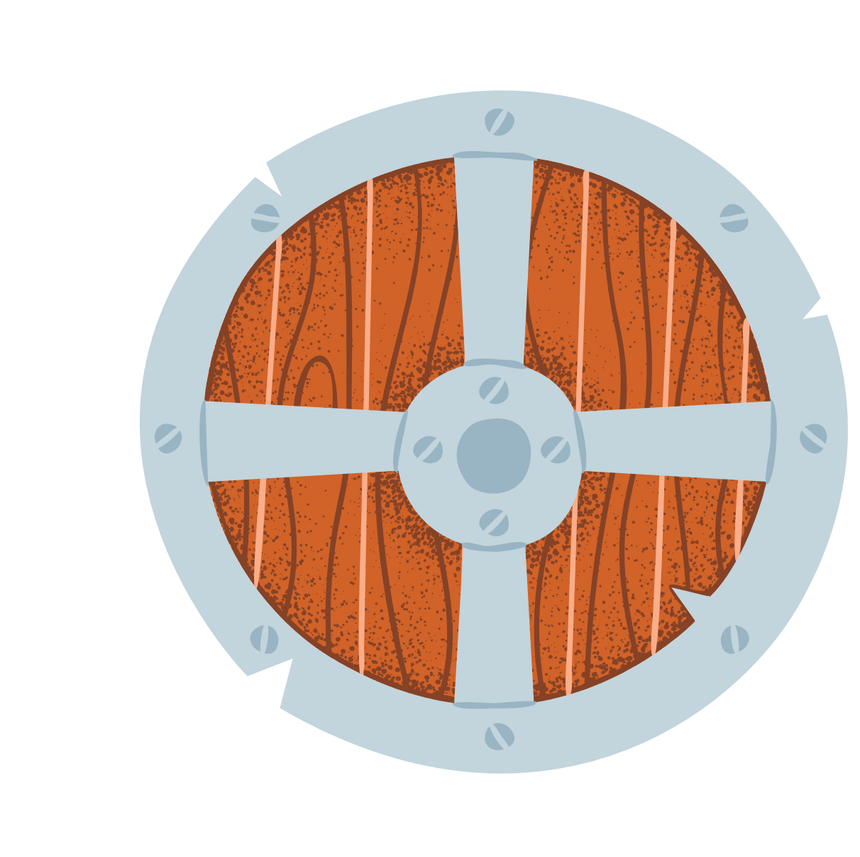
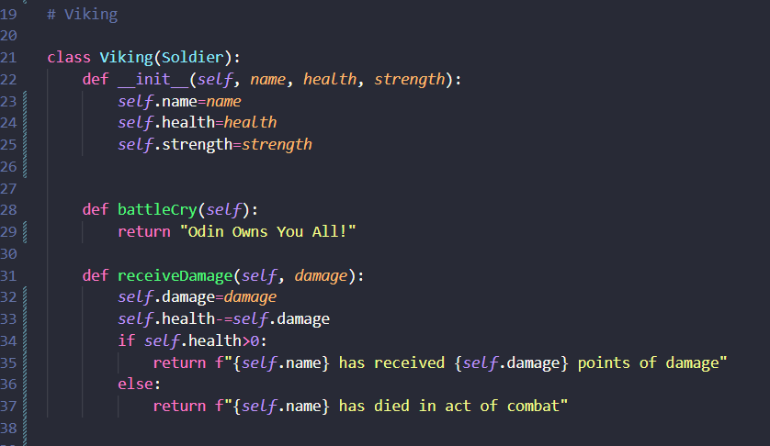
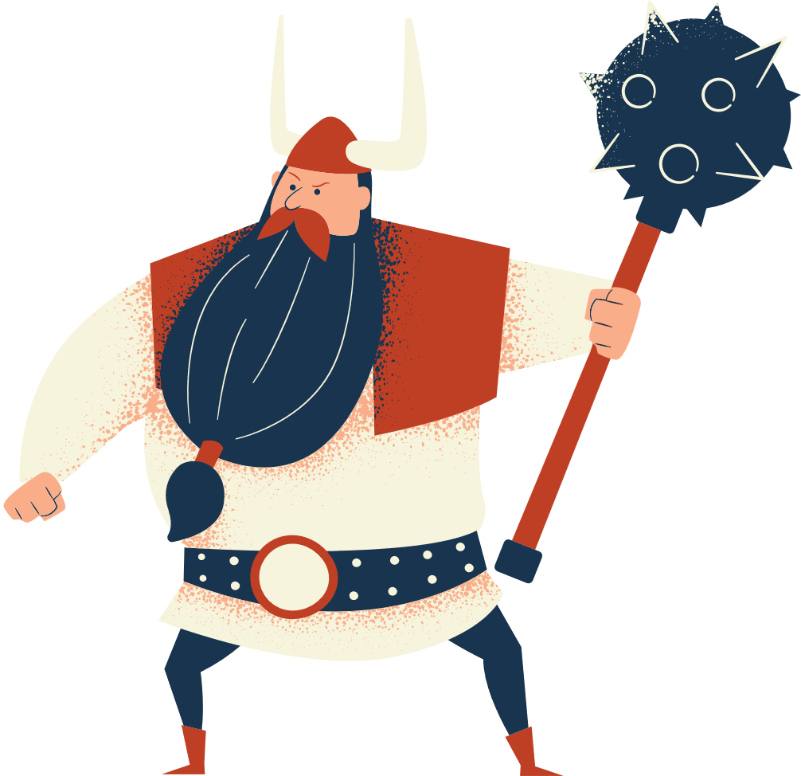
Vikings
When a Viking is attacked by a Saxon, he receives a damage and its health is reduced.

Slide 5

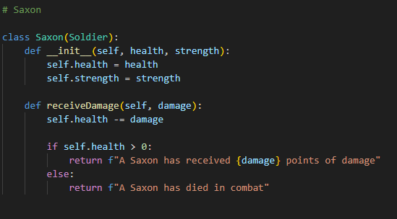
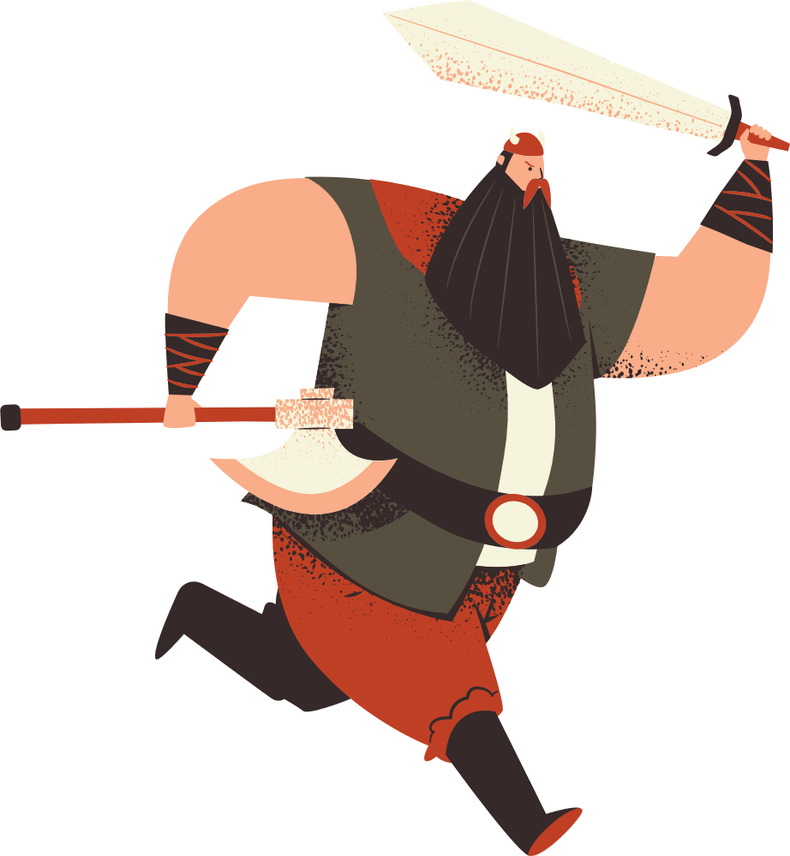
Saxons

Slide 6
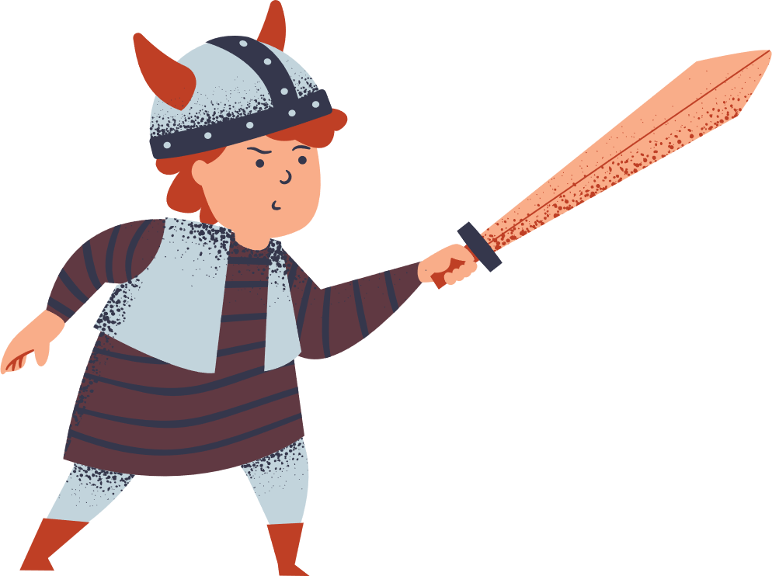
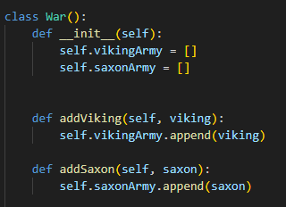
War
  Manages the battle between Vikings and Saxons
  Maintains two armies: vikingArmy and saxonArmy
  Implements game mechanics including attacks and status checking

Slide 7
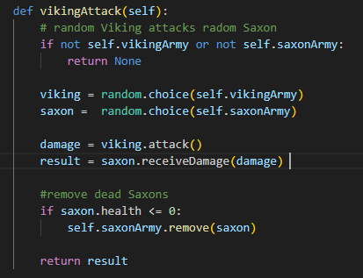
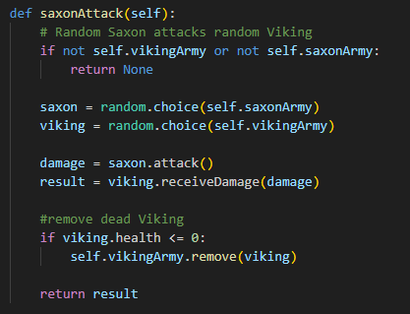
War
The War class orchestrates battles by:
  1. Having Vikings and Saxons attack each other
  2. Removing defeated soldiers from their respective armies
  3. Providing status updates on the war’s progress
Viking Attack:
Saxon Attack:

Slide 8
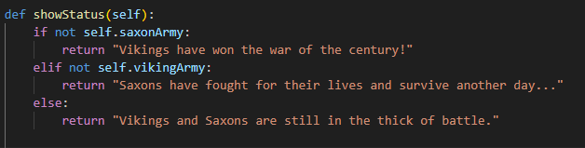
War
Defining the status of the War:

Slide 9
Thank You!

