Slide 1

Mini Project: Vikings
Harmandeep & Aitor & Suzana

Slide 2
Introduction
Vikings and Saxons are in War!!
Core goal: model a war simulation game using Object-Oriented Programming
  Usage of Class, Attributes, methods and instances.
  Defining Inheritance and methods overwriting.
  Run the simulation with randomness and sees who will win the war.

Slide 3
2. Project Setup & Core Concepts
Project Setup
Core Concepts
Main file: vikingsClasses.py
Test files:
  1-testsSoldier.py
  2-testsVikings.py
  3-testsSaxons.py
  4-testsWar.py
Only vikingsClasses.py is modified
Classes and Objects
Inheritance
Method Overriding
Polymorphism
Lists and Loops
Random selection
Testing & Debugging

Slide 4
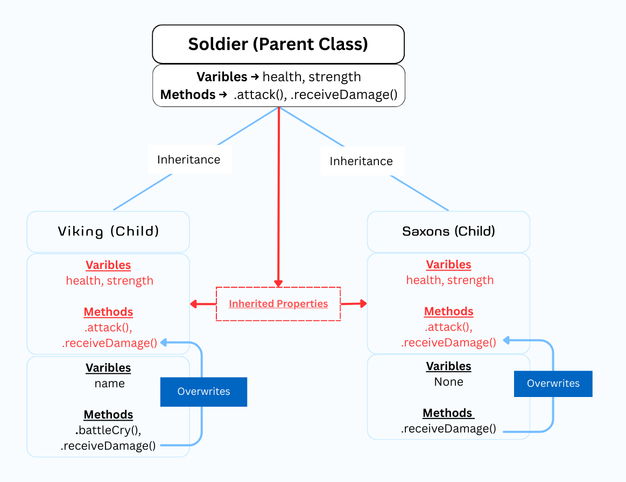
2. Class Structure
Soldier (Base/Parent class)
  health, strength
Viking (inherits Soldier)
  name, battleCry
Saxon (inherits Soldier)
  no name, weaker fighter

Slide 5
3. How the game works?
Manage the War
Simulate the War
War Class:
  Manages interactions between the created classes
  Uses randomness
  Uses loops create armies and run battle rounds
  Cheks conditions: health, army size, end of war
Multiple Vikings and Saxons exist at the same time
One War instance controls everything
  Loop to determine rounds of battle
  Conditionals to check who dies and who wins
  Random module, adds unpredictability

Slide 6
4. Challenges Faced
Understanding Inheritance
  How Viking & Saxon inherit from Soldier Class.
  When to use super(). __int__()
Understanding War Control Mechanism
  How to use "Random" Library to select random Warrior.
  Then identify which "receiveDamage()" method will be use.
Understanding test requirements
  Using "return" to output formatted string instead of using print() function.
  Correctly removing dead soldiers from the appropriate army.
Debugging
  Debug logic errors using test failure messages.
  Example:
    test expects "A Saxon has received 30 points of damage"
    Code ouptut: "A Saxon has received 30 point of damage"
Notes:
What is the inheritance - So this Child class will heir the same attributes and Methods, so parameters and bihaviors of the Parent Class - Soldier.
How to relate with the intire code.
// between attribute (parameter) and instance (is sublevel inside child class)
And after understand how the random library is related with the instance and not the class. I just understood when sow the controller – the file wargame

Slide 7
5. Conclusion
OOP
Clear Game Structure
CLASSES
Share Atributes: health, strength
INSTANCE
Class child : each new viking or saxon
Class WAR
Controller: Manages game play Logic
Shared behavior: Attack, Receive damage
random, loops, and conditionals
Supports
- random not act alone is using inside methods of War Class, operates on instances
Notes:
Loops create armies and run battle rounds
- Conditionals check:
- health
- army size
- win/lose state

Slide 8
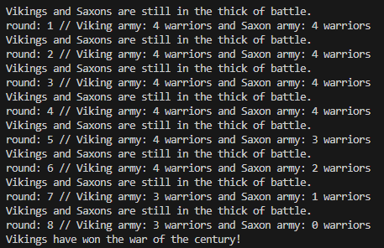
Who won the war?

Slide 9
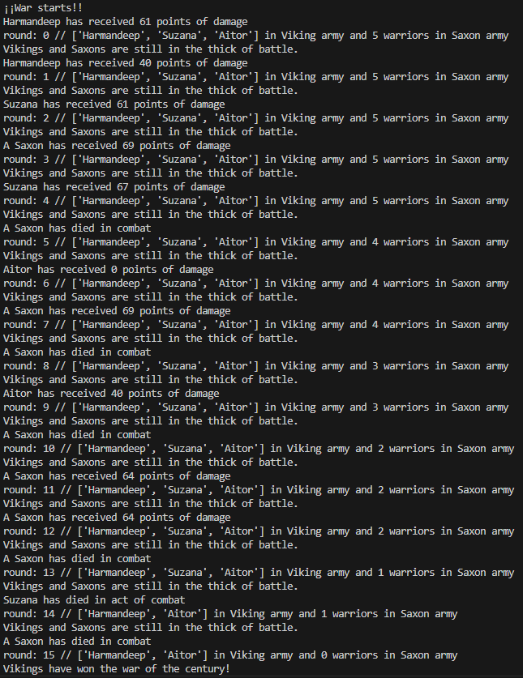

Simulation

Slide 10


Winners

