Slide 1
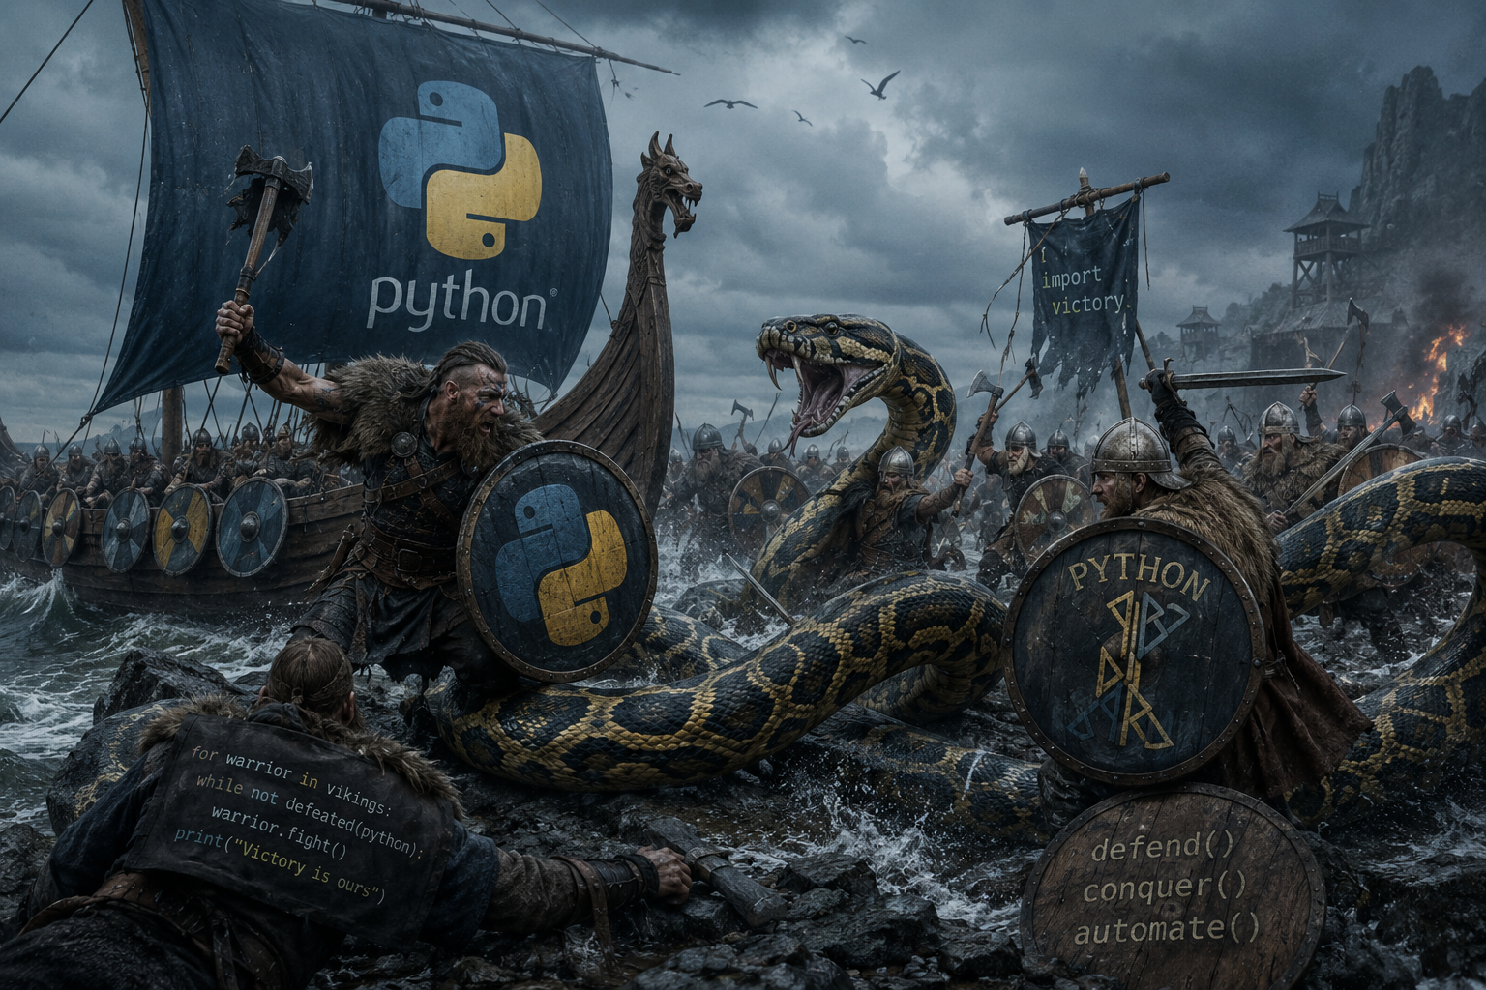
Vikings & Co.

Slide 2
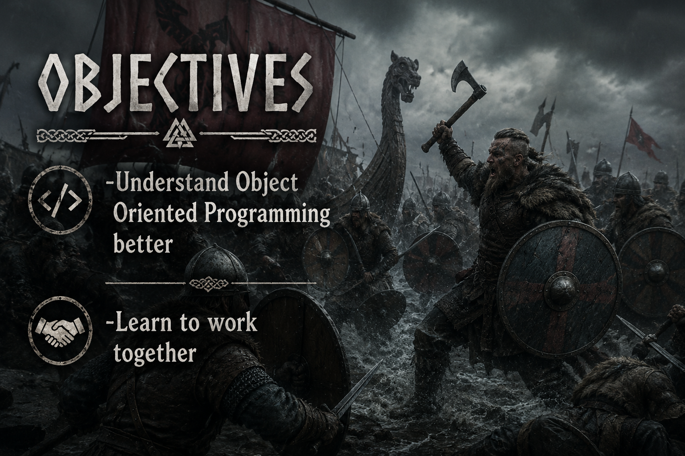

Slide 3

Challenges
Readability of the file through extensions.
Stuck?? No idea what to do next?? Bernardo the saviour!!
Writing the code exactly as per the test expects the output
  Code is fine, what is the problem!!!
  Result not as expected

Slide 4
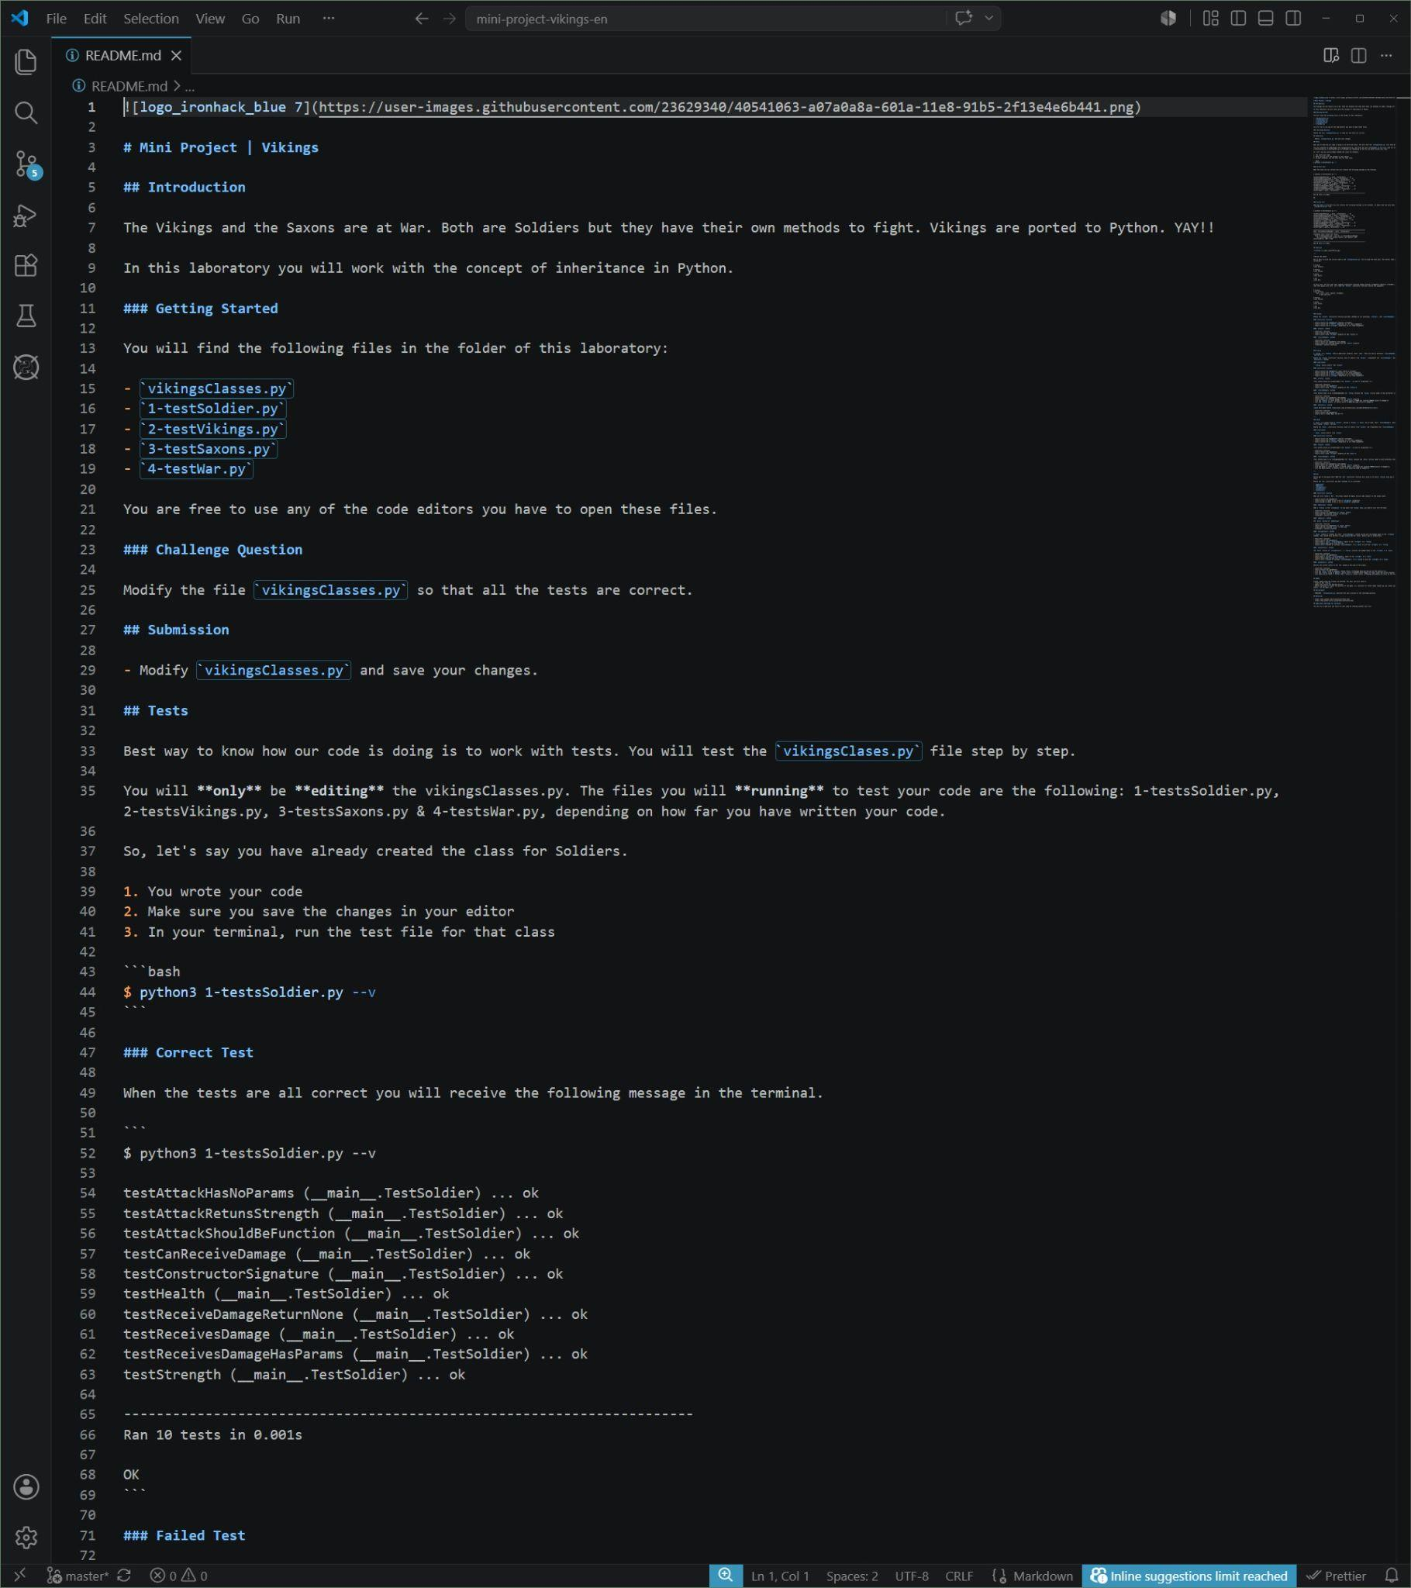
Readme readability

Slide 5
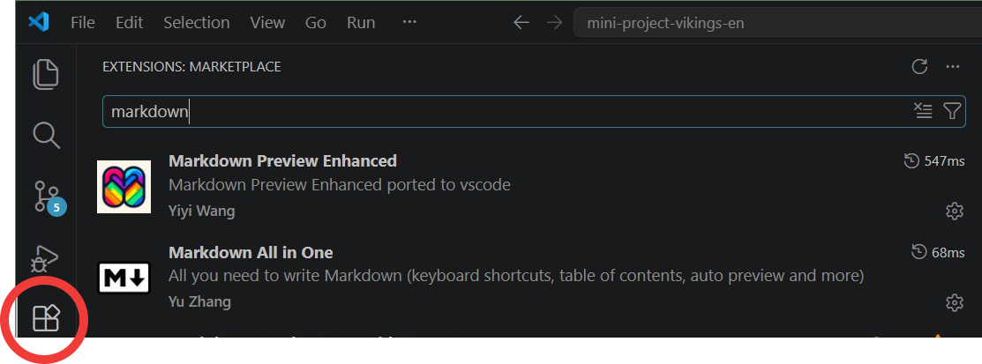
Solution
CTRL + SHIFT + V

Slide 6
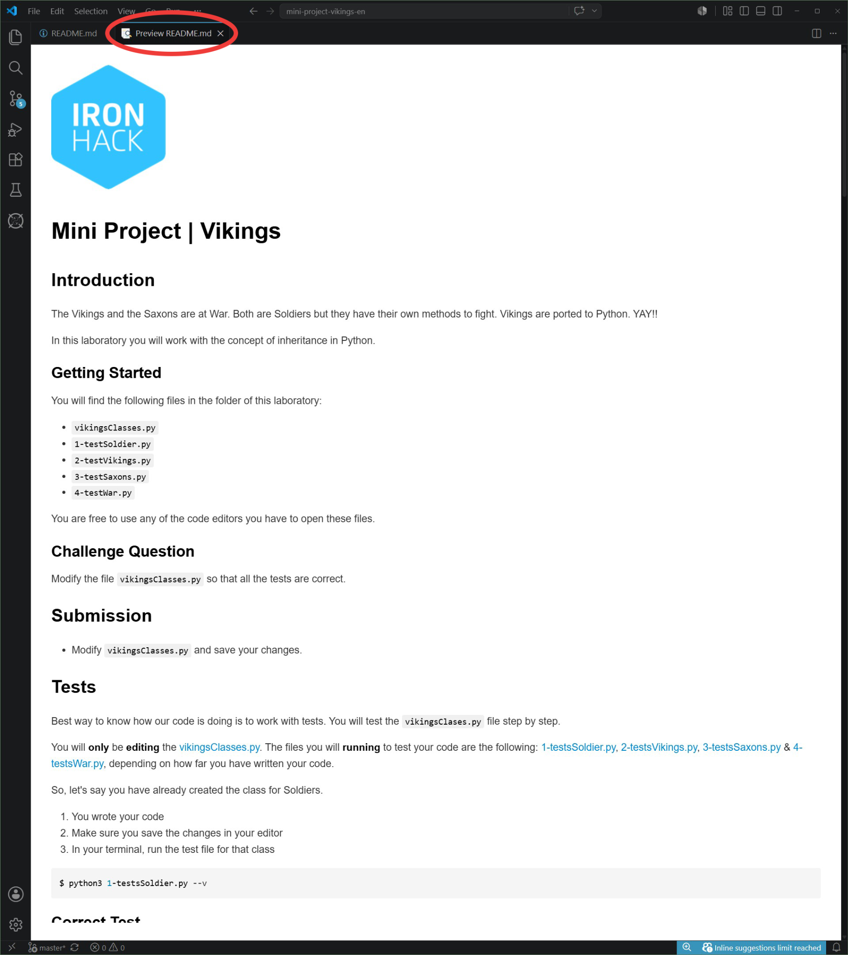
Inconvenience solved!

Slide 7
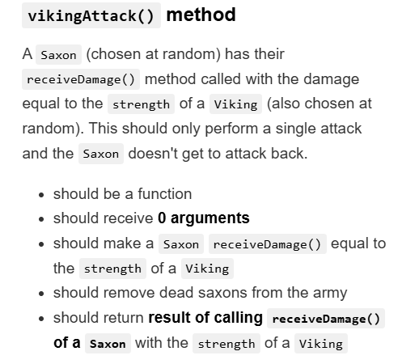
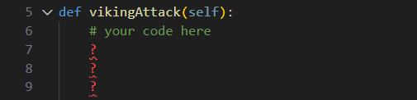
Challenges- Yoan
Sometimes you really don`t know how to continue -> ASK A PEER
Solved problems:
random.choice()
condition IF

Slide 8
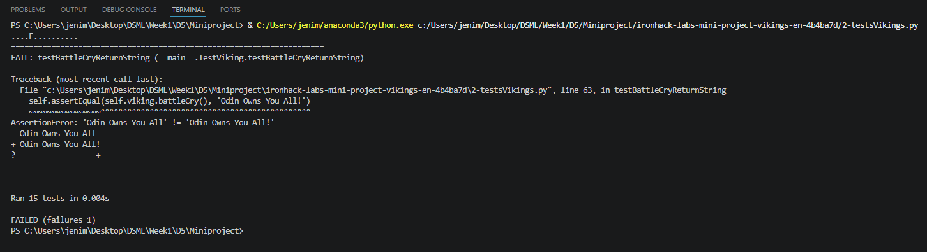
Challenges- Jenifar
The test keeps failing even when the code has no error!
“FOLLOW THE TEXT IN THE INSTRUCTIONS!”

Slide 9
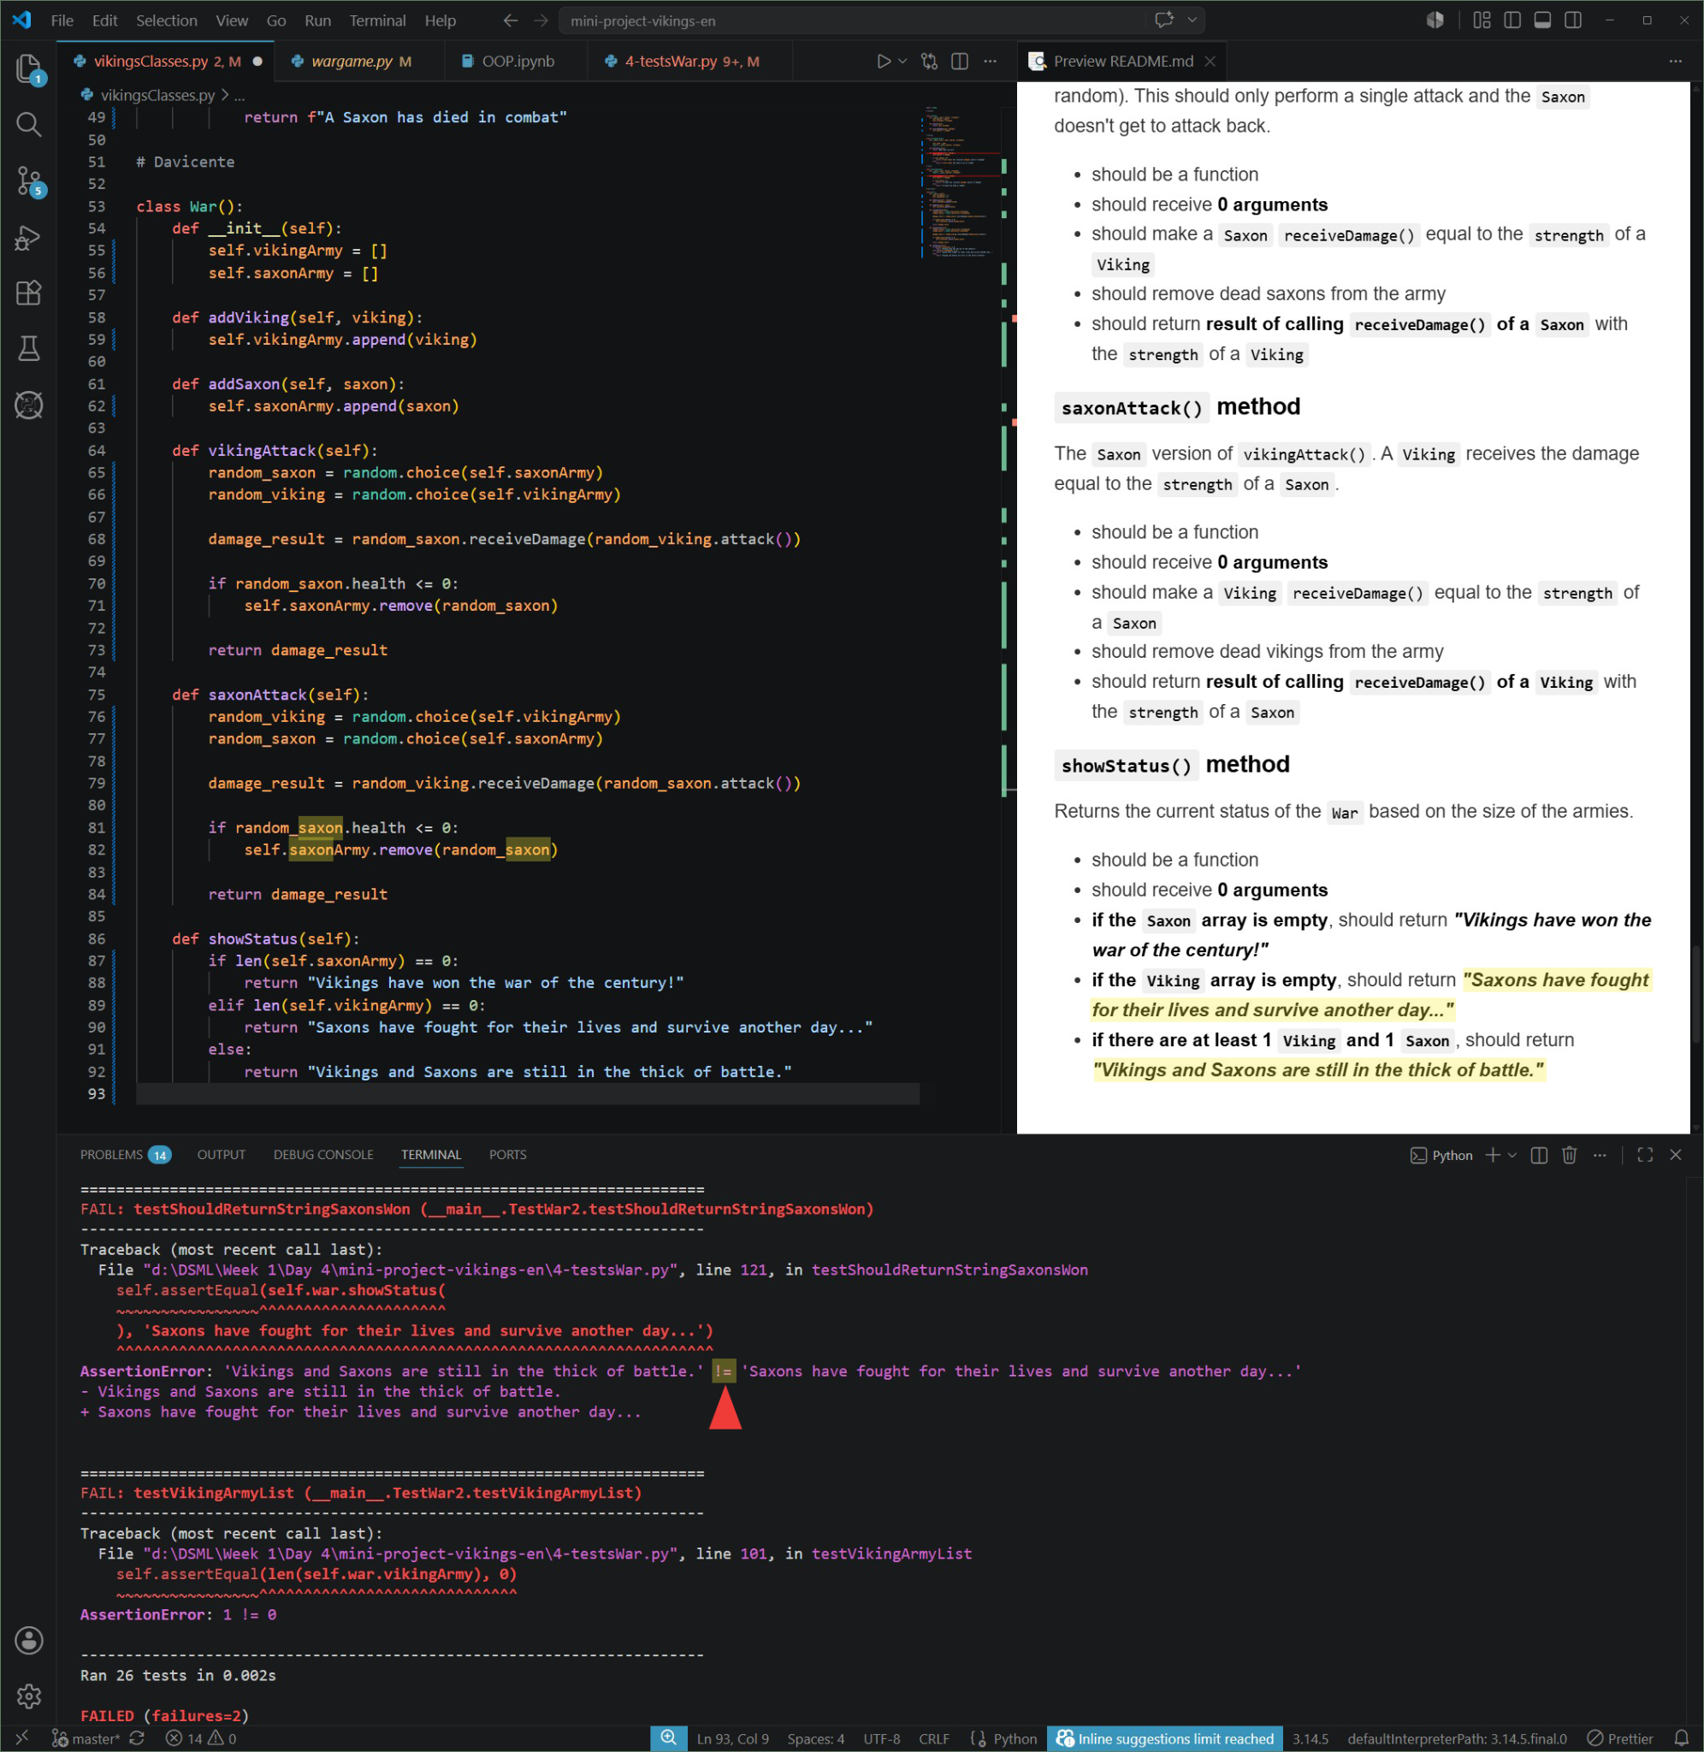
Challenges- Victor
ERROR AssertionError: !=
Check showStatus return message
Not a spelling issue

Slide 10
How we manage the team work? - Bernardo
🎯 Clear task distribution
💬 Open communication, we shared doubts and solutions throughout the process.
🤝 Mutual support, when someone got stuck, the team helped debug and explain.
🐛 Collaborative debugging, correcting errors all together like the typing message ones, that were the most common.
⚡ Different paces, same goal (All together)
✅ We make sure that all the test were passing

Slide 11
Key takeaways:
Teamwork matters — collaborating effectively helped us combine different strengths.
Clear communication — regular check‑ins and shared planning.
Technical growth — we learned debugging strategies and writing cleaner codes.
Problem‑solving mindset — challenges became opportunities to rethink our approach.
Working with tests — automated tests helped us verify correctness and catch hidden bugs.

