Slide 1
Deep Learning: Image Classification with CNN
Team G3
Authors: Jaime Velez, Larry Davila, Latif Calderon, and Juan Andujar
Date: 20 Dec 2024

Slide 2
Project Overview
Selected Dataset: CIFAR-10
Preprocessing Techniques used:
Hypothesis:
The CIFAR-10 dataset consists of 60000 32x32 color images in 10 classes, with 6000 images per class. There are 50000 training images and 10000 test images.
CNN can effectively classify CIFAR10 images with high accuracy.
Objective:
Build a Convolutional Neural Network (CNN) model to classify images from a given dataset into predefined categories/classes.
Normalization & One-Hot Encoding
Data Loading Method:
Direct import using tensorflow.keras.datasets.
Building Model Architecture
Model Training & Evaluation
Transfer Learning
Bonus: Model Deployment
Accuracy & Loss Results and Confusion Matrix
VGG16 Architecture used
Docker Container, Google Cloud Storage, Vertex AI & Flask Web App

Slide 3



Preprocessing Techniques
Normalization
One-Hot Encoding:
Scaled pixel values of images to [0, 1] , converting them to floats, which accelerates model convergence during training.
Transforms categorical labels into binary vectors. Ensuring compatibility with machine learning models and preventing unintended ordinal relationships between classes.

Slide 4
Data Wrangling and Cleaning
Challenges:
Resolution:
Handling dataset size efficiently.
Ensuring data was normalized for model training.
Utilized efficient preprocessing.

Slide 5
Exploratory Data Analysis
Methods:
Analyzed class distribution.
Visualized image samples for each class.
Insights:
Classes are balanced.
Variations in image quality and orientation observed.

Slide 6
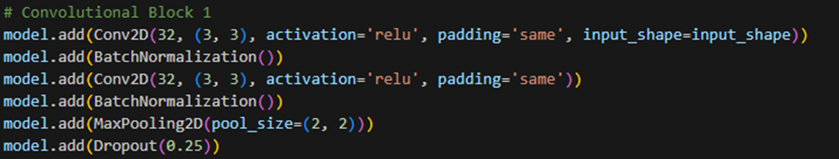
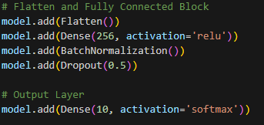
Model Building
Architecture:
4 Convolutional Blocks: ReLU activation, 'same' padding.
Batch Normalization, Max Pooling, and Dropout layers.
Final Dense and Softmax layers.
Hyperparameters:
Optimizer: Adam
Loss Function: Categorical Crossentropy
Batch Size: 64, Epochs: 60 (Early Stopping enabled).

Slide 7
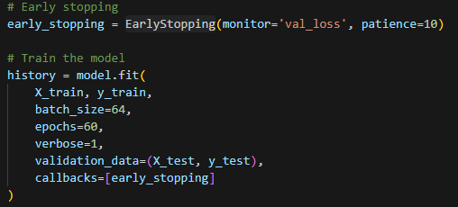
Training Process
Training Results:
Accuracy: 96.82% (11 epochs)
Test Accuracy: 85%
Test Loss: 0.64
Optimization:
Early stopping function used for efficiency.

Slide 8
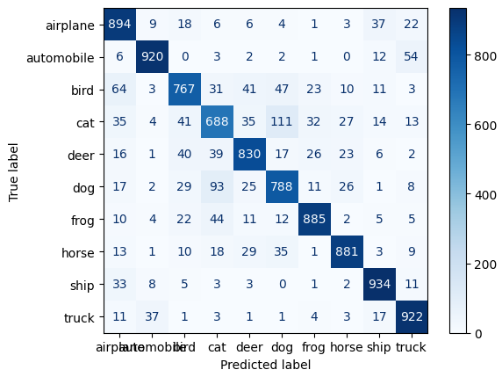
Insights from the Confusion Matrix
Strengths:
High accuracy for airplanes, ships, trucks.
Weaknesses:
Highest Confusion between cats vs. dogs.

Slide 9
Transfer Learning
Architecture: VGG16 pre-trained model.
Results:
Test Accuracy: 65.2%
Test Loss: 1.716
Observation:
Lower accuracy but demonstrated utility of pre-trained models.

Slide 10

Model Saving and Deployment
Saving:
Saved in TensorFlow format for compatibility.
Deployment:
TensorFlow Serving in Docker.
Hosted on Google Cloud using Vertex AI.
Integration:
Endpoint connected to a client application for predictions.

Slide 11

Flask Web Application
Features:
Image Upload and Prediction.
Displays original and preprocessed images.
Technology Stack:
Frontend: HTML, HTMX, Tailwind CSS.
Backend: Flask, Model API integration.
Workflow:
Upload, preprocess, predict, and display results.

Slide 12
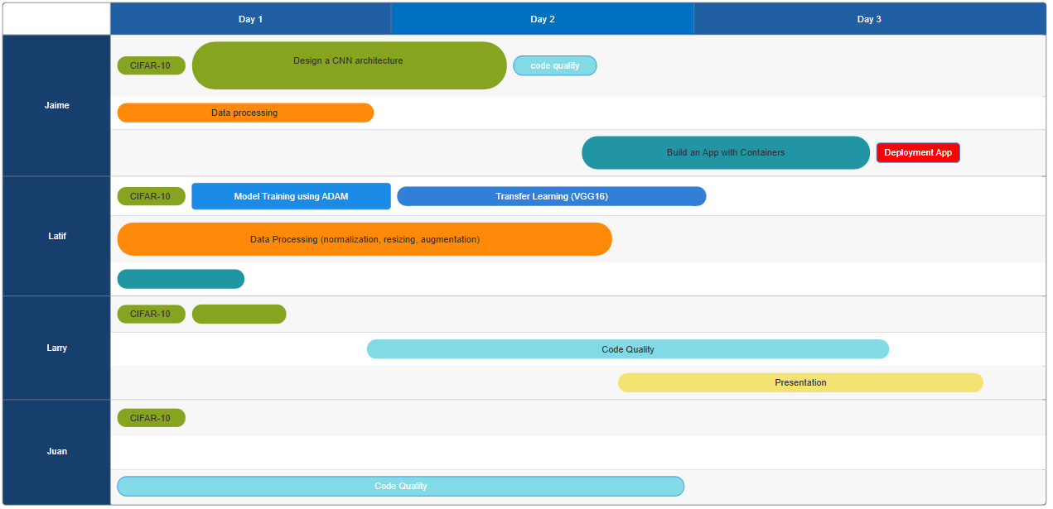
Project Management

Slide 13
Teamwork & Project Management
Workflow:
Followed an iterative refinement process.
What Worked Well:
Clear role distribution.
Improvements:
Enhanced documentation.
Risk Management:
Addressed model overfitting early.

Slide 14
Major Obstacle
Biggest Obstacle:
Overfitting with initial model design.
Learnings:
Importance of regularization techniques.
Effective use of validation data.
Hindsight:
Earlier implementation of dropout layers.

Slide 15
Conclusion and Insights
Hypothesis Outcome:
Supported: Achieved high accuracy with CNN.
Key Learnings:
Iterative model improvement leads to significant accuracy gains.
Importance of balancing model complexity and computational efficiency.
Deployment Model Processes

Slide 16
Thank You!

