Slide 1

COHORT ANALYSIS FOR IRONHACK PAYMENTS

Slide 2
AGENDA
Project Overview:
Conduct cohort analysis to analyze user behavior and performance of the financial services
Metrics:
Investigate usage frequency, incident rates, revenue trends, propose new metric

Slide 3
IMPLEMENTATION DETAILS
Exploratory Data Analysis (EDA):
Value counts for categorical variables
Descriptive statistics
Data cleaning (imputation VS drop):
Assessed missing data – fillna for missing user_id
Data Preprocessing:
Prepared data for reliable analysis:
pd.to_datetime
Unit of analysis: Cohort creation using groupby()

Slide 4
Key findings

Slide 5
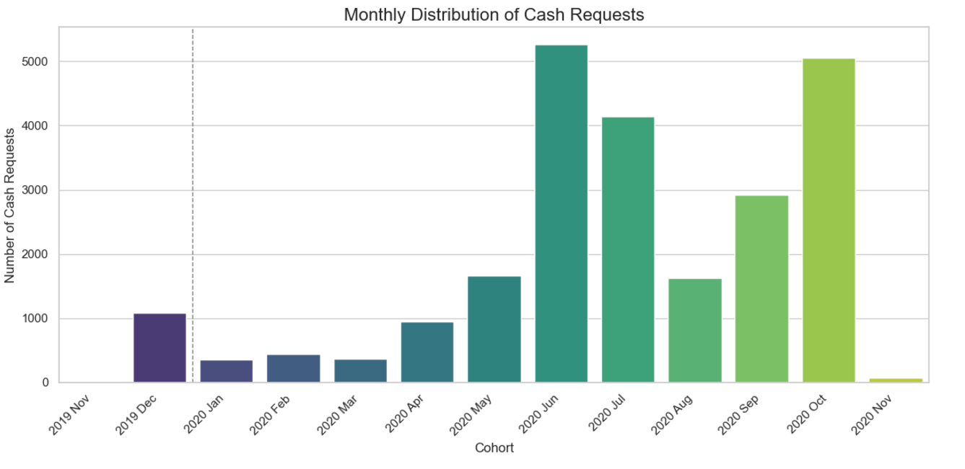
Frequency of Service Usage
- Two peaks in Jun and Oct 2020
- Lowest in Nov 2019
Notes:
1. **Frequency of Service Usage:** Understand how often users from each cohort utilize IronHack Payments' cash advance services over time.

Slide 6
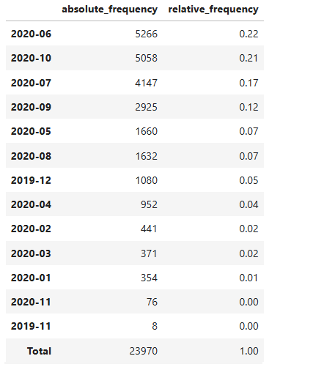
- Value counts by cohort
Notes:
- Sum(amount) by cohort

Slide 7
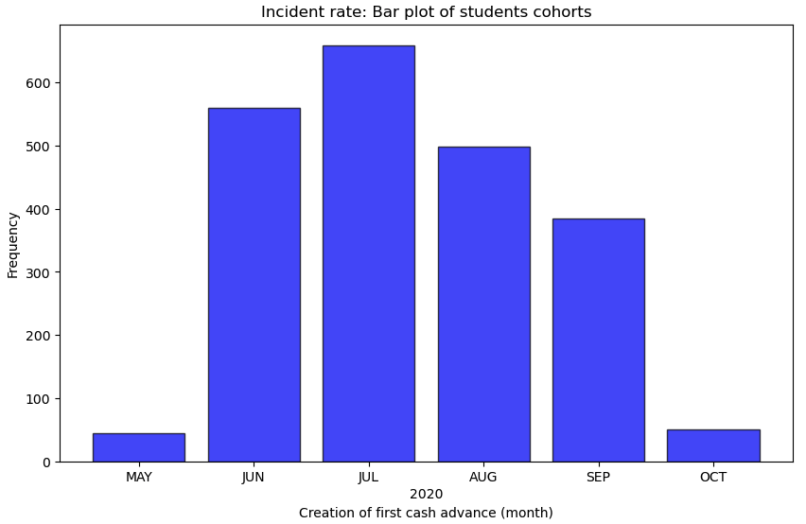
Incident rate
Incident rate: 2,196 (10%)
- Peak in Jul 2020
Notes:
2. **Incident Rate:** Determine the incident rate, specifically focusing on payment incidents, for each cohort. Identify if there are variations in incident rates among different cohorts.

Slide 8
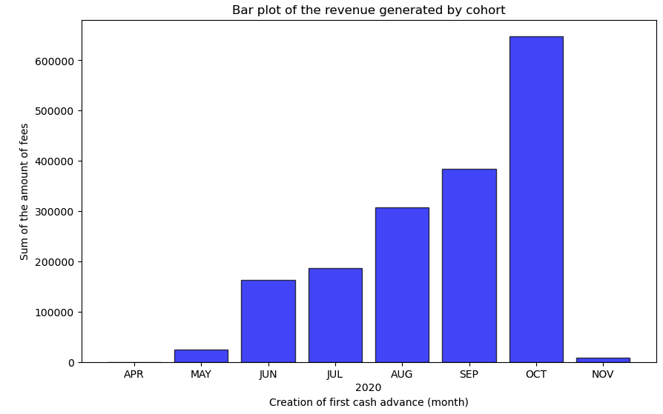
Revenues Generated by Cohort
- Sum by cohort
Amount
Count | 21,057.00
Mean | 81.83
Min | 1.00
Max | 200.00
Notes:
3. **Revenue Generated by the Cohort:** Calculate the total revenue generated by each cohort over months to assess the financial impact of user behavior.

Slide 9
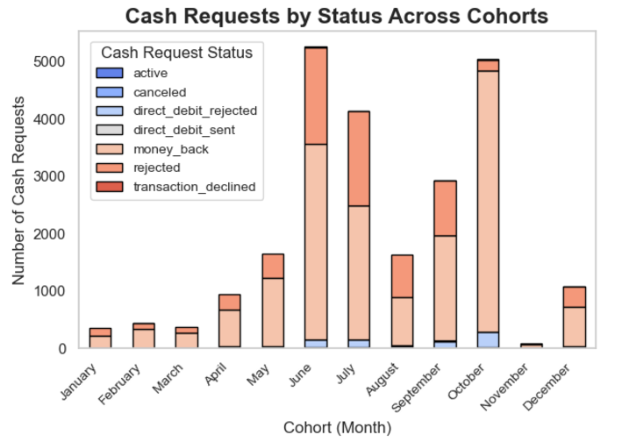
Cash request rends Success
- Choosing a sub-category to explore in the future
- -”money back” vs “rejected”
Notes:
4. **New Relevant Metric:** Propose and calculate a new relevant metric that provides additional insights into user behavior or the performance of IronHack Payments' services.

Slide 10
CHALLENGES
Business understanding:
Understanding the business context of the data to guide the initial analyses
Data cleaning:
Not knowing what some categories mean makes it difficult to interpret potential filtering and think about new metrics
Data exploration:
Timing of the project before univariate lesson
Combination of the databases

Slide 11
Thank you!

