Slide 1
Maven Coffee House
Sylvia Y. Pérez-Montero
December, 2024

Slide 2
Problem
A new operations manager has come on board at Maven Coffee House. As part of their onboarding materials, the data science team has prepared a general overview of the coffee shop’s operations, evaluating the transactional data for its three stores in New York.
The overview is to include transactional analyses, location specifics, and product-level information.
Answers to four key questions will provide a high-level overview of the business:
What was business like over the 6-month period?
Did all three stores behave the same or differently?
What’s the best-selling product?
What’s the best-selling category?

Slide 3
ABOUT THE DATA
The Maven Coffee House data was downloaded from Kaggle on December 19, 2024 (Maven Coffee House Data)
The dataset consists of an EXCEL workbook with three separate tabs; transactions, products, and stores.
Transactions
149,116 records
7 variables
Products
80 records
5 variables
Stores
3 records
2 variables
Cleaning*
The three tables were checked for duplicate records, missing data, outliers and consistent formatting of dates and times. Since there were none, no records were eliminated.
The primary keys of each table (store_id, transaction_id, product_id) appeared in the dataset as integers, so their data type was changed to string.
Assumptions
All stores have the same operating hours and offer the same menu.
The amounts shown within the unit price in the ‘transactions’ table corresponds to the transaction total.
*screenshots of the checks can be found in the appendix

Slide 4
Business questions
Note: The business questions considered were addressed as SQL queries, the screenshots for which are included within the appendix. The graphs presented in this section were created in Tableau, using the same dataset.

Slide 5
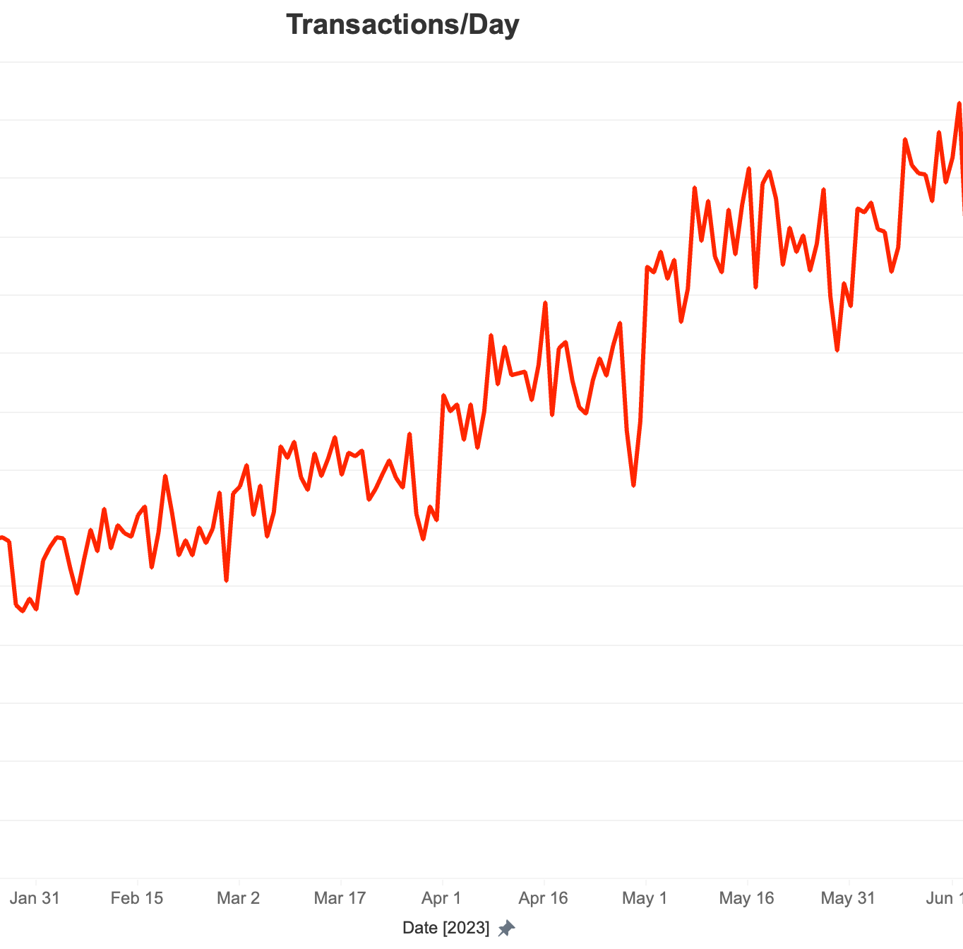
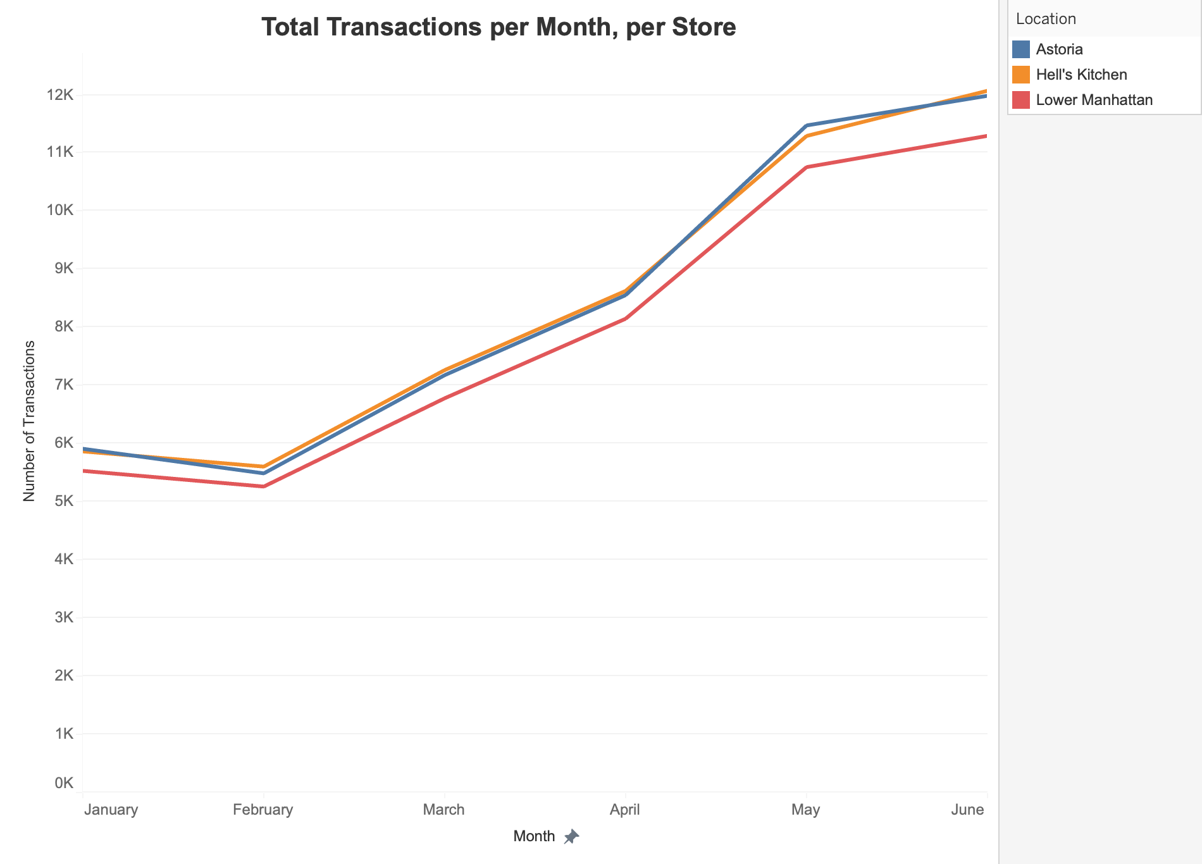


Transaction Analysis*
Business grew consistently throughout the 6-month period.
The Lower Manhattan store has less transactional volume, but a similar growth patters was observed throughout the three stores.
* SQL queries can be found in the appendix

Slide 6
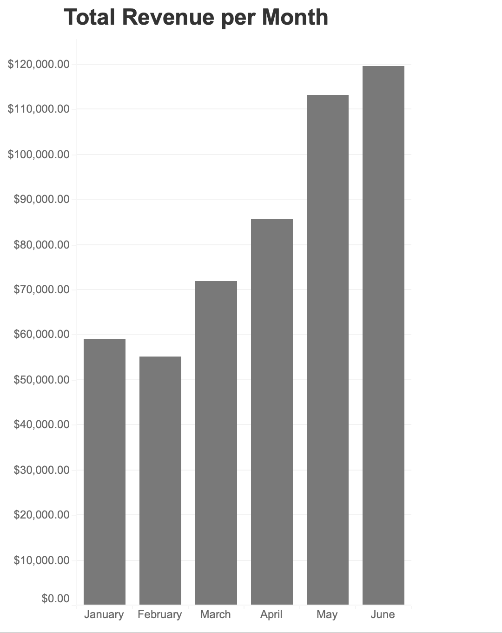
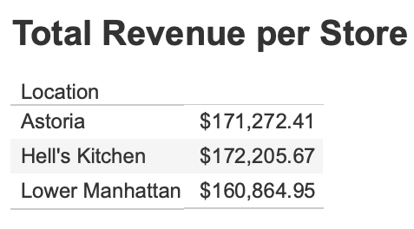
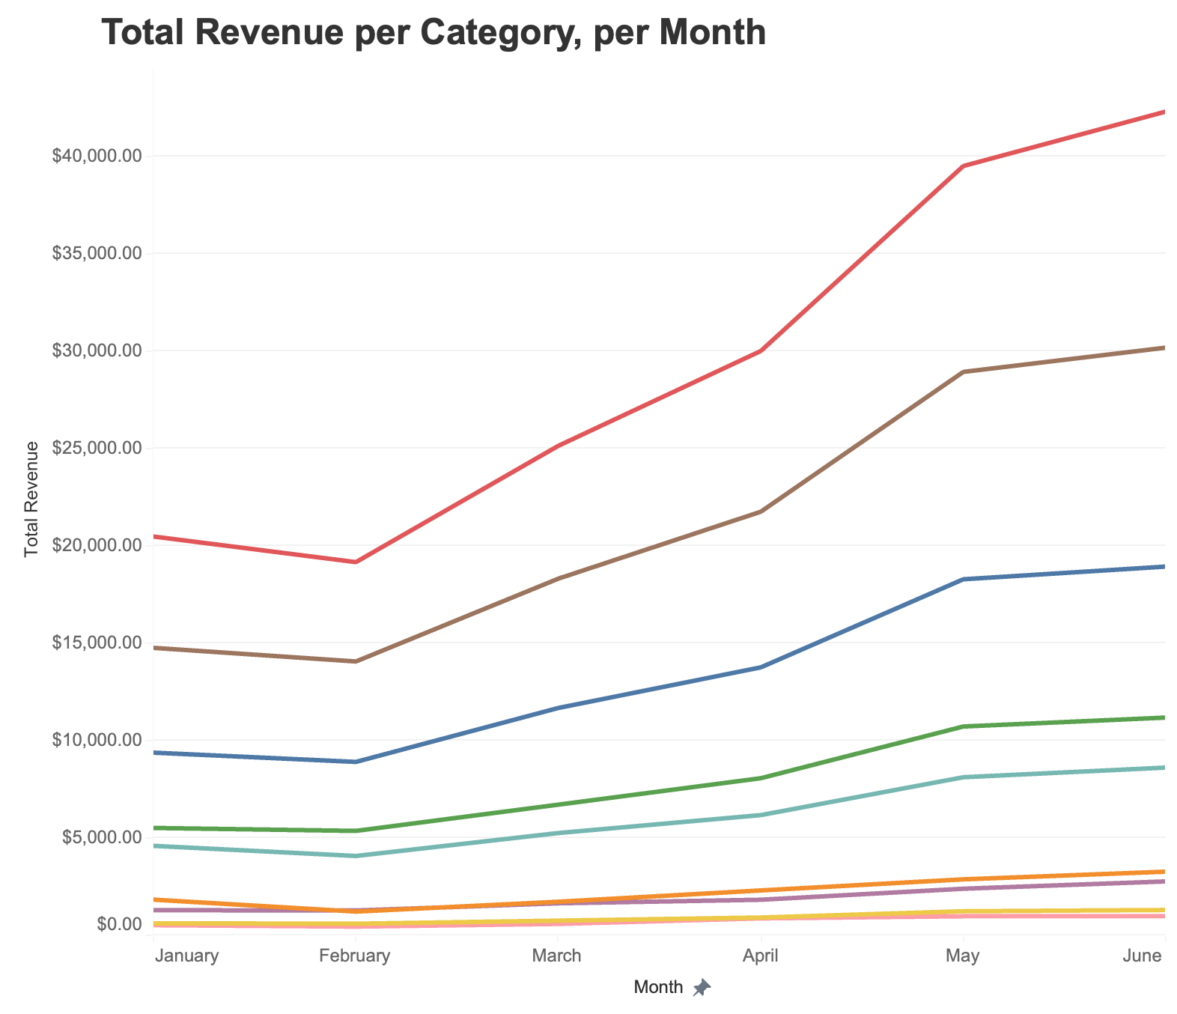
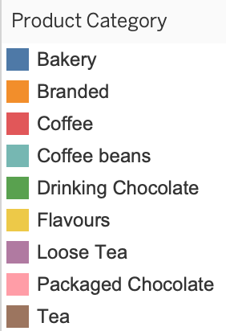
While there was a slight reduction in revenue in February, the rest of the period experienced consistent growth.
Lower Manhattan generates slightly less revenue.
Coffee, tea and bakery goods are the best-selling categories.
Revenue Analysis

Slide 7
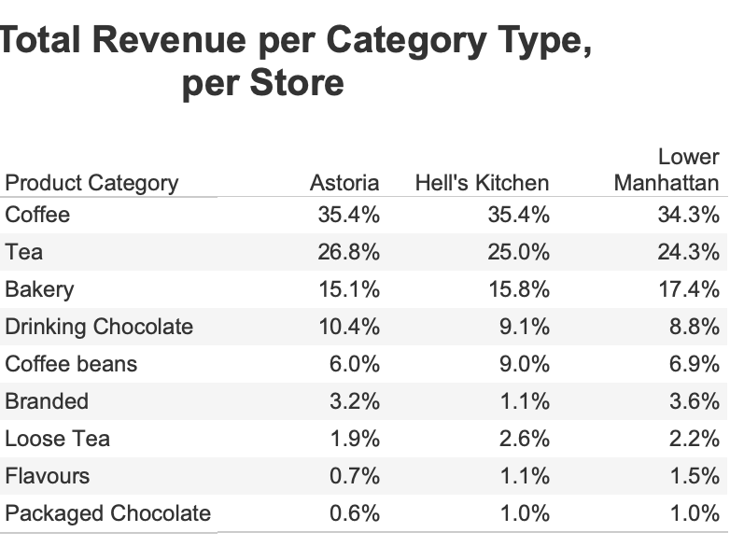
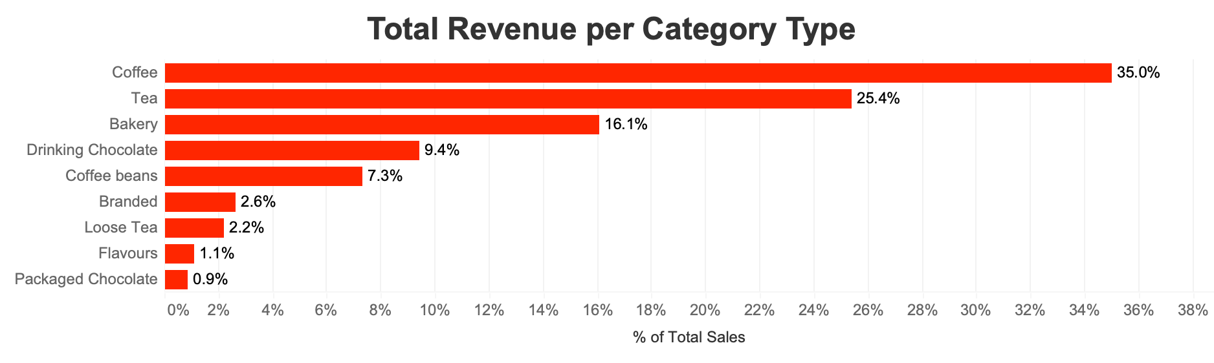
Revenue Analysis
76.5% of all revenue comes from coffee, tea and bakery goods.
The revenue breakdown is consistent among all 3 locations.

Slide 8
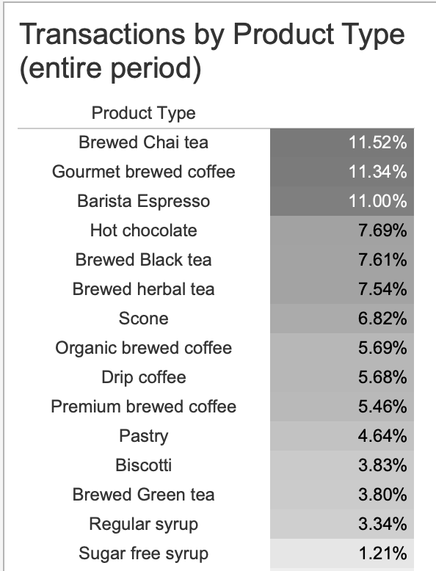
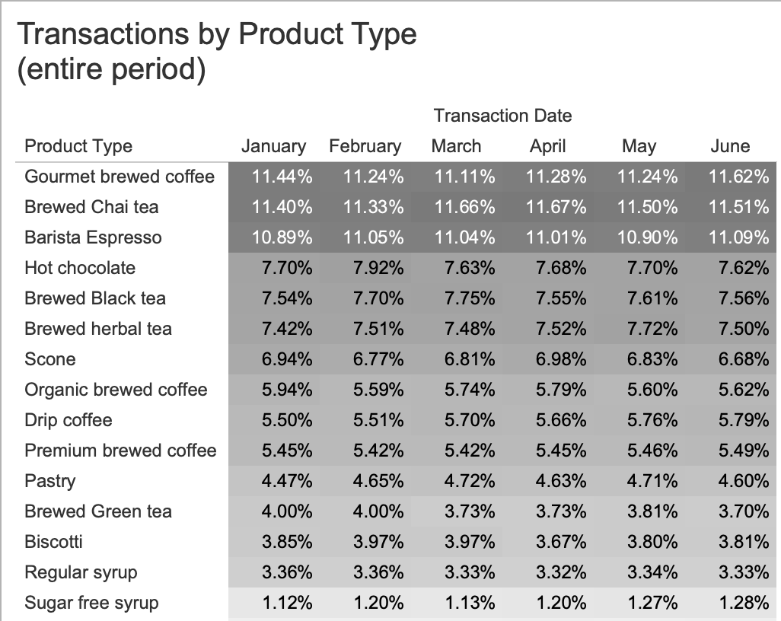
Product sales
Gourmet brewed coffee and brewed chai tea represent the greatest share of transactions, followed by the Barista Espresso coffee.
There is no seasonality observed with respect to transaction mix per month.

Slide 9
In closing…
Business has experienced significant growth over the 6-month period considered for this analysis.
The behavior observed with respect to growth, revenue and star products is consistent across all 3 locations.
The Lower Manhattan location has slightly less traffic and revenue, but its behavior has been similar to the other two locations.
Tea, coffee and bakery goods are the star categories.
Brewed coffee, brewed chai tea and Barista Espresso are the star products.
Given the growth observed, a closer look at marketing and advertising efforts is recommended.
Also recommended are a closer look at peak hours, average transaction times and customer satisfaction to see if there are opportunity areas not contemplated within this report.

Slide 10
APPENDIX

Slide 11
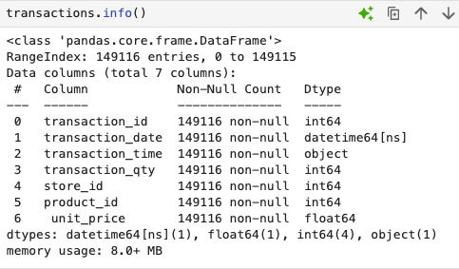
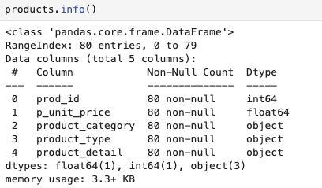
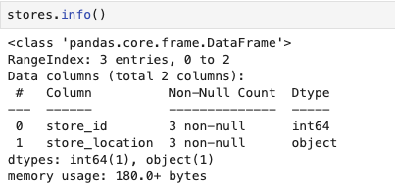
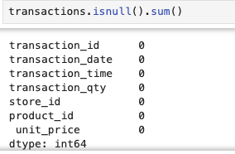
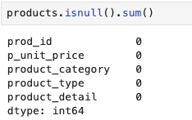
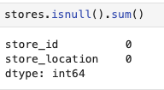
DATA CLEANING
DATA TYPES IN ORIGINAL DATASET
CHECKING FOR DUPLICATES

Slide 12
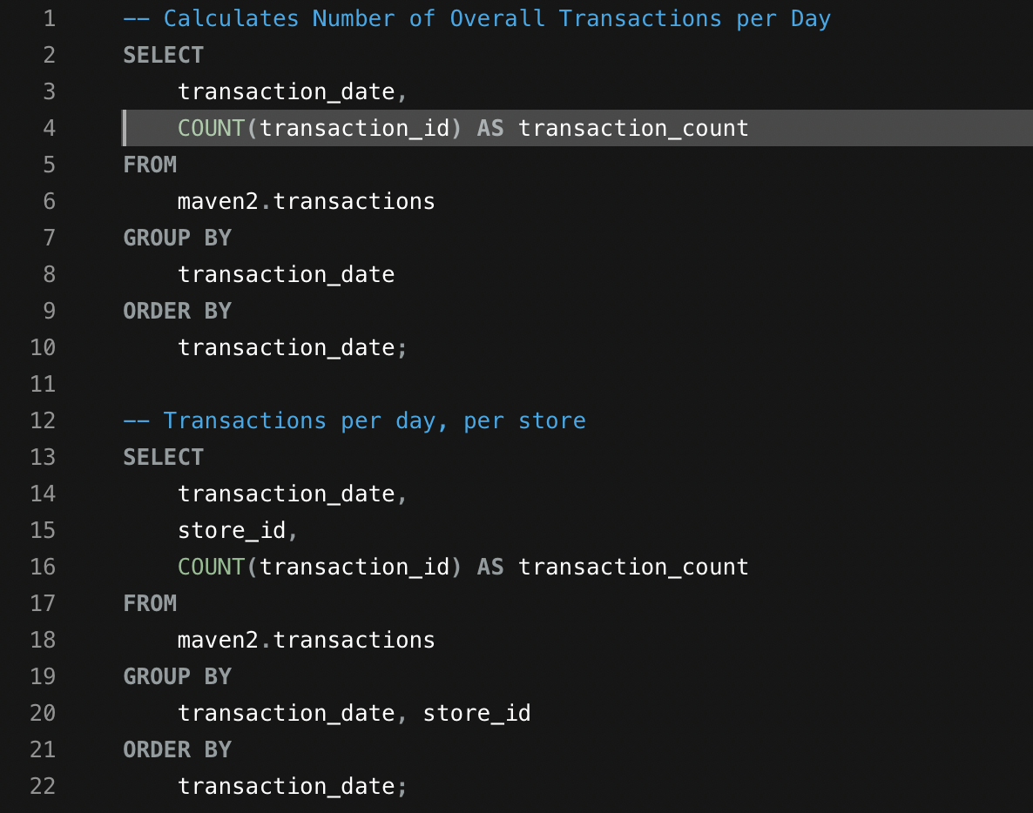
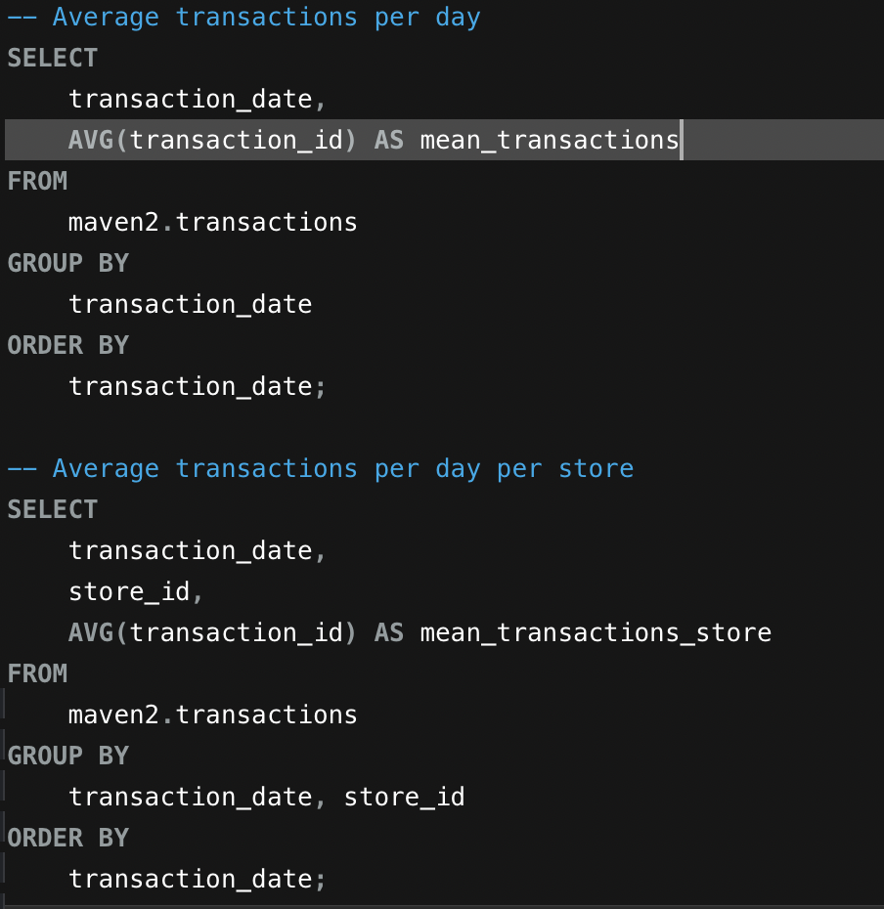
QUERIES (screenshots)

Slide 13
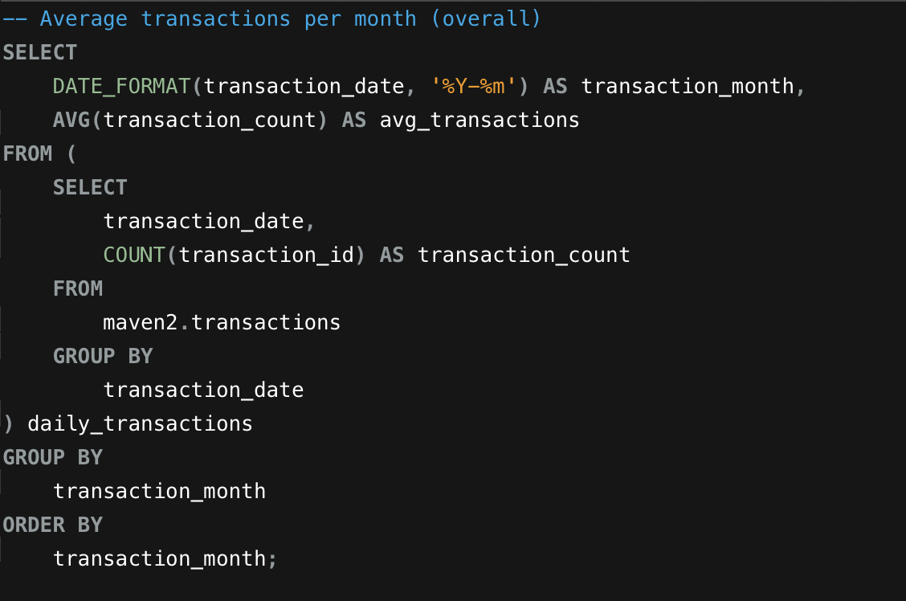
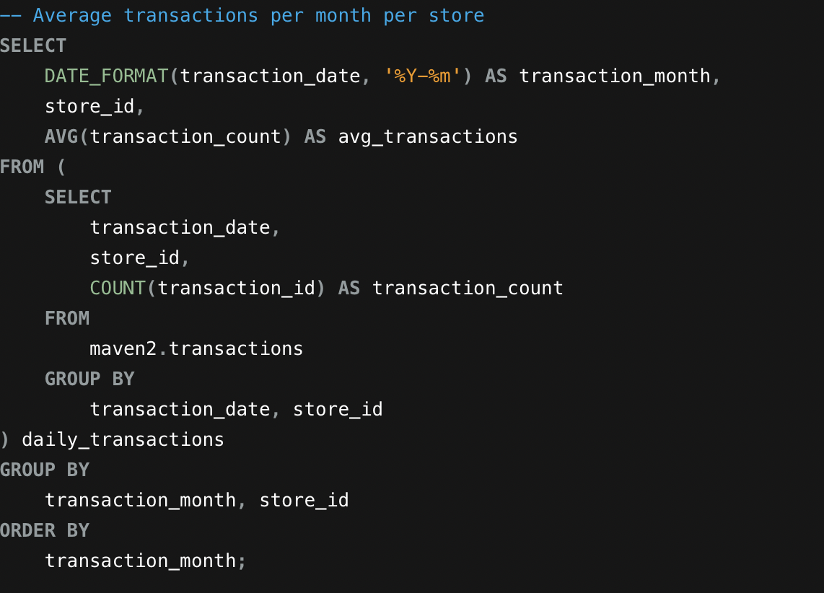
QUERIES (screenshots)

Slide 14
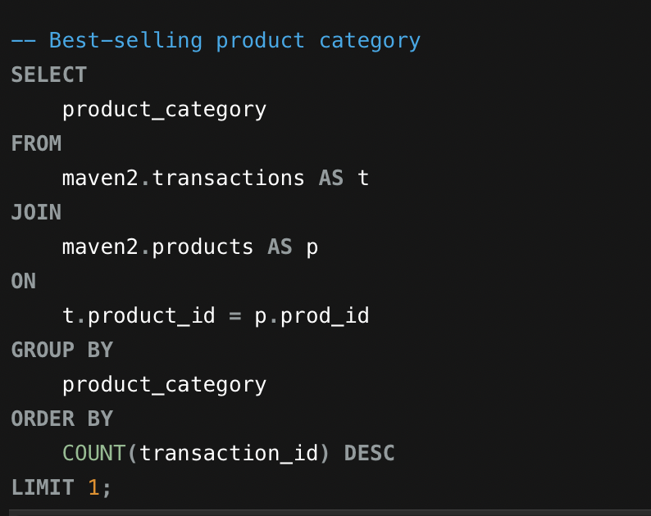
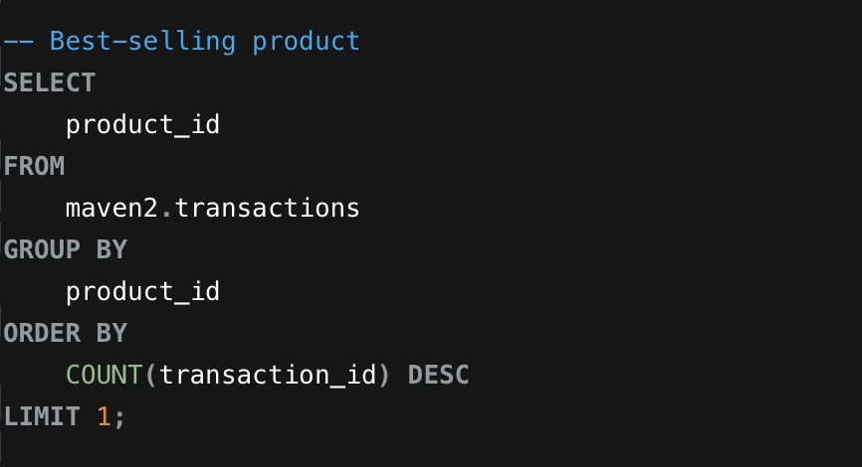
QUERIES (screenshots)

Slide 15
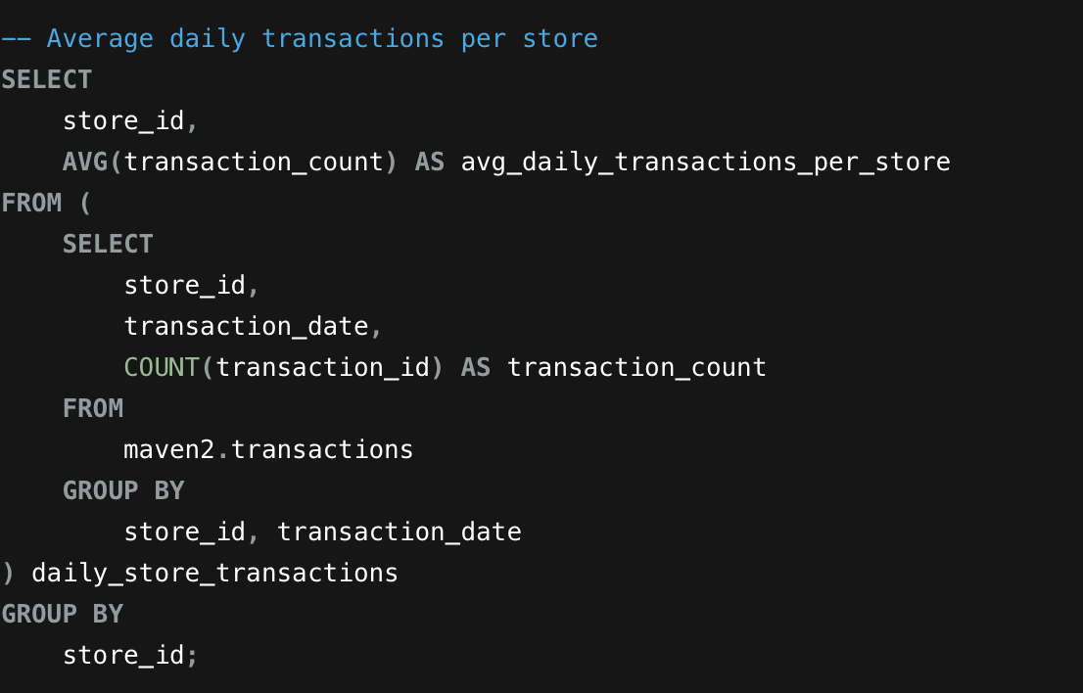
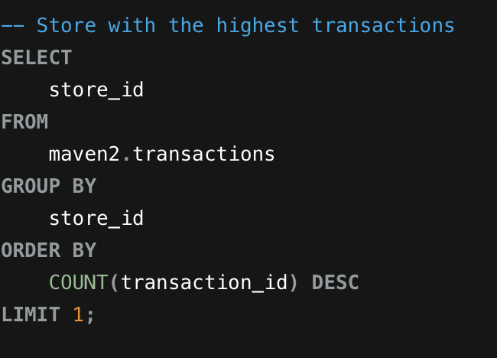
QUERIES (screenshots)

