Slide 1
Balade.AI
Multimodal AI Chatbot for YouTube Video Q&A
LangChain + LangGraph
ChromaDB
Ollama llama3.1:8b
Streamlit
7
280
FR/EN
Benny Michel Junior
Ironhack AI Bootcamp · Final Project · 2026
Videos
Chunks
Bilingual
Notes:
1

Slide 2
The Problem
You watch a 20-minute science video. Two days later, you can't remember the details.
What if you could just ask?
🎬
🌐
⏱️
Video content is unsearchable
Language barriers
Time is wasted
70% of knowledge in YouTube videos is never recalled after viewing
French videos are inaccessible to English-speaking audiences and vice versa
Re-watching a 20-min video to find one specific fact is inefficient
Notes:
1

Slide 3
Architecture
Full RAG + LangGraph Agent Pipeline
01
02
03
04
05
06
YouTube
Chunking
Embeddings
ChromaDB
LangGraph
Streamlit
youtube-transcript-api
chunk=800, overlap=150
multilingual-e5-large
280 chunks · MMR k=4
ReAct Agent + 3 tools
Bilingual FR/EN UI
Key Design Decisions
multilingual-e5-large
FR transcripts + EN queries → same vector space, no translation needed
MMR retrieval
Avoids 4 near-identical chunks from same paragraph → richer LLM context
llama3.1:8b local
No API cost, full privacy, better tool-calling than mistral:7b
Hybrid fallback
If not in transcripts → LLM general knowledge + transparent labelling
Notes:
1

Slide 4
Dataset
7 Balade Mentale videos · 280 chunks · ChromaDB
Les pieuvres vampires des Abysses
35 chunks
Pipeline Config
Marine Biology
Des milliards d'autres planètes !
✂️
Chunk size
34 chunks
800 chars
Astronomy
LE GIGANTISME des Abysses
44 chunks
🔗
Overlap
Marine Biology
150 chars
Créatures géantes et transparentes
48 chunks
Marine Biology
🧮
Embedding
1024 dims
La folle Histoire du système solaire
30 chunks
Astronomy
🔍
Retrieval
MMR k=4
Ces lacs sous-marins impossibles
39 chunks
Oceanography
🌐
Languages
Le froid maximal — Zéro absolu
50 chunks
FR + EN
Physics
Notes:
1

Slide 5
Agent + Tools
LangGraph ReAct Agent · Conversational Memory · 3 Custom Tools
🤖 LangGraph ReAct Agent
🔍 rag_search
Retrieves top-4 chunks via MMR, injects into bilingual prompt, generates answer. Falls back to general knowledge if not found.
Pattern
Reason → Act → Observe → Refine
Memory
6-turn history (HumanMessage / AIMessage)
➕ add_youtube_video
Context
num_ctx = 8192 tokens
Dynamically ingests a new YouTube video at runtime — transcript extraction, cleaning, chunking, embedding — no restart needed.
Detect lang
FR or EN per question
Fallback
📋 list_available_topics
RAG → General knowledge if not found
Returns all 7 indexed videos with titles, URLs and topics so the agent can tell users what content is available.
Tracing
LangSmith full observability
Notes:
1

Slide 6
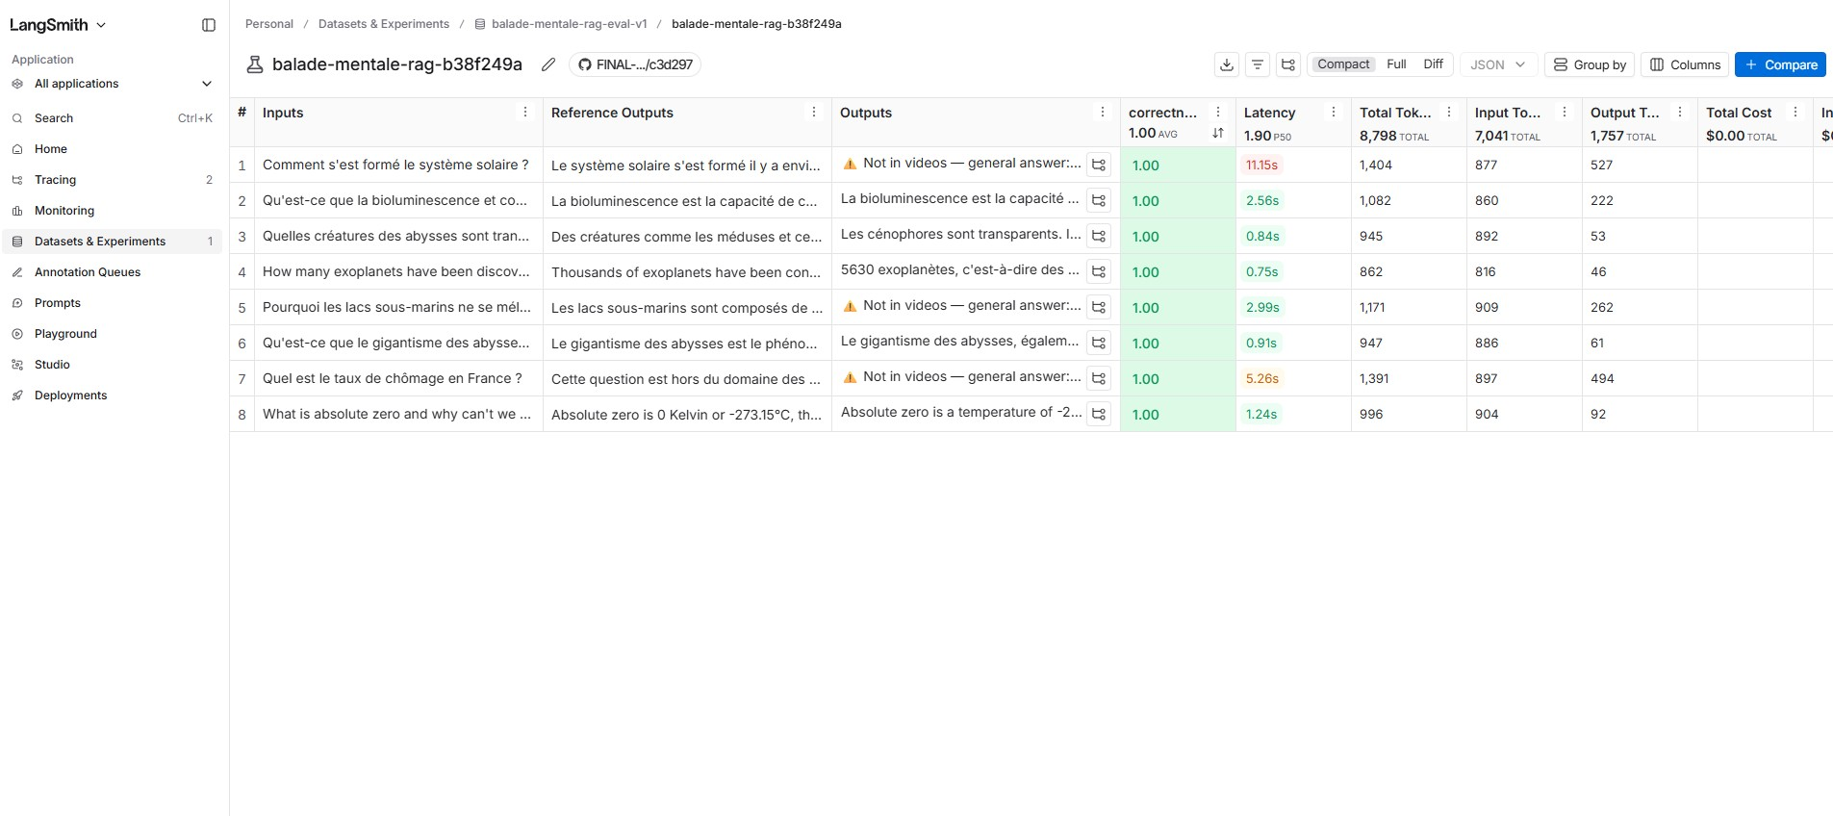
Agent + Tools
LangGraph ReAct Agent · Conversational Memory · 3 Custom Tools
🤖 LangGraph ReAct Agent
🔍 rag_search
Retrieves top-4 chunks via MMR, injects into bilingual prompt, generates answer. Falls back to general knowledge if not found.
Pattern
Reason → Act → Observe → Refine
Memory
6-turn history (HumanMessage / AIMessage)
➕ add_youtube_video
Context
num_ctx = 8192 tokens
Dynamically ingests a new YouTube video at runtime — transcript extraction, cleaning, chunking, embedding — no restart needed.
Detect lang
FR or EN per question
Fallback
📋 list_available_topics
RAG → General knowledge if not found
Returns all 7 indexed videos with titles, URLs and topics so the agent can tell users what content is available.
Tracing
LangSmith full observability
Notes:
1

Slide 7
Web Interface
Streamlit · Dark theme · Bilingual FR/EN
🌐
FR/EN Toggle
📹
Source Citation
Full UI + LLM responses switch language based on your question
Every answer shows exact video name + clickable YouTube link
🎯
Confidence Score
⚠️
Transparent Fallback
Cosine similarity % between question and best matching chunk
Clear badge when answer comes from general knowledge, not transcripts
💬
Chat History
💡
Suggested Questions
6-turn context window — agent remembers previous questions
3 follow-up questions generated after each answer
Notes:
1

Slide 8
Evaluation
LangSmith · LLM-as-Judge · 8 Questions · Correctness Metric
Comment s'est formé le système solaire ?
✓
⚠️ fallback
8/8
Qu'est-ce que la bioluminescence ?
✓
Quelles créatures des abysses sont transparentes ?
✓
How many exoplanets have been discovered?
✓
Correct
Pourquoi les lacs sous-marins ne se mélangent pas ?
✓
⚠️ fallback
Avg score: 1.00 / 1.00
Qu'est-ce que le gigantisme des abysses ?
✓
Judge: llama3.1:8b
Dataset: LangSmith
Quel est le taux de chômage en France ?
✓
⚠️ fallback
What is absolute zero and why can't we reach it?
✓
💡 Note: Score 1.00 reflects LLM self-evaluation (same judge + pipeline). The 3 fallback cases show correct hybrid behaviour — transparent labelling when content is outside the indexed videos.
Notes:
1

Slide 9
What we built
Balade.AI
✅ Full RAG pipeline — transcript → chunks → embeddings → ChromaDB
✅ LangGraph ReAct agent with 3 tools and 6-turn conversational memory
✅ Bilingual FR/EN — same pipeline handles both languages seamlessly
✅ Hybrid fallback — transparent about what comes from videos vs. general knowledge
✅ Streamlit web app with source citation, confidence score, YouTube link
✅ LangSmith tracing + evaluation — 8/8 correctness (1.00 avg score)
⚠️ Whisper speech input — attempted, blocked by ffmpeg DLL on Windows
Ironhack AI Bootcamp · Final Project · 2026
Notes:
1

Slide 10
🎬
Live Demo
streamlit run app.py · localhost:8501
Demo questions
"Qu'est-ce que la bioluminescence ?"
"How was the solar system formed?"
"Quel est le taux de chômage en France ?" ← out-of-scope test
Notes:
<number>

