Slide 1

PROJECT NLP: AUTOMATED CUSTOMER REVIEWS
WEEK 7 PROJECT BY KEREM SENLER & JULIA NUSS

Slide 2
PROJECT OVERVIEW
GOAL:
Developing an NLP model that will automate the processing of customer feedback for a retail company by classifying reviews as ‚Positive‘, ‚Neutral‘ or ‚Negative‘
Comparing traditional models like RandomForest, NaiveBayes and SVM to DeepLearning/pretrained models like BERT
KEY LEARNING OBJECTIVES:
Learning to get a sense for the performance of models in NLP
Which models perform best and how can you refine them?

Slide 3
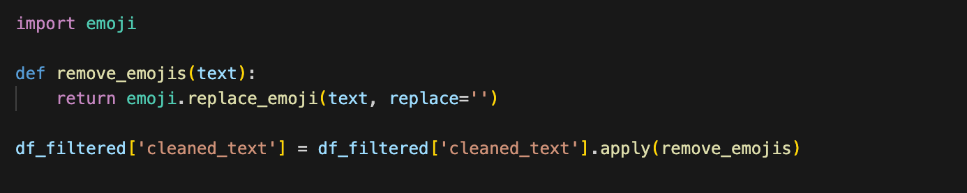
IMPLEMENTATION DETAILS
FIRST STEP: PREPROCESSING THE REVIEWS
Looking at null values, removing lines with null value in reviews.text and reviews.rating
Converting text to lowercase
Removing whitespaces, special characters, emojis and stopwords
Tokenization, Stemming, Lemmatizing

Slide 4
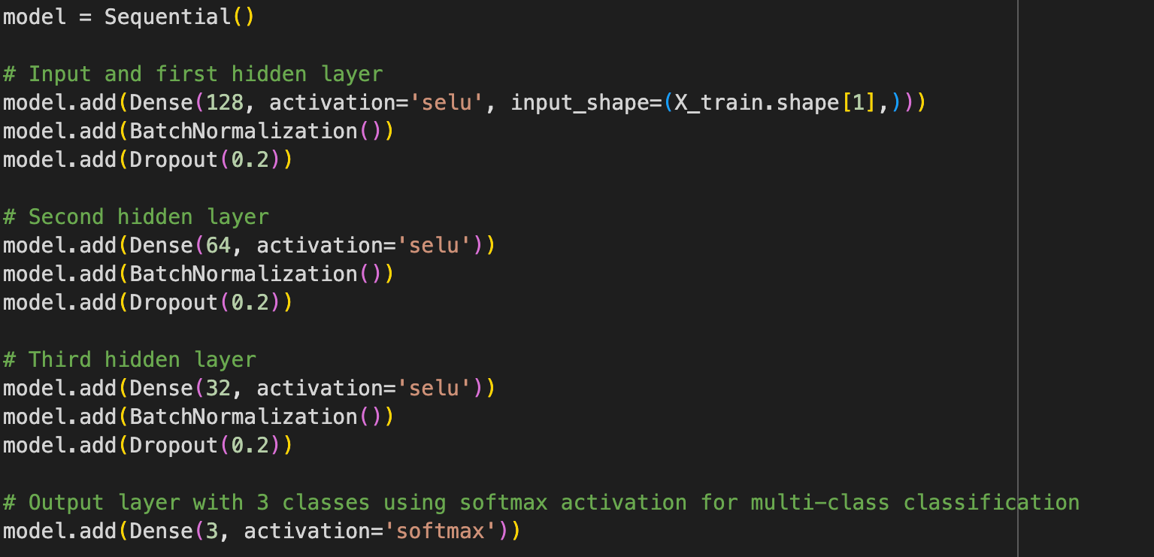
IMPLEMENTATION DETAILS
SECOND STEP: MODEL TRAINING
Models we tried:
Logistic Regression
Multinomial Naive Bayes
Support Vector Machines
RandomForest
Neural Network
BERT base uncased
THIRD STEP: REFINING THE MODELS
Adding/removing amount of epochs, layers, changing activation function,…
NEURAL NETWORK

Slide 5
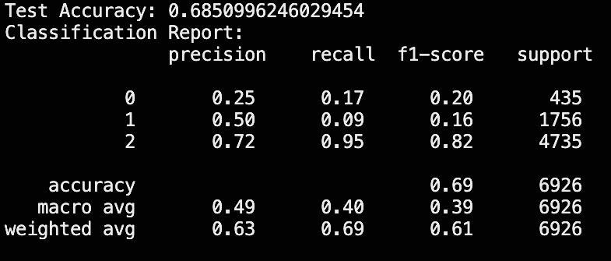
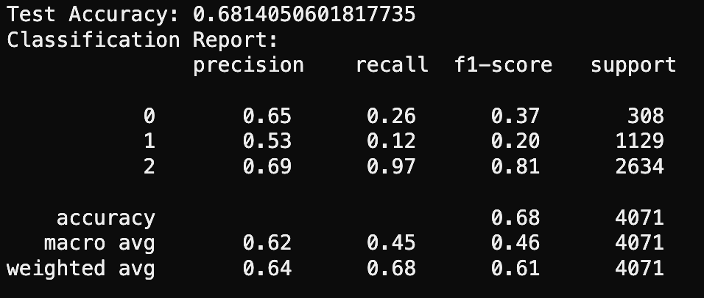
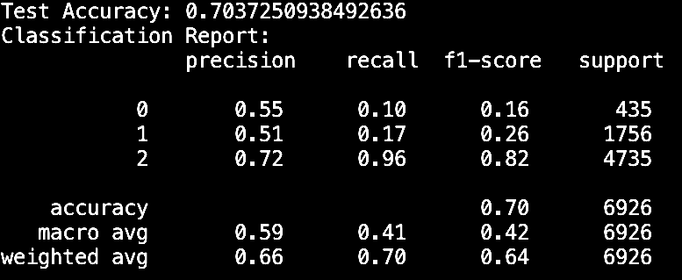
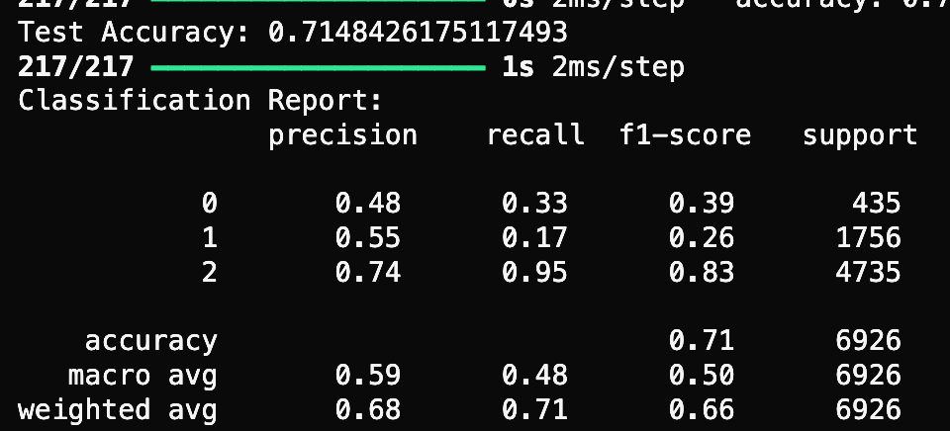
IMPLEMENTATION DETAILS
FOURTH STEP: MODEL EVALUTION
MULTINOMIAL NAIVE BAYES
SUPPORT VECTOR MACHINES
RANDOM FOREST
NEURAL NETWORK

Slide 6
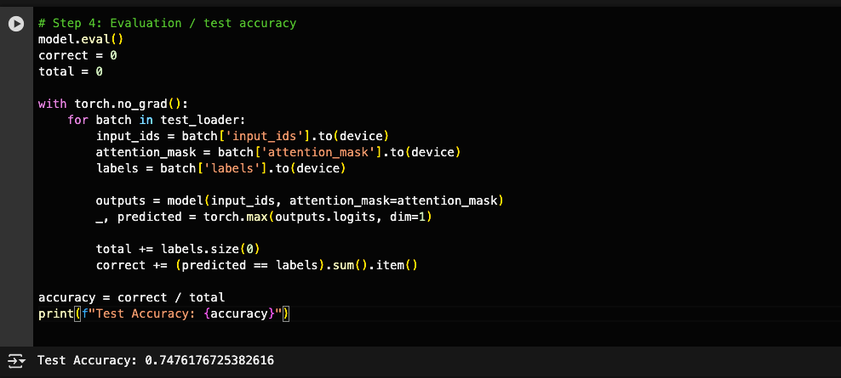
IMPLEMENTATION DETAILS
FOURTH STEP: MODEL EVALUTION
BERT BASE UNCASED

Slide 7
CHALLENGES & SOLUTIONS
FOURTH STEP: MODEL EVALUTION

Slide 8
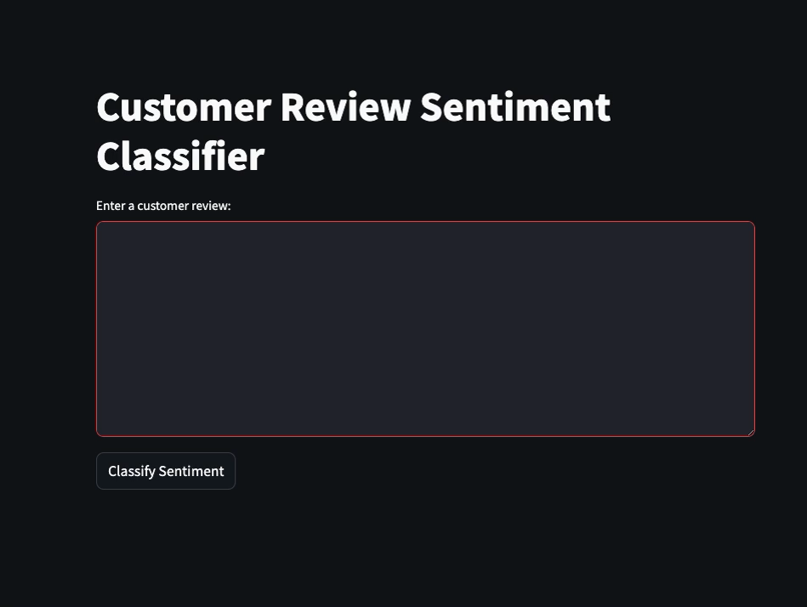
SHOWCASING OUR MODEL

Slide 9
PROJECT NLP: AUTOMATED CUSTOMER REVIEWS
WEEK 7 PROJECT BY KEREM SENLER & JULIA NUSS
THANK YOU FOR LISTENING!
NOW YOU HAVE TWO MINUTES TO GIVE US YOUR REVIEW…

