Slide 1
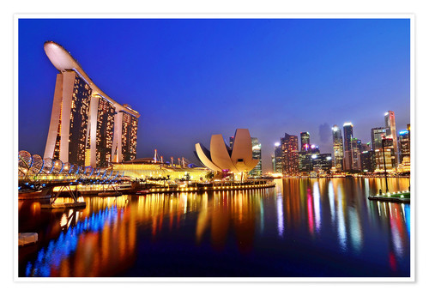
Data Analytics | Project 2
SHE-NGAPORE
Filipe Koch | João Eira | Silvia Nicolau

Slide 2
SINGAPORE
Workflow:
Pick a city
Choose a subject
Define the criteria (ask questions)
Get the database
Process the data through coding
Analyse and conclude
Review

Slide 3

SINGAPORE
Gender Equality in the Labour Market
?

Slide 4

SINGAPORE
Gender Equality in the Labour Market
Criteria:
Salary range
Unemployment rate
Education level
Job function level

Slide 5



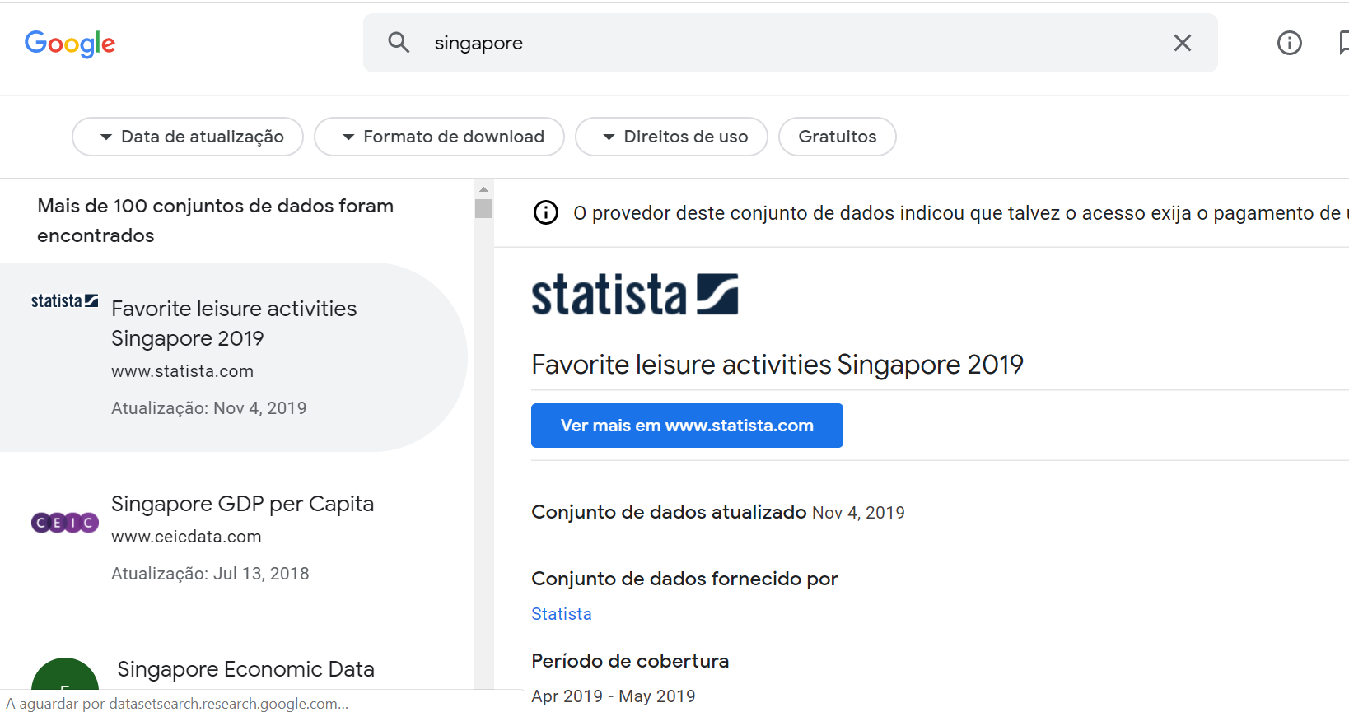
SINGAPORE
Gender Equality in the Labour Market
Databases
Find the best source – Singapore Government’s Data
Search the subject
Select the meaningful files

Slide 6
SINGAPORE
Gender Equality in the Labour Market
Process the data through coding
Cleaning
Reducing
Filtering
Combining

Slide 7
SINGAPORE
Gender Equality in the Labour Market
Analysis – Salary range
Clearly Male earn more than Female
Very slight improvement over time
Salary range (average monthly earning in $USD) | Female | Male | Ratio F/M
2000 - 2009 | $ 2.873 | $ 3.965 | 0,72
2010 - 2018 | $ 4.051 | $ 5.427 | 0,75
Last record (2018) | $ 4.693 | $ 6.118 | 0,77

Slide 8


SINGAPORE
Gender Equality in the Labour Market
0 : 1

Slide 9
SINGAPORE
Gender Equality in the Labour Market
Analysis – Unemployment rate
Unemployment is higher in Female than in Male
The F/M ratio increased from the 1990’s to the 2000’s and then flatenned
Unemployment rate | Female | Male | Ratio F/M
1990 -1999 | 3,0 % | 2,8 % | 1,08
2000 - 2009 | 5,5 % | 4,7 % | 1,15
2010 - 2018 | 4,2 % | 3,6% | 1,16
Last record (2018) | 4,1 % | 3,7 % | 1,11

Slide 10
SINGAPORE
Gender Equality in the Labour Market
0 : 2

Slide 11
SINGAPORE
Gender Equality in the Labour Market
Analysis – Education level
There are more University graduated male than female, although the gap has been shortening
In Below Secondary than more female than male and the gap has been increasing
Education level (Ratio F/M) | Below Secondary | Secondary | Post Secondary | Professional Diploma | University
1990 -1999 | 1,11 | 1,06 | 1,00 | 0,58 | 0,60
2000 - 2009 | 1,15 | 1,11 | 0,89 | 0,81 | 0,76
2010 - 2018 | 1,21 | 1,17 | 0,76 | 0,88 | 0,85
Last record (2018) | 1,27 | 1,16 | 0,75 | 0,91 | 0,86

Slide 12
SINGAPORE
Gender Equality in the Labour Market
0 : 3

Slide 13
SINGAPORE
Gender Equality in the Labour Market
Analysis – Job function level
Male have the higher level jobs whereas female have the lower level ones
In the higher level jobs the gap has decreased but it has increased in Cleaners
Job function level (Ratio F/M) | Administrators | Managers | Office Assistants | Cleaners
1990 -1999 | 0,56 | 0,42 | 5,71 | 1,17
2000 - 2009 | 0,74 | 0,61 | 5,13 | 1,51
2010 - 2018 | 0,74 | 0,68 | 4,32 | 1,72
Last record (2018) | 0,75 | 0,72 | 3,63 | 1,70

Slide 14
SINGAPORE
Gender Equality in the Labour Market
0 : 4

Slide 15
SINGAPORE
Gender Equality in the Labour Market
Conclusion:
No gender equality!
Yet… ☺

Slide 16
SINGAPORE
Gender Equality in the Labour Market
Review
Challenges
Data cleaning proved to be harder than expected
Initial dataset missed information necessary to conclude the analysis
No plotting available
Learnings
Data pre-processing and cleaning is key to success and a takes up a high percentage of the workload
Pandas is a very flexible and time saver tool to process datasets

Slide 17
Thank you!
Nandri | நன்றி

