Slide 1
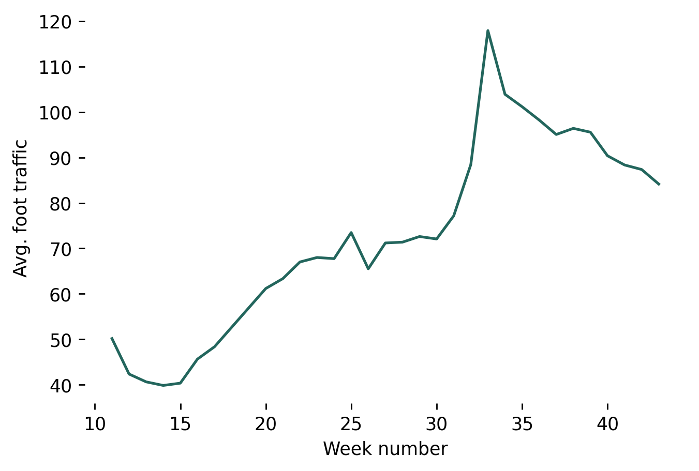
Predicting foot traffic using AutoRegressive models
A winning solution from IronHacks international data science challenge
Problem Statement
COVID-19 has impacted our daily lives. As we are moving out of the lock-down, governments and corporations need to understand citizens' economic and social activity. Forecasting foot traffic in crowded places can help in calculating the risk of infection spread and devise policies to fight the pandemic.
Task
The task is to build a statistical model using the historical movement, COVID-19 incident and policy intervention data collected from week 11 to week 43 to predict the foot traffic in week 44 for 1804 places of interest (POIs)* in Tippecanoe County, Indiana, US.
Winning model
The time series model that won first place in the hackathon is a simple Auto Regression model which uses foot traffic data as the endogenous variable. Mean absolute error (MAE) for the model was 13.5 on test set. statsmodels package was used to build the model.
This was able to outperform Random forest regressors and ARIMA models.
*
A place of interest (POI) is a public place with an address and a name where people spend time (and sometimes also money). Eg.: Restaurant, Gym, Shopping centers.

Slide 2
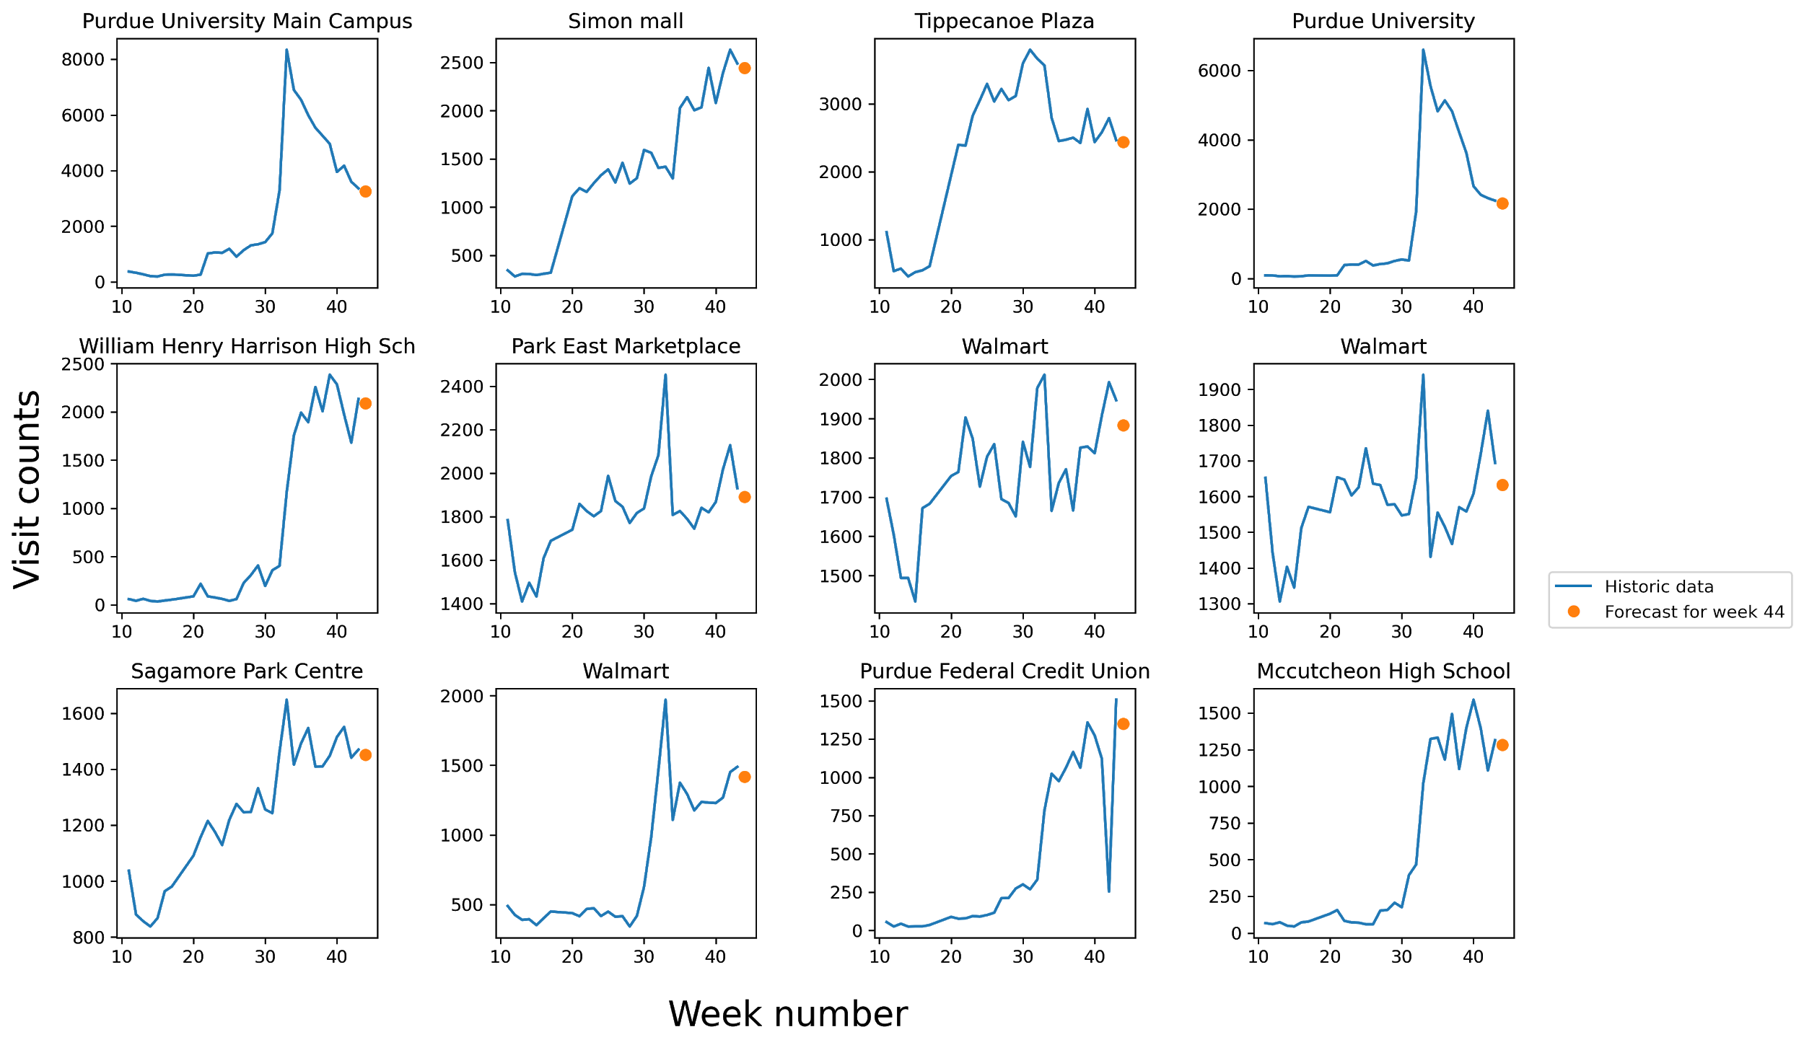
Predictions for top 12 busiest POIs

Slide 3
Policy recommendations
From the plot, we can confidently say that shopping centers and educational institutions are the busiest areas in Tippicanoe country during the pandemic. It is also worthy to note that these places did not get crowded simultaneously. During the first half of the data, shopping centers received high foot traffic whereas the visit counts in Purdue University started to increase only in the second half of the data. After week 30, food outlets like McDonald's and Chick-fil-A also received huge number of visitors.
To conclude, locations like Walmart, Purdue University, Park East Marketplace be classified as high-risk areas and public health officials should focus more on these locations in order reduce the infection spread.

