Slide 1
Task Summary
COVID-19 has affected the lives of every person on the planet in some way leaving a wake of confusion as to how to adapt to this new lifestyle. The pandemic has left many entities including local governments and merchants wondering what the economic and societal implications of it will be. It is therefore my task with IronHacks to help these entities by building a model to accurately predict for weekly foot traffic in 1804 places of interest within Tippecanoe county.
Models tested include linear, lasso, and ridge regression, KNN regression, ARIMA, Exponential Smoothing, VAR, MLP Regression, decision trees, and random forest modeling
The final model was random forest modeling as it provided that highest, consistent accuracy tested on weeks 42 – 44 data.

Slide 2
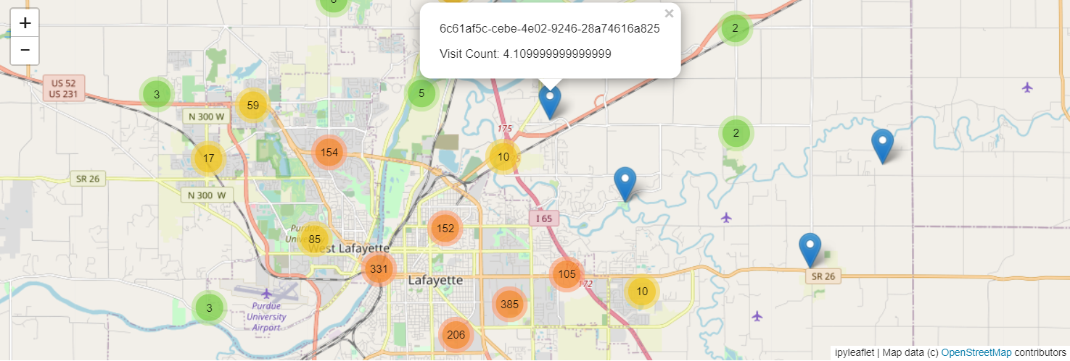
Generated Maps of POI visit counts

Slide 3
Recommendations
Policymakers should be aware that many variables are available to add to this model to improve accuracy. If you would like to use other variables, these variables should be at least as accurate to predict for the next week as it is to predict raw_visit_counts. The variables I would recommend are covid rate in areas of each POI, type and number of executive orders, as well as any other variables that assist in predicting consumer behavior.

